Slide 1




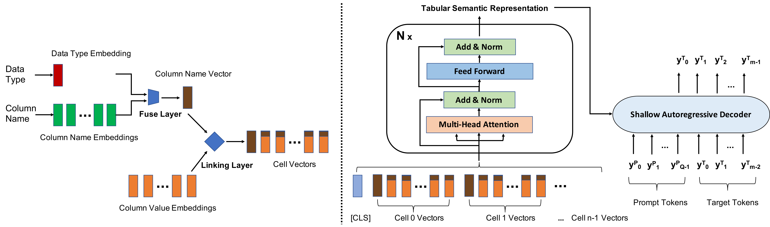
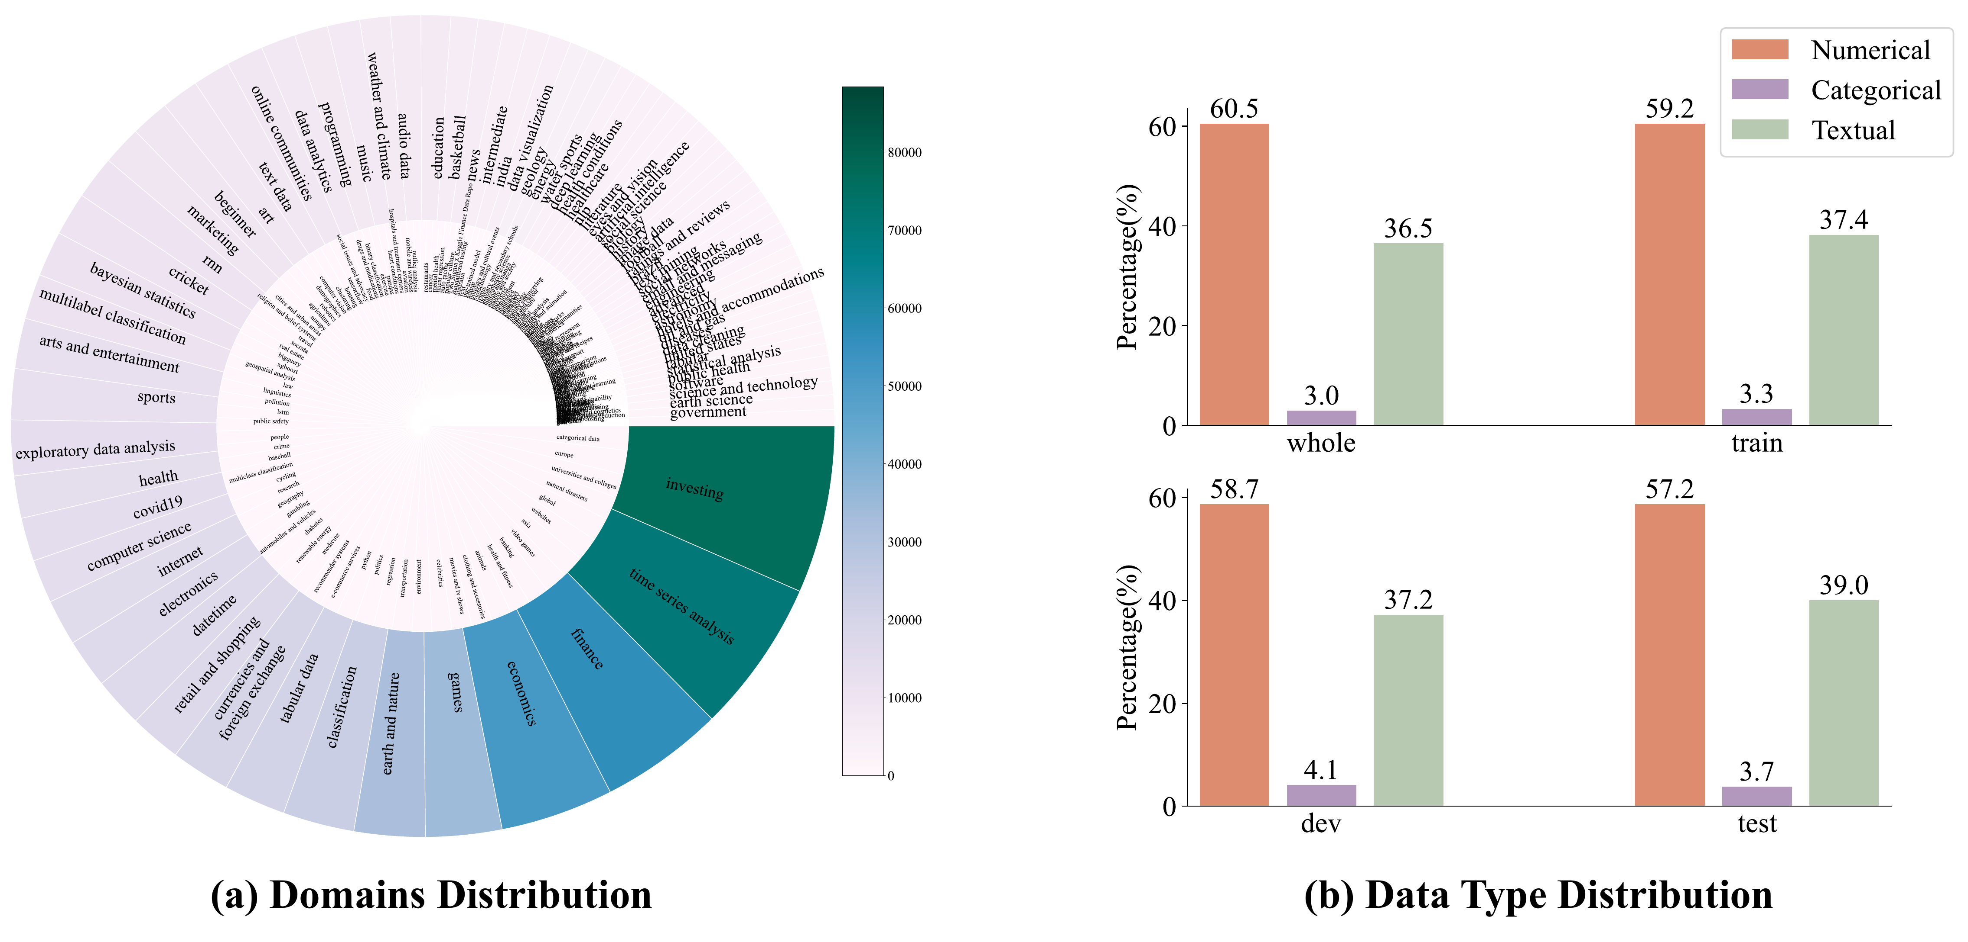

UniTabE: A Universal Pretraining Protocol for
Tabular Foundation Model in Data Science
Yazheng Yang¹, YuQi Wang¹, Guang Liu², Ledell Wu³, Qi Liu¹
¹ The University of Hong Kong ² Beijing Academy of Artificial Intelligence ³ Creatify AI
Problem
Method
Robustness & Zero-Shot
Tabular prediction has no universal
foundation model: every task carries a
different schema, blocking transfer.
1
TabUnit encodes each cell as a key–value pair; a fuse layer gates data-type, a linking layer binds
column→values.
Zero-shot: 0.94 AUC (IO), 0.89 (CA),
no finetuning.
2
Transformer encoder builds the representation; a shallow decoder + prompt generates targets.
Incremental columns: 3.5% AUC
drop vs 7.5% for TransTab-LSTM.
GAP
Prior methods either textualize tables
(losing numerics) or fix the column
structure.
Headline Numbers
Motivation
0.83
~13B
pretraining
samples
One protocol for arbitrarily structured
tables, pretrained at scale, could
transfer across tasks.
Avg AUC · 7 public
benchmarks
3.5%
drop · 1 new
column
beats XGBoost & Tapas
0.94
zero-shot AUC
(IO)
Handling missing values, zero-shot
tasks, and new columns.
Takeaway
Self-supervision works for text and
images — why not tables?
UniTabE architecture overview.
A schema-agnostic cell encoder plus free-
form prompts, pretrained on 13B samples,
yields the first transferable tabular
foundation model.
Key Results
Dataset / Benchmark
Ablation Study
Method
Avg AUC · 7 public
CONFIGURATION
AVG AUC
XGBoost
0.79
Respect table structure instead of
flattening it, and pretrain-then-
transfer works for tables.
Full UniTabE
0.83
Tapas
0.81
− Fuse layer
0.77
UniTabE (ours)
0.83
− Linking layer
0.75
+0.02 avg AUC over the best baseline; also wins
all 12 held-out Kaggle tasks on AUC & R²
− Both layers
0.72
Scan to Read
Paper
arxiv.org/abs/2307.09249
SO WHAT → The linking layer (column↔value binding) matters most of all.
SO WHAT → Pretraining transfers: UniTabE beats XGBoost and prior tabular models on classification and regression.
Venue
UniTabE · ICLR 2024
7TB · 283K tables · 303 domains · ~13B examples. Domain
distribution (a) and per-split data-type mix (b).
Paper

