Slide 1
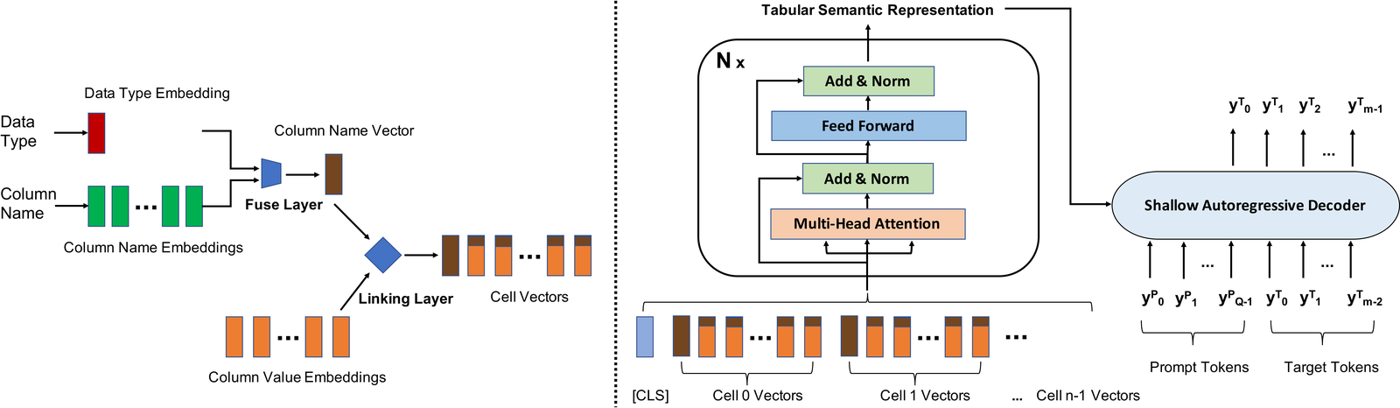
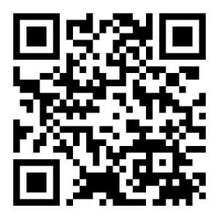



PAPER · DEEP READ
TABULAR FOUNDATION MODELS · ICLR 2024 · arXiv:2307.09249
UniTabE: A Universal Pretraining
ARCHITECTURE AT A GLANCE
Protocol for Tabular Models
Foundation models transformed language and vision,
Cells → TabUnit → Transformer → shallow decoder
yet tabular data, the workhorse of data science, was left behind.
13B
pretraining samples
THE GAP → UNITABE
Every table has a different schema, so models don't transfer.
283K
tables
UniTabE processes any table in one uniform way.
303 domains
0.83
avg AUC
HOW
7 benchmarks
TabUnit encodes each cell · Transformer refines the table · text prompts adapt to tasks
READ THE PAPER
HEADLINE FINDING
arXiv:2307.09249
Scan to open
Pretrained on 13B Kaggle samples, UniTabE beats XGBoost across benchmarks.
HKU · BAAI · Creatify AI
01

Slide 2
The problem: tables resist pretraining
NO FOUNDATION MODEL FOR TABULAR DATA
WHERE TABLES MATTER
THE MISSING PIECE
Tables run the real world
No foundation model yet
Stock prediction, real-estate
Unlike text and images, tabular
forecasting, and credit scoring all
data still has no widely adopted
rest on rows-and-columns data.
pretrained foundation model.
THE ROOT CAUSE
WHY WORKAROUNDS FAIL
Endless, mismatched schemas
Two flawed workarounds
Different column names, data types,
Flatten to text → lose numeric meaning.
and counts mean a model trained on
Assume a fixed schema → no transfer.
one table can't be reused on another.
Both block knowledge transfer.
UniTabE: A Universal Pretraining Protocol for Tabular Foundation Models · Yang et al. · ICLR 2024
02

Slide 3
Can the pretraining recipe work for tables?
LEARN ONCE, TRANSFER TO MANY TASKS
THE PROMISE OF PRETRAINING
THE QUESTION
Learn once, transfer widely
Does it work for tables?
A model absorbs general knowledge from
The authors ask whether this same
huge unlabeled data, then transfers it
pretrain-then-transfer recipe can
cheaply to many downstream tasks.
carry over to structured tables.
THREE INGREDIENTS
THE PAYOFF
What it takes
One model, many tasks
1 Represent any table, any schema
Classification · regression · imputation
2 A framework for many objectives
zero-shot · tables that gain columns,
3 Data large enough to pretrain
all without redesigning per task.
UniTabE: A Universal Pretraining Protocol for Tabular Foundation Models · Yang et al. · ICLR 2024
03

Slide 4
Method: TabUnit + Transformer + prompts
FIGURE 1 · STRUCTURE-FREE, CELL-LEVEL ARCHITECTURE
1
TabUnit per cell
2
Fuse data type
3
Link + encode
4
Shallow decoder
Each cell is a key-value pair:
Name is embedded + mean-pooled;
A linking layer ties columns to
Weak LSTM decoder + prompt
column name is the key,
a data-type gate marks numeric,
values; all cells plus a CLS
keeps knowledge in the encoder.
content is the value.
categorical or textual.
token pass a Transformer encoder.
Pretrain: masking + contrastive.
UniTabE: A Universal Pretraining Protocol for Tabular Foundation Models · Yang et al. · ICLR 2024
04

Slide 5
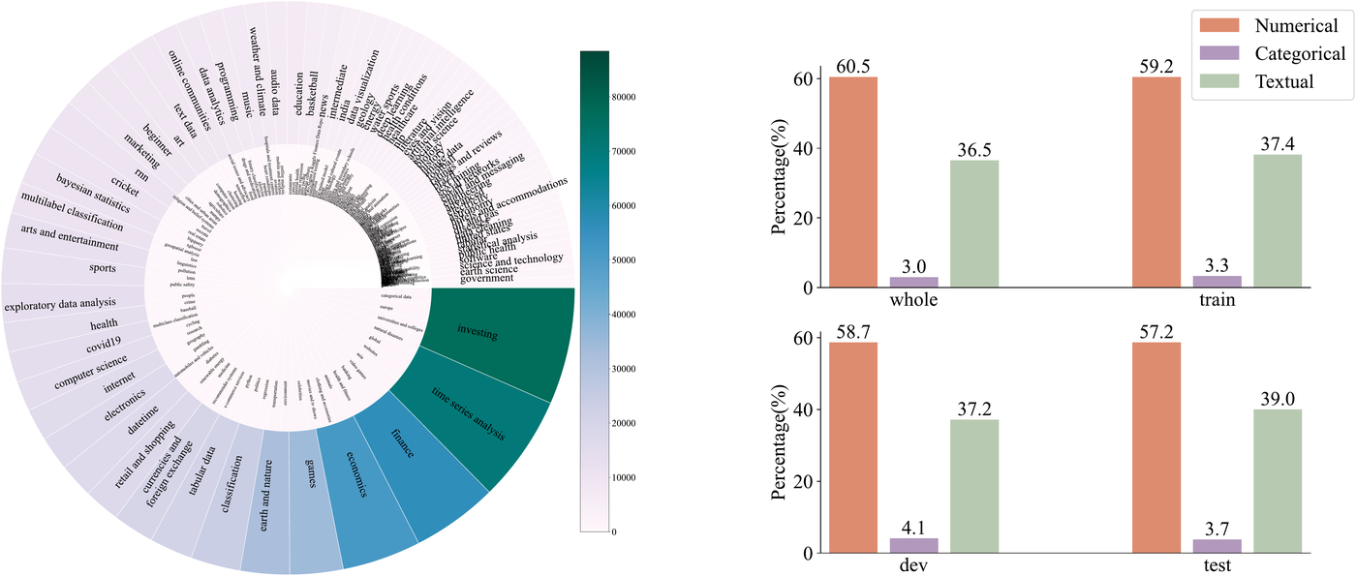
A Kaggle-scale corpus, held-out benchmarks
FIGURE 2 · DOMAIN & DATA-TYPE DISTRIBUTION
DISTRIBUTION OF DOMAINS & CELL DATA TYPES
THE CORPUS
7 TB from Kaggle
303 domains · 283K tables
≈13B individual examples
TABLE SHAPE
≈29 numeric columns
Plus ~8 textual columns
Top: investing, finance, economics
EVALUATION
Left: tables per domain. Right: numeric / categorical /
textual cell proportions across train / dev / test splits.
12 held-out + 7 public
6 classification + 6 regression
never seen, plus 7 public sets
UniTabE: A Universal Pretraining Protocol for Tabular Foundation Models · Yang et al. · ICLR 2024
05

Slide 6
Key result: pretraining beats XGBoost
AVERAGE AUC OVER 7 PUBLIC TABULAR BENCHMARKS
AVERAGE AUC · 7 BENCHMARKS
THE VERDICT
Pretraining pays off.
0.85
0.83
12 HELD-OUT KAGGLE TASKS
0.81
Wins on unseen tasks
0.80
0.79
Across classification and regression,
UniTabE again beats XGBoost and
a strong TransTab variant.
0.75
ZERO-SHOT
Predicts with no finetuning
0.70
On some datasets it predicts
UniTabE
Best baseline
XGBoost
Beats Tapas, FT-Transformer and the industry-favorite XGBoost.
accurately with zero task-specific
finetuning, real transfer.
UniTabE: A Universal Pretraining Protocol for Tabular Foundation Models · Yang et al. · ICLR 2024
06

Slide 7
Ablation: every component earns its place
LINKING LAYER, FUSE GATE, OBJECTIVES, DECODER DEPTH
BIGGEST DROP · LINKING LAYER
FUSE GATE
Removing column–value links
Data-type fusion matters
0.83
→
0.75
Dropping the fuse layer that injects
data-type information also hurts,
and removing both is worse still.
average AUC falls when the linking layer is ablated
PRETRAINING OBJECTIVES
DECODER DEPTH
Two signals, complementary
Shallow decoder wins
Dropping either objective, multi-cell
A 1-layer decoder beats 3- and
masking or contrastive learning,
6-layer ones, confirming the choice
reduces performance too.
to keep knowledge in the encoder.
UniTabE: A Universal Pretraining Protocol for Tabular Foundation Models · Yang et al. · ICLR 2024
07

Slide 8
Takeaway: a foundation model for tables
RESPECT STRUCTURE, PRETRAIN AT SCALE, TRANSFER
THE BIG PICTURE
The pretraining paradigm that reshaped language and
vision can extend to structured tabular data.
THE PRINCIPLE
THE OUTCOME
Respect the structure
A general tabular model
Don't flatten tables into text.
Pretrained on billions of examples,
Represent each cell by its
UniTabE transfers across tasks,
column name, value, and data type,
beats the long-standing XGBoost
refine with a Transformer, and
baseline, and gracefully handles
adapt through free-form prompts.
missing values and new columns.
UniTabE: A Universal Pretraining Protocol for Tabular Foundation Models · Yang et al. · ICLR 2024
08

