Slide 1





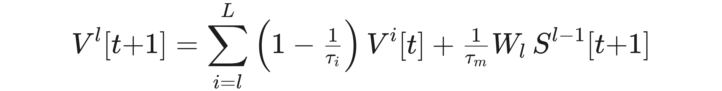
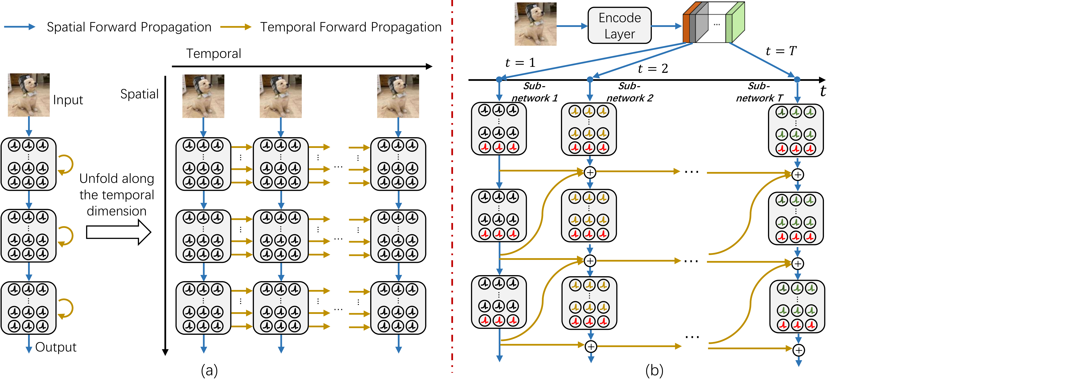
High-Performance Temporal Reversible Spiking
Neural Networks with O(L) Training Memory and
O(1) Inference Cost
Jiakui Hu¹, Man Yao², Xuerui Qiu³, Yuhong Chou⁴, Yuxuan Cai⁵, Ning Qiao⁶, Yonghong Tian^{1,7}, Bo Xu², Guoqi Li^{2,8†}
¹ Peking University ² Institute of Automation, CAS ³ Future Technology, UCAS ⁴ The Hong Kong Polytechnic University ⁵ 01.AI ⁶ SynSense AG ⁷
Peng Cheng Laboratory ⁸ Key Lab of Brain-inspired Intelligence, CAS
Problem
Method
Key Results
Multi-timestep simulation of SNNs costs O(L×T) training memory
and O(T) inference energy. Existing training methods relieve one
bottleneck but never both at once, keeping SNNs from scaling.
1
Encode once. The image is encoded a single time, then split
into T groups — one fed per timestep.
METHOD (IMAGENET-1K)
TOP-1
MEM
MB/IMG
ENERGY
MJ
Spike-driven Transformer
74.6
730.0
4.5
2
Group the network. The SNN is divided into T parameter-
sharing sub-networks, so inference cost is O(1).
T-RevSNN (ResNet-18, 512ch)
73.2
85.7
2.8
~20×
T-RevSNN (ResNet-18, 384ch)
69.8
57.5
1.7
the memory of a plain ResNet-19 to train a 10-timestep
spiking ResNet-19
3
Turn off most neurons. Temporal dynamics are disabled
everywhere except a few key spiking neurons.
8.6× less memory, 2.0× faster training, 1.6× lower energy vs.
the Spike-driven Transformer, at comparable accuracy.
Motivation
4
Make key links reversible. Only last-timestep membrane
potentials are stored; activations are recomputed, giving O(L)
memory.
Temporal gradients in SNNs are largely unimportant — only a
few key neurons carry temporal information that matters.
SO WHAT → Best accuracy among CNN-based spiking ResNets, at the lowest cost in its class.
A gradient-similarity analysis confirms only each stage's last
layer keeps temporal gradients close to the full model.
Headline Numbers
So why pay the full temporal cost for every neuron?
Membrane potentials are exactly recoverable across timesteps, so only the last timestep is stored — memory O(L).
8.6×
2.0×
Faster training
Contribution
Less memory vs. Spike-driven
Transformer
1.6×
Lower inference energy
at comparable 73.2% top-1 accuracy
73.2%
ImageNet-1K top-1
T-RevSNN — a temporal-reversible SNN, cheap to train and
cheap to run.
Takeaway
Only key neurons pass temporal information via multi-level
reversible connections, giving O(L) training memory; once-only
encoding with grouped sub-networks also makes inference cost
O(1), not just training.
Because most temporal gradients don't matter, turning off most
neurons' temporal dynamics and making the rest reversible
delivers O(L) training memory and O(1) inference cost.
A BN-free, ConvNeXt-style block (depth-/point-wise convs) with
a scaled residual connection makes the sparse temporal
interaction train effectively.
Vanilla SNNs unfold every neuron in time (O(L×T) memory, O(T) inference).
T-RevSNN encodes the image once, splits it into T groups over T
parameter-sharing sub-networks, and passes temporal information only at
key neurons — giving O(L) memory and O(1) inference.
Removes the memory and training-time bottleneck that
kept SNNs from scaling — toward larger, practical spiking
networks.

