Slide 1


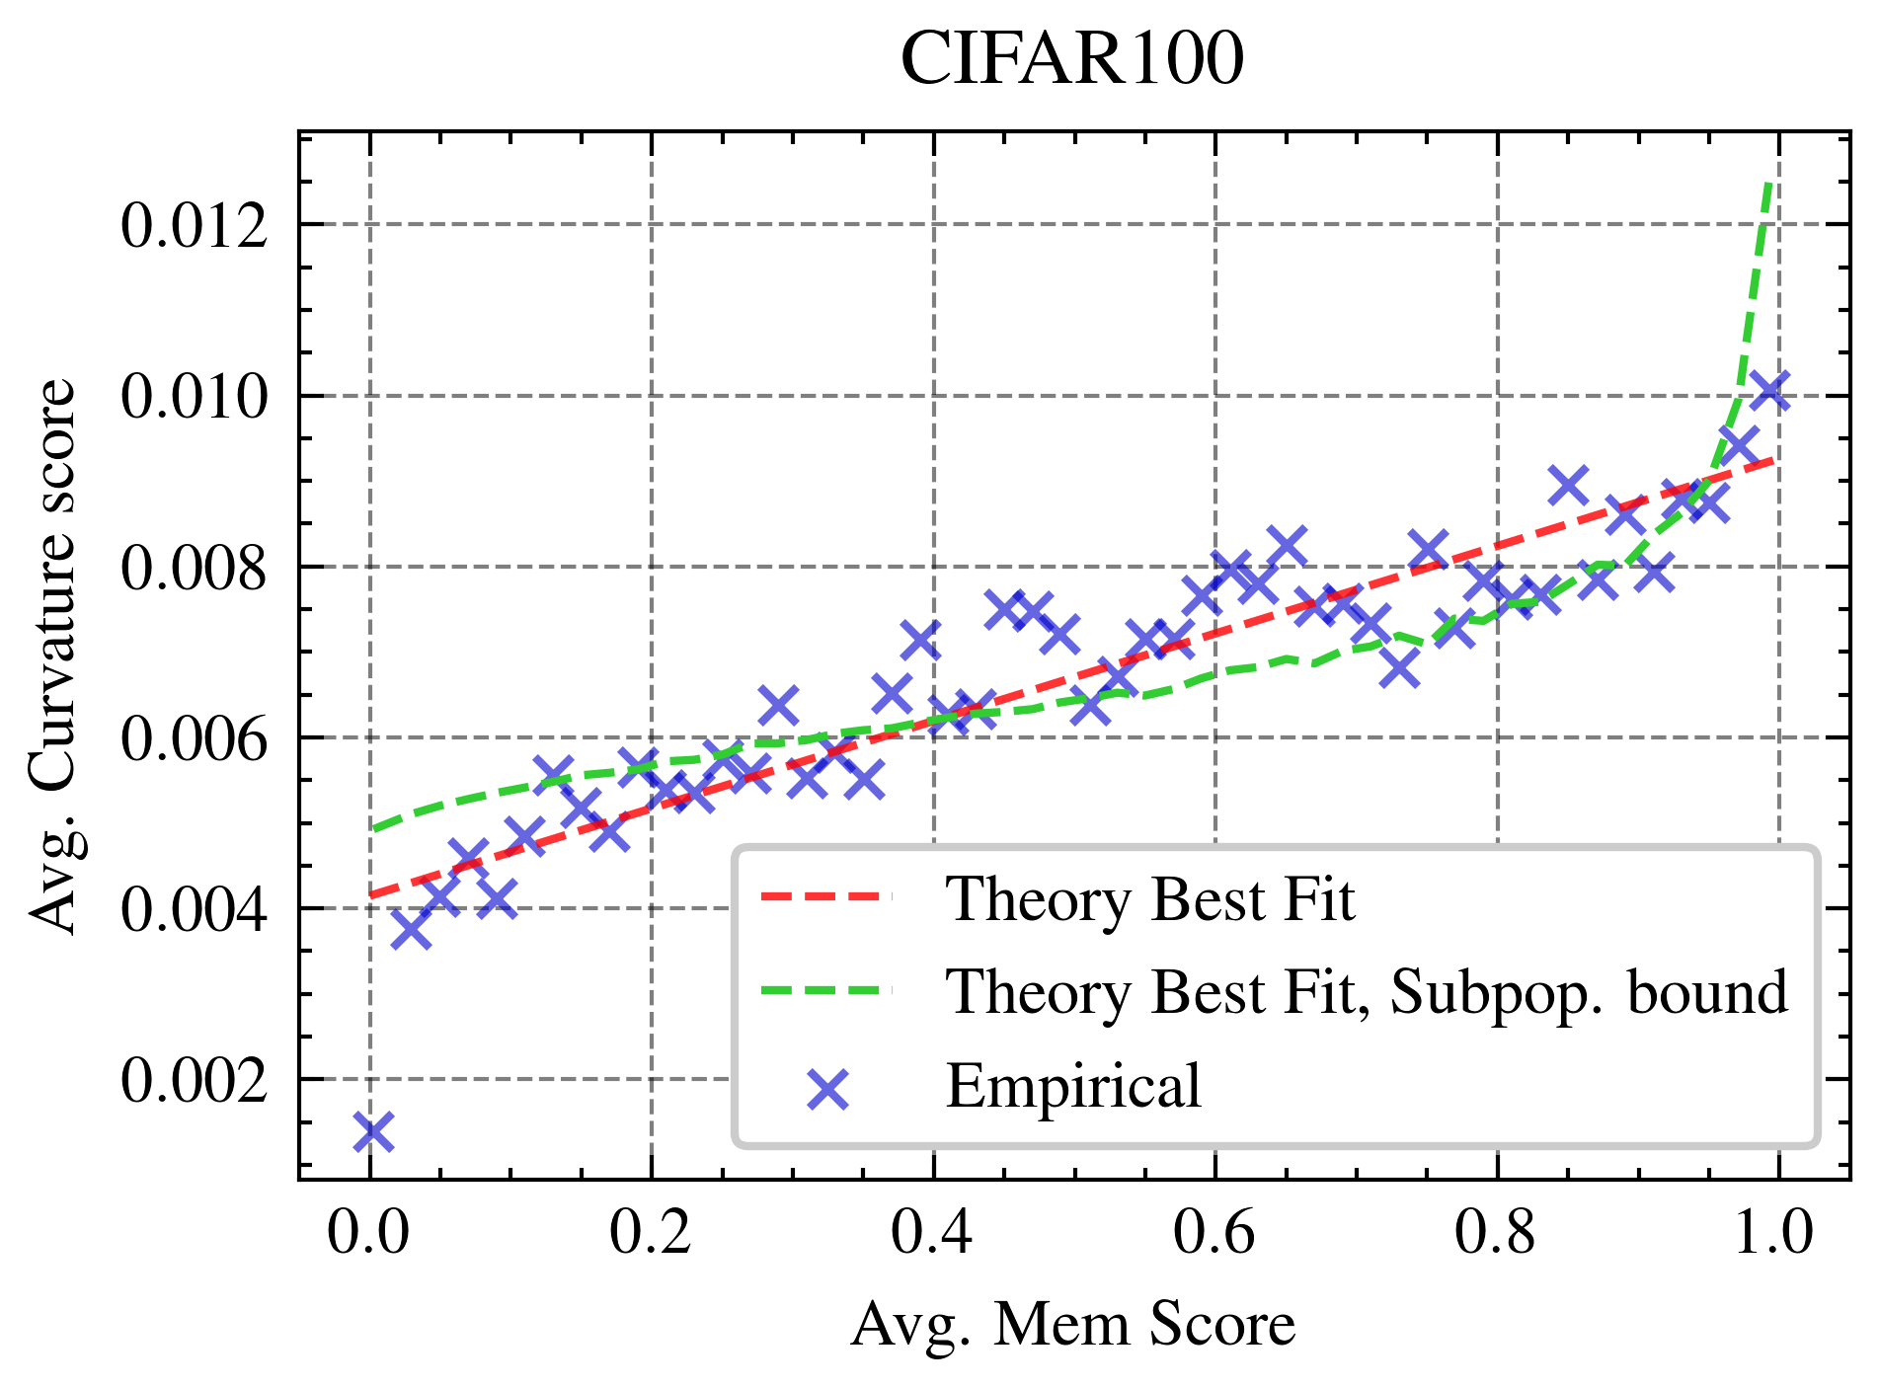
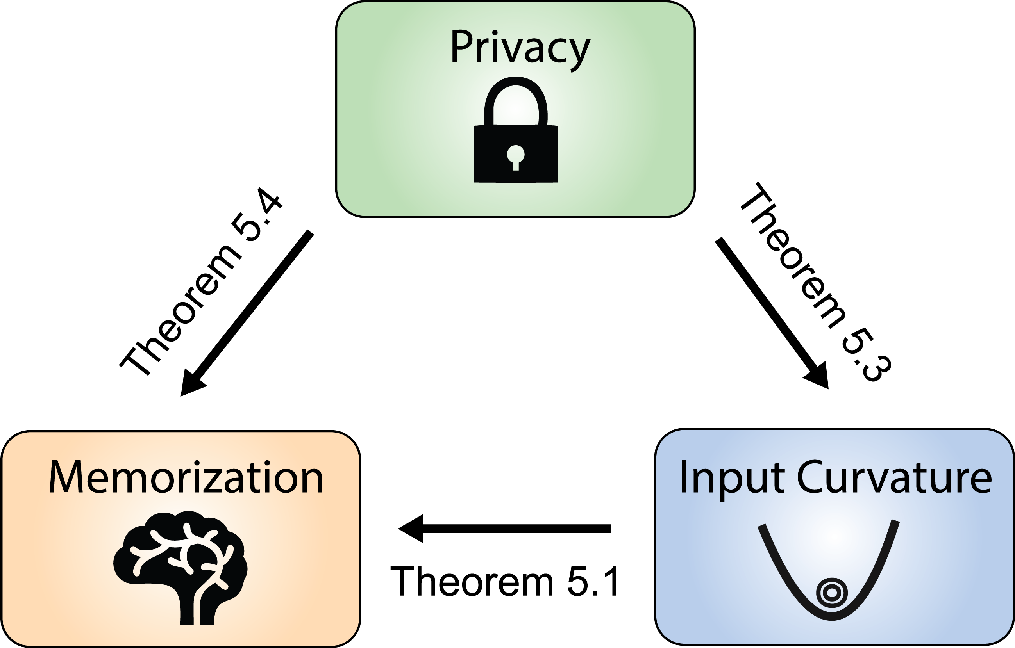
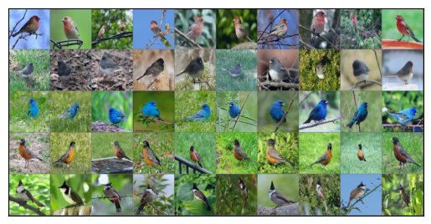
Unveiling Privacy, Memorization, and Input
Curvature Links
Deepak Ravikumar¹, Efstathia Soufleri¹, Abolfazl Hashemi¹, Kaushik Roy¹
¹ Purdue University
Problem
Method
Key Results
Input loss curvature — the trace of the loss Hessian w.r.t. the input — is a widely-used cheap proxy for memorization in deep nets. Yet why curvature and memorization track together, and how either links to differential privacy, had no theory.
A second-order Nesterov–Polyak expansion with a zero-mean perturbation cancels first-order terms, leaving input curvature as the leading term.
Memorization is linear in curvature (Thm 5.1), with the trend cleanest on ImageNet.
Curvature is ~10³× cheaper than the memorization score; stronger privacy lowers both (Thms 5.3–5.4).
Feldman’s memorization score is principled but compute-prohibitive; the curvature proxy was purely empirical — until now.
Curvature is made cheap to measure by Hutchinson’s trace estimator; under stability, generalization & adjacency assumptions, taking expectations yields the three bounds.
Motivation
A rigorous curvature–memorization–privacy link would give a theoretical license to use cheap curvature as a memorization proxy, and explain how privacy mechanisms suppress leakage.
Influence functions assume Hessian convexity & positive-definiteness — conditions that fail for deep nets, so input curvature needs none of them.
Bounds (Thms 5.1/5.3/5.4) linking privacy, memorization & curvature.
Memorization vs. curvature (CIFAR100 & ImageNet).
Dataset / Benchmark
Takeaway
Feldman & Zhang (2020) memorization scores + ensembles: 1000 Small Inception (CIFAR100), 100 ResNet50 (ImageNet).
Curvature provably upper-bounds memorization and is itself bounded by the privacy parameter — a cheap, assumption-light proxy that applies to real deep nets, with privacy provably suppressing both memorization and leakage.
CIFAR-10
CIFAR-100
ImageNet
Small Inception
ResNet50
ImageNet ranked by curvature: low (left) = prototypical, high (right) = memorized.
ResNet18

