Slide 1


ICML 2024 · PURDUE UNIVERSITY · arXiv:2402.18726
Unveiling Privacy, Memorization,
and Input Curvature Links
A rigorous theory bounding memorization by cheap
input loss curvature — and both by differential privacy.
Deepak Ravikumar · Efstathia Soufleri · Abolfazl Hashemi · Kaushik Roy
Scan · Paper
MEMORIZATION
COST GAP
THE BRIDGE
Networks memorize training data.
Feldman score: rigorous, costly.
This paper builds the theory.
Memorization ties directly to
Input loss curvature is a cheap
Formal bounds linking memorization,
generalization, noisy learning,
empirical proxy — ~1000× faster —
curvature & differential privacy,
and privacy leakage.
but was unjustified in theory.
validated on CIFAR & ImageNet.
Notes:
Deep networks memorize training data, and memorization ties to generalization and privacy. Feldman's memorization score is rigorous but costly, while input loss curvature is a cheap proxy nobody could justify. This Purdue ICML 2024 paper builds the missing theory linking memorization, curvature, and differential privacy on CIFAR and ImageNet.

Slide 2
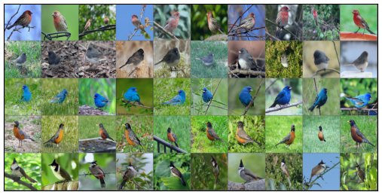
PROBLEM · 02 / 10
Memorization matters — but measuring it is costly
THE STAKES
ImageNet examples ranked by input loss curvature
Why memorization matters
Deep networks overfit and memorize training data.
That memorization is tied to generalization, to noisy
learning, and — critically — to privacy leakage.
THE OBSTACLE
Feldman's score is rigorous but expensive
Feldman's stability-based memorization score quantifies
memorization rigorously, but is computationally
prohibitive — far too expensive to compute at scale.
PROXY
Low curvature → typical, redundant samples
Input loss curvature → a cheap empirical proxy
High curvature → rare, memorized samples
Trace of the input-loss Hessian tracks memorization ~1000× cheaper —
yet the link was purely empirical, with no tie to differential privacy.
Figure 2 · curvature surfaces memorized data
Input Loss Curvature ↔ Memorization ↔ Privacy
02 / 10
Notes:
Deep networks memorize training data, which matters for generalization, noisy learning, and privacy leakage. Feldman's memorization score quantifies this rigorously but is far too expensive. Input loss curvature, the trace of the input-loss Hessian, tracks memorization roughly a thousand times cheaper, yet the connection was purely empirical, with no theory linking either to differential privacy.

Slide 3
MOTIVATION · 03 / 10
Why a rigorous link is worth proving
PAYOFF 1
NO STRONG ASSUMPTIONS
A theoretical license for the cheap proxy
Influence functions don't fit deep nets
If curvature provably upper-bounds memorization,
practitioners can use the cheap curvature proxy
Influence functions
This framework
instead of the expensive memorization score.
Assume Hessian
Needs no
convexity &
convexity or
positive-
definiteness
PAYOFF 2
definiteness.
assumptions.
Explaining why privacy suppresses leakage
✗ Fails for
✓ Applies to
Memorization is itself a privacy risk. Linking
deep networks.
real deep nets.
differential privacy to curvature explains why
privacy mechanisms measurably reduce leakage.
Goal
Turn an empirical coincidence — curvature tracks memorization — into a proven, assumption-light
theory that also connects both quantities to differential privacy.
Input Loss Curvature ↔ Memorization ↔ Privacy
03 / 10
Notes:
Proving curvature bounds memorization would license the cheap proxy over the expensive score. Because memorization is a privacy risk, linking differential privacy to curvature explains why privacy reduces leakage. Unlike influence functions, which assume Hessian convexity that fails for deep nets, this framework needs no such assumptions.

Slide 4
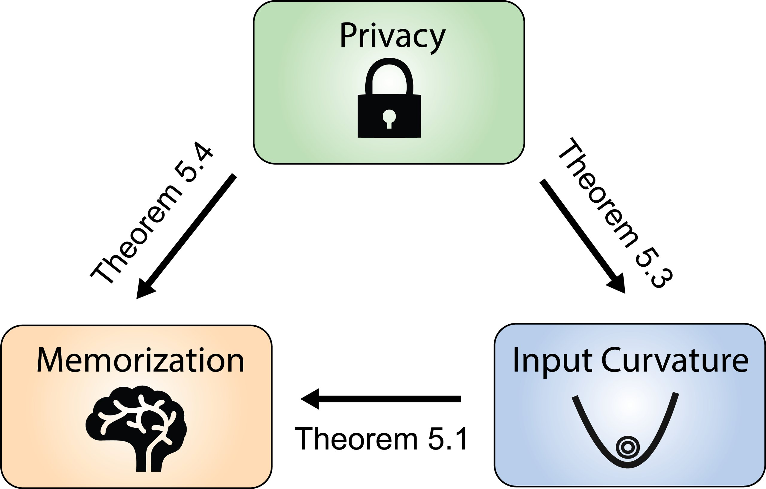
CONTRIBUTION · 04 / 10
Three theorems, one triangle
THEOREM 5.1 · THEOREM 5.3
Three links connect the triangle
Curvature upper-bounds memorization;
privacy ε upper-bounds average curvature.
THEOREM 5.4
Privacy directly upper-bounds memorization.
NO HESSIAN-CONVEXITY ASSUMPTIONS
So the results hold for real deep networks —
and all three are validated empirically.
Figure 1 · Memorization ↔ Input Curvature ↔ Privacy
Input Loss Curvature ↔ Memorization ↔ Privacy
04 / 10
Notes:
The paper proves three links in a triangle connecting memorization, input loss curvature, and differential privacy. First, curvature upper-bounds memorization. Second, the privacy parameter upper-bounds average curvature. Third, privacy bounds memorization directly. None assume Hessian convexity, so they hold for real deep networks, and all three are validated empirically.

Slide 5
METHOD · 05 / 10
From a Taylor expansion to two provable bounds
STEP 1 · SECOND-ORDER EXPANSION
How the pieces fit
A Nesterov-Polyak second-order Taylor
expansion of the loss introduces the input Hessian.
Differential Privacy (ε)
↓ bounds
STEP 2 · BOUND ON MEMORIZATION
A zero-mean perturbation cancels first-order
Input Loss Curvature (tr H)
terms; taking expectations bounds memorization
by expected curvature plus a data-independent offset.
↓ bounds
|mem(A,S,i)| ≤ (1/L) · Eφ[Curvφ(zᵢ, S∖ⁱ)] + c₁
Memorization (mem score)
STEP 3 · PRIVACY → CURVATURE
With the definition of differential privacy, a
smaller ε forces lower average curvature.
Estimation: Hutchinson's trace estimator
E[Curv] ≤ L(m+1)(1 − exp(−ε)) + c₂
h = 1e-3 · n = 10 Rademacher probes (no full Hessian)
Input Loss Curvature ↔ Memorization ↔ Privacy
05 / 10
Notes:
The theory starts from a second-order Nesterov-Polyak expansion of the loss, introducing the input Hessian. A zero-mean perturbation cancels first-order terms, and taking expectations bounds memorization by expected curvature plus a data-independent offset. With the definition of differential privacy, a smaller epsilon forces lower curvature. Curvature itself is estimated cheaply via Hutchinson's trace estimator.

Slide 6
DATASET / BENCHMARK · 06 / 10
What the theory is validated on
THREE STANDARD IMAGE CLASSIFICATION BENCHMARKS
CIFAR-10
CIFAR-100
ImageNet
10 classes
100 classes
1000 classes
SETUP A
SETUP B
Memorization ground truth
Privacy experiments
Feldman & Zhang (2020) precomputed stability-based
ResNet-18 trained with DP-SGD
memorization scores + released model ensembles.
across a range of privacy
1000 models on CIFAR-100 (Small Inception)
budgets ε.
100 models on ImageNet (ResNet-50)
Curvature and memorization are averaged across the
Clip norm 1.0 · lr 0.001 ·
ensemble for each example.
batch size 128.
Because the memorization scores and ensembles are reused from prior work, the bounds are tested against an independent, established ground truth.
Input Loss Curvature ↔ Memorization ↔ Privacy
06 / 10
Notes:
Validation uses CIFAR10, CIFAR100, and ImageNet. Memorization relies on Feldman and Zhang's precomputed scores and ensembles, a thousand models on CIFAR100 and a hundred on ImageNet, using Small Inception and ResNet50. Privacy experiments train ResNet18 with DP-SGD across several budgets.

Slide 7
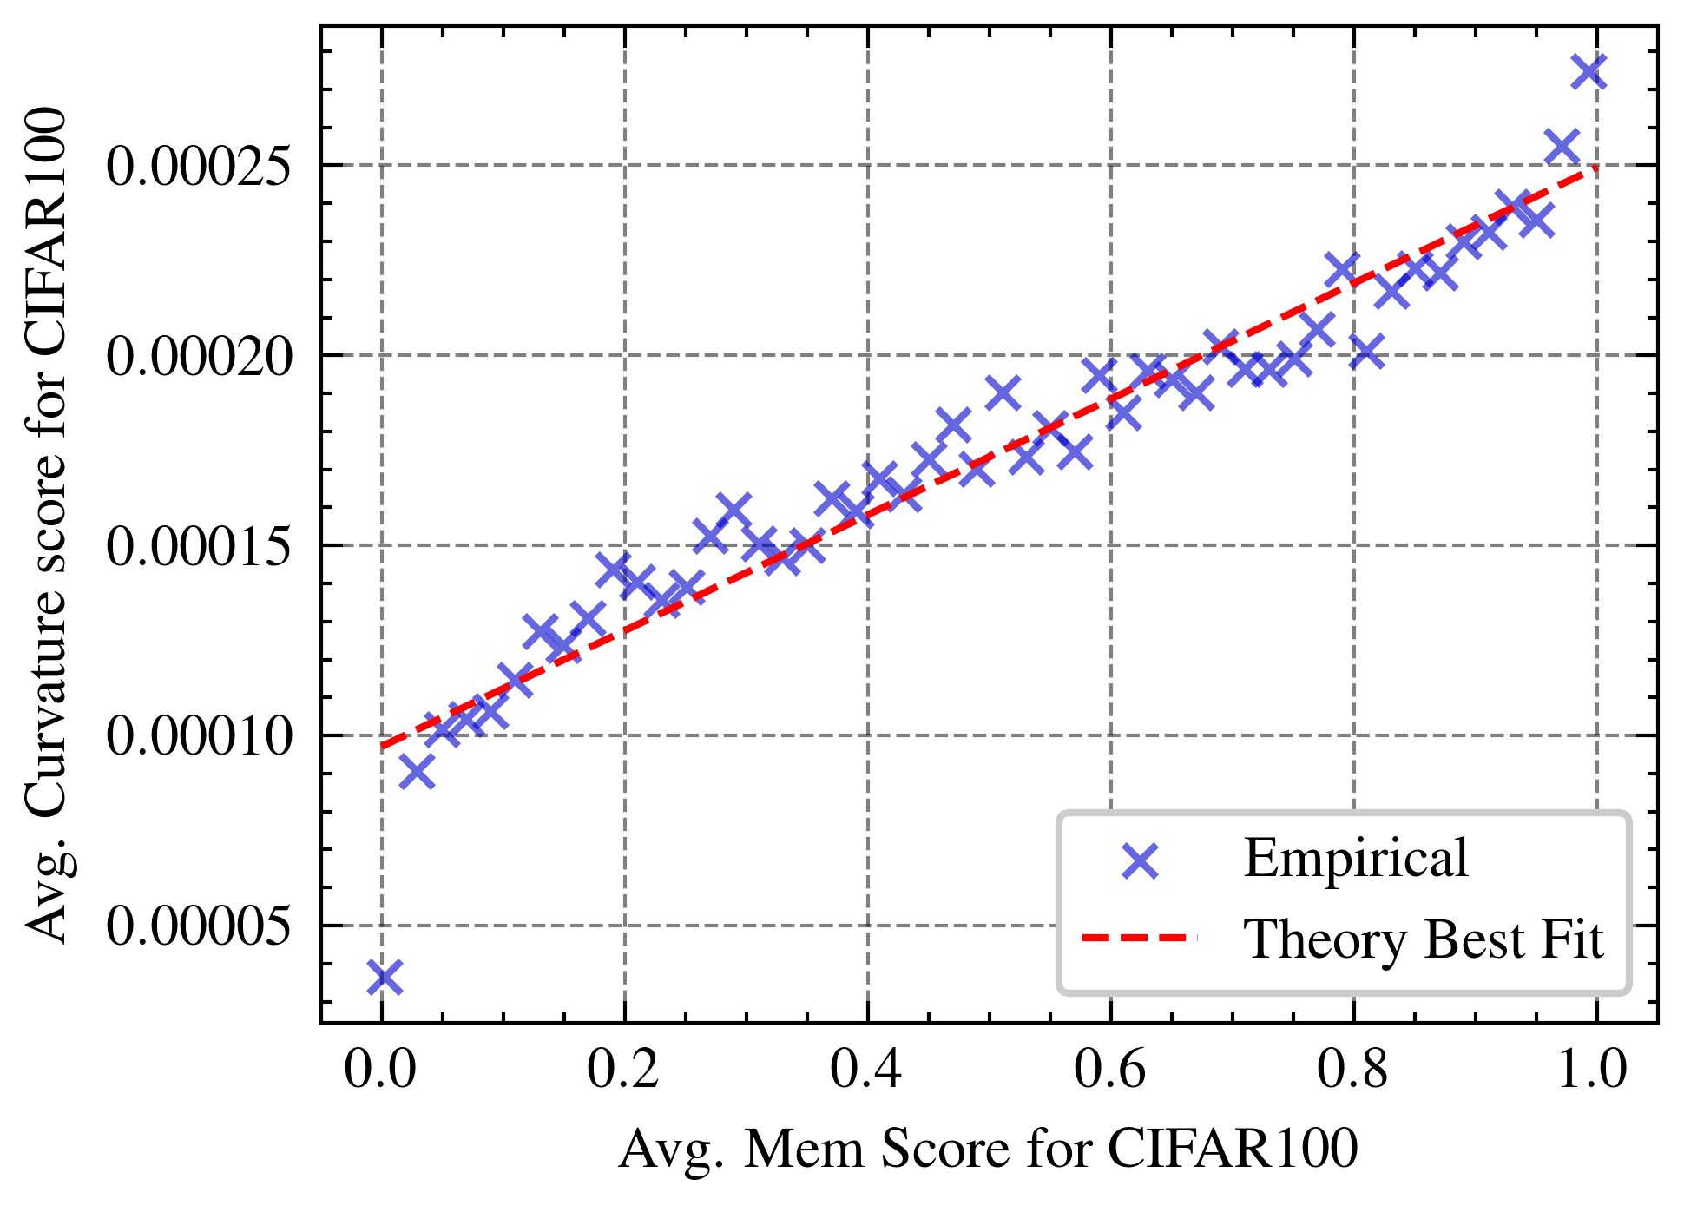
KEY RESULT · 07 / 10
Memorization tracks input loss curvature
Avg. curvature vs. avg. memorization — CIFAR-100
EVERY THEORETICAL PREDICTION HOLDS
The empirical results confirm all three bounds.
WHAT THE PLOTS SHOW
1 · Linear trend
Memorization vs. curvature is strongly linear on
CIFAR-100 and ImageNet — especially clean on ImageNet.
2 · Privacy drives curvature down
Stronger privacy (smaller ε) lowers curvature along
the best-fit curve the theory predicts.
3 · Most-memorized stay bounded
For the most-memorized examples, memorization rises
with the privacy budget while staying under the
Theorem 5.4 upper bound.
Figure 3 · strong linear trend, matching Theorem 5.1's best fit
Theory and experiment agree across CIFAR & ImageNet.
Input Loss Curvature ↔ Memorization ↔ Privacy
07 / 10
Notes:
Every prediction holds. Memorization plotted against input loss curvature shows a strong linear trend on CIFAR100 and ImageNet, especially clean on ImageNet. Stronger privacy drives curvature down along the predicted curve, and for the most-memorized examples, memorization rises with the privacy budget while staying under the theoretical bound.

Slide 8
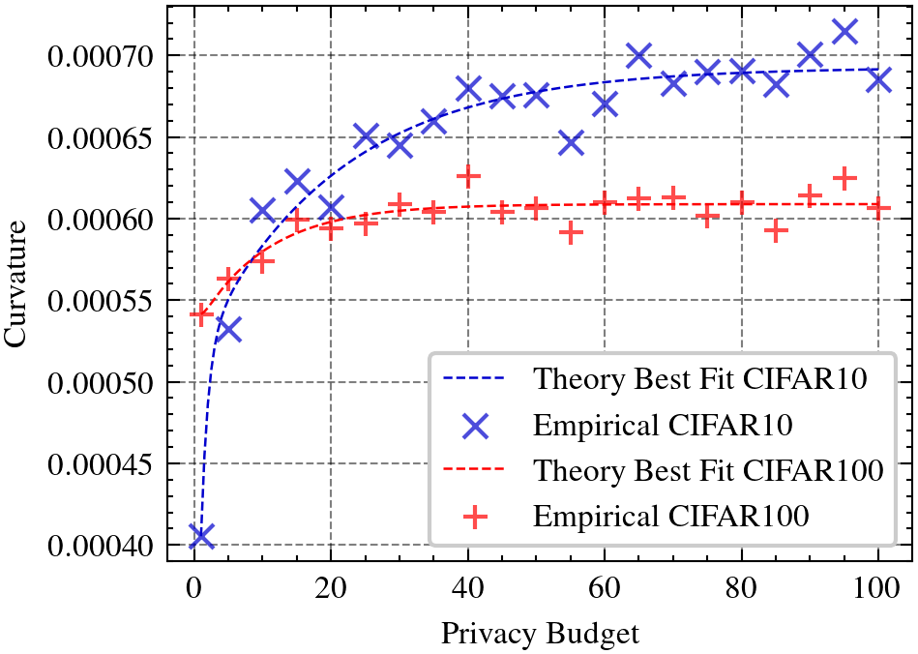
ABLATION STUDY · 08 / 10
How the estimates behave across settings
CONFIG
TOP-500 MOST-MEMORIZED CIFAR-100
Curvature estimator
Memorization collapses under strong privacy,
then recovers as the budget ε grows — tracking
Hutchinson's trace estimator, cheap enough to run
the theoretical bound throughout.
at scale: finite-difference step h = 1e-3, with
n = 10 Rademacher probe vectors.
Curvature vs. privacy budget (CIFAR-10 / 100)
SWEEP
Privacy budget sweep
ε ∈ {1, 10, 20, 30, 40, 50} at fixed δ = 1e-5.
Curvature averaged over 10 random seeds per budget.
Stronger privacy (small ε) → lower curvature;
it recovers as the budget ε loosens.
Cheap by design
The whole sweep is affordable precisely because
curvature avoids computing the full Hessian.
Figure 7 · curvature rises with ε along the theory best-fit
Input Loss Curvature ↔ Memorization ↔ Privacy
08 / 10
Notes:
Curvature uses Hutchinson's trace estimator with step 1e-3 and ten Rademacher vectors, cheap enough to run at scale. Privacy sweeps epsilon over one, ten, twenty, thirty, forty, and fifty at delta 1e-5, averaging ten seeds. The five hundred most-memorized CIFAR100 examples collapse under strong privacy and recover as epsilon grows.

Slide 9
HEADLINE NUMBERS · 09 / 10
Four numbers that define the work
EFFICIENCY
GROUND TRUTH
~1000×
1000 / 100
cheaper to compute
models (CIFAR-100 / ImageNet)
Curvature vs. Feldman's memorization score (~3 orders).
Feldman & Zhang ensembles averaged per example.
PRIVACY BUDGET
ESTIMATOR
ε: 1→50
h=1e-3, n=10
δ = 1e-5 privacy sweep
finite-diff step · Rademacher probes
Six budgets; 3 theorems tie the triangle together.
A few numbers capture the whole result.
Input Loss Curvature ↔ Memorization ↔ Privacy
09 / 10
Notes:
A few numbers capture the work. Input loss curvature is about three orders of magnitude cheaper than the Feldman score. Ground truth averages a thousand models on CIFAR100 and a hundred on ImageNet. Privacy sweeps epsilon from one to fifty at delta 1e-5. Three theorems tie the triangle together.

Slide 10
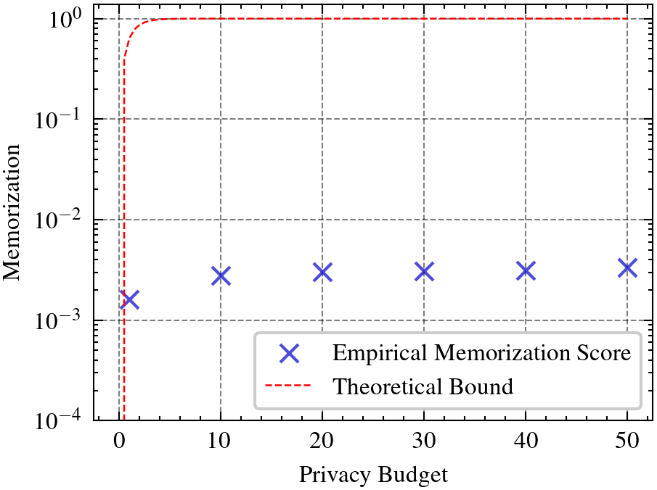
TAKEAWAY · 10 / 10
A cheap measurement, now on firm ground
THE CLOSED TRIANGLE
Now on firm theory
Curvature provably upper-bounds memorization,
and is itself bounded by the differential
privacy parameter — closing the triangle that
also bounds memorization by privacy.
Curvature ≤ f(ε) and memorization ≤ g(curvature)
Scan for the paper
arXiv:2402.18726 · ICML 2024
WHAT IT MEANS
Privacy vs. memorization + bound
✓ Needs no Hessian-convexity assumptions — applies directly to real deep networks.
✓ Cheap input loss curvature is a theoretically justified proxy for the
expensive Feldman memorization score.
✓ Privacy mechanisms provably suppress both curvature and memorization.
✓ Predictions match CIFAR and ImageNet experiments closely.
Figure 8 · empirical scores stay under the bound
Input Loss Curvature ↔ Memorization ↔ Privacy
10 / 10
Notes:
The empirical curvature-memorization link now rests on firm theory. Curvature provably upper-bounds memorization and is itself bounded by the differential privacy parameter, closing the triangle. Needing no Hessian-convexity assumptions, it applies to real deep networks, so cheap curvature is a justified proxy, and privacy provably suppresses both.

