Slide 1



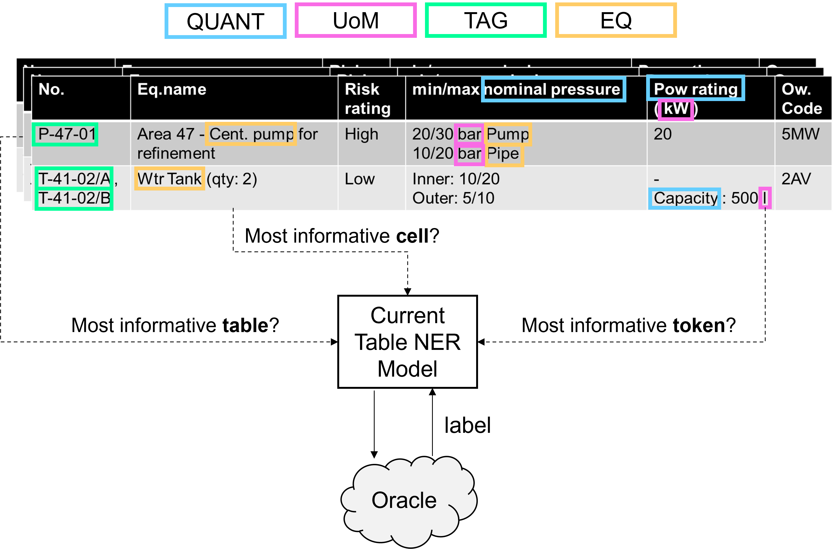
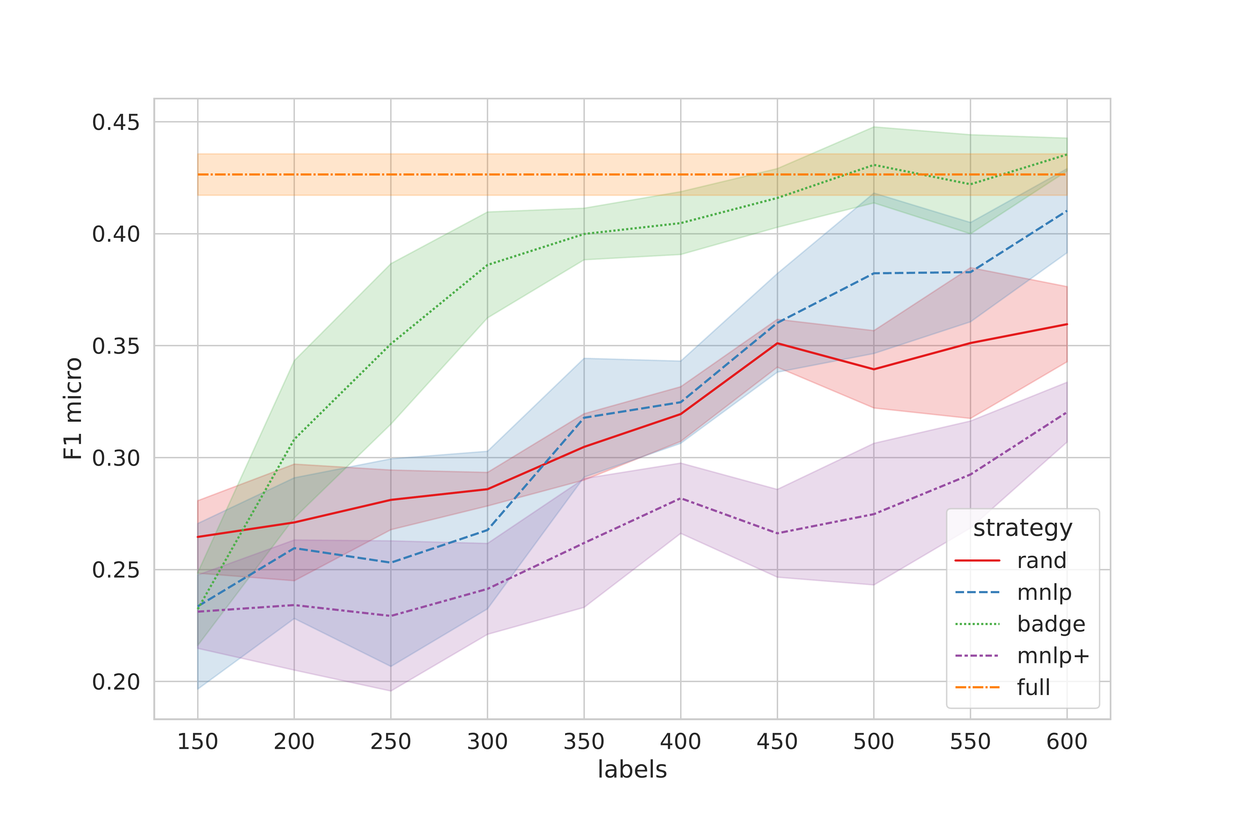
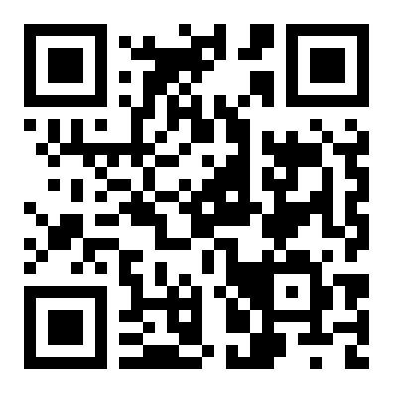
Active Learning with Tabular Language Models
Martin Ringsquandl¹, Aneta Koleva^{1,2}
¹ Siemens AG ² LMU Munich
Problem
Method
Dataset / Benchmark
Ablation Study
Fine-tuning tabular language models needs many labels, but only scarce experts can annotate the technical tables — making labels prohibitively expensive.
Table-biased encoder: a row–column visibility matrix + within-cell positional encoding give tokens full-table context.
Real industrial spreadsheets from multiple plants, downsampled to ≤5 rows per table, expert-annotated cell-by-cell with prodi.gy.
METHOD
DIVERSITY
RESULT
Rand
uniform
baseline
Decoder assigns IO NER tags over four entity types: TAG, EQ, QUANT, UoM.
MNLP
few
≈ Rand
Pool-based active learning then selects batches of the most informative cells for an expert oracle to annotate next.
MNLP+
forced max
< Rand
Random split → 55 training tables (4,774 cells, 1,112 labels) and 24 test tables.
BADGE
balanced
> full-train
Sub-cell NER is nested multi-instance: many cells per table, many token labels per cell — acquire at which level?
Headline Numbers
~77%
55 / 24
of cells contain no entity (label-O only) — extreme class imbalance
0.23
train/test tables
MNLP: uncertainty; BADGE: gradient-embedding batch diversity
NER labels per cell
100 + 50
seed + per-iter
Motivation
5
seeds
Plentiful unlabeled tables paired with costly expert labels make this an ideal active-learning setting.
Key Results
Takeaway
Cell-level acquisition with built-in batch diversity (BADGE) reaches full-training F1 using far fewer expert labels — while forcing maximum table diversity backfires below random.
Large transformers need batch acquisition over many epochs, so they cannot be updated one example at a time.
Naive uncertainty sampling then grabs highly correlated, redundant cells.
Micro-F1 at each active-learning iteration, averaged over 5 seeds.
Questions?
Get in
touch
FIRST
BADGE beats random and even exceeds full-training F1 with far fewer labels; MNLP barely edges random, and MNLP+ (forced max diversity) is the worst.
No prior work combines active learning with tabular language models.
Email: martin.ringsquandl@siemens.com
Overview of the industrial sub-cell NER problem and the active-learning candidate acquisition.
arxiv.org/abs/2211.04128
Paper

