Slide 1
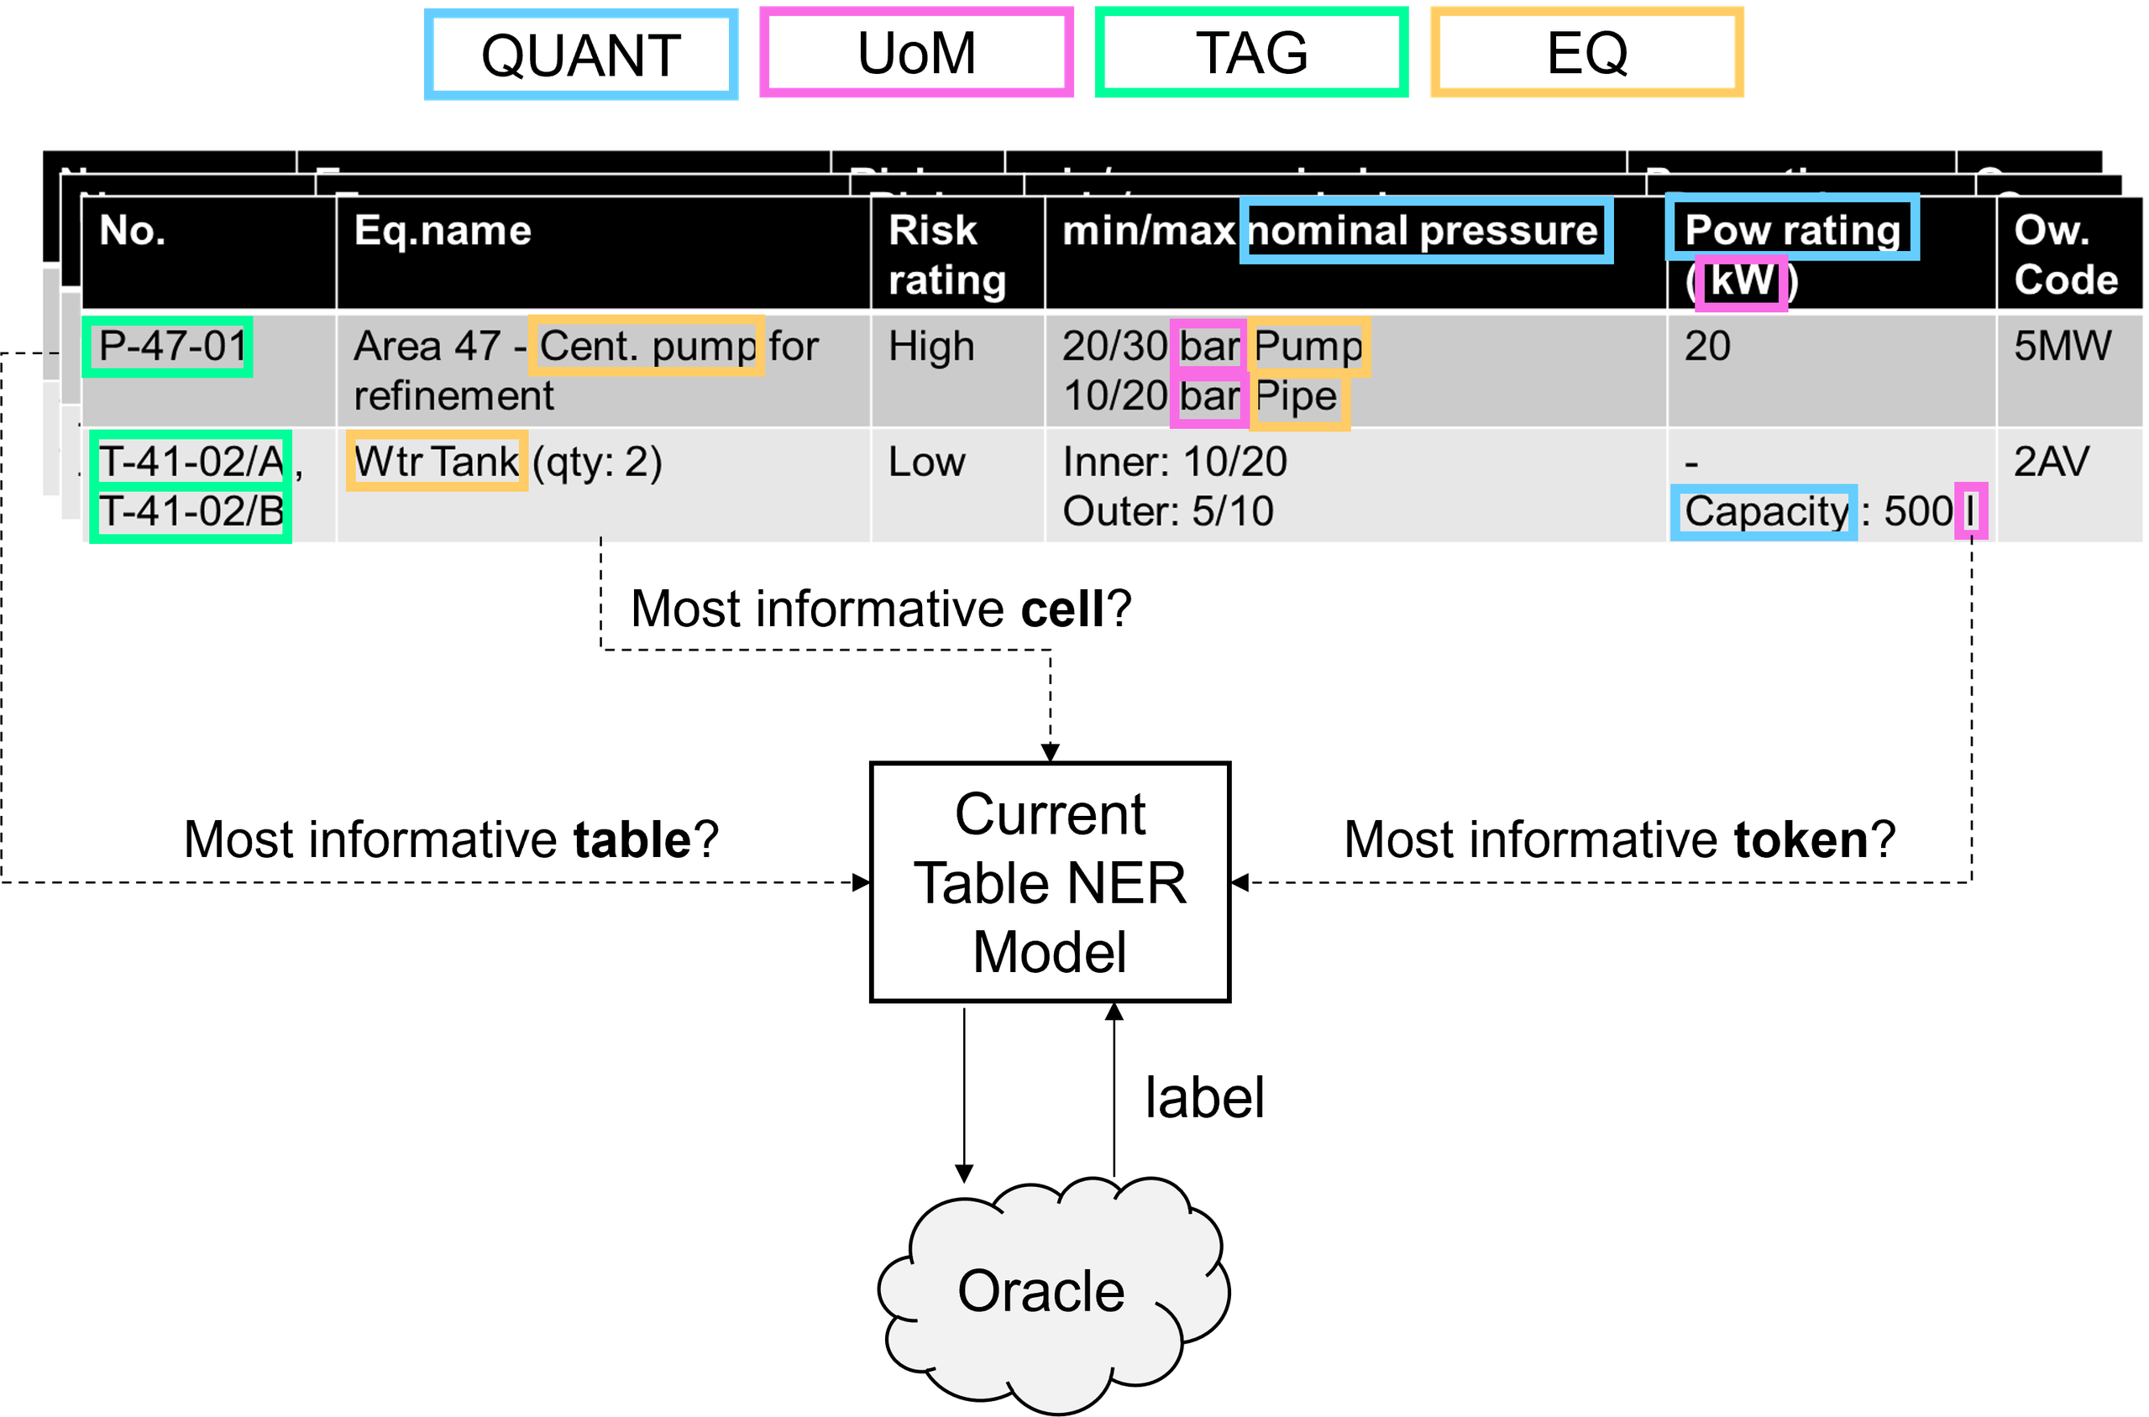
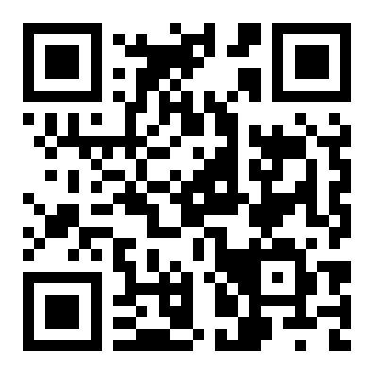
PAPER · DEEP READ
TABLE REPRESENTATION LEARNING WORKSHOP · NeurIPS 2022 · arXiv:2211.04128
Active Learning with
THE TASK · SUB-CELL NER
Tabular Language Models
Reading the mountains of industrial spreadsheets —
without paying for a mountain of expert labels.
Figure 1 · An oracle labels the most informative cells.
Martin Ringsquandl · Aneta Koleva
EQ
TAG
QUANT
UoM
Siemens AG · LMU Munich
READ THE PAPER
arXiv:2211.04128
HEADLINE FINDING
Scan to open
BADGE matches full-training F1 with far fewer labels —
while forcing maximum table diversity actually hurts.
01

Slide 2
The problem: cheap tables, expensive labels
EXTRACTING STRUCTURE FROM INDUSTRIAL SPREADSHEETS
THE SETTING
WHAT IS TRACKED
Industry runs on spreadsheets
Equipment · sensors · vessels
Plant records live in loosely structured
Reading them automatically means
tables — the raw material for automation,
fine-tuning tabular language models
if a model can read them.
on labeled examples.
THE CATCH · COST
A NEW KIND OF PROBLEM
Only experts can annotate
Sub-cell NER
Highly technical, domain-specific
A genuinely new active-learning problem:
language means a handful of experts —
each table holds many cells, and each cell
so labeling gets expensive fast.
carries several token-level labels at once.
Active Learning with Tabular Language Models · Ringsquandl & Koleva
02

Slide 3
Why active learning — and why it is hard here
SPEND EVERY ANNOTATION WHERE IT COUNTS
1
THE RIGHT FIT
2
BATCH MODE
!
THE PITFALL
Plenty of data,
Pick a whole
Correlated
costly labels
batch at once
picks waste budget
Active learning is built for
Big transformers can't learn
Pure uncertainty sampling
exactly this: squeeze the most
one example at a time. They
grabs near-identical cells —
model performance out of
train in batches over epochs,
often from the same table —
every single annotation.
so acquisition is batch-level.
burning the annotation budget.
THE GAP THIS WORK FILLS
No one had studied active learning together with tabular language models.
Despite the obvious fit, the pairing was unexplored — this paper is the first to close it.
Active Learning with Tabular Language Models · Ringsquandl & Koleva
03

Slide 4
Method: a table-aware model in an AL loop
TABULAR LM · IO DECODER · POOL-BASED ACQUISITION
THE PIPELINE
ENCODER · TABULAR LANGUAGE MODEL
FOUR ACQUISITION FUNCTIONS COMPETE
Row–column visibility attention
MNLP
MNLP+
Replaces vanilla attention with a row/column mask and
within-cell positions — every token sees the whole table.
Uncertainty
Forced diversity
Score cells by normalized
MNLP plus a round-robin
log-probability — pick the
across tables to maximize
DECODER · IO TOKEN TAGGING
least confident cells.
table diversity.
Four entity types
EQ tag
EQ name
Quantity
Unit
BADGE
Rand
Uncertain + diverse
Baseline
POOL-BASED ACTIVE LEARNING
k-means++ on per-cell
Sample cells uniformly
Pick the most informative cells
gradient embeddings for a
at random — the control
Each round, an acquisition function selects a batch of cells
balanced batch.
to beat.
for the expert oracle to label, then the model retrains.
Active Learning with Tabular Language Models · Ringsquandl & Koleva
04

Slide 5
A real industrial dataset — and it is sparse
EXPERT-ANNOTATED PLANT SPREADSHEETS
THE DATA
Real plants, not an academic benchmark
ANNOTATION
Spreadsheets from several plants,
downsampled to at most five rows each,
labeled cell-by-cell with the Prodigy tool.
THE SPLIT
EXTREME SPARSITY
55
4,774 cells
≈ 1,100 entity labels
training tables
0.23
24
labels per cell
Figure 1 · Sub-cell NER over a plant table
test tables
77% of cells are empty
Color-coded spans feed the table NER model; an oracle labels the chosen cells.
Active Learning with Tabular Language Models · Ringsquandl & Koleva
05

Slide 6
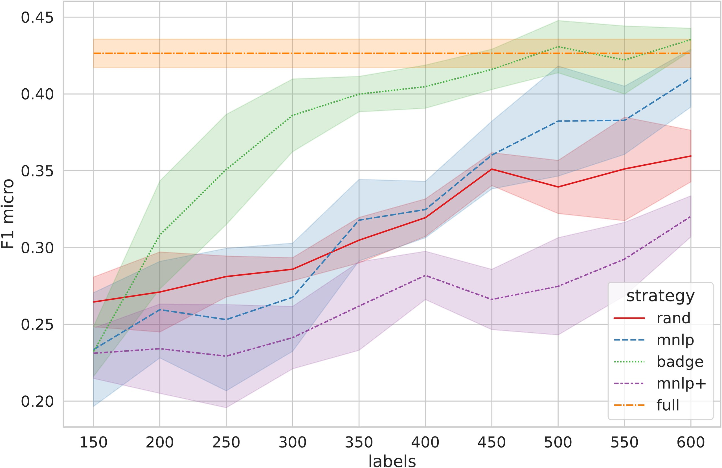
Key result: BADGE beats the full-data ceiling
FIGURE 2 · MICRO-F1 PER ITERATION, AVERAGED OVER 5 SEEDS
HOW TO READ IT
Micro-F1 on held-out tables vs. labels spent.
WINNER · BADGE
Passes the full-data ceiling
Beats random and even the full-training
F1 — using far fewer labels.
MNLP · UNCERTAINTY ONLY
Only edges past random after ~500 labels,
with noticeably higher variance.
MNLP+ · FORCED DIVERSITY
Worst of all
Maximizing table diversity drops it below
Green = BADGE · Blue = MNLP · Red = Rand · Purple = MNLP+ · Orange dashed = full-training ceiling
even random sampling.
Active Learning with Tabular Language Models · Ringsquandl & Koleva
06

Slide 7
Ablation: the right amount of diversity
DISTINCT TABLES SAMPLED PER ITERATION
THE ABLATION
TABLES DRAWN FROM · PER ITERATION
Four functions =
many
a diversity dial
The methods differ mainly in how much
sweet spot
diversity they force — and the right
amount matters enormously.
MNLP
BADGE
MNLP+
HELPS vs. HURTS
BADGE's built-in batch diversity helps.
MNLP+'s forced maximum diversity
few
hurts — dropping below random.
fixates on a few
balanced ✓
spreads too far
THE LESSON
Not maximum diversity — a careful trade-off with per-cell uncertainty.
BADGE sits in the middle of the dial, and that is exactly why it wins.
Active Learning with Tabular Language Models · Ringsquandl & Koleva
07

Slide 8
Takeaway: balance beats maximizing
WHAT TO REMEMBER — AND WHAT IS STILL OPEN
THE LASTING MESSAGE
Active learning can slash the expert-labeling cost of tabular
language models — but only if diversity is handled with care.
WHAT WORKS
THE RECIPE
Cell-level + batch diversity
Balance, don't maximize
BADGE reaches full-training F1 with only
Trade diversity off against per-cell
a fraction of the labels — while bluntly
uncertainty, rather than pushing either
maximizing table diversity backfires.
one to its extreme.
FIRST WORK HERE · TWO OPEN FRONTIERS
1 · Acquisition compute cost
2 · Annotator cognitive load
Table-diverse selection is computationally heavy.
Every new table demands fresh human interpretation.
Active Learning with Tabular Language Models · Ringsquandl & Koleva · arXiv:2211.04128
08

