Slide 1


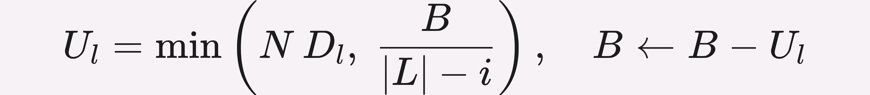
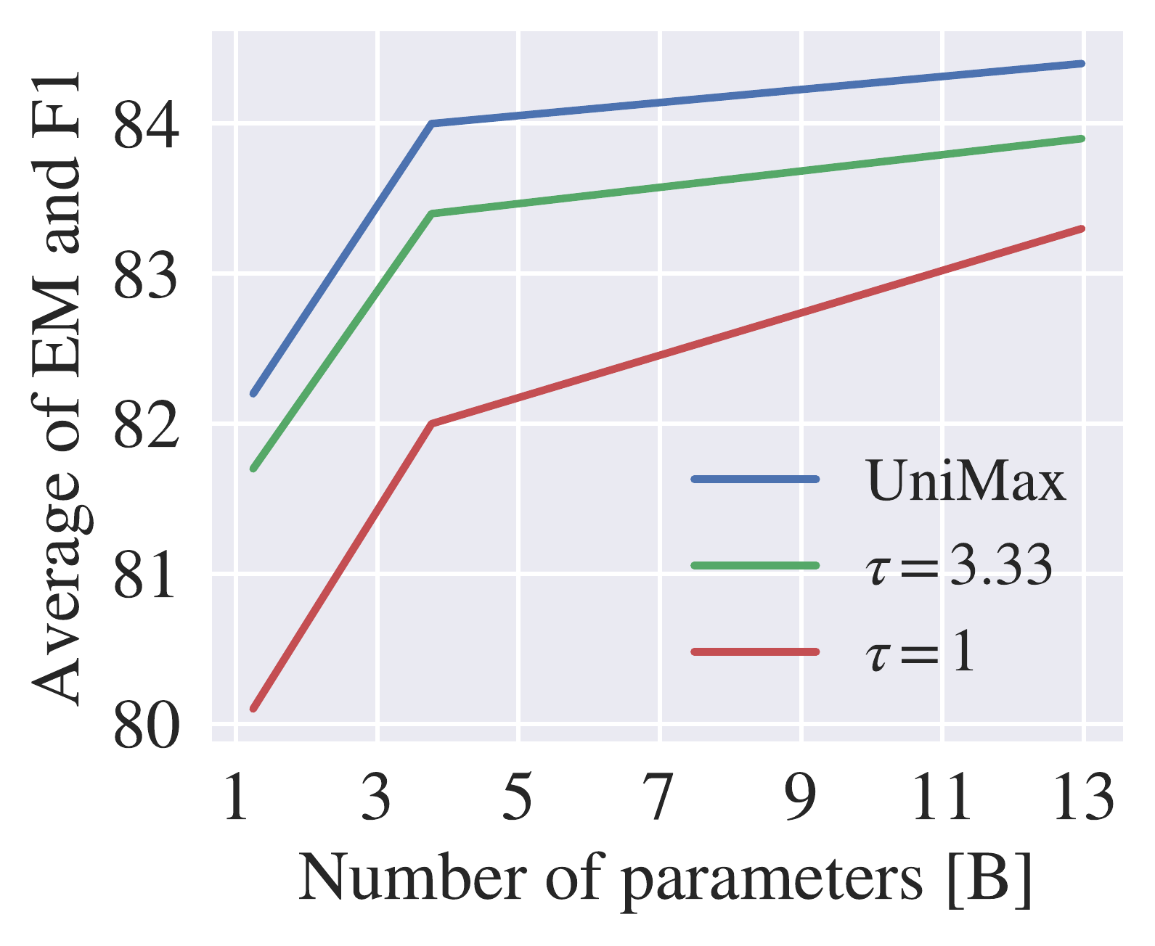
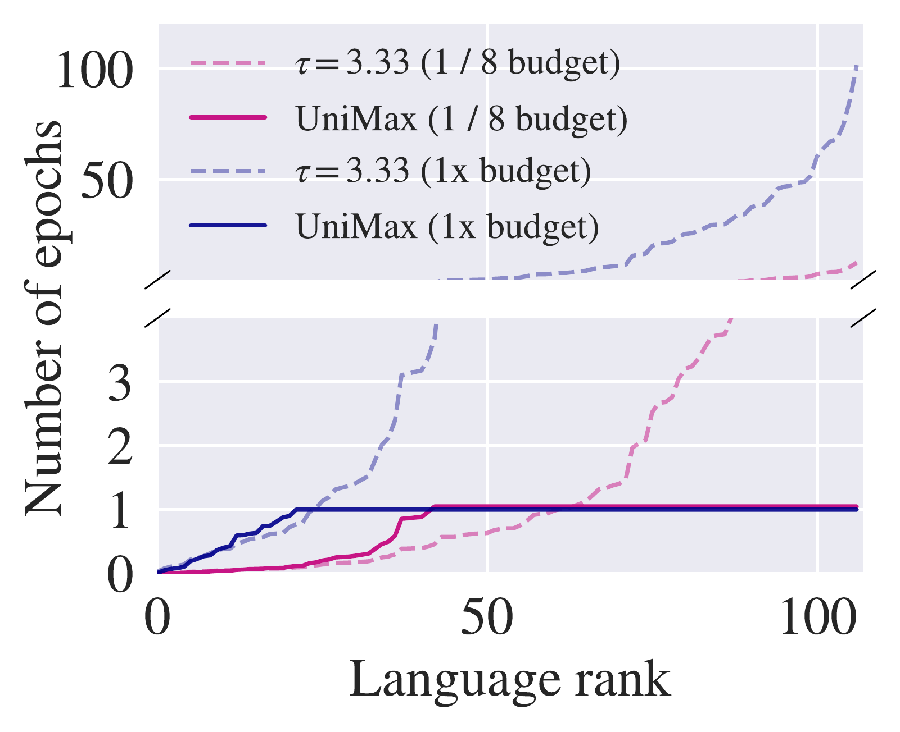
UniMax: Fairer and More Effective Language Sampling for Large-Scale Multilingual
Pretraining
Hyung Won Chung¹, Noah Constant¹, Xavier Garcia¹, Adam Roberts¹, Yi Tay¹, Sharan Narang¹, Orhan Firat¹
¹ Google Research
Problem
Method
Key Results
Multilingual pretraining must decide how much to train on each
language — an open, costly question.
1
Sort languages ascending by corpus size; set budget B = C.
Sampling
TyDi QA
Δ vs τ=1
2
Split the remaining budget uniformly across the languages not
yet allocated.
τ = 1
81.2
—
In mC4, English holds ~9.7 trillion characters — over 92,000×
the lowest-resource language, Yoruba.
τ = 3.33
82.8
+1.6
The dominant fix, temperature sampling (τ), was never evaluated
across model scales.
3
Cap any language above N epochs at N·D_{l}, redistribute the
surplus. N=1 ⇒ no repeats.
UniMax
83.1
+1.9
+1.9 TyDi QA over τ=1, +0.3 over τ=3.33 (Large, ½ budget)
Motivation
Repetition overfits the tail and wastes compute.
Tail over-repeated. At τ=3.33 the rarest languages are seen
>100× — pure duplication.
Languages sorted ascending by size; D_{l} = characters in language l, B = remaining budget, i = index, N = max epochs (N=1 ⇒ no repeats).
Head under-covered. Tuning τ for head languages leaves high-
resource coverage non-uniform.
Headline Numbers
29T
83.1
TyDi QA (Large)
>100×
τ=3.33 tail repeats
characters across 107 languages
9.0B
mC4 documents
Refreshed mC4 corpus & umT5 checkpoints released.
Takeaway
Cap the repeats, spread the rest uniformly — a drop-in
replacement for temperature sampling, with a refreshed
mC4 corpus and umT5 checkpoints.
Average TyDi QA GoldP vs model size — UniMax beats τ=3.33 and τ=1 at
every scale.
SO WHAT → Across TyDi QA, WMT21, XNLI, XQuAD, MLQA & PAWS-X, UniMax wins at every model size — and most WMT21 language pairs improve.
Capping per-language repeats and spreading the rest uniformly
beats temperature sampling, and the win holds as models scale.
UniMax caps every language at ≤1 epoch (N=1); temperature sampling
repeats the lowest-resource tail dozens to 100+ times.

