Slide 1





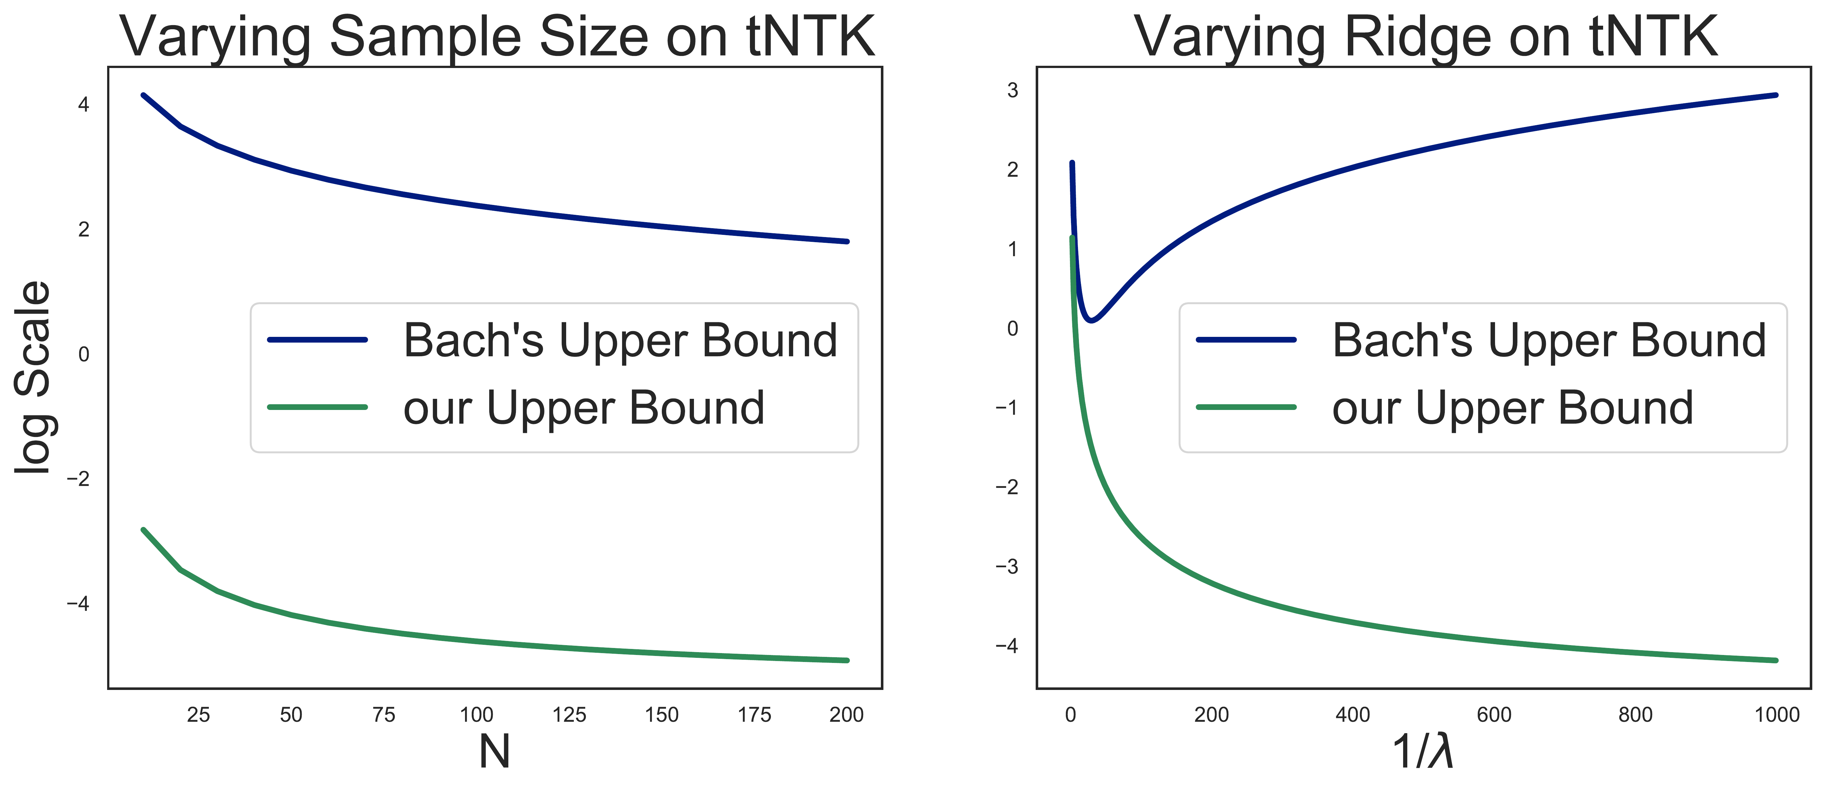
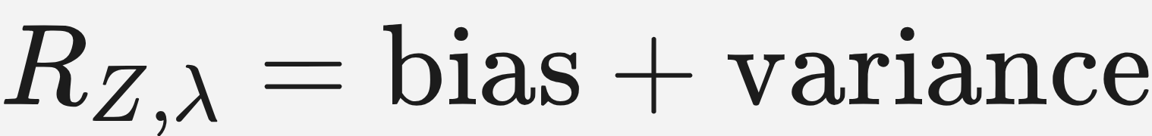
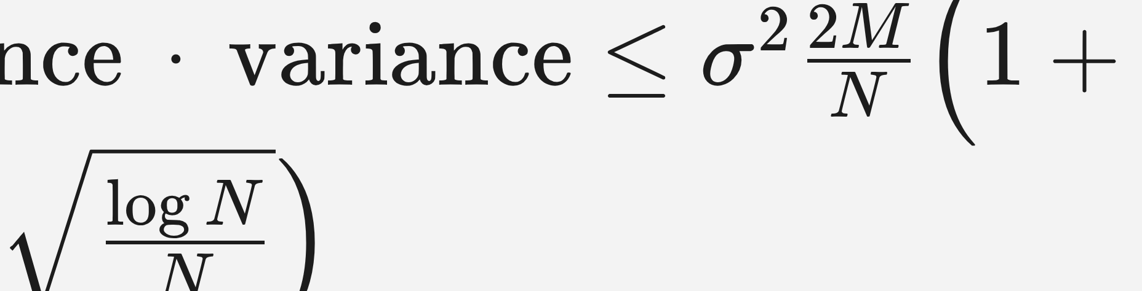
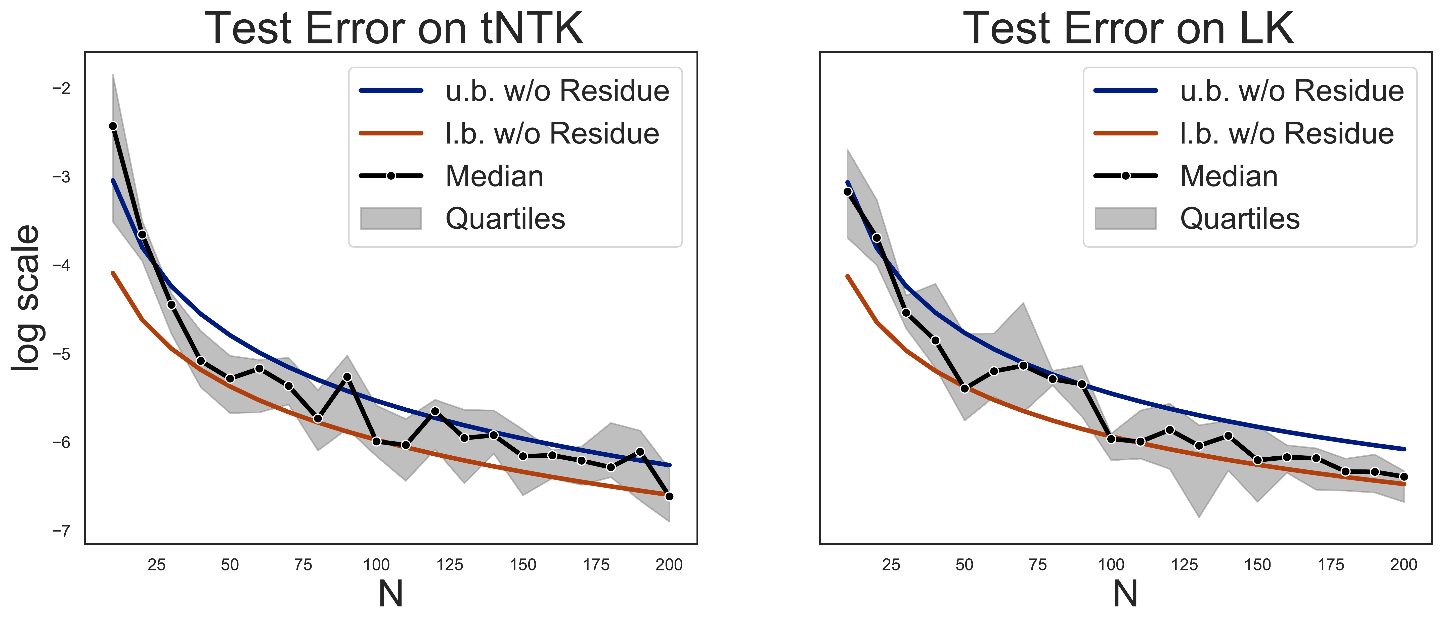
A Theoretical Analysis of the Test Error of Finite-
Rank Kernel Ridge Regression
Tin Sum Cheng¹, Aurélien Lucchi¹, Ivan Dokmanić¹, Anastasis Kratsios^{2,3}, David Belius⁴
¹University of Basel ²McMaster University ³Vector Institute ⁴UniDistance Suisse
Problem
Method
Key Results
Classical statistical-learning guarantees give loose, often
vacuous bounds on the test error of finite-rank kernel ridge
regression (KRR) — worst in the ridgeless limit, and with no
matching lower bound to prove any upper bound is actually tight.
Decompose the test error with the classical bias–variance split,
then bound each part with high probability — for any ridge λ
chosen independently of N, including λ → 0.
Key tools: sub-Gaussian covariance concentration + a
Neumann-series expansion of the matrix inverse, analysed in
the L²ρ eigenfunction basis to decouple spectrum from
sampling noise.
The last-layer fine-tuning kernel is exactly finite-rank —
precisely the regime where existing bounds are loosest, one-
sided, and often vacuous as regularization vanishes.
Motivation
Delivers a matching lower bound — the first for finite-rank KRR
— that provably meets the upper bound as N grows and stays
sharp in the ridgeless limit.
Finite-rank kernels arise in last-layer fine-tuning: with the
backbone frozen and only the head trained, the induced kernel
has rank M far below the sample size N.
Ours (green) sits ≈7 nats below Bach's (blue) — ≈10³× tighter — tracking
the true error, for varying N (left) and inverse ridge 1/λ (right). Natural-log
scale.
· Test error splits into bias + variance; the sharp variance term scales as σ²·2M/N in the regime N > M.
Prior analyses are asymptotic, assume a fixed ridge, or bound
only the expected error — none certify a single run.
·
Headline Numbers
Last-layer fine-tuning
Few-shot learning
Ridgeless λ → 0
10×
≥1−2/N
success prob.
Contribution
Validated on two controlled finite-rank kernels — the truncated NTK
(tNTK) and a low-rank kernel (LK) — where the spectrum and target
decomposition are known exactly:
1st
two-sided bound
1
Non-vacuous ridgeless bounds. Sharp high-probability
upper bounds that keep improving as λ → 0, valid for any ridge in
the under-parameterized regime N > M.
faster error decay
σ²·2M/N
variance rate
log N / N decay vs. the O(√(log N / N)) Rademacher rate —
and the confidence itself sharpens as N grows
N > M
under-param.
2
10–200
10
λ→0
stays tight
2
Matching lower bound. The first high-probability lower bound
for finite-rank KRR — provably meeting the upper bound as N
grows, so the bounds are tight, not just a safe envelope.
kernels: tNTK, LK
sample size N
random trials
Takeaway
Finite-rank KRR — the model behind last-layer fine-tuning —
admits sharp two-sided non-asymptotic test-error bounds that
stay tight for any ridge, including ridgeless. In that limit the bias is
controlled solely by the finite-rank error and the variance solely by
the noise level: a far more honest generalization certificate than
earlier one-sided or asymptotic results.
3
Empirical validation. A dramatic improvement over the
closest prior bound (Bach's), confirmed on the tNTK and LK
kernels across the full range of N.
Technical key: analysing the target in the L²ρ eigenfunction
basis decouples the kernel spectrum from sampling
randomness, giving sharper constants than the classical RKHS
basis, and a bound that stays tight for any ridge λ including the
ridgeless limit.
Analysing the target in the L²ρ eigenfunction basis —
decoupling the spectrum from sampling noise — is the key
move, and a template other finite-rank analyses can reuse
for sharper, two-sided guarantees.
Our upper (u.b.) and lower (l.b.) bounds sandwich the measured test error
across N, on both the tNTK and LK kernels — and converge together as N
grows.

