Slide 1





NEURIPS 2023 · LEARNING THEORY
A Theoretical Analysis of the Test Error
of Finite-Rank Kernel Ridge Regression
We sharply analyze the test error of finite-rank KRR — the model behind
tuning a frozen pre-trained network's last layer.
Matching upper & lower bounds
Non-asymptotic and two-sided — tight for any regularization, including the ridgeless limit.
Tin Sum Cheng · Aurélien Lucchi · Ivan Dokmanić · Anastasis Kratsios · David Belius
University of Basel · McMaster University · Vector Institute · UniDistance Suisse
SCAN FOR PAPER
Notes:
This work sharply analyzes the test error of finite-rank kernel ridge regression, the model behind tuning a frozen network's last layer. It derives matching upper and lower bounds that stay tight for any regularization.

Slide 2
01 · PROBLEM
Tight guarantees are missing for finite-rank KRR
THE SETUP
THE TROUBLE
Last-layer learning = finite-rank KRR
Classical bounds are far too loose
Kernel ridge regression is a workhorse for
understanding generalization.
Require the ridge λ bounded away from 0
Freeze a pre-trained network and train only its
last layer → regression with a finite-rank
Provide only upper bounds (one-sided)
kernel of rank M.
Become vacuous as λ → 0 (ridgeless)
Frozen
→
Features
→
Finite-rank
backbone
φ(x) ∈ ℝᵐ
kernel
No tight, two-sided certificate exactly where
last-layer models live.
Finite-Rank KRR · NeurIPS 2023
02 / 10
Notes:
Kernel ridge regression helps explain generalization, and tuning a network's last layer behaves like it with a finite-rank kernel. But classical bounds are far too loose here: they keep the ridge above zero, give only upper bounds, and go vacuous as regularization vanishes.

Slide 3
02 · MOTIVATION
A common recipe, but the theory lags behind
WHY NOW
Freeze the backbone, retrain only the final layer — and it defines a finite-rank kernel
Transfer learning
Reservoir computing
Few-shot learning
WHAT PRIOR WORK MISSES
Need input dim → ∞
Fix a ridge schedule λ(N)
Bound expected error
asymptotic, high-dimensional limits
hold only for a prescribed decay
no high-probability control
Almost none give a lower bound — so you can never claim your upper bound is tight.
Finite-Rank KRR · NeurIPS 2023
03 / 10
Notes:
Freezing a pre-trained backbone and retraining only the final layer is everywhere, and it defines a finite-rank kernel. Yet the theory lags: many results need the input dimension to grow, others fix how the ridge decays, and almost none give a lower bound, without which tightness cannot be claimed.

Slide 4
03 · CONTRIBUTION
Sharp, two-sided bounds — valid for any ridge
1
Improve as λ → 0
2
Matching lower bound
3
Large empirical gain
Bounds get better toward the
A sharp lower bound provably
Dramatically tighter than the
ridgeless limit — and stay
matches the upper bound as N
closest prior bound (Bach) —
non-vacuous, unlike prior
grows — tight in a precise
validated on two finite-rank
work.
sense.
kernels.
KEY TECHNICAL TRICK
Analyze the target in the L²ρ eigenfunction basis {ψₖ}
Decouple the kernel spectrum from the randomness of sampling — the source of the sharper
constants, instead of working in the RKHS basis.
Finite-Rank KRR · NeurIPS 2023
04 / 10
Notes:
The contribution is threefold. First, the bounds improve as the ridge goes to zero. Second, a sharp lower bound matches the upper bound as samples grow, so both are tight. Third, experiments show a large gain over prior work. The key trick: work in the eigenfunction basis, separating spectrum from sampling noise.

Slide 5
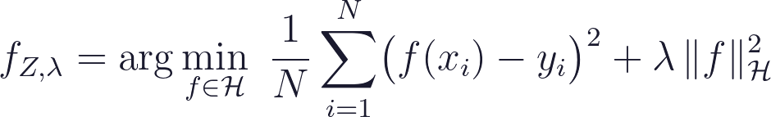
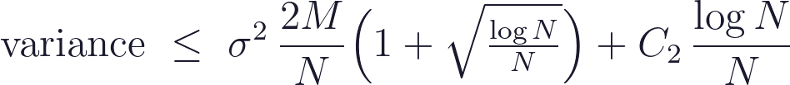
04 · METHOD
Bias–variance split, bounded for any ridge
ESTIMATOR → SPLIT
KEY INGREDIENTS
Regularized least squares over the RKHS:
Careful algebra on the ridge terms
Sub-Gaussian covariance concentration
Test error splits cleanly into two terms:
Neumann-series inverse expansion
bias = noiseless error · variance = label-noise error — each bounded w.h.p.
HOLDS FOR ANY RIDGE VALUE
Valid for λ chosen independently of N —
not only for a ridge that shrinks with the sample.
Finite-Rank KRR · NeurIPS 2023
05 / 10
Notes:
The method starts from the kernel-ridge estimator and splits the test error into a bias term and a variance term, each bounded with high probability. The key ingredients: careful algebra on the ridge terms, a sub-Gaussian covariance concentration inequality, and a Neumann-series expansion. That lets the bounds hold for any ridge value.

Slide 6
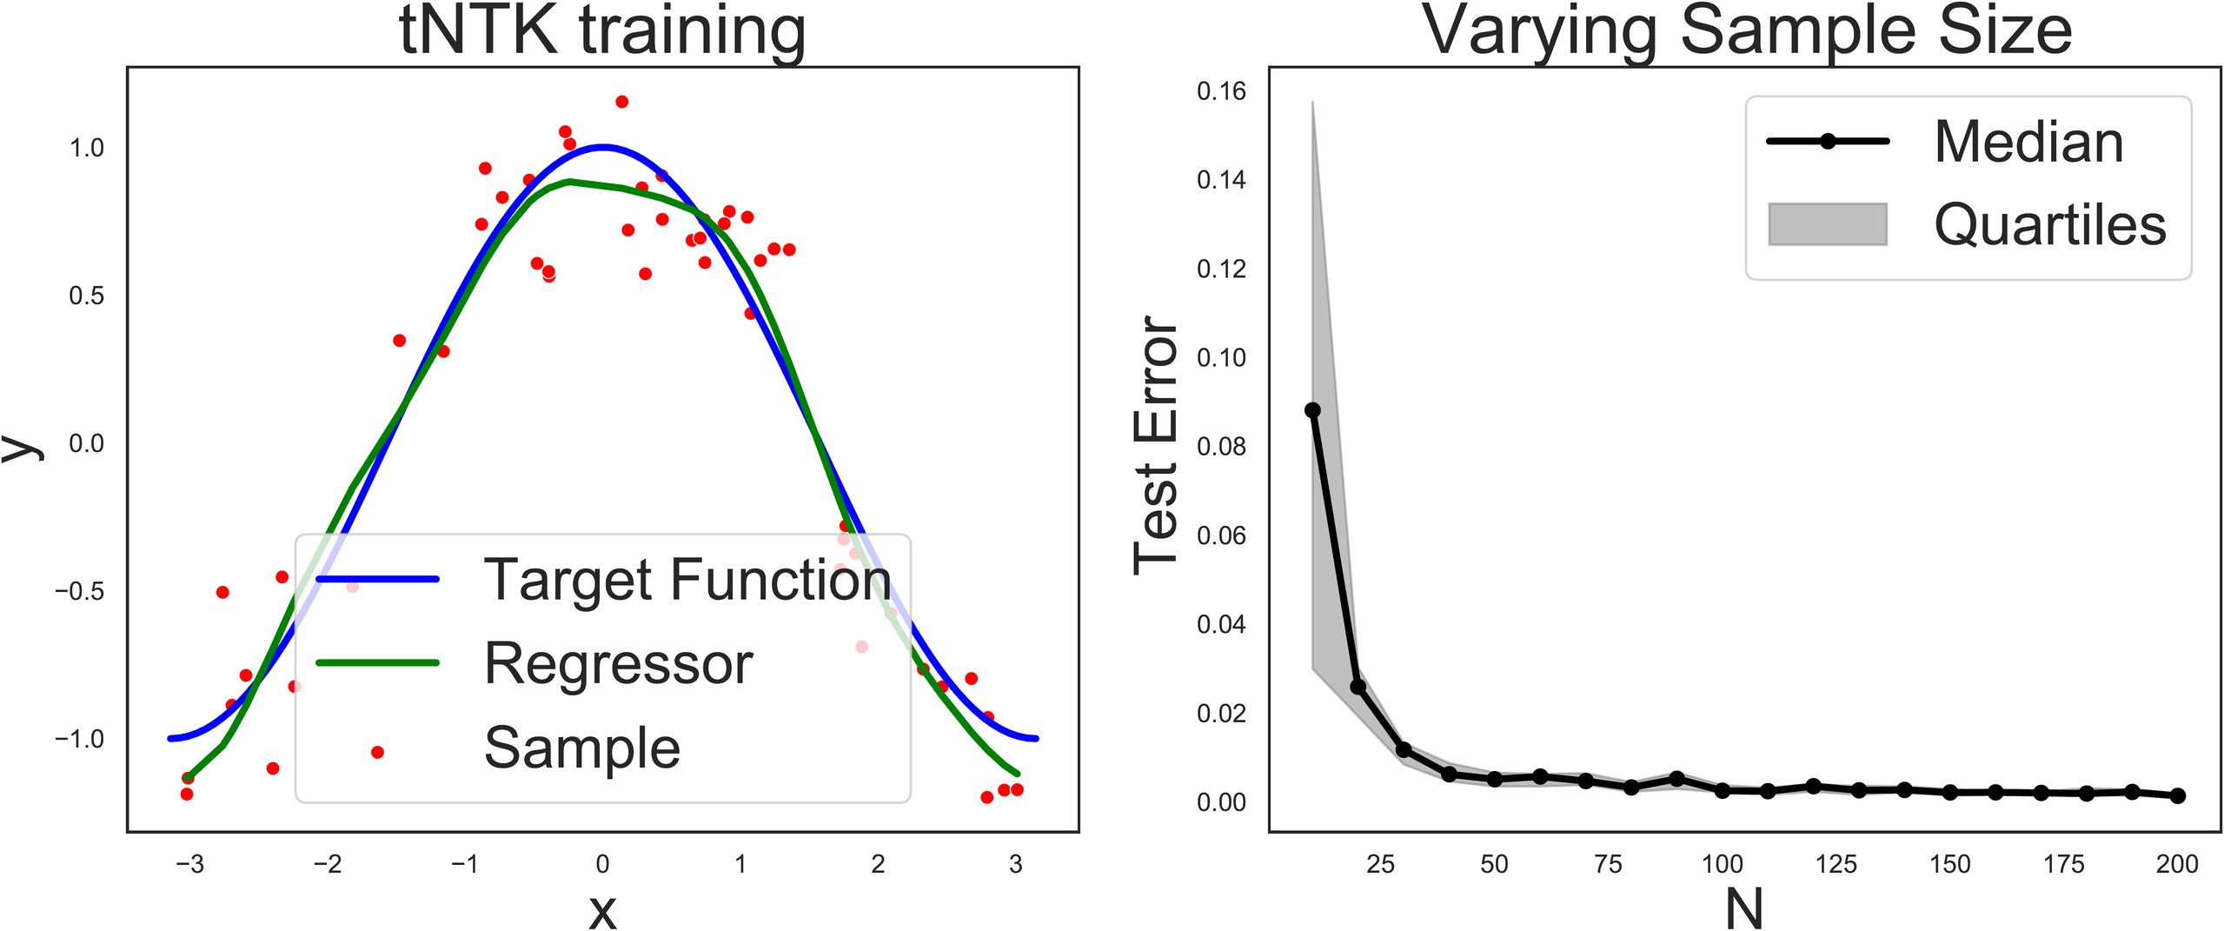
05 · DATASET / BENCHMARK
Controlled synthetic finite-rank kernels
A THEORY PAPER
FIGURE 1 · KRR ON A FINITE-RANK KERNEL
Controlled synthetic settings — no natural-
image data. True spectrum & target
decomposition are known.
TWO FINITE-RANK KERNELS
tNTK — truncated Neural Tangent Kernel
mimics a wide network's last layer
LK — a constructed low-rank kernel
a separately built finite-rank kernel
EXPERIMENTAL SWEEP
Left: KRR training. Right: test error vs sample size N,
N ≈ 10 → 200 · many ridge values λ
over 10 iterations; upper/lower quartiles as error bars.
10 trials · median + quartile error bars
Finite-Rank KRR · NeurIPS 2023
06 / 10
Notes:
Being a theory paper, the experiments use controlled synthetic settings. The authors test two finite-rank kernels: a truncated neural tangent kernel and a constructed low-rank kernel. For each they sweep sample sizes from ten to two hundred and many ridge values, averaging ten trials with median and quartile bars.

Slide 7
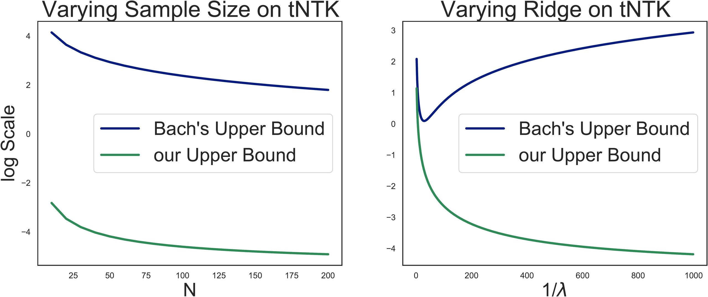
06 · KEY RESULT
The bounds bracket the true test error
FIGURE 2 · COMPARISON OF TEST-ERROR BOUNDS
SANDWICHED & TIGHT
Upper & lower bounds bracket the error on
both kernels — and squeeze together as N
grows (the signature of tightness).
VS. THE CLOSEST PRIOR BOUND
Stark gain against Bach: the new bound
hugs the true error while Bach's floats
far above (orders of magnitude).
RIDGELESS LIMIT
Upper bounds vs N (left) and vs 1/λ (right), natural-log
scale. New bound tracks the true error; Bach's sits far above.
Bias → irreducible finite-rank error;
variance → the noise level alone.
Finite-Rank KRR · NeurIPS 2023
07 / 10
Notes:
The new upper and lower bounds bracket the error across sample sizes on both kernels, and squeeze together as samples grow. Against Bach's bound the gain is stark: the new bound hugs the true error while Bach's floats far above. In the ridgeless limit, bias reduces to the finite-rank error and variance to the noise.

Slide 8
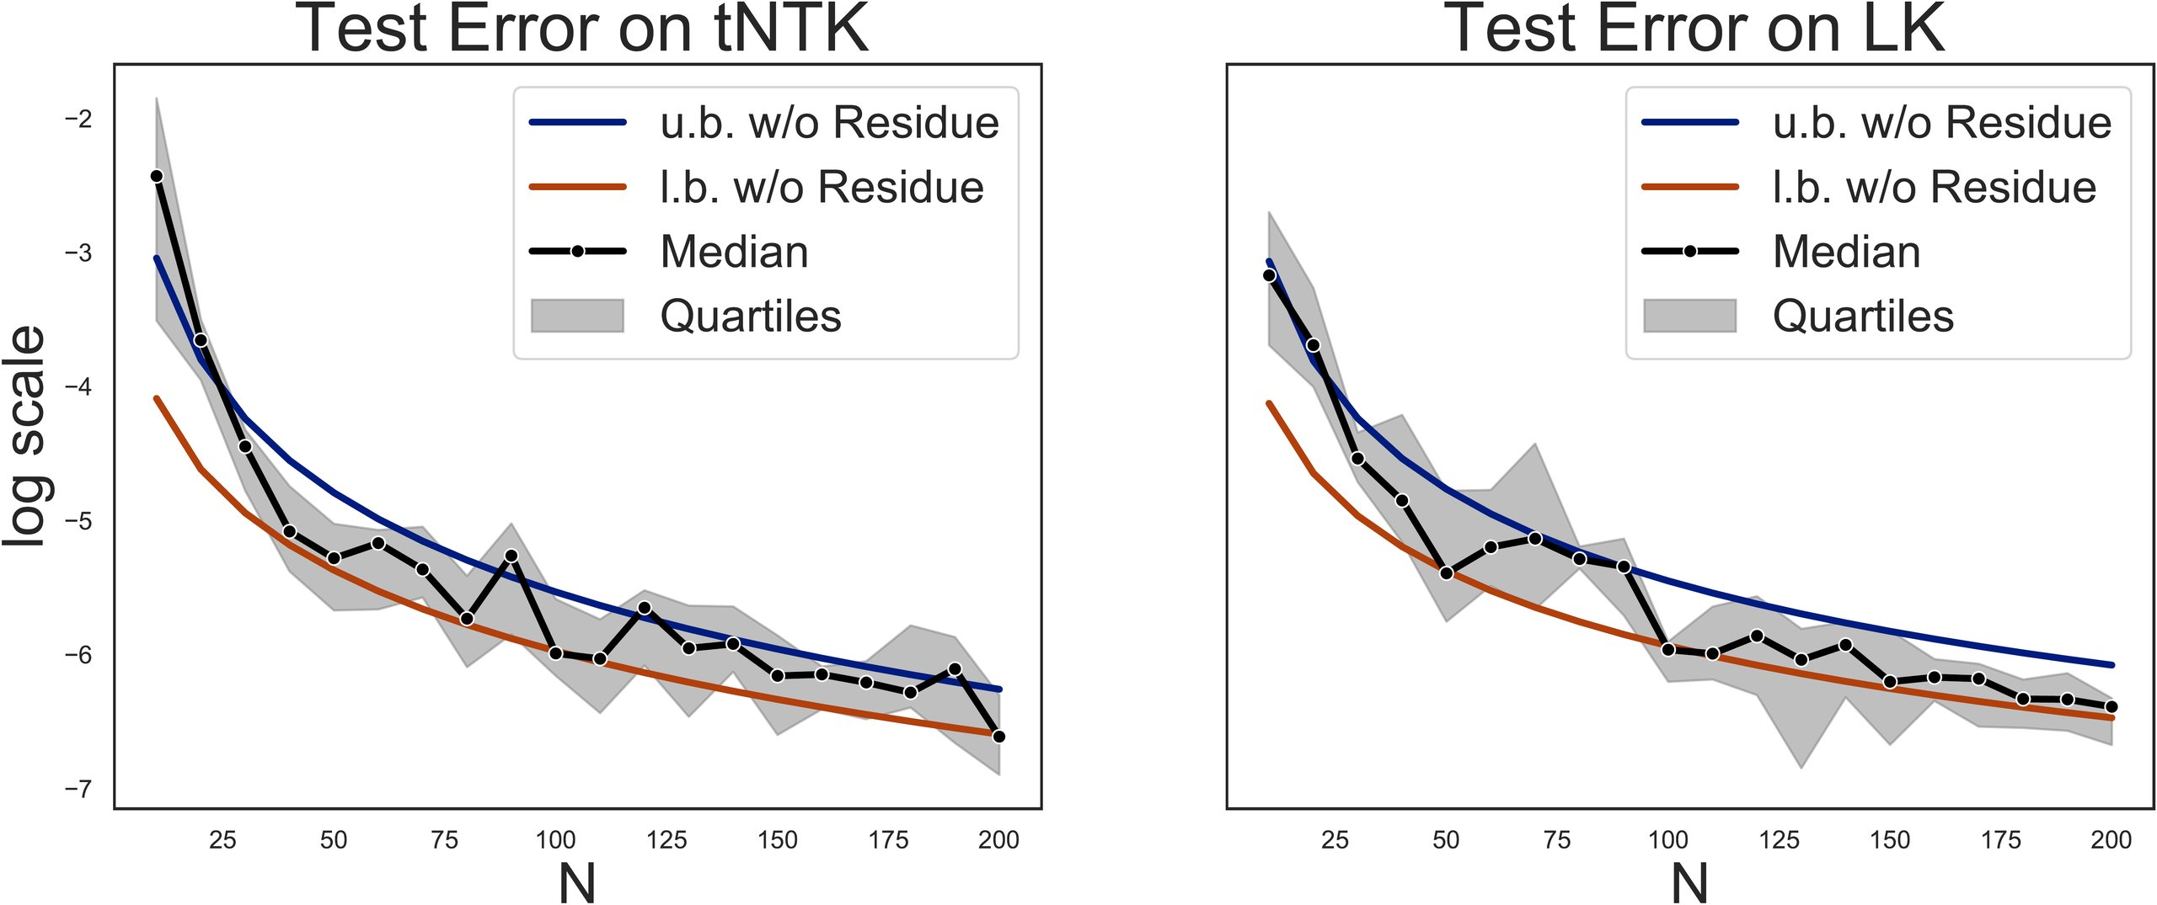
07 · ABLATION STUDY
Which terms matter, and which wash out
SELF-ABLATION
FIGURE 3 · RESIDUES DROPPED FOR SIMPLICITY
Ablate the bound, term by term
Finite-rank error — irreducible floor
never vanishes, even with infinite data
Residue terms — shrink like log N / N
negligible for large samples
RIDGE SWEEP
New bound → improves toward λ = 0
Bach's bound → worsens
Simplified bounds stop bracketing only for small N —
exactly as predicted — and recover tightness as N grows.
isolating the ridge-dependence as the source of the gain
Finite-Rank KRR · NeurIPS 2023
08 / 10
Notes:
The paper ablates its bound. The finite-rank error is an irreducible floor, while residue terms shrink at a log-N-over-N rate and vanish for large samples. Dropped, the simplified bounds fail only in the small-sample regime, as predicted. A ridge sweep shows the new bound improves toward the ridgeless limit while the prior worsens.

Slide 9
08 · HEADLINE NUMBERS
The bounds, in four numbers
CONFIDENCE
UPPER-BOUND DECAY
≥ 1 − 2/N
O(log N / N)
Holds with high probability — the
An order of magnitude faster than the
confidence itself sharpens as N grows.
√(log N / N) Rademacher rate.
VARIANCE BOUND
A NEW CAPABILITY
σ² · 2M / N
1st lower bound
M = kernel rank — valid in the under-
The first high-probability lower bound for
parameterized regime N > M.
finite-rank KRR — prior work offered none.
Finite-Rank KRR · NeurIPS 2023
09 / 10
Notes:
The bounds hold with probability at least one minus two over N. The upper bound decays at a log-N-over-N rate, faster than the square-root Rademacher rate. Variance scales as noise times twice the rank over N. And these are the first finite-rank bounds with a high-probability lower bound.

Slide 10
09 · TAKEAWAY
Finite-rank KRR — the model behind last-layer
fine-tuning — now has genuinely sharp bounds:
matching upper and lower, tight for any ridge.
Matching U.B. + L.B.
Tight for any λ
Including ridgeless
THE KEY IDEA
Work in the eigenfunction basis, separating spectrum from sampling noise
A far more honest certificate of test error than loose, one-sided, asymptotic guarantees —
and a template other finite-rank analyses can borrow.
Cheng, Lucchi, Dokmanić, Kratsios, Belius · NeurIPS 2023 · arXiv:2310.00987
Notes:
The takeaway: finite-rank kernel ridge regression, behind last-layer fine-tuning, has sharp bounds, matching upper and lower, tight for any regularization including none. The key idea, working in the eigenfunction basis to separate spectrum from sampling noise, is a template others can borrow.

