Slide 1



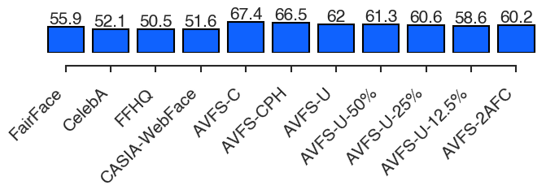


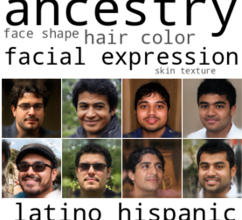
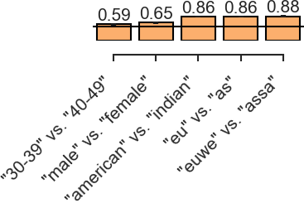
A View From Somewhere: Human-Centric Face
Representations
Jerone T. A. Andrews¹, Przemysław Joniak², Alice Xiang¹
¹ Sony AI ² University of Tokyo
Problem
Method
Key Results
Face datasets are audited with categorical demographic labels (race, gender, age) that are often missing, legally restricted, and biased when inferred — and blind to how similar two same-labeled faces really are.
A conditional ResNet-18 embeds each face in 128-D, trained on odd-one-out (3AFC) triplet judgments.
AVFS beats semantic-label baselines on both held-out and novel faces.
A per-annotator sigmoid mask gates the dimensions; a sparsity + non-negativity penalty leaves about 22 interpretable dimensions.
MODEL · ACC. (%)
SAME-STIM.
NOVEL-STIM.
FairFace (best base.)
55.9
51.9
Rigid taxonomies erase multi-ethnic people and flatten the continuous nature of human diversity.
AVFS-U (ours)
62.0
57.5
All-ones masks give AVFS-U; conditional variants are AVFS-C and AVFS-CPH.
AVFS-C (ours)
67.4
61.7
Motivation
Similarity is continuous & observer-dependent — aligning with human perception skips semantic labels.
: annotator mask · : face embedding. Odd-one-out = 3-way softmax over the triplet's similarities.
Prior embeddings can't place unseen faces, or pool judgments and ignore annotator differences.
Who is judging shapes what looks similar.
Fig. 1 — Same-stimuli odd-one-out accuracy over 24,060 judgments; every AVFS model beats the label-trained baselines.
Annotator masks generalize even to entirely novel faces.
Headline Numbers
638,180
22
interpretable dims
67.4%
best OOO accuracy
human similarity judgments
−8.9
pts on mask swap
Takeaway
From human similarity judgments, not labels, we learn a continuous, interpretable, perception-aligned space.
Fig. 4a — Linear SVMs recover annotator demographics from their learned masks; every AUC beats chance.
Fig. 2 — One learned AVFS-U dimension: top-scoring stimulus faces with their human topic labels.
GENERALIZES
Extends to almost any human decision-making task.

