Slide 1
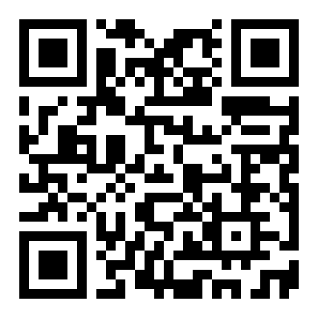
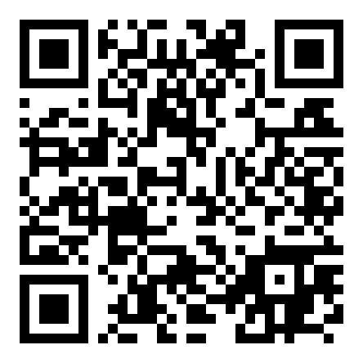


Scan for more
ICLR 2023
A View From Somewhere
Human-Centric Face Representations
Jerone T. A. Andrews · Przemyslaw Joniak · Alice Xiang
Sony AI · University of Tokyo
Paper · arXiv:2303.17176
No demographic labels
Learn from 600K+ human judgments of face similarity,
aligned with perception.
Code · github.com/SonyAI
A continuous, interpretable space
Avoids invasive categories; captures the continuous
nature of human diversity.
A View From Somewhere — Human-Centric Face Representations (ICLR 2023)
01 / 10

Slide 2
PROBLEM
Categorical labels are the wrong tool
01
Diversity = demographic labels
02
Unreliable & restricted
Dataset diversity is almost always measured with
Labels are often unavailable, legally restricted
categorical labels: race, gender, or age.
to collect, and biased when inferred by
annotators.
03
They flatten appearance
04
Rigid taxonomies cause harm
Skin tone becomes only light or dark, yet two
They erase multi-ethnic people, shift meaning
faces with the same label can look very
across cultures, and harm those who are
different.
mislabeled.
A View From Somewhere — Human-Centric Face Representations (ICLR 2023)
02 / 10

Slide 3
MOTIVATION
Similarity is continuous, and personal
1
2
3
Continuous & personal
Align with perception
Prior embeddings fail
Face similarity is
Learn a representation aligned
They either cannot embed new
fundamentally continuous and
with human perception to skip
faces beyond the training set,
depends on who is doing the
semantic labels while still
or pool every judgment and
judging.
measuring diversity.
lose annotator differences.
A View From Somewhere — Human-Centric Face Representations (ICLR 2023)
03 / 10

Slide 4
CONTRIBUTION
A View From Somewhere (AVFS)
AVFS
A new judgment dataset
638K
~5K
+ identity
triplet judgments
faces
annotator id &
A View From Somewhere
demographics
A conditional framework
that learns face
A conditional learning framework
representations directly
from human similarity
Produces a continuous, low-dimensional, human-interpretable embedding
judgments.
space, plus per-annotator masks showing how different people weigh
different visual dimensions.
A View From Somewhere — Human-Centric Face Representations (ICLR 2023)
04 / 10

Slide 5
METHOD
Conditional odd-one-out embedding
1
2
3
4
ResNet-18 encoder
Annotator gating mask
Masked similarity
Sparse & non-negative
Face -> 128-d embedding
->
Learnable mask m per
->
s = < ReLU(e_a)*m ,
->
Sparsity + non-negativity
Triplet odd-one-out:
annotator: m = sigmoid(w)
ReLU(e_b)*m >
penalty on dimensions
pick the least-similar face
scales each dimension
-> odd-one-out prob
~22 active dims remain
Trained end-to-end on 638K odd-one-out judgments; masks are the only per-annotator parameters.
A View From Somewhere — Human-Centric Face Representations (ICLR 2023)
05 / 10

Slide 6
DATASET / BENCHMARK
638K judgments, annotator-aware
Dataset composition
Three evaluations
638,000
4,921
Same stimuli
triplet judgments
near-frontal faces
held-out judgments over the same 4,921 faces
Novel stimuli
80,000 judgments over entirely new faces
Every judgment is labeled by who made it
Semantic baselines
Each triplet records the annotator's identifier
attribute recognizers trained on CelebA + FairFace
and self-identified demographic attributes,
enabling per-annotator conditioning.
A View From Somewhere — Human-Centric Face Representations (ICLR 2023)
06 / 10

Slide 7
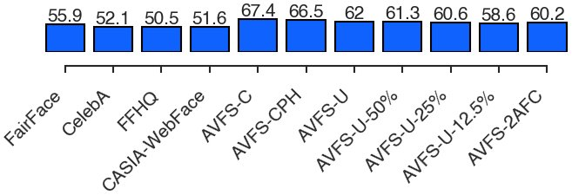
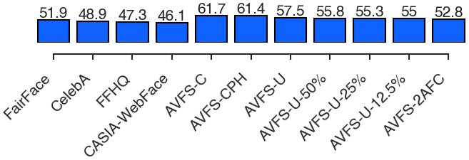
KEY RESULT
Beats semantic-label baselines
Predicting human similarity judgments
Masks generalize
Accuracy and Spearman's r vs. baselines trained on semantic labels
Annotator-specific masks
Same stimuli (Fig. 1)
transfer even to triplets of
entirely novel faces.
The embedding is far more
aligned with the human mental
Novel stimuli (Fig. 3)
representation of faces than
spaces from categorical labels.
A View From Somewhere — Human-Centric Face Representations (ICLR 2023)
07 / 10

Slide 8
ABLATION STUDY
Annotators are not interchangeable
Shuffle test
Accuracy collapses
How many dimensions?
Randomly re-assign which
6-13
annotator mask attaches to each
62%
of the 80K judgments, and
dimensions recover most
recompute accuracy 100 times.
true annotators
predictive accuracy
v
53%
15-22
80,000
judgments · x100 shuffles
shuffled annotators
dimensions explain the full
similarity structure
Similarity is context-dependent.
A View From Somewhere — Human-Centric Face Representations (ICLR 2023)
08 / 10

Slide 9
HEADLINE NUMBERS
The whole story in four numbers
638K
22
61.7 -> 52.8
human judgments
interpretable dimensions
% accuracy
over 4,921 distinct faces
retained at ~62% val. accuracy
when annotators are scrambled
All achieved without ever training on a single semantic label.
A View From Somewhere — Human-Centric Face Representations (ICLR 2023)
09 / 10

Slide 10
TAKEAWAY
Perception over taxonomy
Learn from judgments, not labels
Beyond faces
Learning face representations from human similarity
The framework only needs to
judgments, rather than demographic labels, yields a
track which annotator made
continuous, interpretable, perception-aligned embedding
which judgment, so the same
space.
conditional approach extends
to almost any task built on
human decisions.
Continuous
Interpretable
Perception-aligned
Label-free diversity
Paper · arXiv:2303.17176
Code · github.com/SonyAI/
a_view_from_somewhere
A View From Somewhere — Human-Centric Face Representations (ICLR 2023)
10 / 10

