Slide 1



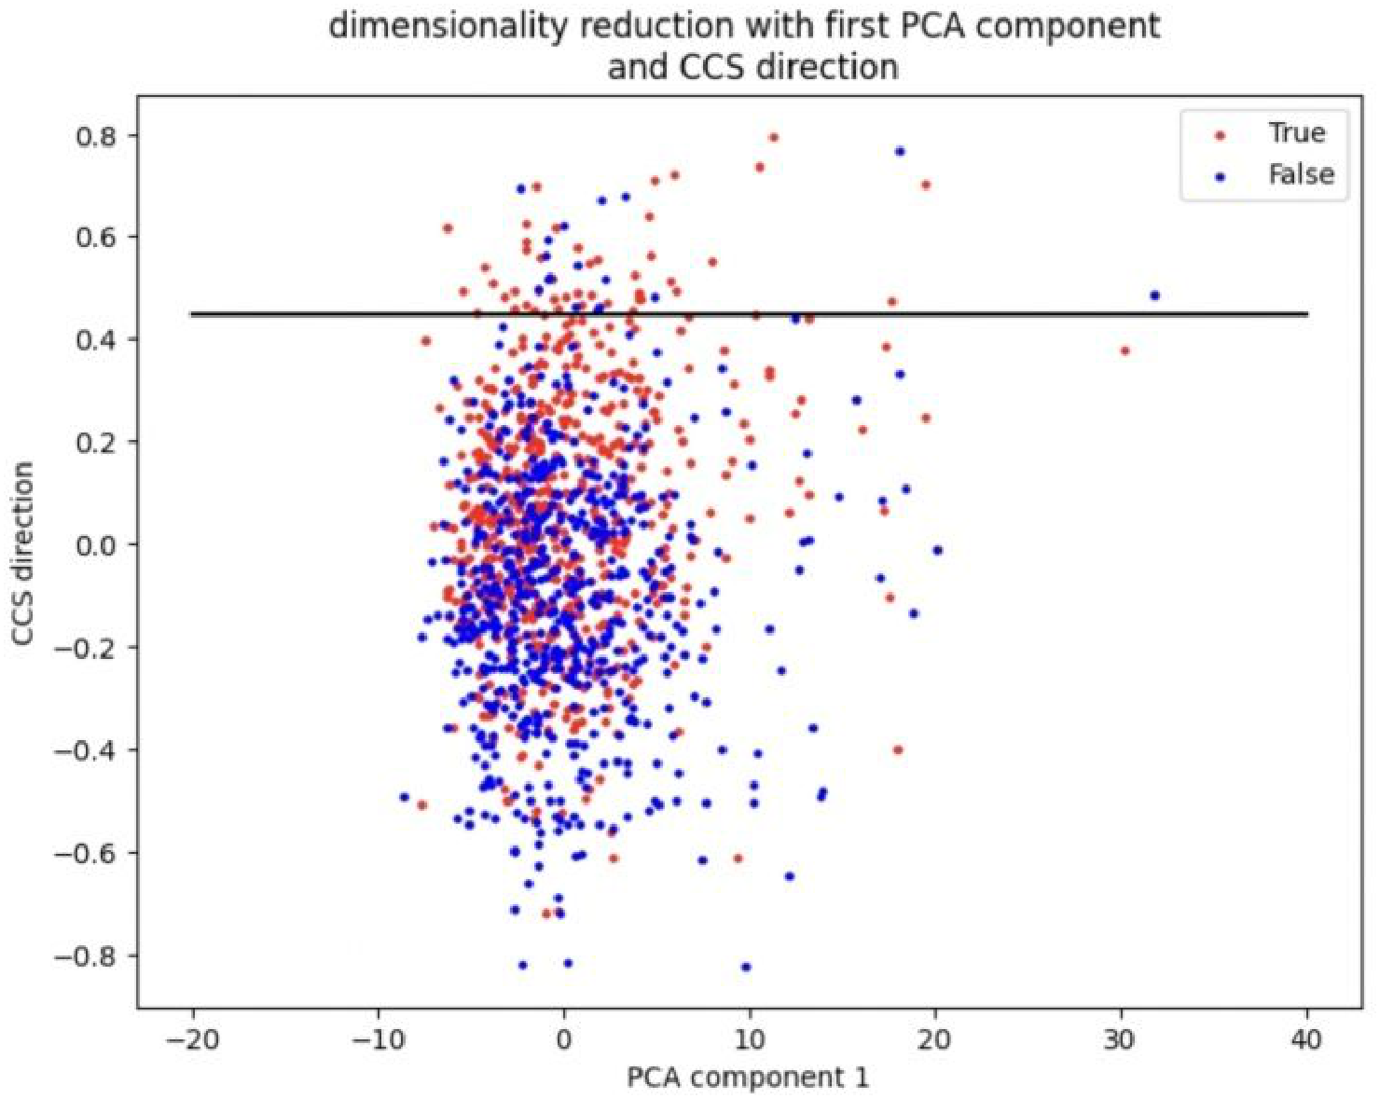
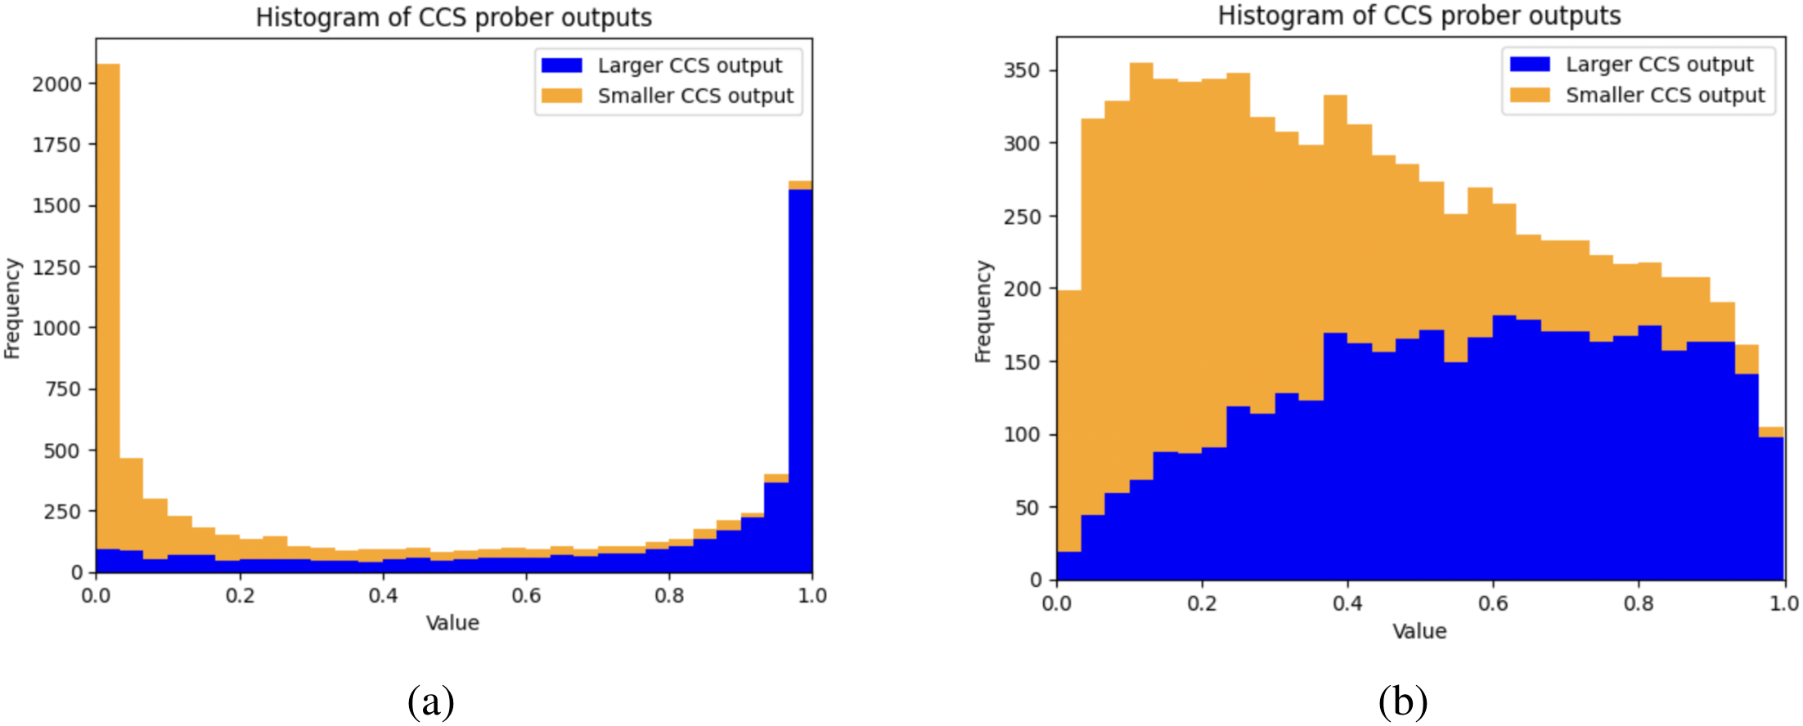


Comparing Optimization Targets for Contrast-
Consistent Search
Hugo Fry¹, Seamus Fallows¹, Ian Fan¹, Jamie Wright², Nandi Schoots³
¹ Independent ² Oxford University ³ King's College London
Problem
Method
Key Results
Headline Numbers
Contrast-Consistent Search (CCS) recovers a language model’s internal “truth” direction without labels, using only the constraint that a statement and its negation disagree.
Decompose CCS along a unit direction θ̂ into displacement variance σ_{d}² (how far a statement and its negation separate) and midpoint variance σ_{m}² (how far their midpoint sits from origin).
LOSS
COS ↔ CCS
AVG ACC
0.7557
MD-Acc test acc (CCS 0.71)
CCS (self)
0.78
0.7105
0.63
MD-CCS
0.63
0.7178
MD-CCS ↔ CCS cosine similarity
10⁻²³⁷
odds of 0.63 by chance
MA / SMR / PCA
0.14–0.17
—
vs 0.78 CCS self-similarity
CCS works well — yet what its loss optimizes for, and whether that target is optimal, is poorly understood.
CCS’s double-saturating sigmoid forces a trade-off: maximize the displacement variance σ_{d}² while driving the midpoint variance σ_{m}² toward zero.
MD-Acc
0.38
0.7557
4×5
models × datasets
Supervised (ceiling)
—
0.8674
The new Midpoint-Displacement (MD) loss makes this explicit via one knob λ: MD-CCS mimics CCS, MD-Acc is tuned for accuracy.
+4% avg accuracy over CCS · wins on 3 of 4 models
Takeaway
Motivation
CCS works because of the displacement information in its contrast-pair training data — the gap between a statement and its negation — not the shape of its loss function. A simple Midpoint-Displacement loss reproduces CCS closely and, retuned, outperforms it.
SO WHAT → MD-CCS’s 0.63 similarity (vs 0.14–0.17 for every other accurate loss) is specific to MD — it faithfully recovers CCS’s target, not a generic byproduct of high accuracy.
Safely deploying LLMs means reliably reading their latent knowledge of truth; understanding why a probe like CCS works is a prerequisite for trusting and improving it.
·
0.63
0.78
~0.15
4×5
Prior work framed CCS around clustering activations and learning calibrated probabilities. The authors show both pictures are misleading.
MD-CCS ↔ CCS
CCS self-sim
MA / SMR / PCA
models × datasets
The exact loss is interchangeable among accurate probes; the real lever is the displacement–midpoint trade-off.
CCS needs no linearly-separable clusters — it classifies by displacement alone — and can succeed even when its “probabilities” pile up near 0.5.
Scan to Read
Paper
Code
A cleaner account of CCS’s true optimization target is needed before the probe can be trusted or improved.
CCS prober outputs on UnifiedQA T5-Large: the encoder (a) is highly confident yet only 52.3% accurate, while the decoder (b) piles near 0.5 yet reaches 97.8% — confident “probabilities” can mislead.
Activations projected onto PC 1 (x) and the CCS direction θ̂ (y), coloured by ground-truth label. CCS classifies by displacement along θ̂, not a separating hyperplane.
arxiv.org/abs/2311.00488
github.com/ash-ai-safety-hub/g3-nandi

