Slide 1




NEURIPS 2023 · LATENT KNOWLEDGE / INTERPRETABILITY
Comparing Optimization Targets
for Contrast-Consistent Search
SCAN FOR PAPER & CODE
CCS: an unsupervised probe reading a model's sense of truth from its activations.
Hugo Fry · Seamus Fallows · Ian Fan · Jamie Wright · Nandi Schoots
Independent · Oxford University · King's College London
Paper
Code
THE DRIVING QUESTION
What does CCS actually optimize?
CONTRIBUTION
A new Midpoint-Displacement loss that reproduces CCS — and, retuned, beats it.
Fry, Fallows, Fan, Wright & Schoots · Comparing Optimization Targets for Contrast-Consistent Search
01
Notes:
Contrast-Consistent Search, or CCS, is an unsupervised probe that reads a language model's sense of truth from its activations. But what does CCS actually optimize? This paper explains its target and derives a new loss, Midpoint-Displacement, that matches CCS and can beat it.

Slide 2
What CCS does — and the open question
PROBLEM · CONTRAST-CONSISTENT SEARCH
HOW CCS WORKS
THE OPEN QUESTION
A truth direction, learned without labels
CCS works — but why?
Recovers a direction in activation space
that should encode whether a statement is true or false.
Despite working surprisingly well, nobody had
pinned down two things:
Fully unsupervised — no labels
the probe never sees the ground-truth answer.
1
What is its loss really optimizing for?
One constraint: negation must disagree
a statement and its negation should get opposite verdicts.
The mechanism behind its success was unexplained.
2
Is that target even the best one?
φ⁺ “true”
must disagree
φ⁻ “false”
Could a different objective recover truth better?
This paper sets out to answer exactly that.
Source: Introduction · Contrast-Consistent Search (Burns et al. 2023) as analysed by Fry et al.
02
Notes:
CCS recovers a direction in a model's activations encoding whether a statement is true or false, using no labels, only the constraint that a statement and its negation disagree. Yet nobody had pinned down what its loss really optimizes, or whether that target is best.

Slide 3
Why understanding CCS matters
MOTIVATION
WHY IT MATTERS
Capable models state falsehoods with confidence. Probes that read a model's own representation of truth
could help us catch this — but only if we actually understand how they work.
THE TWO ORIGINAL EXPLANATIONS
THE AUTHORS' CLAIM
Clustering
Learning truth
Both pictures
activations
probabilities
mislead.
CCS is said to split the
CCS is said to output
Neither clustering nor
activations into two clusters
calibrated probabilities of
probabilities capture what
with a separating hyperplane.
a statement being true.
CCS truly optimizes.
✕ Misleading
✕ Misleading
GOAL
A cleaner account of its target.
Source: §1 Introduction & Motivation
03
Notes:
Safely deploying capable models means catching confident falsehoods, and probes that read a model's own truth representation could help, but only if we understand them. CCS was explained through clustering activations and learning probabilities. The authors argue both pictures mislead, motivating a cleaner account of its target.

Slide 4
Three contributions
CONTRIBUTION
The paper makes three contributions — clearing up misconceptions, deriving a new loss,
and grounding both in a broad empirical comparison.
1
CLARIFY
2
DERIVE
3
COMPARE
Two misconceptions
A new loss
Broad evaluation
Classifies by displacement
From a heuristic account of
Many losses compared across
Uses only the statement-vs-
what CCS optimizes, the authors
models and datasets. The result:
negation displacement — no
derive a single new objective:
separating hyperplane needed.
✓ A faithful proxy for CCS
Midpoint-
MD tracks CCS's learned direction.
Probabilities near ½ are OK
Displacement
CCS can succeed even when its
probability outputs pile up
✓ And can beat it
around one half.
A single knob λ controls its
Retuned, MD gives higher accuracy.
behaviour.
Source: §1 Contributions
04
Notes:
The paper makes three contributions. First, it corrects two misconceptions: CCS classifies using only the displacement between a statement and its negation, needing no separating hyperplane, and succeeds even when probabilities cluster near one half. Second, it derives a new Midpoint-Displacement loss. Third, a comparison shows it proxies, and can beat, CCS.

Slide 5
Two statistics, one trade-off, one loss
METHOD · MIDPOINT-DISPLACEMENT
TWO STATISTICS ALONG THE PROBE DIRECTION θ̂
σ_d² displacement — how far the statement & negation are pushed apart
σ_m² midpoint — how far their midpoint sits from the origin
THE SIGMOID FORCES A TRADE-OFF
MIDPOINT-DISPLACEMENT MAKES IT EXPLICIT
CCS's double-saturating sigmoid pushes the
probe in two competing directions at once:
σ_d² ↑
Maximize displacement
One knob, λ, sets the balance of the two terms:
spread the pair far apart
λ → MD-CCS
λ → MD-Acc
σ_m² ↓
Minimize midpoint
chosen to reproduce
tuned for maximum
keep the midpoint near the origin
CCS's probe.
accuracy.
Source: §3 Optimization target & the Midpoint-Displacement loss
05
Notes:
CCS is described by two statistics along the probe direction: sigma-d-squared, how far a statement and its negation are pushed apart, and sigma-m-squared, how far their midpoint sits from origin. Its saturating sigmoid forces a trade-off between the two. Midpoint-Displacement makes this explicit with one knob, lambda, reproducing CCS or maximizing accuracy.

Slide 6
Models, datasets & contrast pairs
DATASET / BENCHMARK
MODELS & DATASETS
CONTRAST-PAIR CONSTRUCTION
Hidden-state activations from four models
QUESTION
“Is the Earth flat?” → append each answer
UnifiedQA T5-Large
UnifiedQA T5-Large
encoder
decoder
φ⁺
φ⁻
“… Yes.”
“… No.”
DeBERTa
GPT-Neo
activation set A
activation set B
encoder model
autoregressive model
5 datasets
Each set normalized independently
removes the mean of each answer set separately.
Results are averaged over five datasets,
So the probe can't cheat
including BoolQ.
it cannot simply detect which answer was appended.
Source: §4 Experimental setup
06
Notes:
Experiments use hidden-state activations from four models: the encoder and decoder of UnifiedQA T5-Large, DeBERTa, and GPT-Neo, averaged over five datasets including BoolQ. Contrast pairs append two exclusive answers, each set normalized independently so the probe cannot detect the answer token.

Slide 7
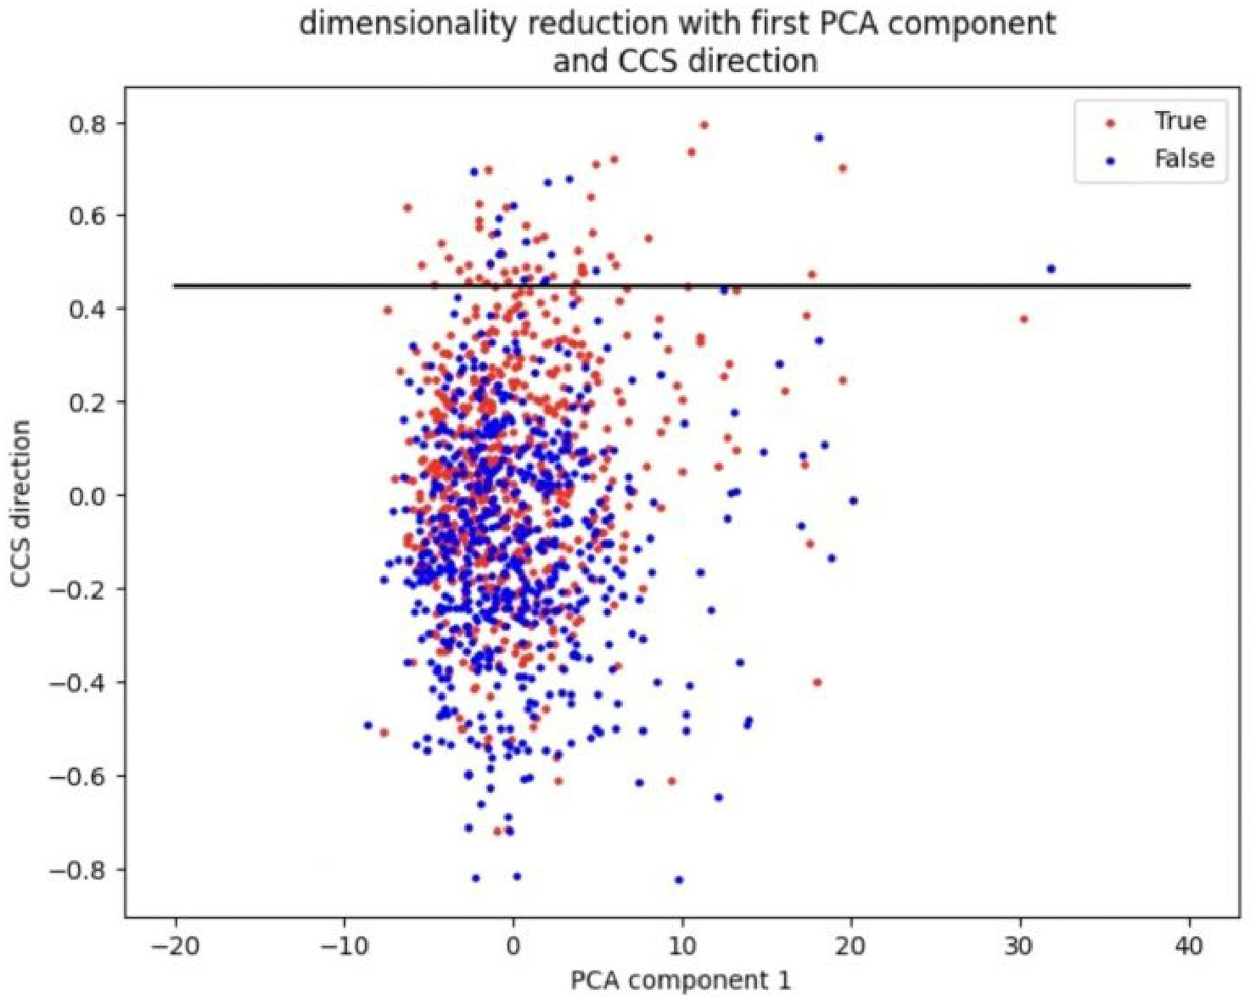
MD recovers CCS's probe direction
KEY RESULT · COSINE SIMILARITY TO CCS
AVG. COSINE SIMILARITY OF LEARNED PROBE DIRECTIONS TO CCS
FIGURE 1 · CCS GEOMETRY
1.0
0.78
0.75
0.63
0.5
0.25
~0.15
Datapoints projected onto PC1 (x) and the
0
probe direction θ̂ (y); colour = truth label.
CCS ↔ CCS
MD-CCS
PCA / MA / SMR
Chance of 0.63 at random ≈ 10⁻²³⁷.
self-similarity
tuned to imitate CCS
other accurate losses
Source: §5 Results · cosine similarity of learned probe directions
07
Notes:
The headline: Midpoint-Displacement tuned to imitate CCS gives probe directions averaging cosine similarity about zero point six three to real CCS probes, while CCS agrees with itself only at zero point seven eight. Other accurate losses like PCA sit near zero point one five, so the resemblance is specific to Midpoint-Displacement.

Slide 8
One knob λ decides the trade-off
ABLATION STUDY · MD-CCS vs MD-Acc
A CLEAN, SINGLE-VARIABLE ABLATION
The two variants share everything but one hyper-parameter, λ — so any difference
between them isolates the displacement-vs-midpoint trade-off itself.
COSINE SIMILARITY TO CCS
AVERAGE TEST ACCURACY
0.63
0.72
0.76
→
0.38
MD-CCS
MD-Acc
λ set to mimic CCS
λ retuned for accuracy
The CCS-matching λ is robust
MD-CCS
MD-Acc
it barely changes across datasets and models.
λ mimics CCS
λ tuned for accuracy
Source: §5 Ablation · varying λ between MD-CCS and MD-Acc
08
Notes:
The two Midpoint-Displacement variants differ only in lambda. Tuned to mimic CCS, cosine similarity is about zero point six three; tuned for accuracy, it drops to zero point three eight, showing the displacement-versus-midpoint trade-off defines CCS's target. Retuning lambda raises test accuracy to zero point seven six.

Slide 9
The numbers at a glance
HEADLINE NUMBERS · 4 MODELS × 5 DATASETS
PROBE SIMILARITY TO CCS
0.63
0.78
~0.15
MD-CCS ↔ CCS
CCS ↔ CCS
PCA / MA / SMR
average cosine similarity
self-similarity (the ceiling)
competing losses
TEST ACCURACY & COVERAGE
0.76
0.71
3 / 4
MD-Acc accuracy
CCS accuracy
models won
accuracy-tuned variant
the baseline it beats
by roughly four percent
Source: §5 Results tables · averaged over 4 models × 5 datasets
09
Notes:
A few numbers: Midpoint-Displacement matched to CCS reaches average cosine similarity about zero point six three, versus CCS self-similarity zero point seven eight, while competing losses reach only zero point one five. The accuracy-tuned variant averages zero point seven six accuracy versus zero point seven one, winning on three of four models, across five datasets.

Slide 10
It's the data, not the loss formula
TAKEAWAY
THE TAKE-HOME MESSAGE
CCS works because of the displacement information
in its contrast-pair data —
not its specific loss formula.
A SIMPLE LOSS SUFFICES
THE REAL LEVER
MD reproduces CCS — then beats it
The loss formula is interchangeable
✓ Matched to CCS, it recovers the same probe
Among high-accuracy probes, the exact loss
direction (cosine ≈ 0.63).
barely matters. What actually defines the
target is the balance between two quantities:
✓ Retuned for accuracy, it outperforms CCS
(0.76 vs 0.71 average).
σ_d² displacement
σ_m² midpoint
Fry et al. · Comparing Optimization Targets for Contrast-Consistent Search · arXiv:2311.00488
10
Notes:
The take-home: CCS succeeds because of the displacement information in its contrast-pair data, not its specific loss formula. A simple Midpoint-Displacement loss reproduces CCS and, retuned, beats it. The exact loss is interchangeable; the real lever is the displacement-versus-midpoint trade-off.

