Slide 1



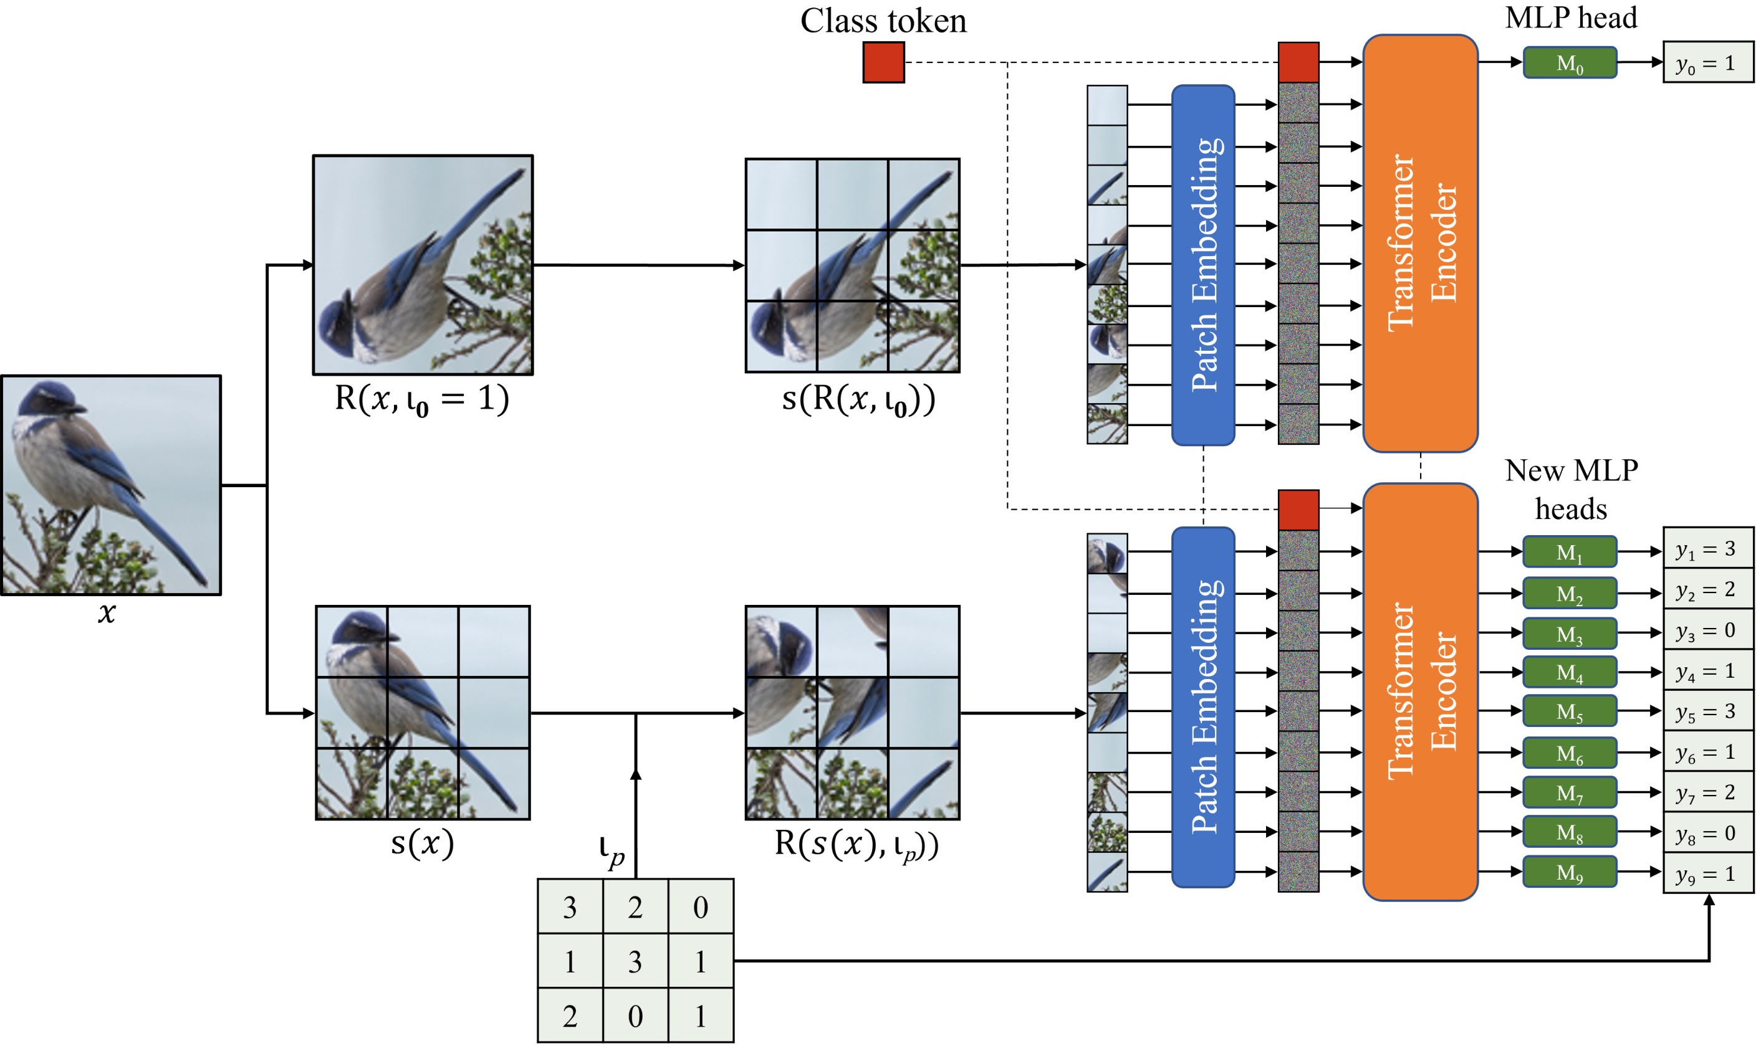
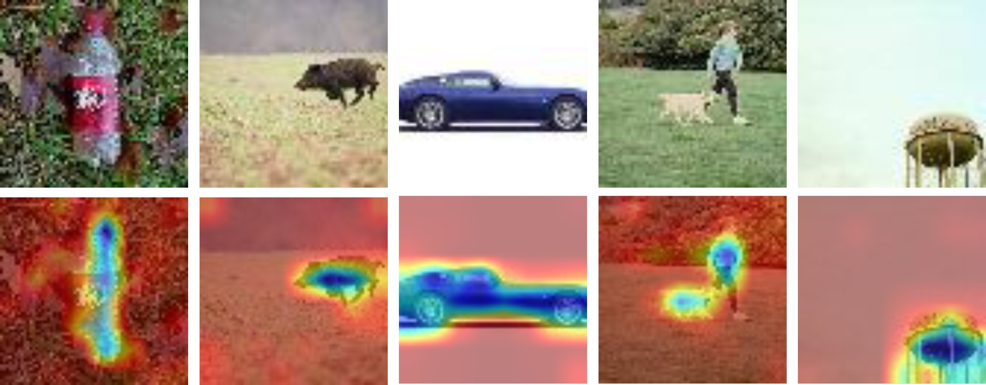
PatchRot: A Self-Supervised Technique for Training
Vision Transformers
Sachin Chhabra¹, Prabal Bijoy Dutta¹, Hemanth Venkateswara², Baoxin Li¹
¹ Arizona State University ² Georgia State University
Problem
Method
Key Results
Vision transformers (ViTs) lack the built-in inductive biases of
ConvNets — locality and translation equivariance — so they only
outperform CNNs when huge labeled datasets are available.
Labeling data at that scale is expensive and time-consuming.
Rotate the whole image or each patch by a random multiple of
90° (0/90/180/270) and train the ViT to predict every angle as a
4-way classification. The class token's head predicts the image
rotation (global); new per-patch MLP heads predict each patch's
rotation (local).
Method (top-1 %)
CIFAR-10
CIFAR-100
Supervised (scratch)
83.9
50.2
RotNet
88.7
62.5
Existing self-supervised pretext tasks (jigsaw, colorization,
image rotation) were designed for ConvNets and ignore the
patch-token structure that makes ViTs distinctive.
PatchRot (ours)
92.6
70.6
A buffer gap between patches (cut from a larger P+B grid, then
randomly cropped) stops the model cheating via edge continuity.
Pretraining runs at reduced resolution; the patch heads are then
discarded and only the class-token head is fine-tuned at full
resolution with interpolated positional embeddings.
PatchRot > RotNet > Supervised at every fine-tuning depth
(NF→MLP) across all four datasets.
81.1%
90.2%
4 / 4
Motivation
semi-sup CIFAR-10
(4k labels)
CIFAR-100
top-5
datasets beat
both baselines
A ViT processes an image as a sequence of patch tokens with
self-attention, so it can emit an output for every patch — not just
one global vector like a ConvNet.
SO WHAT → Even linear probing (frozen network, head only) nears supervised accuracy, and fine-tuning one encoder block already beats training from scratch — 81.1% with just 4k labels vs 53.7% supervised. The features also localize salient objects with no labels.
RotNet showed that predicting a single image-level rotation
angle already teaches a ConvNet rich features; pushing rotation
prediction to the patch level is a natural fit for a token-based
model, yet unexplored.
predict the rotation index ι (4-way) for the whole image via the class token and for each of N patches via new MLP heads
Headline Numbers
+8.7 pts
CIFAR-10 top-1
(full fine-tune)
+20.4 pts
94.1%
A self-supervised task built for ViTs should learn global
structure (whole image) and local detail (each patch) at once.
FashionMNIST
top-1 accuracy
CIFAR-100 top-1 gain (70.6 vs 50.2%)
73.4%
Tiny-ImageNet
top-5 accuracy
Takeaway
A simple, ViT-native pretext task — rotate images and
patches to learn global + local features, and beat
supervised-from-scratch and RotNet across datasets,
transfer, and low-label settings. The buffer-gap trick and
reduced-resolution pretraining keep it cheap and general.
PatchRot pipeline: image and per-patch rotations are predicted in separate,
weight-shared passes — the class token predicts image rotation, new MLP
heads predict each patch's rotation.
Paper: arxiv.org/abs/2210.15722
Code: github.com/s-chh/PatchRot
Attention maps of a PatchRot-trained ViT (Tiny-ImageNet): the model
attends to the salient object with no labels.

