Slide 1


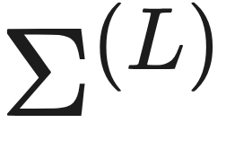


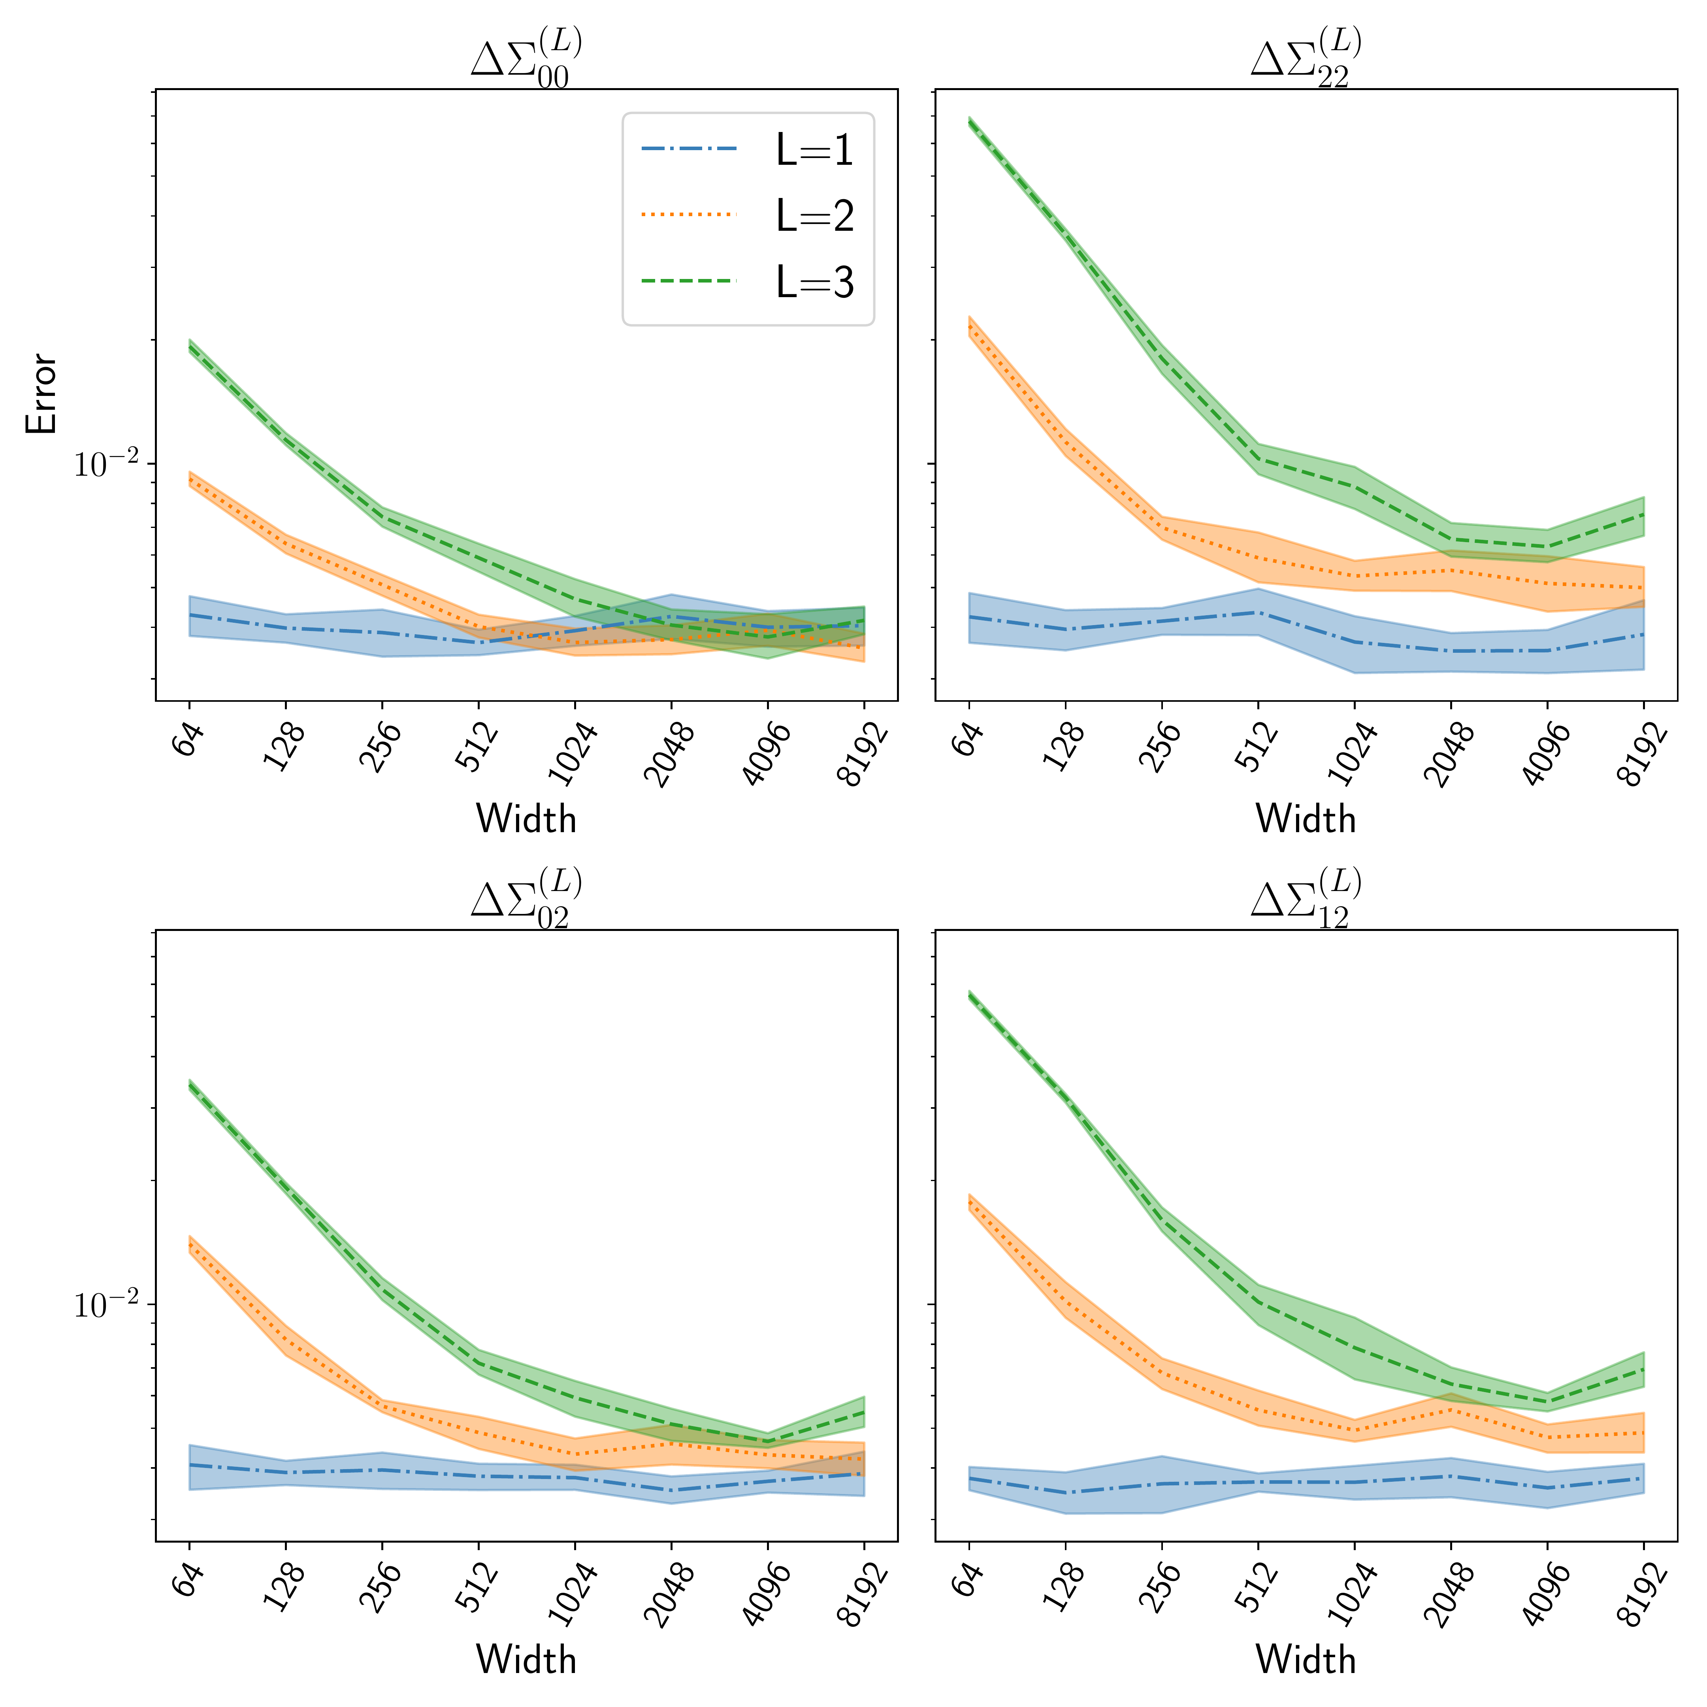
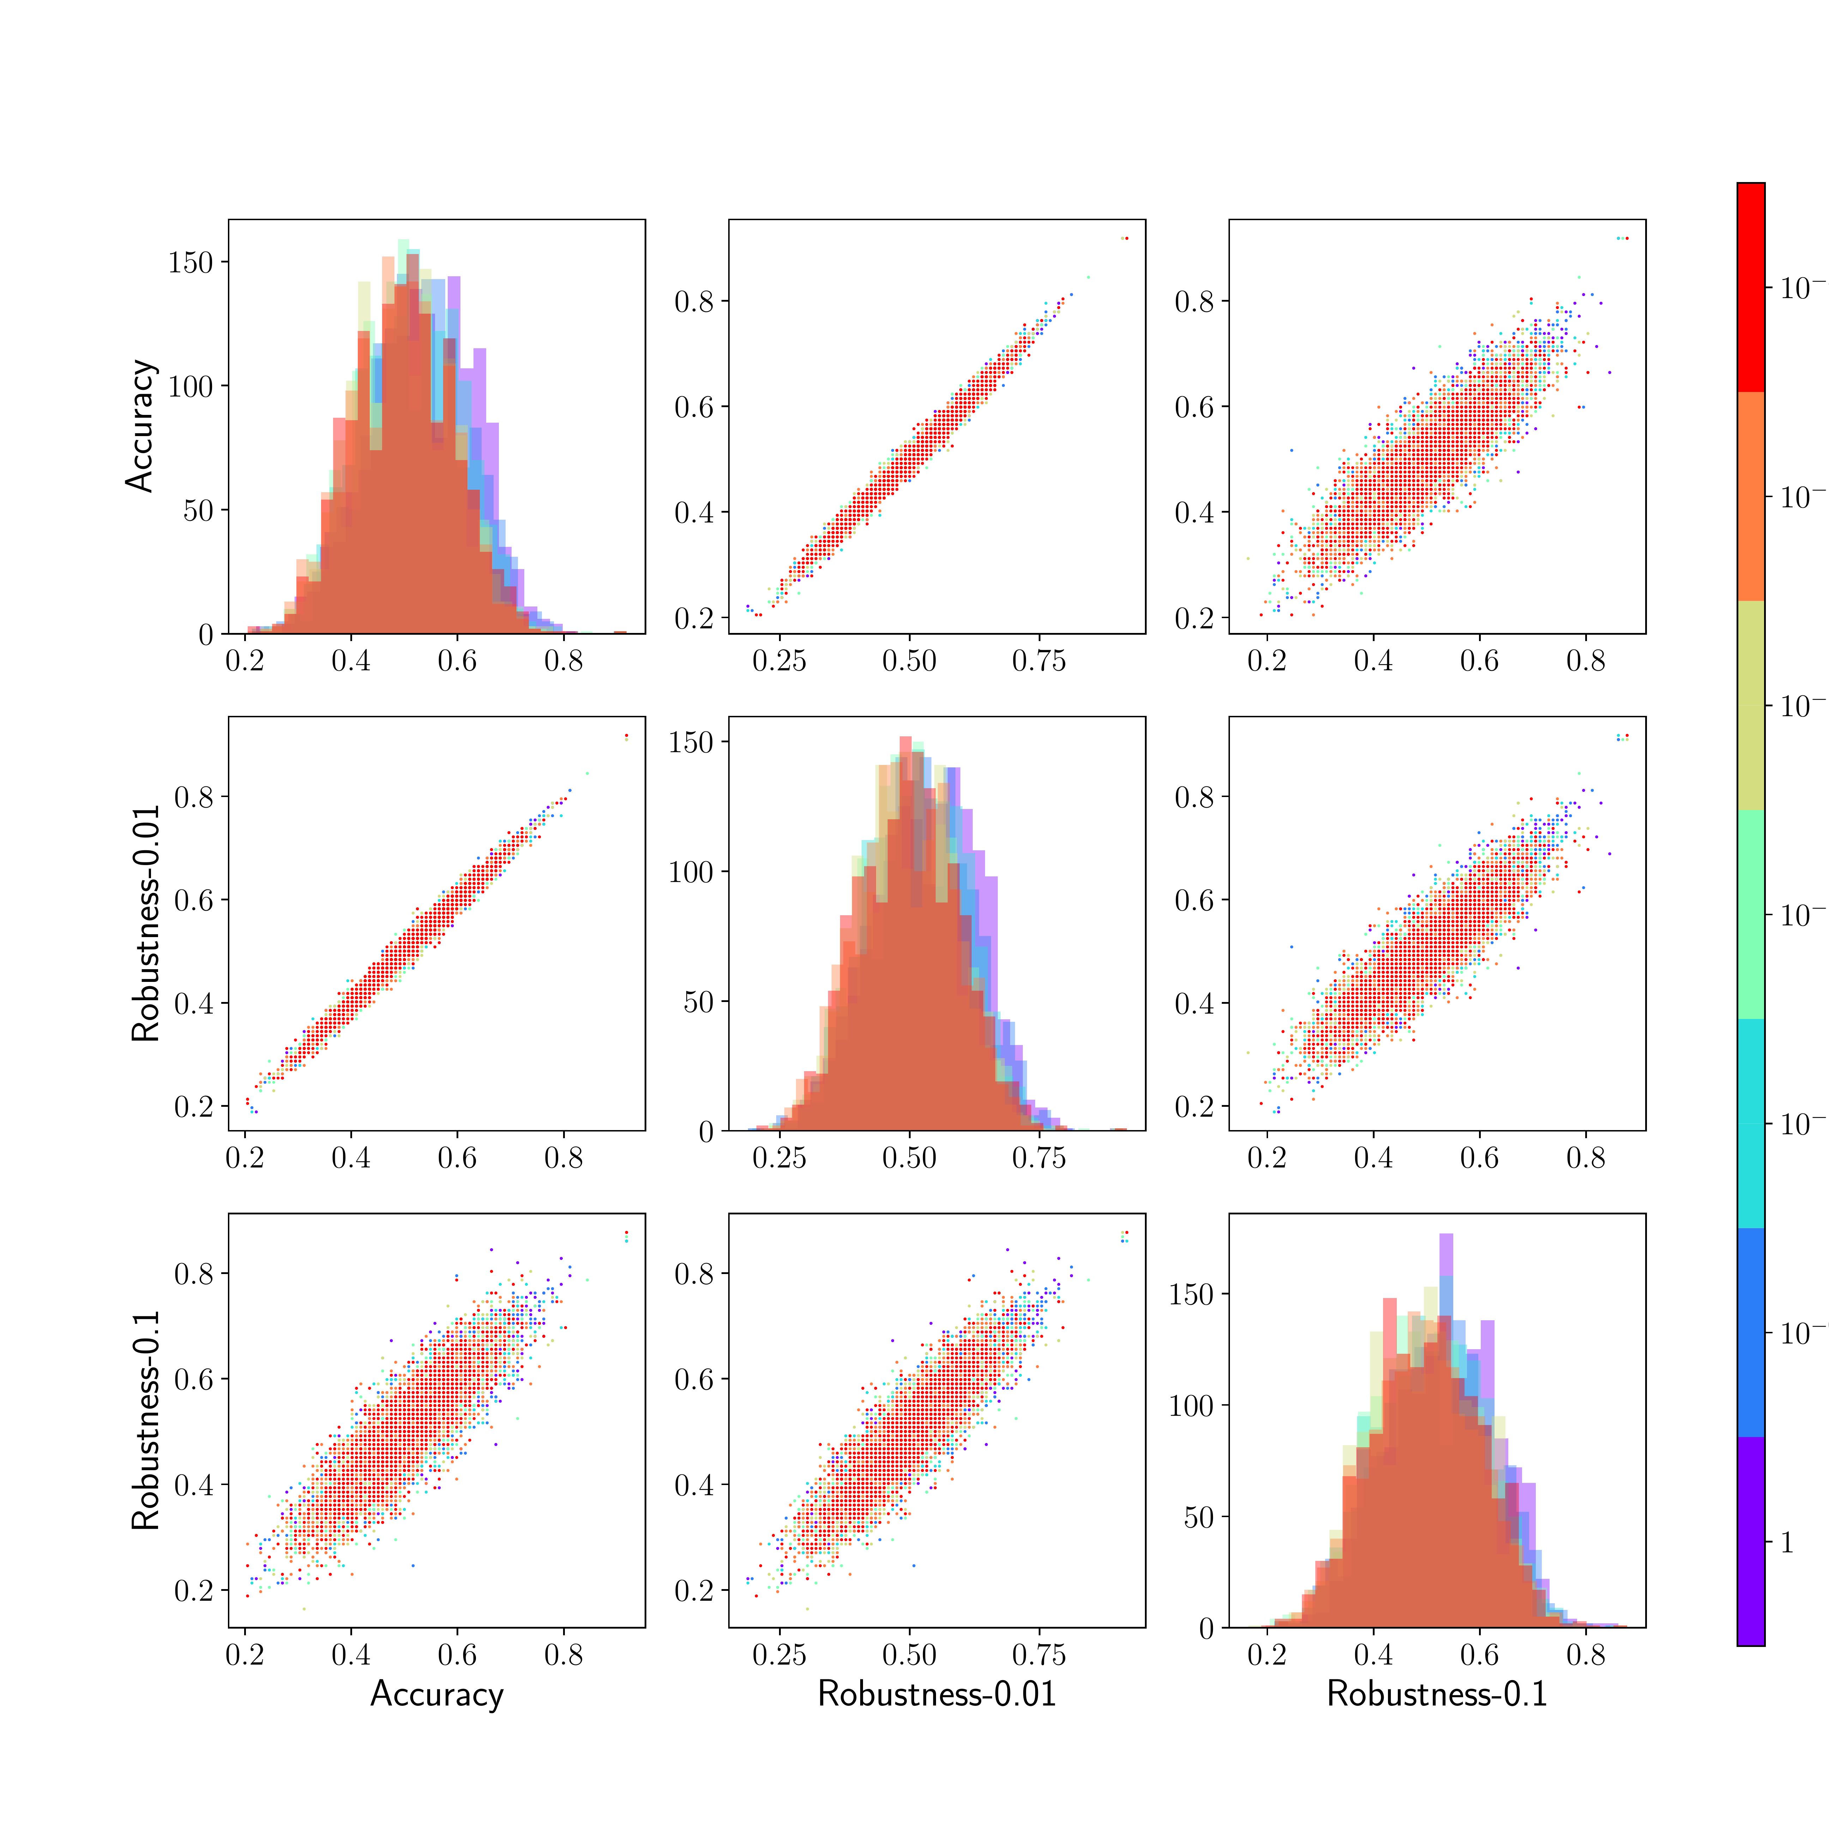
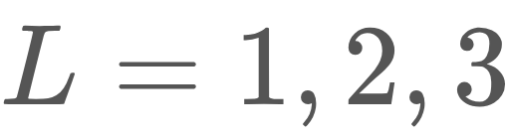
An Infinite-Width Analysis on the Jacobian-Regularised Training of a Neural
Network
ICML
2024
POSTER
Taeyoung Kim · Hongseok Yang
¹ School of Computing, KAIST
Paper
Problem
Method
Key Results
Accuracy ↔ Robustness
OPEN
Tensor programs → GP. Recast MLP-and-Jacobian convergence as a tensor program → joint GP convergence and the Jacobian NNGP kernel.
Wider ⇒ closer, exactly as the theory predicts.
Infinite-width theory describes a network's output — never its Jacobian.
As MLP width grows, the finite Jacobian NNGP kernel converges to its deterministic limit and the scaled finite JNTK converges to the limiting JNTK — confirming Theorems 3.1 & 4.3.
Under Jacobian regularisation, more-accurate eigenfeatures are also more-robust — the two align.
Constant JNTK ⇒ kernel regression. The JNTK stays constant in the wide limit, so training linearises to a kernel regressor built from the limiting JNTK , rescaled by .
Infinite-width theory (NNGP, NTK) explains how a network's output initialises and trains — but says nothing about its input–output Jacobian, the object encoding smoothness and used to enforce robustness to input noise and attacks.
Standard training shows little correlation, and never yields the accurate-but-fragile eigenfeatures reported for the finite NTK (Tsilivis & Kempe, 2022).
robust loss = MSE + λ·Jacobian penalty (wide-limit solution: kernel regression).
Headline Numbers
Motivation
64–8192
widths (2⁶–2¹³)
10⁶
λ=0.01
It works — unexplained. Penalising the Jacobian is a simple, strong adversarial defence, with no theory of why.
Jacobian coeff κ=0.1
MC samples per covariance estimate
11 / 6
full-rank depth GeLU/erf
The right lens was never applied. The infinite-width limit that explained standard training had never reached the Jacobian, let alone “robust” training.
Takeaway
Infinite-width theory now reaches the Jacobian: robust training of a wide MLP behaves like kernel regression with a Jacobian NTK.
Smoothness is the target. The Jacobian measures output sensitivity to input — exactly what robustness methods control.
Max-norm distance between the Jacobian NNGP kernel and its finite estimate vs. width, depth — error falls with width (Thm 3.1).
Pairplot of accuracy vs. robustness (0.01 / 0.1 perturbation) over eigenfeatures of robust training; colour = coefficient λ. Tight diagonals ⇒ accuracy & robustness rise together.
The first infinite-width account of why Jacobian regularisation improves adversarial robustness — making accuracy and robustness align rather than trade off — plus practical tests for when its key full-rank assumption holds.
A simple penalty on the Jacobian buys robustness — this work explains it from the infinite-width viewpoint.
SO WHAT → The widest net (8192) doesn't yet meet the eigenvalue bound, but the trend implies only wider nets are needed.
Stronger regularisation tightens the coupling: the penalty aligns accuracy and robustness rather than trading them off.

