Slide 1
PAPER EXPLAINER · arXiv:2210.00641
DARTFormer
INSIDE THIS PAPER
Finding the Best Type of Attention
01
02
The question: which
DARTFormer =
Search for the best attention, and test whether
attention for a long-range
differentiable NAS,
mixing several is even better.
task? Could mixing help?
applied to attention.
03
04
A supernetwork of many
Finds the best single
efficient attentions in
attention; mixing beats
parallel, ranked by
the average, never
masked-validation-drop.
the best.
Jason Ross Brown¹ · Yiren Zhao²¹ · Ilia Shumailov³ · Robert D. Mullins¹
¹University of Cambridge ²Imperial College London ³University of Oxford

Slide 2
02 · PROBLEM
No single efficient attention wins everywhere
O(n²)
✕
?
Quadratic cost → a family of efficient variants
But none is best everywhere
The awkward question
Long Range Arena benchmarking showed the best attention depends heavily on the task when training from scratch (no pretraining).
How do you efficiently discover the right attention for a given long-range task — without simply training them all?
Dot-product attention scales O(n²) with sequence length, so many efficient alternatives appeared: Longformer, Bigbird, Performer, Reformer, Synthesizer, …

Slide 3
03 · MOTIVATION
Could a mixture of attentions be optimal?
01
02
03
Heads specialize
Mixing is richer
The direct question
A long-standing intuition: each attention head learns a different kind of relationship
— much as convolutional kernels learn different features.
If that holds, a Transformer mixing several attention types could learn a richer set of relations and outperform any single-attention model.
This paper takes that intuition seriously and asks directly: is the optimal attention for a task actually a mixture — rather than assuming the answer?

Slide 4
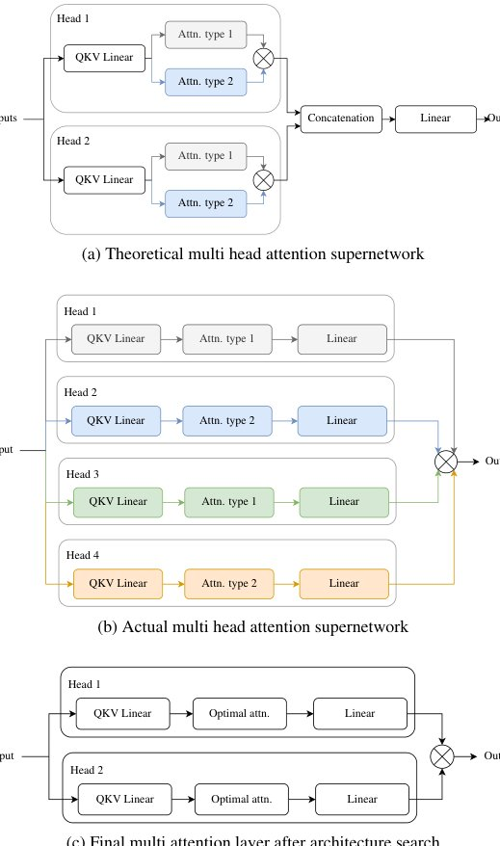
04 · CONTRIBUTIONS
Three contributions
3
contributions
This paper makes three, in sequence.
①
DARTFormer — a DARTS-style search
Differentiable architecture search that efficiently finds
the best attention for a task.
②
Extends it to heterogeneous Transformers
Build & search multi-attention models that combine several
attention types — via NAS Prune (expensive iterative pruning)
and NAS One-shot (cheap single pass).
③
Most importantly — a negative result
Empirically, these heterogeneous Transformers CANNOT beat
the best homogeneous Transformer on the long-range NLP
tasks studied.
Fig. 4 — multi-head attention search space

Slide 5
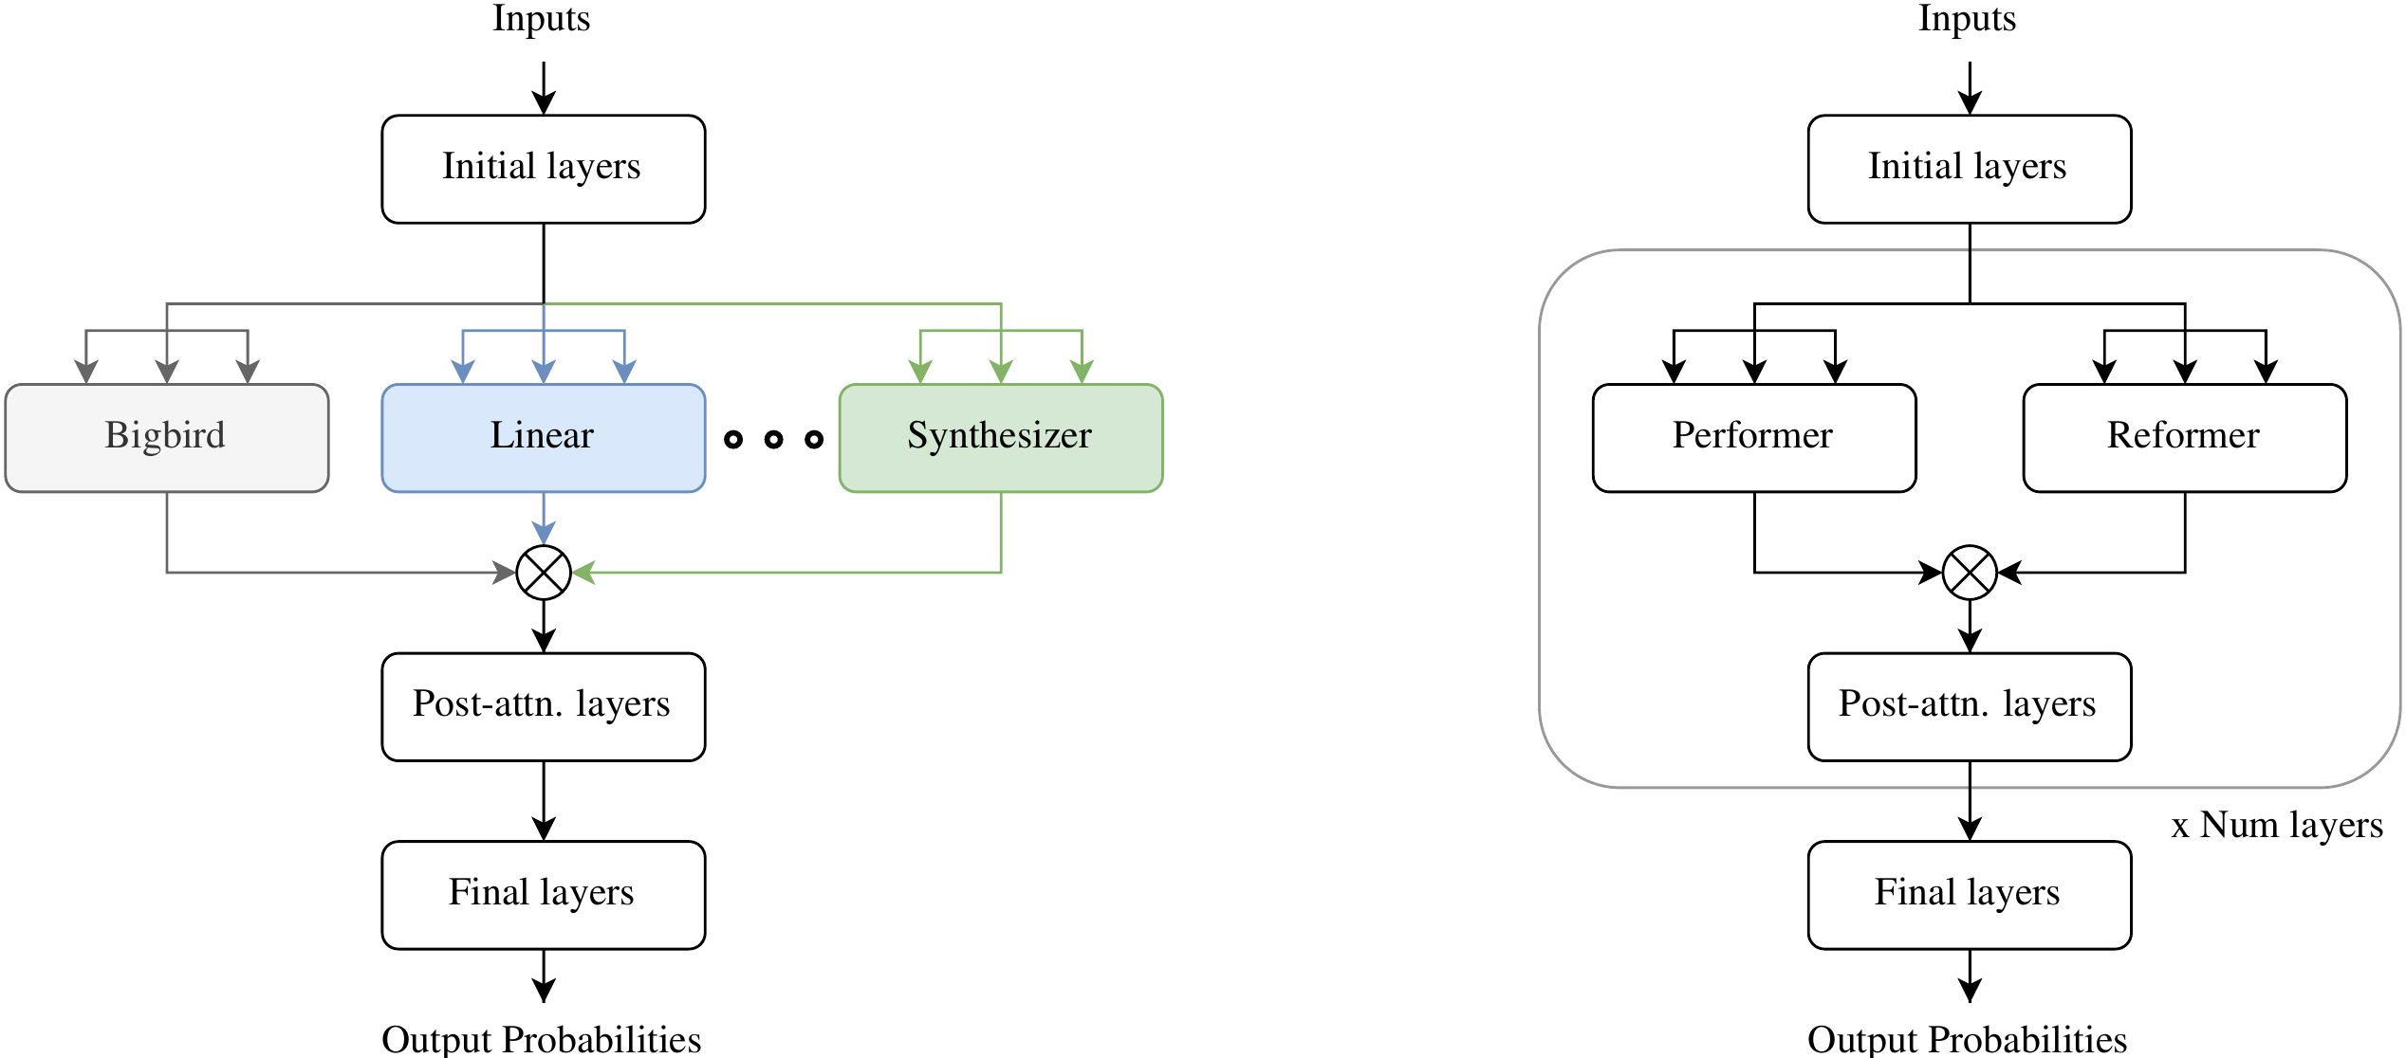
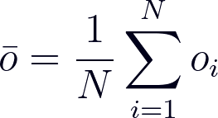

05 · METHOD
Supernetwork + masked-validation-drop
Single-layer supernetwork: one candidate block per efficient attention, in parallel (Fig. 1).
Fixed-α averaging
Masked-drop score
Build the model
Homogeneous → take the top-scoring block.
Heterogeneous → prune worst-first with fine-tuning, or take the top-4 and stack into a full Transformer.
Simply AVERAGE candidate outputs, no learned softmax edge weights, no bi-level optimization → supernetwork trains straight to convergence.
Score = masked validation-accuracy drop: mask a block, measure how far val- accuracy falls; the biggest drop = the best attention.

Slide 6
06 · DATA & SEARCH SPACE
Three LRA tasks · nine candidate attentions
All experiments use three tasks from the Long Range Arena (LRA) benchmark —
chosen to stress long-sequence modeling.
IMDb
ListOps
Document matching
byte-level binary
tokens
10-way
tokens
byte-level
tokens
text classification
1k
classification
2k
document retrieval
4k
NINE CANDIDATE ATTENTION MECHANISMS
Bigbird
Linear Transformer
Linformer
Local
Longformer
Performer
Reformer
Sparse Transformer
Synthesizer
Hyperparameters largely follow the original LRA setup.

Slide 7
07 · KEY RESULT
The headline finding
Beat the average — not the best
splits in two.
✓ Homogeneous selection works
✗ Mixtures never win
The masked-validation-drop search correctly
When the authors assemble heterogeneous
identifies the best attention for text
Transformers that mix several attention
classification and ListOps — Reformer stands
types, none beats the best single-attention
out with a drop ≈ 12 while every other
model on any of the three tasks.
attention scores below 0.5.
Reformer drop ≈ 12 · others < 0.5
0 of 3 tasks improved by mixing
Mixing attention helps you beat the AVERAGE choice —
but not the BEST one.

Slide 8
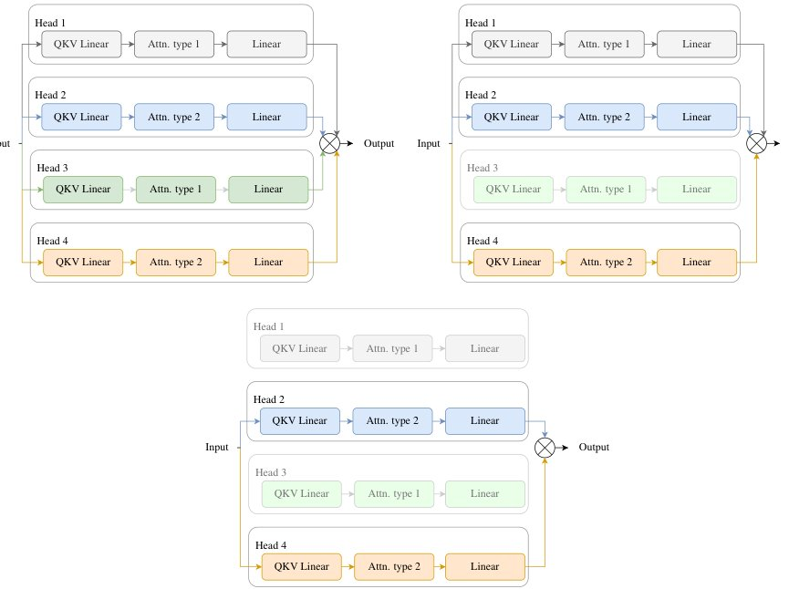
08 · ABLATION
The cheap search is good enough
A practical takeaway comes from comparing
the two heterogeneous search procedures.
NAS PRUNE (EXPENSIVE)
Repeatedly remove the worst block and fine-
tune. It offers NO consistent advantage over
NAS One-shot, the cheap single-pass top-
scoring selection, when good attentions are
correctly identified.
Tilting the mixture toward the strongest
attentions, or giving them more heads, also
failed to give consistent gains, reinforcing
Fig. 3 — NAS Prune removes the worst block,
that the cheap method is good enough.
worst-first.

Slide 9
09 · HEADLINE NUMBERS
The pattern is consistent
ListOps — selection signal
Document matching (4k)
Text classification (1k)
11.85
71.1%
64.5%
Reformer masked-validation-drop score
Synthesizer — best homogeneous
Performer — best homogeneous
vs < 0.5 for every other attention — a strikingly clean signal.
NAS Prune 67.0% · NAS One-shot 64.7% (heterogeneous trails)
NAS Prune 63.9% · NAS One-shot 64.4% (never ahead)
Across 9 attention mechanisms and 3 tasks — the pattern is consistent:
heterogeneous is never ahead.

Slide 10
10 · TAKEAWAY
A cheap recipe — and a cautionary lesson
The recipe
THE DEEPER LESSON
For a given task it's often unclear which attention will do best. DARTFormer offers a cheap, reliable recipe: train a single- layer mixed-attention Transformer and rank by masked validation accuracy drop.
The deeper lesson is a cautionary one for the field.
THE FINDING
Combining diverse attention mechanisms beats the AVERAGE single choice — but never the BEST one.
⚠ Very low drop scores warn the pick may be unreliable.
The different attentions don't simply add complementary biases the way intuition assumes.
DARTFormer · arXiv:2210.00641 · University of Cambridge · Imperial College London · University of Oxford

