Slide 1



NeurIPS 2022
Langevin Autoencoders
for Learning Deep Latent
Variable Models
Langevin dynamics samples the intractable posteriors of deep latent
models accurately, but is slow: a fresh chain for every data point.
Idea: amortize sampling into a shared encoder network.
A provably valid MCMC method that beats variational autoencoders.
Paper
Code
Shohei Taniguchi · Yusuke Iwasawa · Wataru Kumagai · Yutaka Matsuo
The University of Tokyo
arXiv:2209.07036 · github.com/iShohei220/LAE

Slide 2
The Problem: an intractable posterior
02 · PROBLEM
MAXIMUM-LIKELIHOOD TRAINING
MCMC / LANGEVIN DYNAMICS
The gradient is an expectation
Accurate sampling,
over the latent posterior.
but painfully slow.
∇θ log p(x) =
One separate chain per data point:
E p(z|x) [ ∇θ log p(x,z) ]
x₁
… × n points
Deep latent variable models explain data
through hidden variables z. Learning by
Traditional Langevin dynamics runs a fresh
maximum likelihood requires averaging over
chain of iterations for every single data
the posterior p(z | x).
point, and converges slowly.
That posterior is intractable.
Rarely practical for deep models.
Langevin Autoencoders · NeurIPS 2022
2 / 10

Slide 3
Motivation: efficiency vs. flexibility
03 · MOTIVATION
VARIATIONAL INFERENCE (VAE)
MCMC / LANGEVIN
Amortization = efficiency
Flexible, but never amortized
One shared encoder predicts the latents
MCMC has no tractability limit: it can
for all data points at once, instead of
capture any posterior shape.
per-point optimization.
Yet no one had truly amortized it. Earlier
But: limited flexibility
hybrids only used an encoder to warm-start
VI relies on tractable distributions like
sampling, still running one chain per point.
Gaussians, so its approximation power is
Flexibility without amortization’s speed.
fundamentally capped.
THE GOAL
Amortization’s efficiency + MCMC’s flexibility.
Langevin Autoencoders · NeurIPS 2022
3 / 10

Slide 4
Contributions
04 · CONTRIBUTION
Two main contributions
Amortized Langevin
The Langevin
1
2
Dynamics (ALD)
Autoencoder (LAE)
A new MCMC algorithm that removes
A framework for training deep generative
per-datapoint sampling iterations entirely,
models built on ALD that, remarkably,
running Langevin updates on the
amounts to only a small modification of
parameters of a shared encoder.
a traditional autoencoder.
GUARANTEE
SPECIAL CASES
Proven to keep the true posterior as
Ordinary Langevin dynamics and the plain
its stationary distribution.
autoencoder both fall out of it.
Langevin Autoencoders · NeurIPS 2022
4 / 10

Slide 5
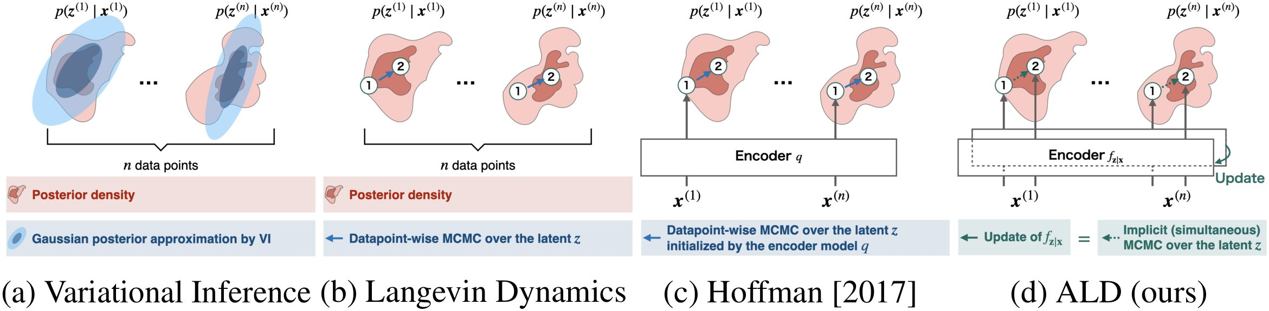
Method: move the noise into the encoder
05 · METHOD
Fig. 1 — From (a) variational inference and (b, c) per-point Langevin to (d) ALD, which updates the encoder itself.
KEY IDEA
ENCODER AS SAMPLER
THEOREM
IN PRACTICE
Randomness moves
Outputs are the
Provable
A tiny tweak to
to the encoder
samples
convergence
the AE loop
Instead of noising each
The encoder maps x → z;
A fixed feature extractor +
A few update steps before
latent, run Langevin on the
updating its parameters
a trainable linear layer
each decoder step, with
encoder’s parameters.
moves the latents.
wider than the batch.
optional M-H correction.
Langevin Autoencoders · NeurIPS 2022
5 / 10

Slide 6
How it is evaluated
06 · BENCHMARK
Validation in two stages
STAGE 1 · SANITY CHECK
STAGE 2 · REAL IMAGES
Toy problems, known answers
Four standard datasets
Conjugate bivariate Gaussian
MNIST
SVHN
A posterior with a known
closed-form solution.
CIFAR-10
CelebA
Random-network posterior
METRIC
A harder, multimodal posterior
Negative ELBO per dimension (lower is
defined by a randomly
better), over 3 seeds, shared architectures.
initialized neural network.
Langevin Autoencoders · NeurIPS 2022
6 / 10

Slide 7
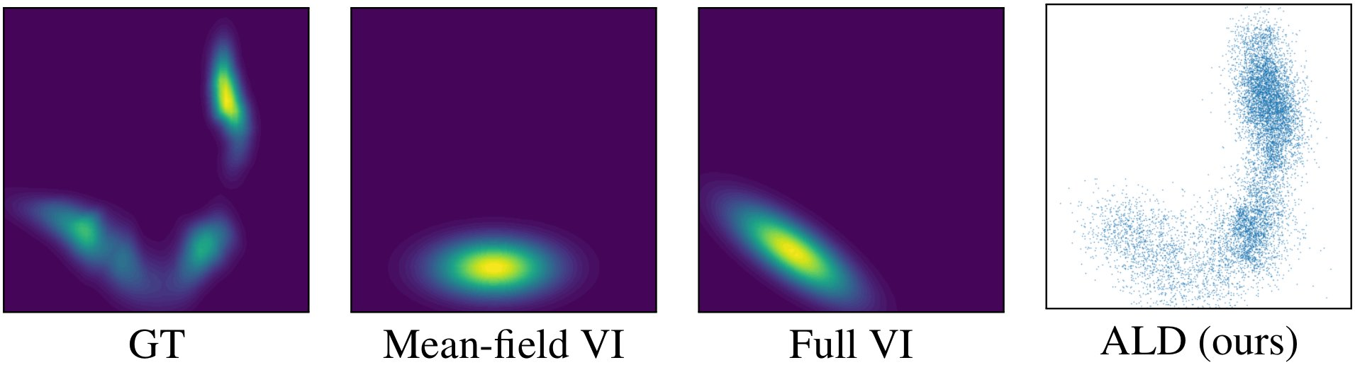
Key Result: it captures the true posterior
07 · KEY RESULT
Fig. 3 — Only ALD (right) reproduces the multimodal ground-truth posterior; mean-field and full VI collapse it.
TOY PROBLEMS
IMAGE DATASETS
THE LESSON
Faithful posteriors
Lowest ELBO on all 4
Better sampling →
ALD reproduces multimodal,
LAE beats the VAE, its flow
better models
correlated shapes that mean-
extension, and the encoder-
More accurate posteriors train
field and full VI miss.
initialized Langevin method.
better generative models.
Langevin Autoencoders · NeurIPS 2022
7 / 10

Slide 8
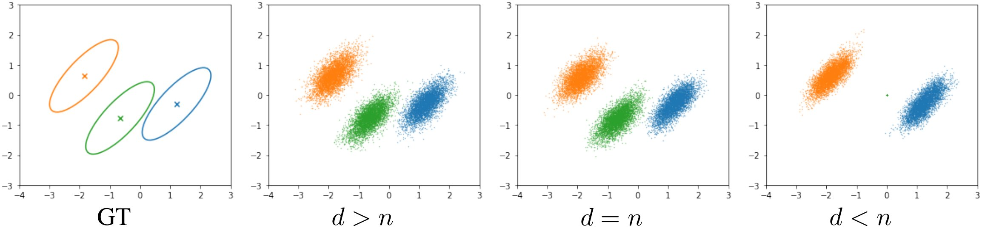
Ablations: what actually matters
08 · ABLATION
Two ablations
ENCODER CAPACITY
Theory,
confirmed
When the last linear
layer’s width d is at
Fig. 2 — When d ≥ n the samples match ground truth; at d < n some points collapse.
least the batch size n,
samples match the true
posterior.
ON IMAGE DATASETS
If d < n:
M–H step is important
Iterations barely matter
samples for some data
The Metropolis–Hastings rejection
As long as it is ≥ 2 — so the
points collapse.
step stabilizes training.
experiments use just two steps.
Langevin Autoencoders · NeurIPS 2022
8 / 10

Slide 9
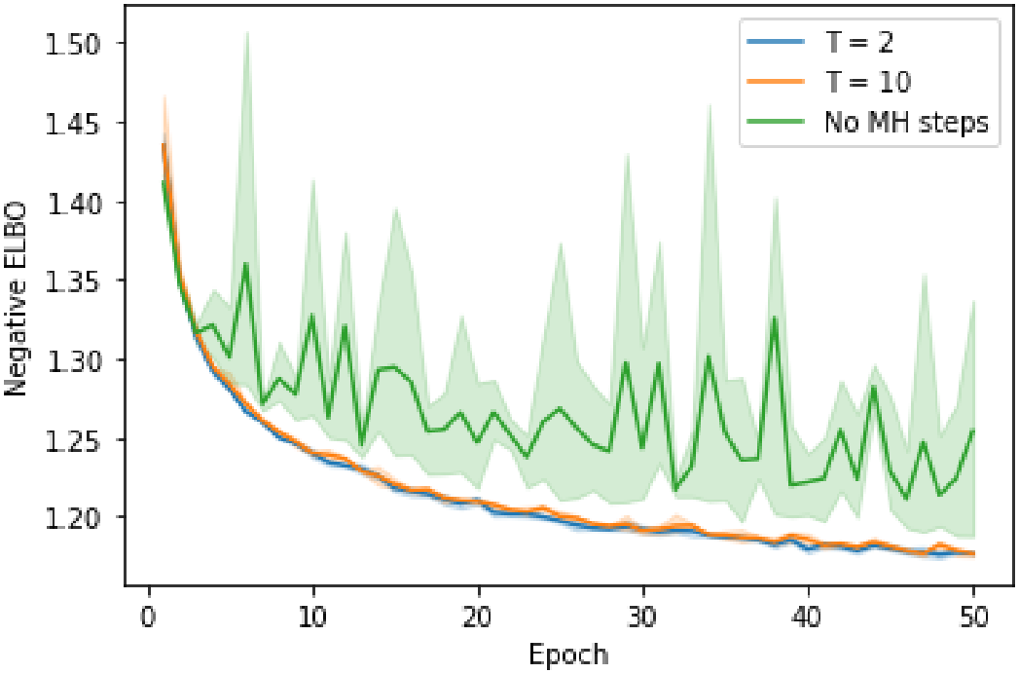
The numbers
09 · HEADLINE NUMBERS
Consistent, but modest, gains
Negative ELBO per dimension — lower is better. LAE = Langevin autoencoder (ours).
Dataset
VAE
LAE (ours)
MNIST
1.189
1.177
CIFAR-10
4.82
4.77
CelebA
4.67
4.64
SVHN
4.44
4.41
Fig. 4 — Training ELBO: dropping the M–H step destabilizes it.
THE COST
Training is about
2.25× slower
than a VAE, but as fast as the encoder-initialized Langevin.
Langevin Autoencoders · NeurIPS 2022
9 / 10

Slide 10
Takeaway
10 · TAKEAWAY
Move the Langevin noise from the latents to the encoder’s parameters —
and posterior sampling becomes both efficient and flexible.
EFFICIENT
FLEXIBLE
Amortized across all data
Genuine MCMC
One shared encoder replaces
Not a constrained Gaussian — it
per-datapoint sampling chains.
can capture any posterior shape.
THE RESULT
Provably valid as MCMC. Almost identical to a standard autoencoder in code.
Yet it consistently beats variational autoencoders on test likelihood.
In effect: the ordinary autoencoder, reframed as bias-corrected, sampling-based inference.
Langevin Autoencoders · NeurIPS 2022 · arXiv:2209.07036
10 / 10

