Slide 1



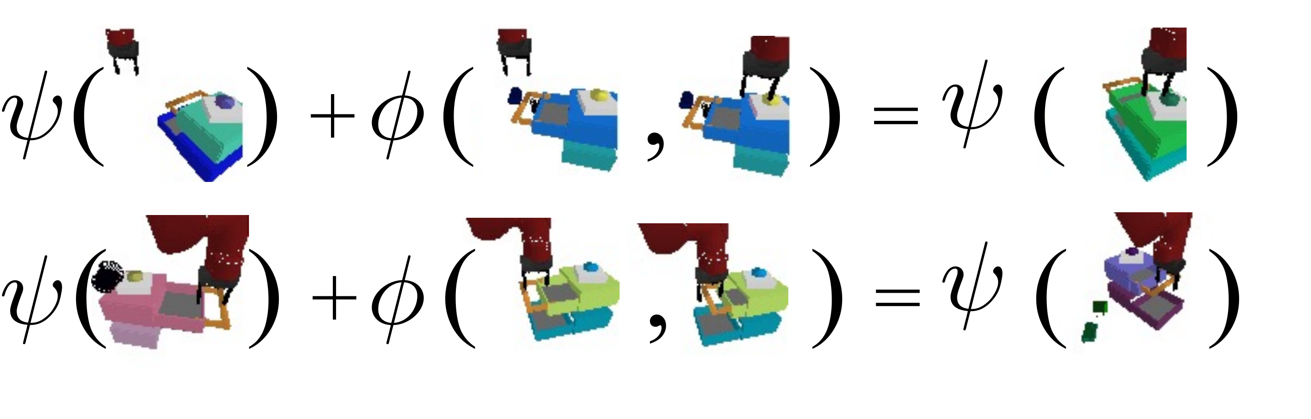
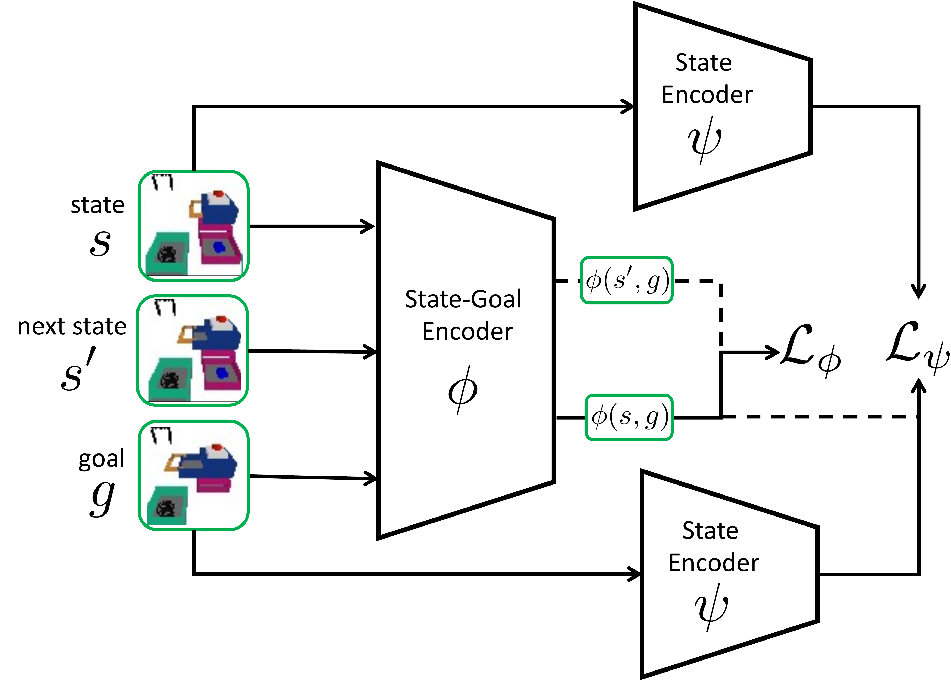
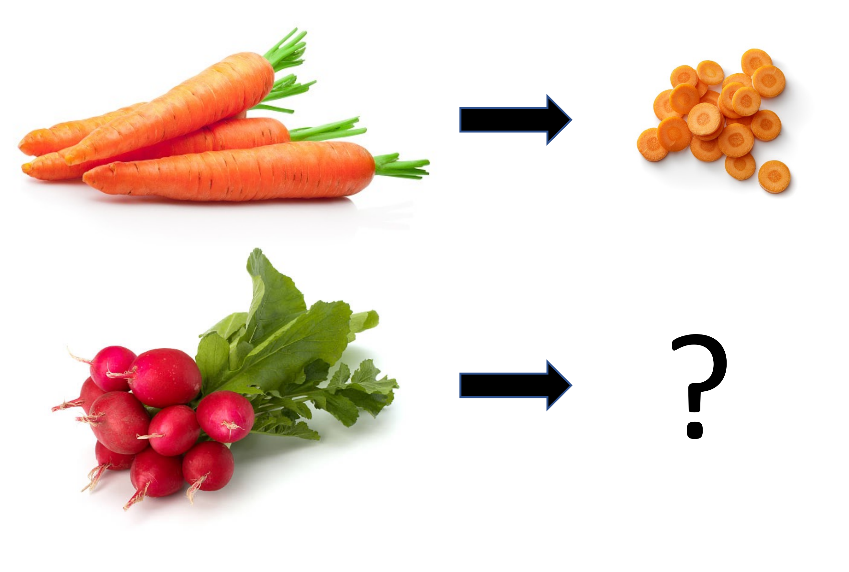
Bisimulation Makes Analogies in Goal-Conditioned
Reinforcement Learning
Philippe Hansen-Estruch¹, Amy Zhang^{1,2}, Ashvin Nair¹, Patrick Yin¹, Sergey Levine¹
¹ University of California, Berkeley ² Meta AI Research
Problem
Method
Key Results
Goal-conditioned RL assumes the agent is handed the exact goal configuration — yet the precise goal state is usually unknown before a task is even attempted.
Learn a Siamese state encoder ψ and a state-goal encoder φ fit to an on-policy goal-conditioned bisimulation metric.
Method
Metric
At test time, compute ψ(s)+φ(s_{a},g_{a}) and take its nearest ψ-neighbour as the inferred goal.
CPV (next best)
0.176
A scalable interface should instead let a user give an analogous example and have the agent infer its own goal.
GCB (ours)
0.403
2.3× the next best on Analogy · best on 5 / 6 settings
Motivation
composability — goals add by arithmetic
Humans solve whole families of tasks because a goal representation can be invariant to irrelevant details yet equivariant to the parts that differ.
Prior bisimulation methods only made a representation robust to distractors within a single task, not across analogous goals.
Analogy arithmetic: ψ(s) + φ(s_{a},g_{a}) composes a goal; rightmost = its nearest neighbour in ψ space.
SO WHAT → Only GCB infers goals from an analogy — and stays robust under distractors.
Headline Numbers
0.403
0.448
Drawer + VD
Analogy success (GCB)
0.322
BD + VD
GCB representation learning: a Siamese state encoder ψ and state-goal encoder φ make goals composable.
2.3× next-best (0.176)
5 / 6
settings won
Takeaway
Dataset / Benchmark
Bisimulation as an equivalence over tasks, not just states, lets goals compose by latent arithmetic and generalize to unseen goals.
PyBullet manipulation over 84 object geometries — success vs. the true goal over 5 seeds, offline RL (IQL).
Analogous tasks share the same skill and functional change from start to goal.
Point a robot at an example task; it infers its own goal — provably sufficient for any state-only reward.
Drawer
Button + Drawer
Analogy
+ Video Distractors

