Slide 1
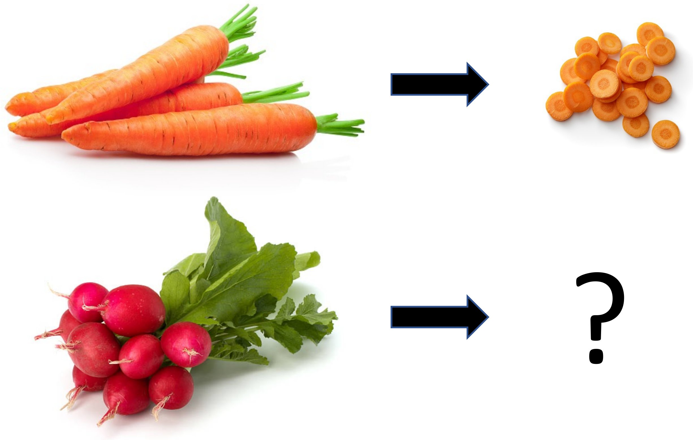

PAPER · DEEP READ
THE ANALOGY MOTIF
ICML 2022 · arXiv:2204.13060
Bisimulation Makes
Analogies
in goal-conditioned RL
Tell a robot what to do by analogy — not by an exact goal image —
and let it infer the equivalent goal for its own situation.
Hansen-Estruch · Zhang · Nair · Yin · Levine
Dice a carrot, then a radish: same skill, different object.
UC Berkeley · Meta AI Research
Group equivalent
tasks, not just
STATE ABSTRACTION
GOALS BY ANALOGY
PROVABLY SUFFICIENT
equivalent states.
Behaviorally equivalent
Compose goals with simple
Enough for any task with a
Skills transfer to new,
state-goal pairs share one
arithmetic in latent space:
state-only reward, not just
unseen goals.
representation.
ψ(s) + φ(sₐ,gₐ)
goal reaching.
PAPER
01
Notes:
What if a robot could be told what to do by analogy, not by an exact goal image? This ICML 2022 work from Berkeley and Meta introduces goal-conditioned bisimulation: a state abstraction where behaviorally equivalent state-goal pairs share a representation, so goals compose by simple arithmetic in latent space.

Slide 2
The goal is rarely handed to you
PROBLEM · WHAT GOAL-CONDITIONED RL ASSUMES
01
02
03
04
THE STANDARD SETUP
THE MISMATCH
A CONCRETE EXAMPLE
THE ALTERNATIVE
Goal-conditioned RL
But in the real world
Ask a robot to close
Specify tasks by
usually hands the agent
you rarely know the
a drawer — you may not
analogy instead.
the exact goal it should
precise goal in advance.
know how the closed
reach.
drawer even looks.
Show the agent a similar
task being solved, and let
The exact configuration
it work out its own goal.
of the goal is usually
Given as a
unknown before the task
target image g
is even attempted — an
A far more
or exact state.
unrealistic assumption
Closed = ?
scalable interface
for most applications.
for real tasks.
From “here is the exact goal” → “here is an analogous task; figure out your goal.”
Goal-Conditioned Bisimulation · ICML 2022
02
Notes:
Goal-conditioned reinforcement learning usually hands the agent the exact goal, as a target image or state. But in the real world you rarely know the precise goal in advance. Asking a robot to close a drawer, you may not know how the closed drawer looks. We want to specify tasks by analogy instead.

Slide 3
Humans solve families of tasks
MOTIVATION · INVARIANCE, EQUIVARIANCE, AND ANALOGY
DICE A CARROT · THEN A RADISH
SAME SKILL, DIFFERENT OBJECT
The target objects differ, but the skill required and the
functional change from the start state to the goal are
essentially the same.
THE RIGHT REPRESENTATION
Invariant
Equivariant
to irrelevant details
to the factors that vary
(color, distractors).
between analogous tasks.
THE GAP WE CLOSE
Prior bisimulation metrics learned representations robust to
The objects differ, but the transformation from
visual distractors — but only for a single task.
whole to diced — the analogy — is the same.
We lift that idea to whole families of analogous tasks.
Goal-Conditioned Bisimulation · ICML 2022
03
Notes:
Consider dicing a carrot versus a radish. The objects differ, but the skill and the functional change from start to goal are the same. Good task representations are invariant to irrelevant details and equivariant to what varies. Prior bisimulation work handled distractors for one task; we lift that idea to families of tasks.

Slide 4
What the paper contributes
CONTRIBUTION · GOAL-CONDITIONED BISIMULATION (GCB)
3
THREE CONTRIBUTIONS
A new abstraction, a way to learn it, and a proof that it is enough.
1
Define GCB
2
Learn it by metric
3
Prove sufficiency
A new state abstraction that
A practical metric-learning
Theoretical guarantee that the
groups state-goal pairs which
objective learns the abstraction
learned representation retains
behave equivalently.
directly from pixels.
what control needs.
CAPTURES
NEW GOALS FROM
SUFFICIENT FOR
Functional
Latent-space
Any state-only
equivariance
arithmetic
reward task
across analogous tasks.
over analogies.
not just goal reaching.
Goal-Conditioned Bisimulation · ICML 2022
04
Notes:
The paper makes three contributions. It defines goal-conditioned bisimulation, grouping state-goal pairs that behave equivalently to capture functional equivariance. It gives a metric-learning objective so new goals arise from latent arithmetic. And it proves the representation is sufficient for any state-only reward task.

Slide 5
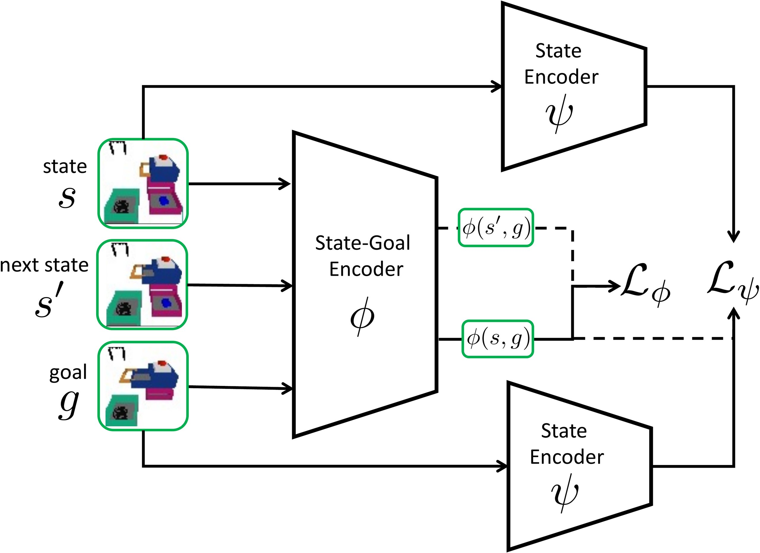
Two encoders that make goals composable
METHOD · REPRESENTATION LEARNING IN GCB
φ · STATE-GOAL ENCODER
Encodes a state-goal pair so its ℓ₁ distance matches an
on-policy goal-conditioned bisimulation metric —
how differently two tasks behave.
ψ · STATE ENCODER
Encodes a single state so that the goal embedding minus
the state embedding equals φ of that pair.
This equality is the key.
GOALS BECOME COMPOSABLE
Figure 3 · State-goal encoder φ and Siamese state encoder ψ; dashed = stopped gradients.
Add an analogous pair to your current state, then take the
nearest neighbor in ψ space to recover a concrete goal:
THE TWO OBJECTIVES
ψ(s) + φ(sₐ, gₐ) → nearest-neighbor goal
φ metric loss — match the bisimulation distance:
HOW IT IS TRAINED
L_φ = (‖φ(sᵢ,gᵢ) − φ(sⱼ,gⱼ)‖₁ − ‖rᵢ−rⱼ‖₂ − γ‖φ̄ᵢ′ − φ̄ⱼ′‖₂)²
φ, ψ, and the policy π(ψ(s), φ(s,g)) are learned
ψ composability — what lets goals add:
concurrently — offline, on top of Implicit Q-Learning.
ψ(gᵢ) − ψ(sᵢ) = φ(sᵢ, gᵢ)
Encoders: six-layer CNNs → 256-dim latents.
05
Notes:
GCB learns two encoders together. Phi encodes a state-goal pair so its L1 distance matches an on-policy bisimulation metric, capturing how differently two tasks behave. Psi encodes a state so the goal embedding minus the state embedding equals phi. That makes goals composable: add an analogous pair to your state, then take the nearest neighbor in psi space to recover the goal. Training is offline on Implicit Q-Learning.

Slide 6
A manipulation suite built for generalization
DATASET / BENCHMARK · PYBULLET SIMULATED MANIPULATION
THE ENVIRONMENT
SIX TASK SETTINGS · CLEAN + VIDEO DISTRACTORS (VD)
A PyBullet simulation of
Drawer
Button & Drawer
Analogy
robotic manipulation, with
randomly generated
Position a drawer to a
Position a drawer or
Infer the goal from an
workspaces.
target openness.
press a button (BD).
analogous example.
Drawer + VD
BD + VD
Analogy + VD
84
VIDEO DISTRACTORS
object geometries
Each task is also evaluated with distracting video played into the
scene — a direct test of whether the representation isolates only
the task-relevant structure.
Deliberately designed to
showcase several distinct
types of generalization.
EVALUATION PROTOCOL
5×
Offline RL: a demo policy
Success measured against the true goal, averaged over 5 random seeds.
reaches the goal ~80% of episodes.
Goal-Conditioned Bisimulation · ICML 2022
06
Notes:
GCB is tested in a PyBullet manipulation suite of randomly generated workspaces built from eighty-four object geometries. Tasks span Drawer, Button-and-Drawer, and dedicated Analogy tasks, each also run with added video distractors to probe robustness. Results average over five seeds.

Slide 7
Best on five of six task settings
KEY RESULT · FINAL AVG. SUCCESS RATE (± STDERR, 5 SEEDS)
METHOD
Drawer
Dr+VD
BD
BD+VD
Analogy
An+VD
ROBUST TO DISTRACTORS
GCB
0.533
0.448
0.440
0.322
0.403
0.303
0.448
0.322
this work
CPV
0.400
0.209
0.228
0.198
0.176
0.121
Drawer + VD
BD + VD
best of all methods
best of all methods
VAE
0.463
0.261
0.522
0.115
0.280
0.112
GC-DBC
0.269
0.261
0.358
0.255
NA
NA
Also compared: CCVAE · CPC · CURL · RAD · Pixel (9 methods total)
GOAL INFERRED FROM ANALOGY
The only representation that supports
WHERE GCB WINS
goal inference from an analogous pair.
Top method on 5 of 6 settings (only VAE edges it on clean BD),
0.403
and the strongest method on every distractor-augmented task —
vs
0.176
evidence the representation isolates task-relevant structure.
Green = best in column.
GCB
CPV (next best)
Roughly 2× the next-best baseline.
Source: Table 1 — BD = Button and Drawer, VD = Video Distractors
07
Notes:
Across six settings, GCB is top on five, and wins on every distractor task, isolating task-relevant structure. It reaches about forty-five percent on Drawer with distractors and thirty-two on Button-and-Drawer. On analogy tasks, where the goal is inferred from an example, it roughly doubles the next-best baseline.

Slide 8
What actually matters in the design
ABLATION STUDY · VALIDATING THE KEY CHOICES
ABLATIONS CONFIRM THE DESIGN
Each key design decision was tested — and the chosen one holds up.
1 · GROUNDING TERM
2 · METRIC LOSS FOR φ
3 · LATENT DIMENSIONALITY
φ(gᵢ, gᵢ)
ℓ₁
>
ℓ₂
chosen
weaker
Adding φ of a goal with itself
Fitting φ to the bisimulation
success ≈ flat across latent sizes
as a normalizing constant in
metric with an ℓ₁ loss works
Varying the dimensionality of
ψ's objective improves
better than an ℓ₂ loss.
φ and ψ has little effect on
performance.
downstream control.
Confirms the empirical
The ℓ₁ distance in the
The method is not sensitive
choice in Eq. 7.
objective is the right choice.
to this hyperparameter.
Goal-Conditioned Bisimulation · ICML 2022
08
Notes:
Ablations confirm the design. Adding a grounding term, phi of a goal with itself, as a normalizing constant in psi's objective helps. An L1 metric loss for phi beats L2. And varying the latent dimensionality barely changes control, so the method is not sensitive to that choice.

Slide 9
The numbers that matter
HEADLINE NUMBERS · SUCCESS RATE, 5 SEEDS
HEADLINE RESULTS
5 / 6
Best method on 5 of 6 task settings — and every distractor task.
DRAWER + VD
BUTTON & DRAWER + VD
ANALOGY
0.448
0.322
0.403
± 0.033 success rate
± 0.021 success rate
± 0.041 vs 0.176 (CPV)
Best of all methods
Best of all methods
≈ 2× the next-best method
with video distractors added.
on the harder BD task.
goal inferred from an example.
Goal-Conditioned Bisimulation · ICML 2022 · VD = Video Distractors
09
Notes:
Some headline numbers. On Drawer with video distractors, GCB reaches zero point four four eight, best of any method. On Button-and-Drawer with distractors, zero point three two two, again best. On analogy, zero point four zero three versus zero point one seven six for the next best, over five seeds.

Slide 10
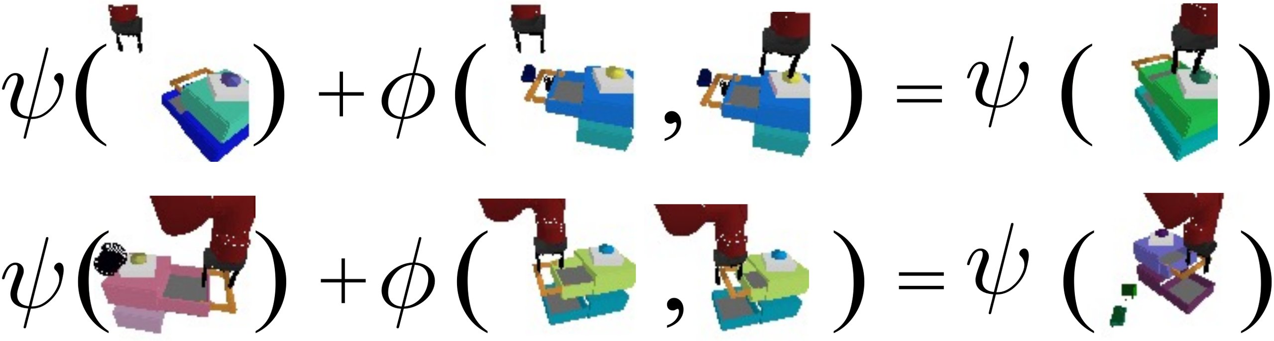
Point at an example; infer your own goal
TAKEAWAY
ANALOGY ARITHMETIC IN LATENT SPACE
ψ(current state) + φ(analogous pair) = ψ(inferred goal) — the rightmost frame is the nearest neighbor in ψ space.
THE CORE IDEA
WHY IT MATTERS
Equivalence over tasks,
Goals become composable
not just over states.
by simple arithmetic.
Treating bisimulation as an equivalence
Point a robot at an example task and it
over tasks gives a representation where
infers the right goal for its own situation —
analogous tasks line up in one space.
a far more flexible task interface.
Skills generalize to new, unseen goals.
Provably sufficient for any state-only reward task.
Bisimulation Makes Analogies in Goal-Conditioned Reinforcement Learning · ICML 2022 · arXiv:2204.13060
10
Notes:
The takeaway: treating bisimulation as an equivalence over tasks, not just states, aligns analogous tasks in one space. Because goals become composable by arithmetic, you can point a robot at an example and have it infer its own goal, provably sufficient for any state-only reward task.

