Slide 1







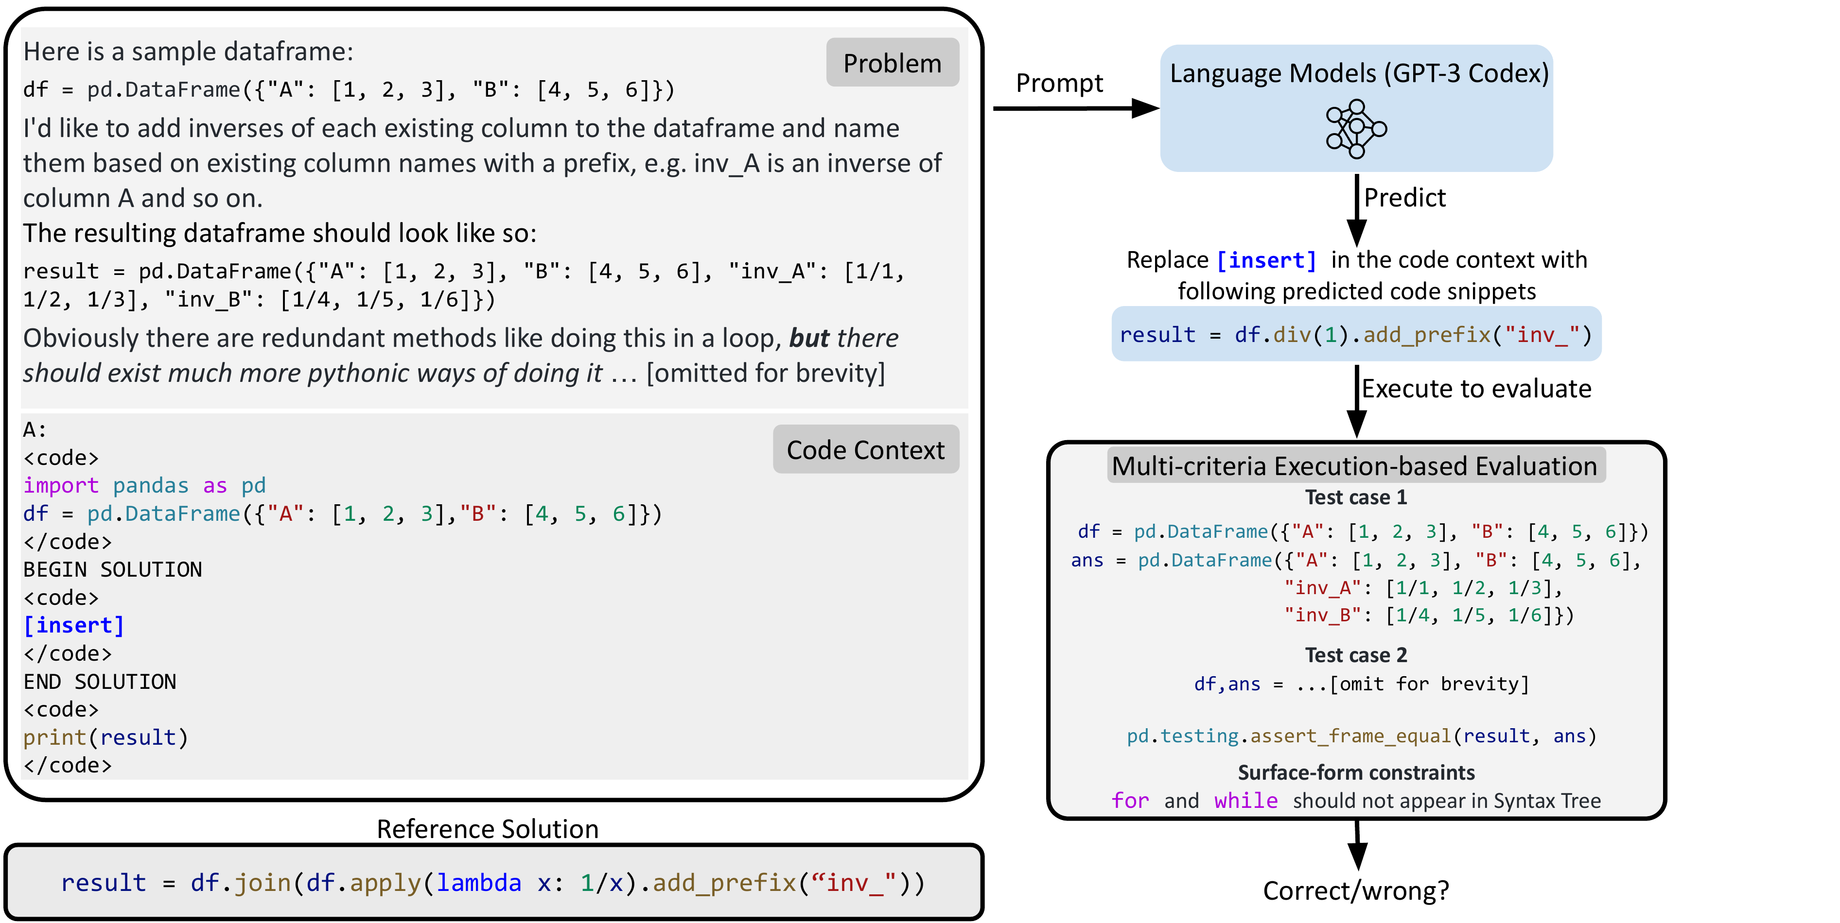
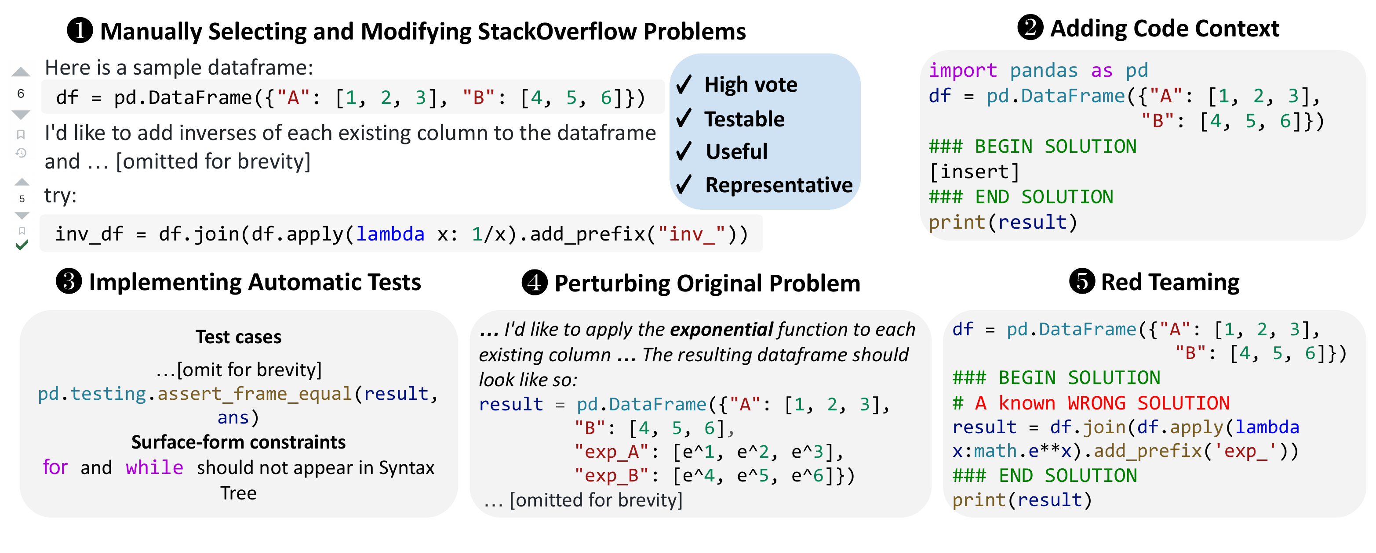


DS-1000: A Natural and Reliable Benchmark for Data Science
Code Generation
Yuhang Lai¹, Chengxi Li¹, Yiming Wang^{1,2}, Tianyi Zhang³, Ruiqi Zhong⁴, Luke Zettlemoyer^{5,6}, Scott Wen-tau Yih⁶, Daniel Fried⁷, Sida Wang⁶, Tao
Yu^{1,5}
¹ The University of Hong Kong ² Peking University ³ Stanford University ⁴ UC Berkeley ⁵ University of Washington ⁶ Meta AI ⁷ Carnegie Mellon University
Problem
Method
Dataset / Benchmark
Headline Numbers
Existing code benchmarks target
competition or interview-style puzzles.
They lack naturalistic data science context,
and often score answers with unreliable
surface metrics like BLEU. No prior
benchmark combined naturally occurring,
diverse-context problems with reliable
execution-based evaluation.
Select & rewrite high-vote, testable, useful,
representative StackOverflow posts, then add code
context with insertion markers.
1000 problems from 451 unique StackOverflow
posts; over half are perturbed against memorization
(152 surface, 235 semantic, 162 difficult rewrites).
43.3%
1000
problems · 7
libraries
Best model (Codex-
002, Insertion)
1.8%
false
discovery rate
Implement automatic tests — execute test cases
and check surface-form (API / keyword) constraints
in the syntax tree.
NumPy
Pandas
TensorFlow
PyTorch
SciPy
far from solved — ample
headroom
140
avg words /
problem
Scikit-learn
Matplotlib
Perturb each problem to defend against
memorization, then red-team the evaluation to
reject known-wrong solutions.
Key Results
Takeaway
Model
Completion
Insertion
DS-1000 is a realistic, reliably evaluated,
memorization-resistant benchmark on
which even the best code model reaches
only 43.3% — exposing a large gap in data
science code generation. Its execution-
based metric and perturbation strategy
keep the benchmark trustworthy and
genuinely hard to game.
Motivation
Every problem, solution, and metric is reviewed by
at least three expert annotators; problems use an
official insertion (infilling) prompt format.
InCoder-6B
7.4
7.5
Real StackOverflow problems carry rich
context — buggy code, errors, I/O
examples — that prior benchmarks omit.
Codex-Cushman
18.1
—
Codex-001
20.2
—
RELIABLE
Codex-002
39.2
43.3
As models improve, surface metrics
diverge from intent; execution-based
evaluation becomes essential.
Accepted solutions must pass executable test
cases and surface-form API/keyword checks — a
multi-criteria bar that rejects plausible-but-wrong
code.
SO WHAT → DS-1000 separates model strength (7.4% → 43.3%); Insertion adds +4.1% for Codex-002.
Natural problems + execution-based,
multi-criteria evaluation +
perturbation = a trustworthy, hard-to-
game standard.
Ablation Study
PERTURBATION
NUMPY-100
DS-1000
Surface
−21.7
−3.4
Semantic
−48.9
−9.0
SO WHAT → On memorization-prone numpy-100, Codex-002 collapses after perturbation while DS-1000 barely moves — in 36% of semantic cases the model still returns the original answer.
Scan to
Read
An example DS-1000 problem: the model fills
[insert]; the code is executed against test
cases and surface-form constraints.
Project
ds1000-code-gen.gith
ub.io
The five-stage pipeline for building DS-1000: select & modify,
add code context, implement tests, perturb, and red-team.
Paper
Code

