Slide 1


ICML 2023 · BENCHMARK
DS-1000
AT A GLANCE
1,000
real problems
A Natural and Reliable Benchmark
across 7 Python libraries
for Data Science Code Generation
NumPy · Pandas · TensorFlow · PyTorch
SciPy · scikit-learn · Matplotlib
Sourced from real StackOverflow questions
Yuhang Lai · Chengxi Li · Yiming Wang · Tianyi Zhang · Ruiqi Zhong · Tao Yu +4 co-authors
HKU · Peking · Stanford · UC Berkeley · U. Washington · Meta AI · CMU
Reliable + hard to game
Execution-based, multi-criteria evaluation
instead of surface metrics like BLEU.
Built-in memorization defense via
deliberate problem perturbation.
Code + data
Paper
github.com/HKUNLP/DS-1000
arxiv.org/abs/2211.11501
DS-1000 · ICML 2023
01 / 10
Notes:
We present DS-1000, a natural and reliable benchmark for data science code generation. DS-1000 gathers a thousand real problems across seven widely used Python libraries such as NumPy and Pandas, all drawn from StackOverflow. It pairs these realistic problems with reliable execution-based evaluation and a built-in defense against memorization, giving the community a trustworthy yardstick for data science coding models.

Slide 2
02 · PROBLEM
Why data science code generation needed a benchmark
1
Specialized, not accessible
2
Models could help — unmeasured
Data science coding is central across many
Code-generation models could lower those
fields, yet it demands fluency in specialized
barriers, but the community lacked a
libraries — a real barrier for everyday users
benchmark to measure real progress on
who just want to get work done.
everyday data science tasks.
3
Wrong problems & wrong metrics
4
The missing benchmark
Most datasets test competitive / interview
No benchmark combined natural, richly
algorithms, not real-world usage — and
contextual problems with a reliable,
score answers with surface-form metrics
execution-based way to judge whether an
like BLEU that drift from intent.
answer is actually correct.
DS-1000 · ICML 2023
02 / 10
Notes:
Data science coding is central to many fields, yet it demands fluency in specialized libraries that create real barriers for everyday users. Code generation models could lower those barriers, but the community lacked a benchmark to measure real progress. Most existing datasets focus on competitive or interview-style problems that test algorithms rather than real-world usage, and many score answers with surface-form metrics like BLEU that drift away from what programmers actually intend. There was no benchmark combining natural, richly contextual problems with a reliable, execution-based way to judge correctness.

Slide 3
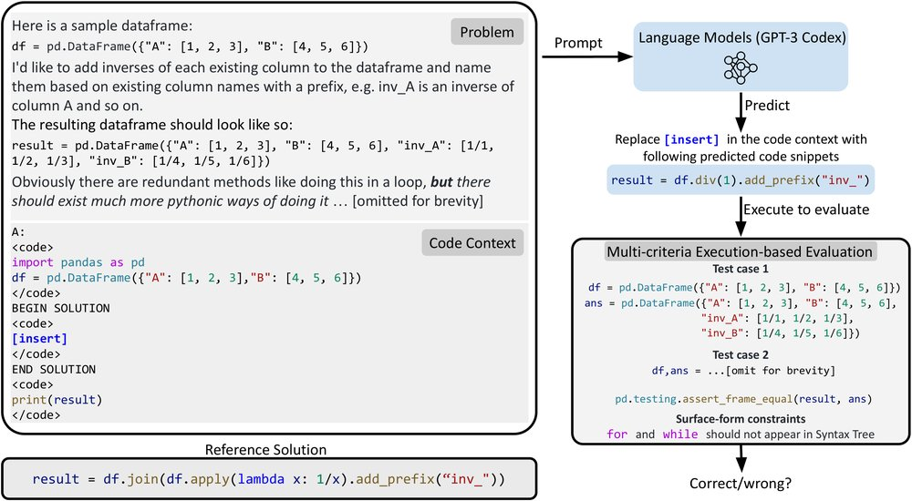
03 · MOTIVATION
Natural problems, judged by running the code
Not textbook prompts
A REAL DS-1000 PROBLEM (Figure 1)
Real data science questions rarely look
like the clean, self-contained prompts
used by earlier benchmarks.
Surface scores mislead
Prior benchmarks strip that richness away,
and as models improve, BLEU-style scores
reward text that looks right but won't run.
The design principle
Build from natural, real-world problems —
and judge every answer by actually
A natural prompt with broken code, an error, and concrete input
executing the code against tests.
/output — the model fills in [insert], then code is executed to pass
multi-criteria tests and surface-form constraints.
DS-1000 · ICML 2023
03 / 10
Notes:
Real data science questions rarely look like clean textbook prompts. On StackOverflow, users describe messy contexts: their broken code, the error they hit, and concrete input-output examples of what they want. Prior benchmarks strip that richness away. At the same time, as models get better, surface-form scores like BLEU become misleading, rewarding text that looks right but does not run. This motivates a benchmark built from natural problems and judged by actually executing the code.

Slide 4
04 · CONTRIBUTION
Three contributions, then a public benchmark
CONTRIBUTION 1
CONTRIBUTION 2
CONTRIBUTION 3
1,000 realistic
Reliable
Memorization
problems
evaluation
defense
Diverse, richly contextual
Multi-criteria checks that run
Problems are perturbed so a
problems adapted from natural
test cases and enforce surface-
model cannot simply recall a
StackOverflow questions across
form constraints — accepted
pre-training answer — it must
seven popular Python libraries.
solutions are nearly always right.
actually solve the task.
Released to the community & benchmarked
5
The authors publicly release DS-1000 and use it to evaluate five state-of-the-art
SOTA models
code-generation models across three model families.
DS-1000 · ICML 2023
04 / 10
Notes:
DS-1000 makes three contributions. First, it provides a thousand realistic problems with diverse contexts, adapted from naturally occurring StackOverflow questions across seven popular Python libraries. Second, it implements reliable multi-criteria evaluation that runs test cases and checks surface-form constraints, so accepted solutions are almost always genuinely correct. Third, it proactively defends against memorization by perturbing problems so models cannot simply recall pre-training answers. The authors release the benchmark and use it to evaluate five state-of-the-art code models.

Slide 5
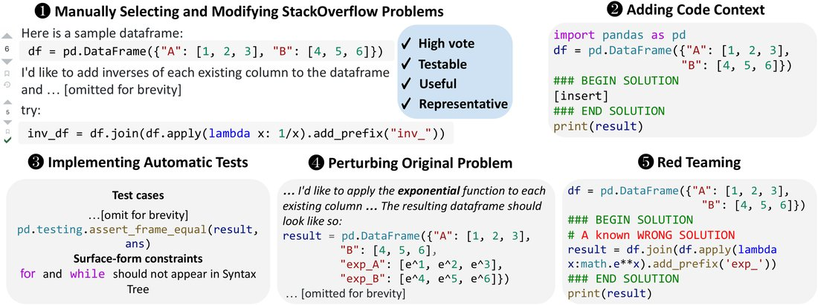
05 · METHOD
A five-stage pipeline, reviewed by experts
THE FIVE-STAGE BUILD PIPELINE (Figure 2)
Automatic tests
Perturbation
Red-team + review
Check functional correctness by
Each problem is perturbed:
Evaluation must reject known-
executing test cases, and enforce
surface edits keep the solution,
wrong solutions. Every problem,
surface-form constraints — e.g.
semantic edits change it, plus
solution and metric is reviewed by
forbidden APIs in the syntax tree.
deliberately difficult rewrites.
at least three expert annotators.
DS-1000 · ICML 2023
05 / 10
Notes:
DS-1000 is built through a five-stage pipeline. Annotators first select high-vote, testable, useful, and representative StackOverflow problems and rewrite them for clarity. They add a code context with insertion markers showing exactly where the model must fill in code. They then implement automatic tests that check functional correctness by executing test cases and also enforce surface-form constraints, such as forbidding certain APIs or keywords in the syntax tree. To defend against memorization, they perturb each original problem, using surface perturbations that leave the reference solution unchanged and semantic perturbations that change it, plus deliberately difficult rewrites. Finally they red-team the evaluation, requiring it to reject known-wrong solutions. Every problem, solution, and metric is reviewed by at least three expert annotators.

Slide 6
06 · DATASET
What is inside DS-1000
1,000
problems from
Over half modified to resist memorization
451 unique SO posts
152
235
162
Spanning 7 widely used Python libraries:
NumPy · Pandas · TensorFlow · PyTorch ·
surface
semantic
difficult
SciPy · scikit-learn · Matplotlib
Perturbation types applied to the original problems.
Per-problem, on average
Far richer context
1.6
140
3.6
140
test cases
words
solution lines
words / problem, on average
About 1 in 5 problems also carry surface-form constraints.
Several times the context of comparable
data science code datasets.
DS-1000 · ICML 2023
06 / 10
Notes:
DS-1000 contains a thousand problems originating from four hundred fifty-one unique StackOverflow posts, spanning seven widely used Python libraries: NumPy, Pandas, TensorFlow, PyTorch, SciPy, Scikit-learn, and Matplotlib. More than half of the problems are modified from their sources to resist memorization, including one hundred fifty-two surface perturbations, two hundred thirty-five semantic perturbations, and one hundred sixty-two difficult rewrites. On average each problem has one point six test cases, one hundred forty words, and a reference solution of three point six lines, and about one in five carry surface-form constraints. With a hundred forty average words per problem, DS-1000 is far richer in context than other data science datasets.

Slide 7
07 · KEY RESULT
Hard, but not solved — the best model hits 43.3%
AVERAGE ACCURACY ON DS-1000 (%)
A wide spread of ability
7.4% → 43.3%
43.3
39.2
across five models from three families — DS-1000
clearly separates weak from strong systems.
Infilling helps
+4.1%
insertion format supplies right-hand
context, beating completion format.
Infilling matters for data science coding.
7.4
Weak models struggle badly
CodeGen-6B and InCoder-6B fall below
Codex-002
Codex-002
Weakest
5% accuracy on some libraries — plenty of
insertion
completion
6B model
headroom remains for future models.
DS-1000 · ICML 2023
07 / 10
Notes:
DS-1000 clearly separates models of different strength. The best public system, Codex-002 in the insertion format, reaches only forty-three point three percent average accuracy, nontrivial but far from solved, leaving substantial room for improvement. Across five models from three families, accuracy ranges from seven point four percent up to forty-three point three percent. Insertion format, which supplies right-hand context, gives Codex-002 a four point one percent boost over completion format, underscoring the value of infilling for data science coding. Weaker models such as CodeGen-6B and InCoder-6B fall below five percent on some libraries.

Slide 8
08 · ABLATION
Perturbation exposes memorization
A memorization stress-test
DS-1000 barely moves
To show why memorization matters, the authors
3–9%
probe numpy-100 — a very popular, widely
shared problem set likely seen in pre-training.
drop after the same perturbation
Its problems appear far less often online, so a
CODEX-002 ON NUMPY-100
model cannot lean on a memorized solution.
72.5
Accuracy collapses
once problems are perturbed.
40.6
A practical, future-proof defense
36%
Because the gentle drop tracks how rarely problems appear online,
perturbation stays effective as models scale — a practical defense
of semantic cases still return the
against memorization by future models.
original, now-incorrect answer —
recall, not reasoning.
Trustworthy scores, even for models yet to come.
original
perturbed
DS-1000 · ICML 2023
08 / 10
Notes:
To show why memorization matters, the authors probe the popular numpy-100 problem set. Codex-002 scores seventy-two point five percent there, but accuracy collapses to forty point six percent after perturbation, and in thirty-six percent of semantic cases the model still returns the original, now-incorrect answer, evidence that it is recalling memorized solutions rather than reasoning. On DS-1000 the perturbation drop is much gentler, about three to nine percent, because these problems appear less often online. This confirms perturbation as a practical defense against memorization by future models.

Slide 9
09 · HEADLINE NUMBERS
DS-1000 in four numbers
SCALE
HEADROOM
1,000
43.3%
problems
best model accuracy
over 7 libraries · from 451 unique SO posts
nontrivial, but far from solved
RELIABILITY
CONTEXT
1.8%
0.5%
140
accepted yet wrong
rejected yet correct
words per problem, on average
Accepted solutions are almost always genuinely correct.
far richer context than comparable datasets
DS-1000 · ICML 2023
09 / 10
Notes:
A few numbers capture DS-1000. It offers a thousand problems over seven libraries, drawn from four hundred fifty-one unique StackOverflow posts. The best model reaches only forty-three point three percent accuracy. The evaluation is highly reliable: among all solutions it accepts, just one point eight percent are actually incorrect, and only about half a percent of rejected ones are truly correct. And with a hundred forty words per problem on average, its contexts are far richer than comparable datasets.

Slide 10
10 · TAKEAWAY
A data science code benchmark you can trust
WHAT IT IS
WHY IT HOLDS UP
WHAT IS NEXT
43.3%
Realistic ·
Trustworthy &
Reliable · Robust
hard to game
is the best so far
A benchmark that is realistic in its
Natural StackOverflow problems,
Even the strongest model reaches
problems, reliable in its evaluation,
judged by executing code against
only 43.3% — a clear signal of how
and resistant to memorization —
tests and surface-form constraints,
much room remains for progress in
all at the same time.
defended by deliberate perturbation.
data science code generation.
DS-1000 · A Natural and Reliable Benchmark for Data Science Code Generation
Paper: arxiv.org/abs/2211.11501 · Code & data: github.com/HKUNLP/DS-1000 · ICML 2023
10 / 10
Notes:
DS-1000 gives the community a data science code benchmark that is realistic, reliably evaluated, and resistant to memorization. Because it is built from natural StackOverflow problems, judged by executing code against test cases and surface-form constraints, and defended by deliberate perturbation, its scores are trustworthy and hard to game. And because even the strongest model reaches only forty-three point three percent, it makes clear how much room remains for progress in data science code generation.

