Slide 1






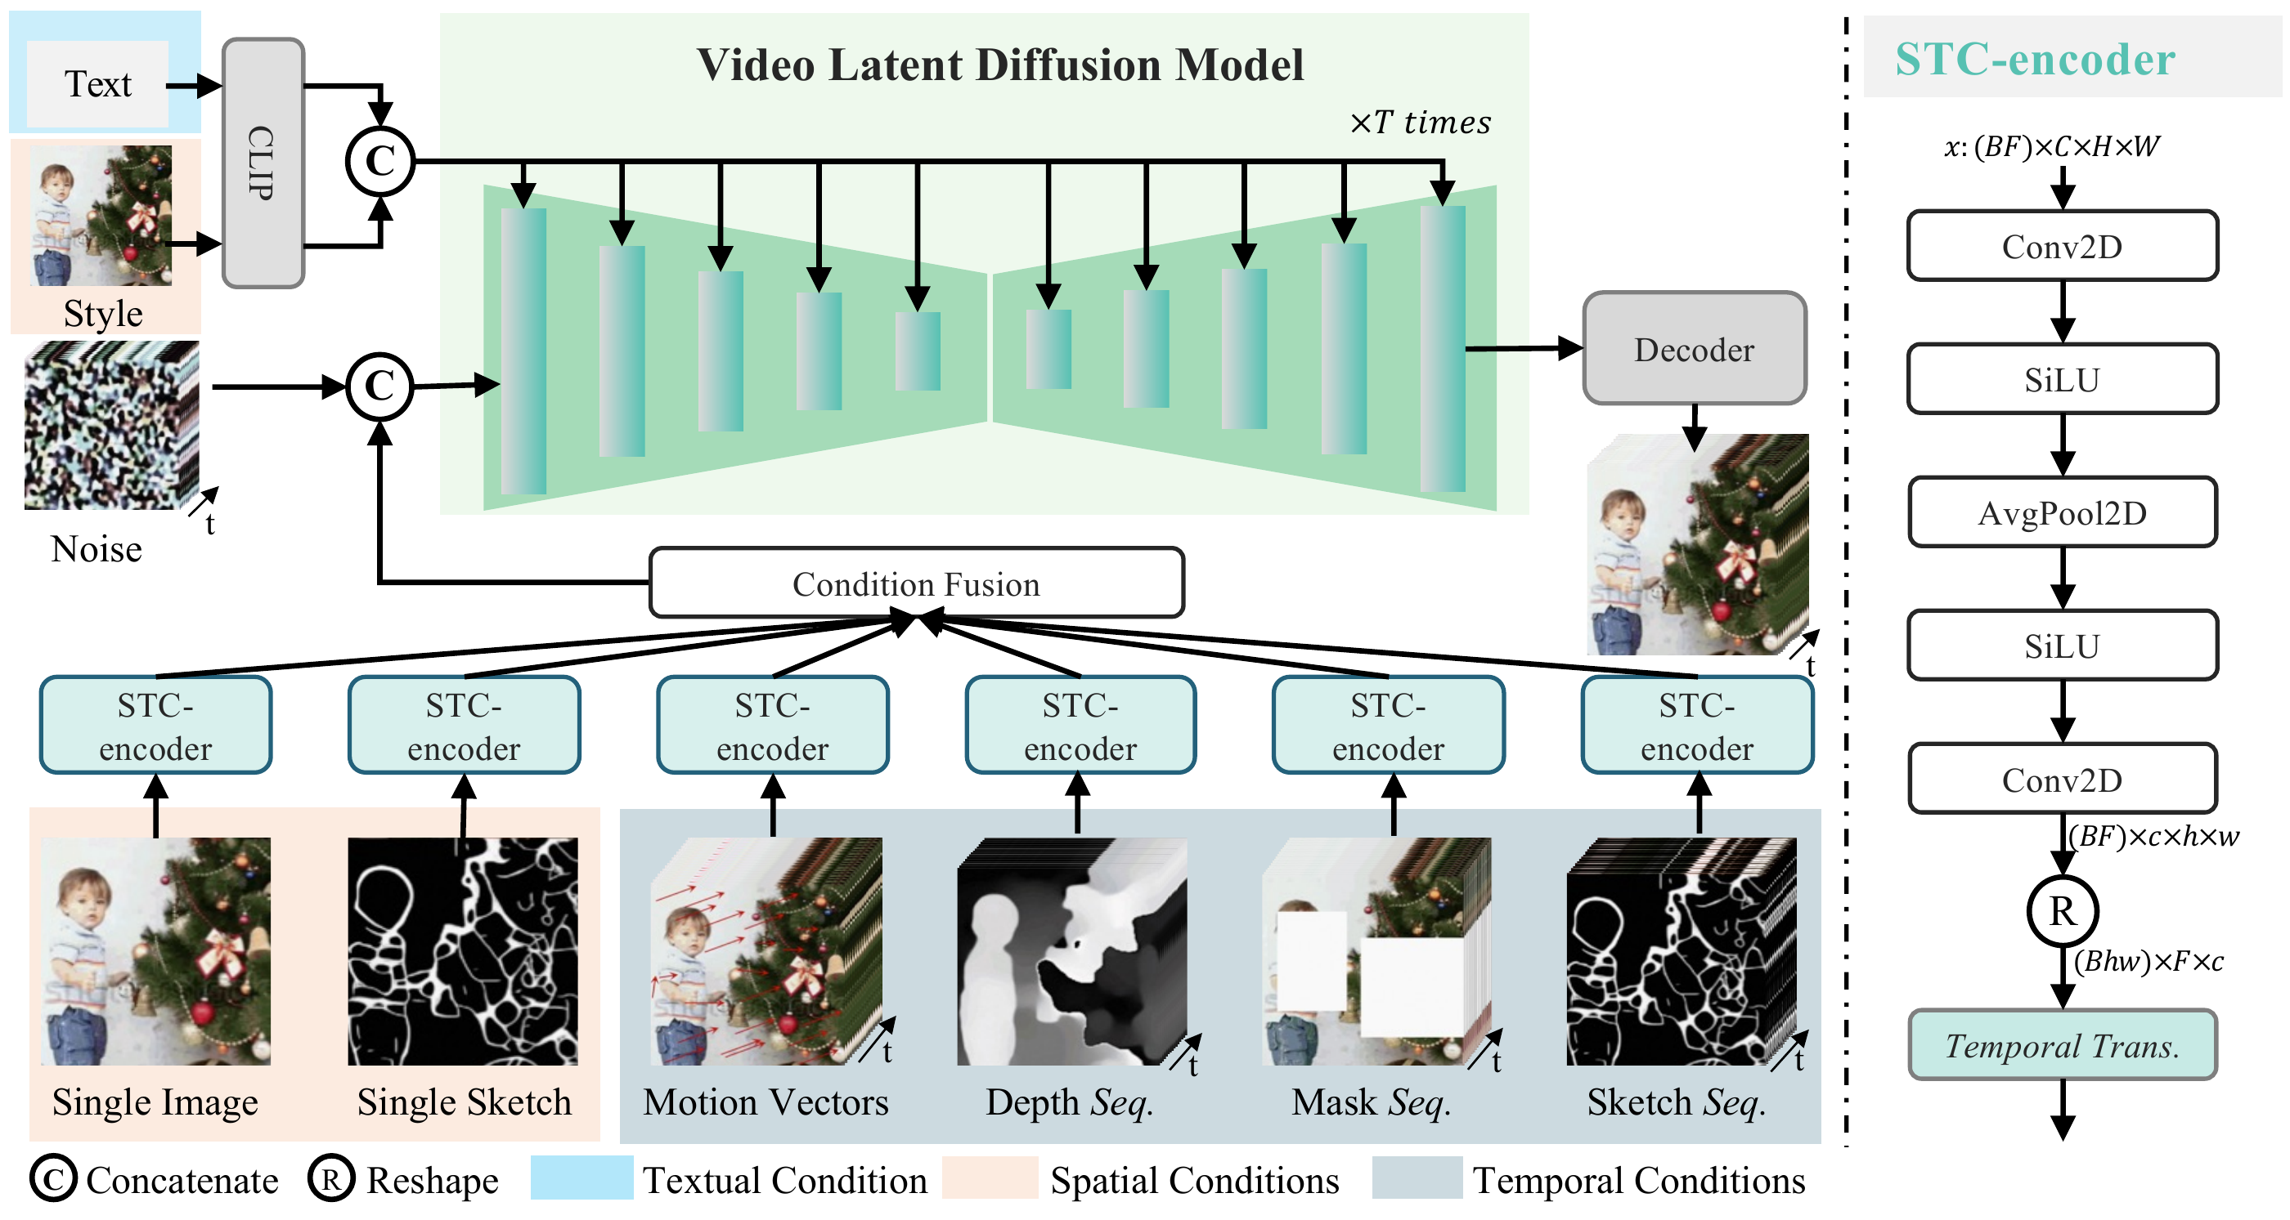
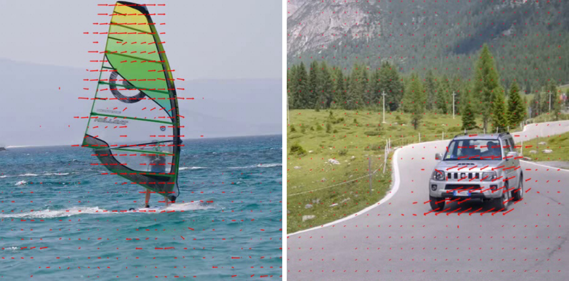


VideoComposer: Compositional Video Synthesis with Motion Controllability
Xiang Wang^{1*}, Hangjie Yuan^{1*}, Shiwei Zhang^{1*}, Dayou Chen^{1*}, Jiuniu Wang¹, Yingya Zhang¹, Yujun Shen², Deli Zhao¹, Jingren Zhou¹
¹ Alibaba Group ² Ant Group
Problem
Method
Dataset / Benchmark
Headline Numbers
Controllable video synthesis is far harder
than for images: temporal dynamics vary
widely across clips, and every generated
frame must stay temporally consistent.
Trained on WebVid10M (10.3M video–caption
pairs) and the LAION-400M image corpus.
580
0.2932
CLIPSIM
Decompose each video into textual, spatial and
temporal conditions that can be freely composed.
2.18
motion-ctrl
error
Text-to-video quality measured on MSR-VTT;
motion control on 1000 clips.
FVD · MSR-VTT
(zero-shot)
8+
Sequential conditions pass through the STC-encoder
(2× 2D conv → avg-pool → temporal Transformer), fused
by element-wise addition.
condition types
Spatial controls designed for images
give no reliable handle on how
content moves and evolves over time.
WebVid10M
LAION-400M
MSR-VTT
vs 803 stage-1 pre-training
10.3M
train pairs
Fused controls are concatenated with the noisy latent;
text & style enter via cross-attention. Two-stage training;
DDIM + classifier-free guidance at inference.
Key Results
Takeaway
Motivation
Method (zero-shot)
FVD ↓
CLIPSIM ↑
By treating a video as a composition of
textual, spatial and temporal conditions
— and pairing compressed-video motion
vectors with a unified STC-encoder —
VideoComposer delivers flexible,
controllable video synthesis with strong
inter-frame consistency and no loss in
text-to-video quality.
Motion vectors are extracted in standard compressed
formats to encode inter-frame variation as a cheap,
explicit temporal signal.
Stage-1 T2V pre-train
803
—
Use motion vectors from compressed
video as an explicit temporal condition
— direct guidance on dynamics.
VideoComposer
580
0.2932
−223 FVD from compositional training
Naively fusing heterogeneous
conditions breaks consistency,
motivating one unified space-time
encoder.
SO WHAT → Multi-condition control costs nothing in T2V quality — it even beats stage-1 pre-training.
denoise latent under composed conditions ; predicts the added noise
Ablation Study
MOTION
To control a video, control its motion
— not just its appearance.
One model driven by text, sketches,
depth, masks, reference video, or two
strokes — motion becomes an
explicit, editable dimension.
Adding motion vectors cuts motion-control error
from 4.03 to 2.67 (lower is better).
The STC-encoder lowers it further to 2.18 — both
ingredients matter.
4.03
2.67
2.18
Scan to Read
text only
+ motion vectors
+ STC-encoder
Overall architecture: a video is decomposed into textual, spatial
and temporal conditions, embedded by the unified STC-encoder or
CLIP, then jointly guide the VLDM denoiser.
SO WHAT → Motion vectors supply the temporal signal; the STC-encoder makes the model use it — sharpening motion control and inter-frame consistency.
Motion vectors extracted from compressed
video encode inter-frame variation, giving an
explicit, cheap temporal-dynamics signal.
Paper
Code

