Slide 1
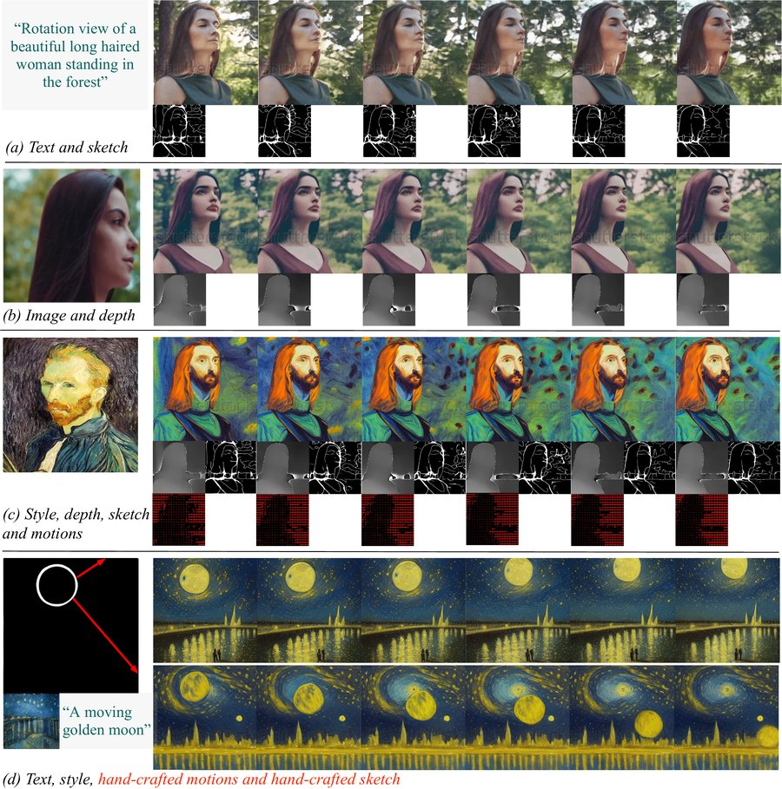



NeurIPS 2023
COMPOSITIONAL VIDEO SYNTHESIS
VideoComposer
Controllable video synthesis with motion controllability
Wang, Yuan, Zhang, Chen, Wang, Zhang, Shen, Zhao, Zhou
Alibaba Group · Ant Group
COMPOSE FROM THREE CONDITION FAMILIES
Textual
Spatial
Temporal
caption · style
sketch · depth · image
motion vectors · mask
Text, sketch, depth, motion & strokes → coherent video
TWO KEY IDEAS
Code
Motion vectors from compressed video = explicit temporal signal
GitHub
STC-encoder fuses diverse controls, keeps frames consistent
VideoComposer · Alibaba & Ant Group
01 / 10

Slide 2
02 · THE PROBLEM
VideoComposer
Controlling video is far harder than images
Customizable image generation is mature — steering how a video moves over time is the open frontier.
1
Images: solved
2
Video adds time
3
Controls don't
transfer
Diffusion models made
A new temporal axis:
image generation
motion patterns vary
Reusing spatial controls
highly controllable.
enormously across clips.
built for images gives
no reliable handle on
Text, layout, subject and
And every generated frame
temporal dynamics.
style are all steerable in
must stay consistent with
a single generated frame.
its neighbouring frames.
→ controllable video stayed
an open challenge.
VideoComposer · NeurIPS 2023
02 / 10

Slide 3
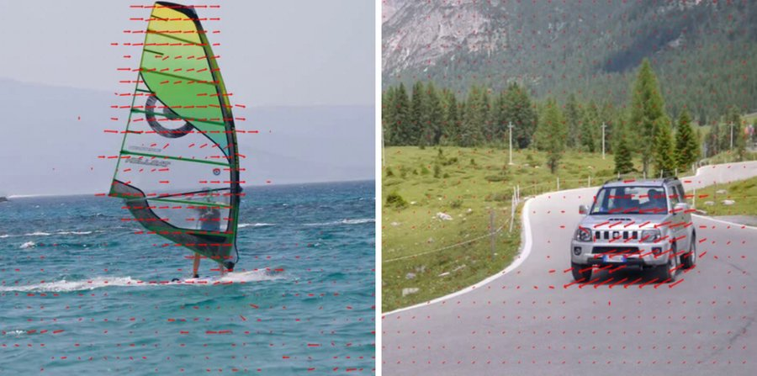
03 · MOTIVATION
VideoComposer
Give motion its own explicit signal
Control the motion, not just the appearance
EXAMPLES OF MOTION VECTORS
A video is defined by how things move across frames.
THE INSIGHT
THE HANDLE
Motion vectors
A control signal
already live inside
Feed motion vectors in as
compressed video to encode
conditioning, and users can
inter-frame change — cheap,
prescribe how things move
explicit temporal dynamics.
— directly and predictably.
But mixing motion vectors with sketches, depth and images
naively hurts frame-to-frame consistency.
Per-pixel arrows encode how content
→ motivates one unified encoder for space and time.
moves between adjacent frames.
VideoComposer · NeurIPS 2023
03 / 10

Slide 4
04 · CONTRIBUTION
VideoComposer
What VideoComposer contributes
Three contributions
One model handles text · image · sketch · depth · mask · motion vectors · style, composed arbitrarily.
01
02
03
Compositional
Motion vectors as
STC-encoder
framework
temporal control
Spatio-Temporal Condition
A user supplies any subset
Motion vectors from
A lightweight module that
of textual, spatial and
compressed video become
turns every sequential
temporal conditions — the
an explicit temporal
condition into a shared
model recomposes a video
control signal
representation
obeying all of them.
for guiding dynamics.
— boosting consistency.
VideoComposer · NeurIPS 2023
04 / 10

Slide 5
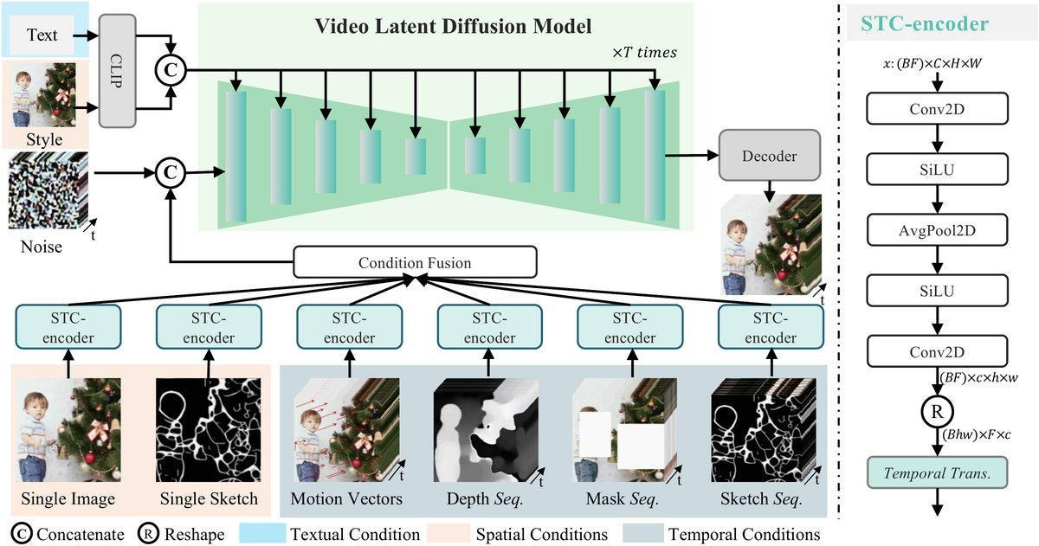
05 · METHOD
VideoComposer
Inside VideoComposer
OVERALL ARCHITECTURE
Latent diffusion backbone
Denoises video in a compressed latent space;
each video splits into three condition families.
The shared STC-encoder
Motion vectors, depth, masks & sketches all enter
one module:
2 convolutions + pooling → local spatial structure
temporal Transformer → change across frames
Fusion
Sum & concat with the noisy latent; text + style via cross-attention.
Decompose → STC-encode → fuse with noisy latent → denoise
Training & inference
L
VLDM
= 𝔼 [ ‖ ε − ε
θ
( z
, c, t ) ‖²₂ ]
latent denoising loss
Two-stage training; DDIM sampling + classifier-free guidance.
t
VideoComposer · NeurIPS 2023
05 / 10

Slide 6
06 · DATA & BENCHMARK
VideoComposer
Trained public, evaluated standard
TRAINING · TWO PUBLIC DATASETS
EVALUATION
WebVid-10M
MSR-VTT
≈ 10.3M video–caption pairs
Text-to-video generation quality,
scraped from the web — the
measured with FVD and
source of temporal dynamics.
CLIP similarity (CLIPSIM).
LAION-400M
Motion controllability
CLIP-filtered image–caption pairs
1,000 caption–video pairs, scored
added for visual quality and
with a dedicated
per-frame appearance.
motion-control error.
VideoComposer · NeurIPS 2023
06 / 10

Slide 7
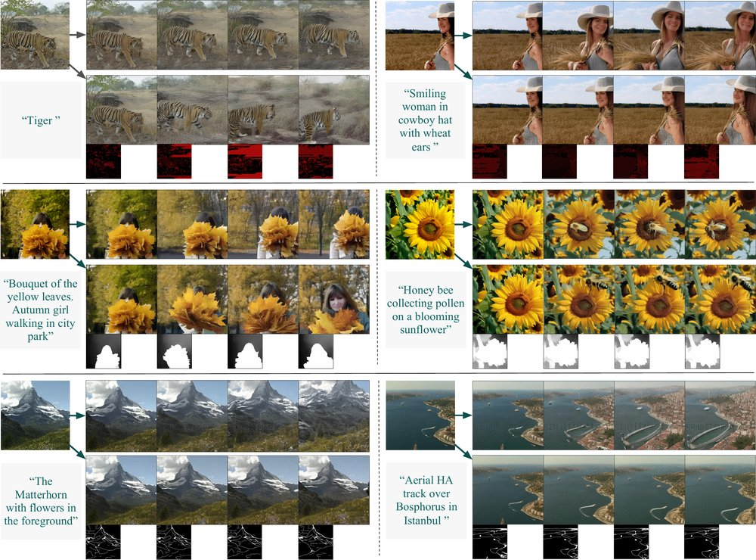
07 · KEY RESULT
VideoComposer
Control at no cost to quality
MSR-VTT · ZERO-SHOT
Videos faithfully follow the conditions
580
0.2932
FVD · lower is better
CLIPSIM · higher is better
Better than its own text-to-video pre-training
Compositional training does not hurt raw quality (FVD, lower = better)
Stage-1 T2V pre-training
competitive with SOTA T2V
803
Full VideoComposer
580
Compositional image-to-video: outputs track the supplied controls.
VideoComposer · NeurIPS 2023
07 / 10

Slide 8
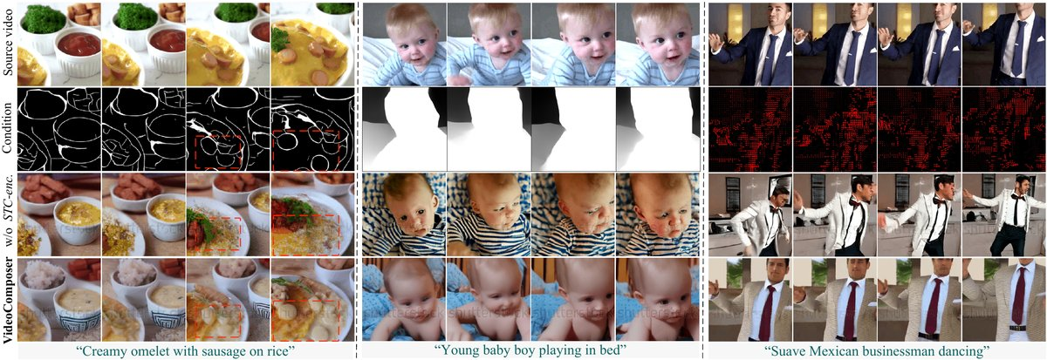
08 · ABLATION STUDY
VideoComposer
Where does the control come from?
Isolating the source of temporal control
Metric: motion-control error on 1,000 caption–video pairs — lower is better.
① Text only
QUALITATIVE ABLATION
baseline
4.03
② + Motion vectors
2.67
−1.36
③ + STC-encoder
2.18
best
Without the STC-encoder, temporal structure and consistency degrade.
Both matter: motion vectors supply the temporal signal,
and the STC-encoder makes the model actually use it.
VideoComposer · NeurIPS 2023
08 / 10

Slide 9
09 · HEADLINE NUMBERS
VideoComposer
The impact, in numbers
A few numbers capture the impact of compositional, motion-aware video generation.
MSR-VTT · QUALITY
MOTION-CONTROL ERROR
TRAINING DATA
580
2
2.18
FVD (zero-shot)
public datasets
full VideoComposer
0.2932
WebVid-10M
from 4.03
10.3M video–caption pairs
CLIP similarity
text-only baseline · 46% lower
+ LAION-400M
VideoComposer · NeurIPS 2023
09 / 10

Slide 10
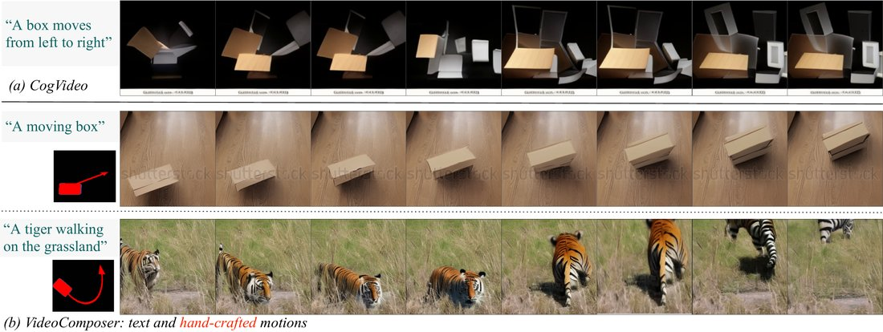
10 · TAKEAWAY
VideoComposer
Motion becomes a control dimension
THE LASTING TAKEAWAY
Treat a video as a composition of conditions —
and give motion its own explicit signal.
Compressed-video motion vectors + one
HAND-CRAFTED MOTION
STC-encoder → steer content and motion together.
DRIVE THE SAME MODEL WITH
Text
Sketches
Depth
Masks
Reference video
Two strokes
…all while keeping frames consistent and text-to-video
quality intact.
Two simple strokes drive coherent, controllable motion.
VideoComposer · Alibaba & Ant Group · NeurIPS 2023
10 / 10

