Slide 1


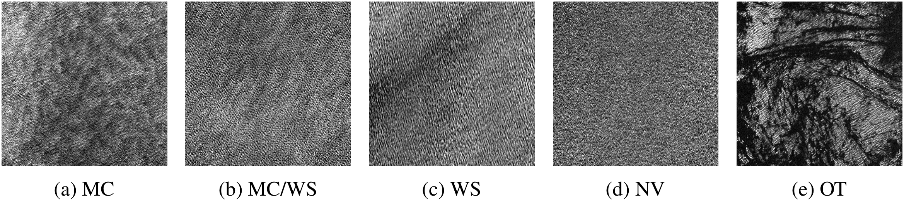
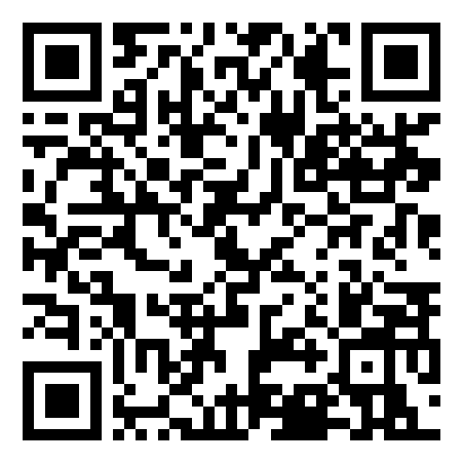
Self-supervised detection of atmospheric
phenomena from Sentinel-1 SAR imagery
Yannik Glaser¹, Peter Sadowski¹, Justin E. Stopa²
¹ Information & Computer Sciences, Univ. of Hawaiʻi at Mānoa ² Ocean Engineering, Univ. of Hawaiʻi at Mānoa
Problem
Method
Ablation Study
Machine learning on Sentinel-1 SAR
ocean imagery is bottlenecked by sparse
expert labels: only trained analysts can
annotate radar vignettes, capping labeled
datasets at a few thousand images.
Backbone: a standard ResNet-50 pretrained with SwAV — a clustering-based contrastive framework that trains
the network to predict the swapped cluster assignment of one augmented view from another.
PROTOCOL
IMAGENET
SWAV
Weighted kNN frozen
0.859
0.864
Modest batches, big compute: a feature queue (16 batches, 1000 centroids) avoids SimCLR-style giant
batches; trained at batch 1024 on 8× V100, 65 epochs (~10 days), then fine-tuned on a single V100.
Full fine-tune
0.931
0.929
Prior classifiers trained on a biased,
single-label dataset that misrepresents
the true ocean population.
Headline Numbers
0.93
2.9M
unlabeled
SAR images
Best micro-AUROC ·
fine-tuned
2,300
labeled
vignettes
Motivation
honest tie: SSL ≈ ImageNet
+0.10
WS AUROC
vs CmWV
Contrastive self-supervised learning
turns vast unlabeled pools into reusable
embeddings — proven on natural and
medical images, yet barely tested on
remote-sensing SAR.
Example 20×20 km SAR scenes along the atmospheric-stability continuum: (a) MC, (b) MC/WS, (c) WS, (d) NV, and (e) a
biological slick (OT). Downstream, the embedding is scored under all three evaluation protocols below.
1
›
2
›
3
Takeaway
Weighted kNN
Linear probe
Fine-tune
SSL pretraining on massive unlabeled
SAR matches but does not beat plain
ImageNet transfer here — yet both jump
far past the prior state of the art.
frozen backbone
frozen + softmax
all weights
Can it turn that unlabeled stream into a
strong, reusable SAR representation
and overcome the labeling bottleneck?
Dataset / Benchmark
Key Results
SSL's promise for SAR is real but
unproven — longer training and
remote-sensing-specific pretext
tasks are the clear next step.
Pretraining pool: 2,943,550 unlabeled Sentinel-1
A/B Wave-mode images (2017–2019), each 20×20
km at 5 m resolution.
CLASS · AUROC
CMWV
IMAGENET
SWAV
The honest test: pretrain once on ~3M
images, then benchmark against
ImageNet transfer and the prior CmWV
classifier under three protocols.
Wind streaks (WS)
0.727
0.850
0.831
Convection (MC)
0.793
0.873
0.872
Labeled benchmark: 2,300 expert-consensus,
multi-label vignettes, split 60/20/20 across train,
validation, and test.
Negligible var. (NV)
~0.95
~0.95
~0.95
UNTAPPED
Best fine-tuned micro-AUROC = 0.93 · +0.10–
0.12 over CmWV
Sentinel-1 alone collects ~120,000
Wave-mode ocean images every
month — an enormous free resource
contrastive learning could exploit.
Freely available from ESA's Open Access Hub, at
no cost and with no licensing restrictions; tiles zero-
padded to 450×450 px.
SO WHAT → Both models beat the prior CmWV state of the art on the hardest classes.
MC
WS
NV
OT
Scan to read the full paper
ml4physicalsciences.github.io

