Slide 1

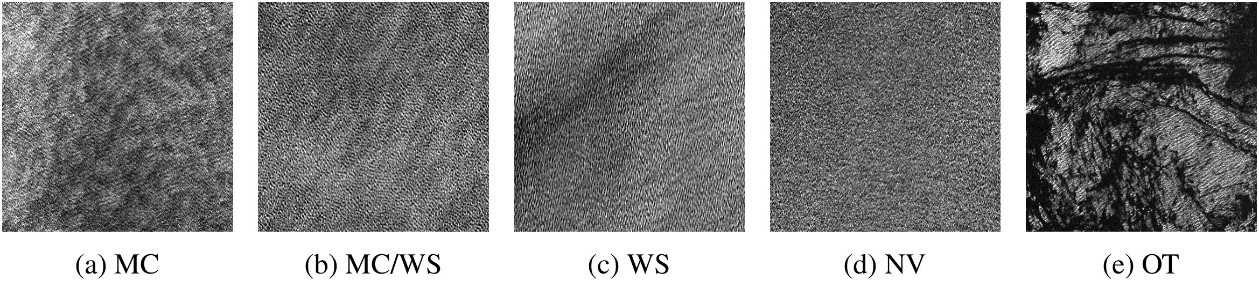
NEURIPS 2022 · ML4PS WORKSHOP
Self-supervised detection of
atmospheric phenomena from SAR
Yannik Glaser · Peter Sadowski · Justin E. Stopa — University of Hawaiʻi at Mānoa
Radar reads the sea surface — day or night, through any cloud
The labeling bottleneck
This work asks
Teaching machines to read radar is hard —
Can self-supervised learning on 3 million
only trained experts can label it, so
unlabeled Sentinel-1 images overcome that
expert labels stay scarce.
bottleneck? An honest, preliminary study.

Slide 2
02 · PROBLEM
A firehose of images, almost no labels
Sentinel-1 at global scale
Vision is ready, labels are not
ESA's Sentinel-1 radar satellites image the
Computer vision can process these images,
global ocean at unprecedented scale —
but machine learning is held back by a lack
waves, turbulence, fronts, and biological
of labeled data — only trained experts can
slicks all leave signatures.
annotate radar vignettes.
A biased legacy dataset
Not the real ocean
Earlier work relied on a biased set that
The result was a training set that did not
picked only exemplary images and forced a
reflect the real distribution of ocean
single label per image — even though
conditions the models must face.
phenomena usually coexist.

Slide 3
03 · MOTIVATION
Contrastive learning, meet remote sensing
A proven idea
Rare in remote sensing
Contrastive self-supervised learning has
It works for natural and medical images,
transformed computer vision: train on huge
but has rarely been applied to remote
pools of unlabeled data to learn embeddings
sensing — exactly where unlabeled data is
that transfer to downstream tasks.
most abundant.
WHY IT MATTERS HERE
The hypothesis
120,000
Can contrastive learning on that unlabeled
stream overcome the scarcity of expert
Wave-mode ocean images every month
labels for SAR analysis? That is the
question this study tests.
from Sentinel-1 alone

Slide 4
04 · CONTRIBUTION
Three contributions
This paper makes three contributions — a dataset, a representation, and a fair comparison.
01
02
03
New labeled benchmark
SwAV embedding
Rigorous comparison
~2,300 randomly sampled,
~3 million unlabeled
Benchmarked against
multi-label radar
Sentinel-1 images over
ImageNet transfer and the
observations that better
three years train a SwAV
prior CmWV classifier —
represent the real ocean
contrastive embedding of
across three downstream
population.
SAR scenes.
evaluation protocols.

Slide 5
05 · METHOD
SwAV: cluster, then predict
Swap clusters between views
No giant batches
SwAV assigns image representations to
Unlike SimCLR, SwAV avoids prohibitively
clusters, then trains the network to predict
large batches by storing recent cluster
the cluster assignment of one augmented
assignments in a queue — keeping training
view from another.
tractable.
Training setup
Three eval protocols
Backbone: standard ResNet-50
Measuring representation quality three ways:
Batch 1,024 · 8× V100 GPUs
Weighted k-nearest-neighbor
Queue 16 batches · 1,000 centroids
Linear eval (frozen + softmax)
65 epochs · ~10 days compute
Full end-to-end fine-tuning

Slide 6
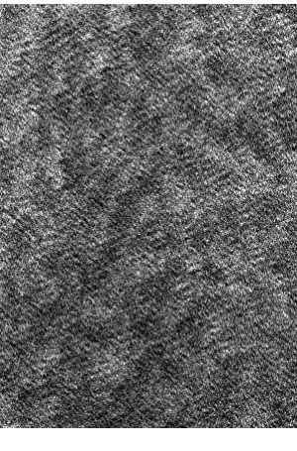
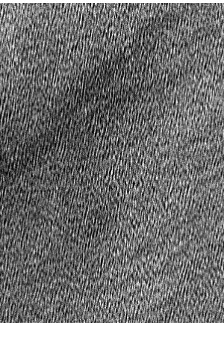
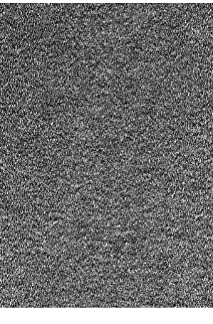
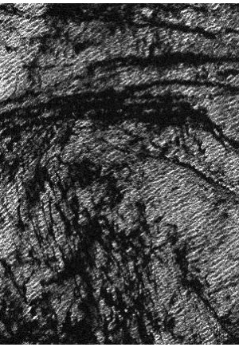
06 · DATASET / BENCHMARK
Two datasets: a firehose and a benchmark
Two datasets drive the study — one huge unlabeled pool, one small labeled set.
UNLABELED PRETRAINING POOL
Labeled benchmark
≈ 3 million
2,300 expert vignettes · 4 consensus multi-label classes
unlabeled Wave-mode ocean images
Sentinel-1 A & B · 2017–2019 · 20 × 20 km · 5 m
90% training · 10% validation
Stratified split 60 / 20 / 20
MC
WS
NV
OT
training · validation · held-out test
MC · WS · NV · Other (multiple labels can co-occur)

Slide 7
07 · KEY RESULT
Big jumps on the hardest classes
BEST MICRO-AVG AUROC
Detection on the two hardest classes — AUROC
0.93
CmWV (prior)
New models
fine-tuned models
~0.85
~0.87
Both beat CmWV
0.79
Contrastive and ImageNet models
0.73
comfortably beat the old CmWV
on the two hardest classes.
Easy class: a tie
On negligible variability, all
three models land near
0.5
0.95.
Wind streaks
Convection cells

Slide 8
08 · ABLATION STUDY
The gap closes when you fine-tune
The most informative comparison is across the three evaluation protocols.
Backbone FROZEN
All weights FINE-TUNED
Self-supervised holds a small edge
The edge vanishes — even reverses
PROTOCOL
SSL
IMAGENET
PROTOCOL
SSL
IMAGENET
k-NN
0.864
0.859
Fine-tune all
0.929
0.931
Linear eval
0.841
0.836
Gap ≈ 0 — ImageNet now edges ahead
The benefit of self-supervised pretraining vanishes once the whole network can adapt.

Slide 9
09 · HEADLINE NUMBERS
The study in four numbers
SELF-SUPERVISED TRAINING
LABELED BENCHMARK
≈ 3M
2,300
unlabeled radar images
expert vignettes across 4 classes
BEST FINE-TUNED MODEL
HARDEST CLASSES
0.93
into the mid-.80s
wind streaks & convection cells,
micro-averaged AUROC
up from CmWV 0.73 / 0.79

Slide 10
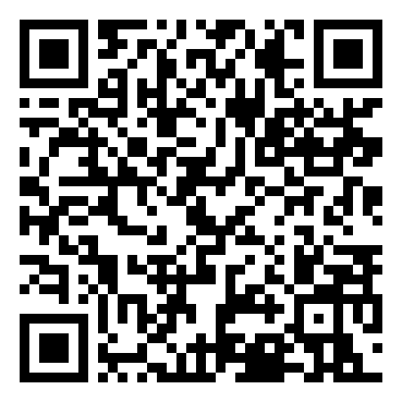
10 · TAKEAWAY
Honest verdict, real progress
✗ Only marginal gains
✓ A real leap over prior work
In this preliminary study, self-supervised
Yet both approaches deliver a dramatic
contrastive learning gives only marginal
improvement over the previous state-of-
gains over simply transferring features
the-art CmWV classifier for reading
from a model trained on natural images —
atmospheric phenomena from ocean radar.
while costing far more compute.
The idea still holds promise — longer training,
READ THE
better tuning, and remote-sensing-specific
PAPER
pretext tasks deserve exploration first.
NeurIPS 2022
Glaser · Sadowski · Stopa — University of Hawaiʻi at Mānoa

