Slide 1




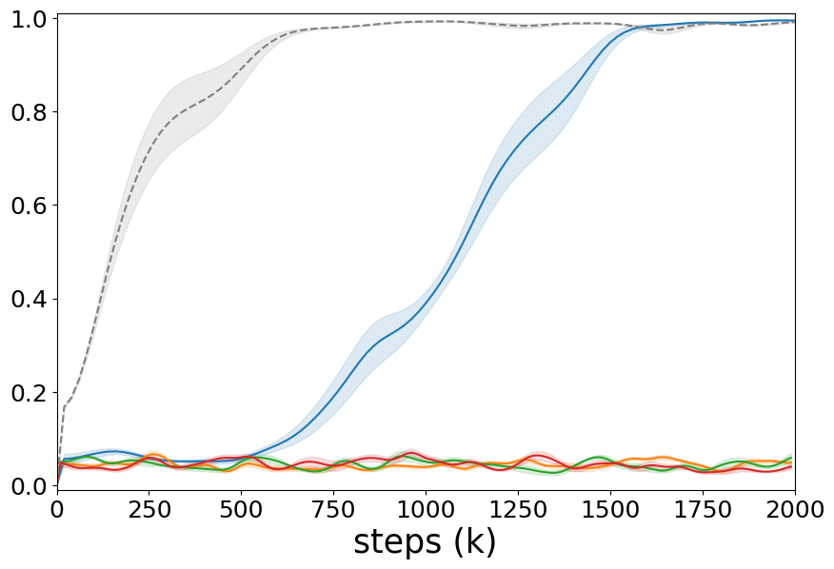
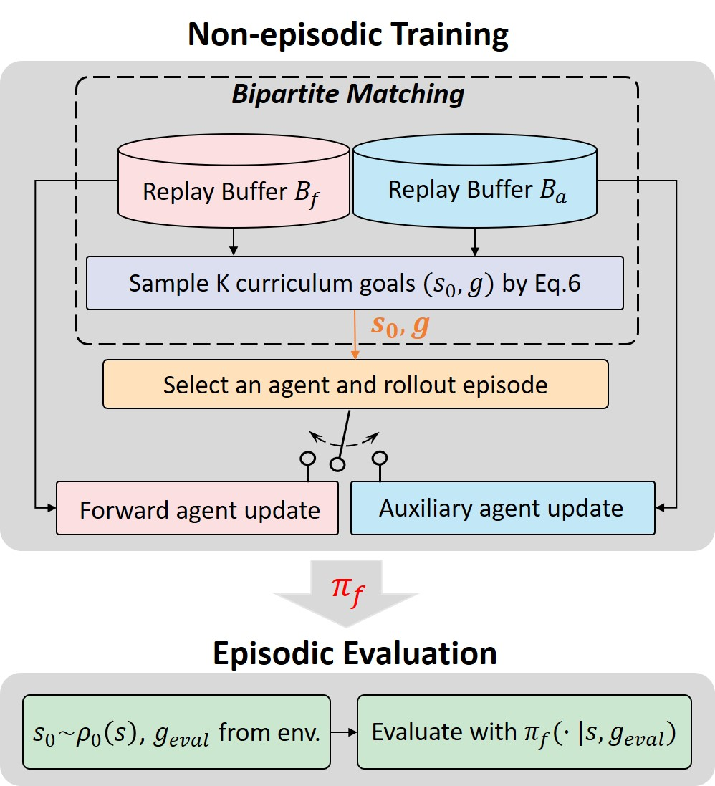
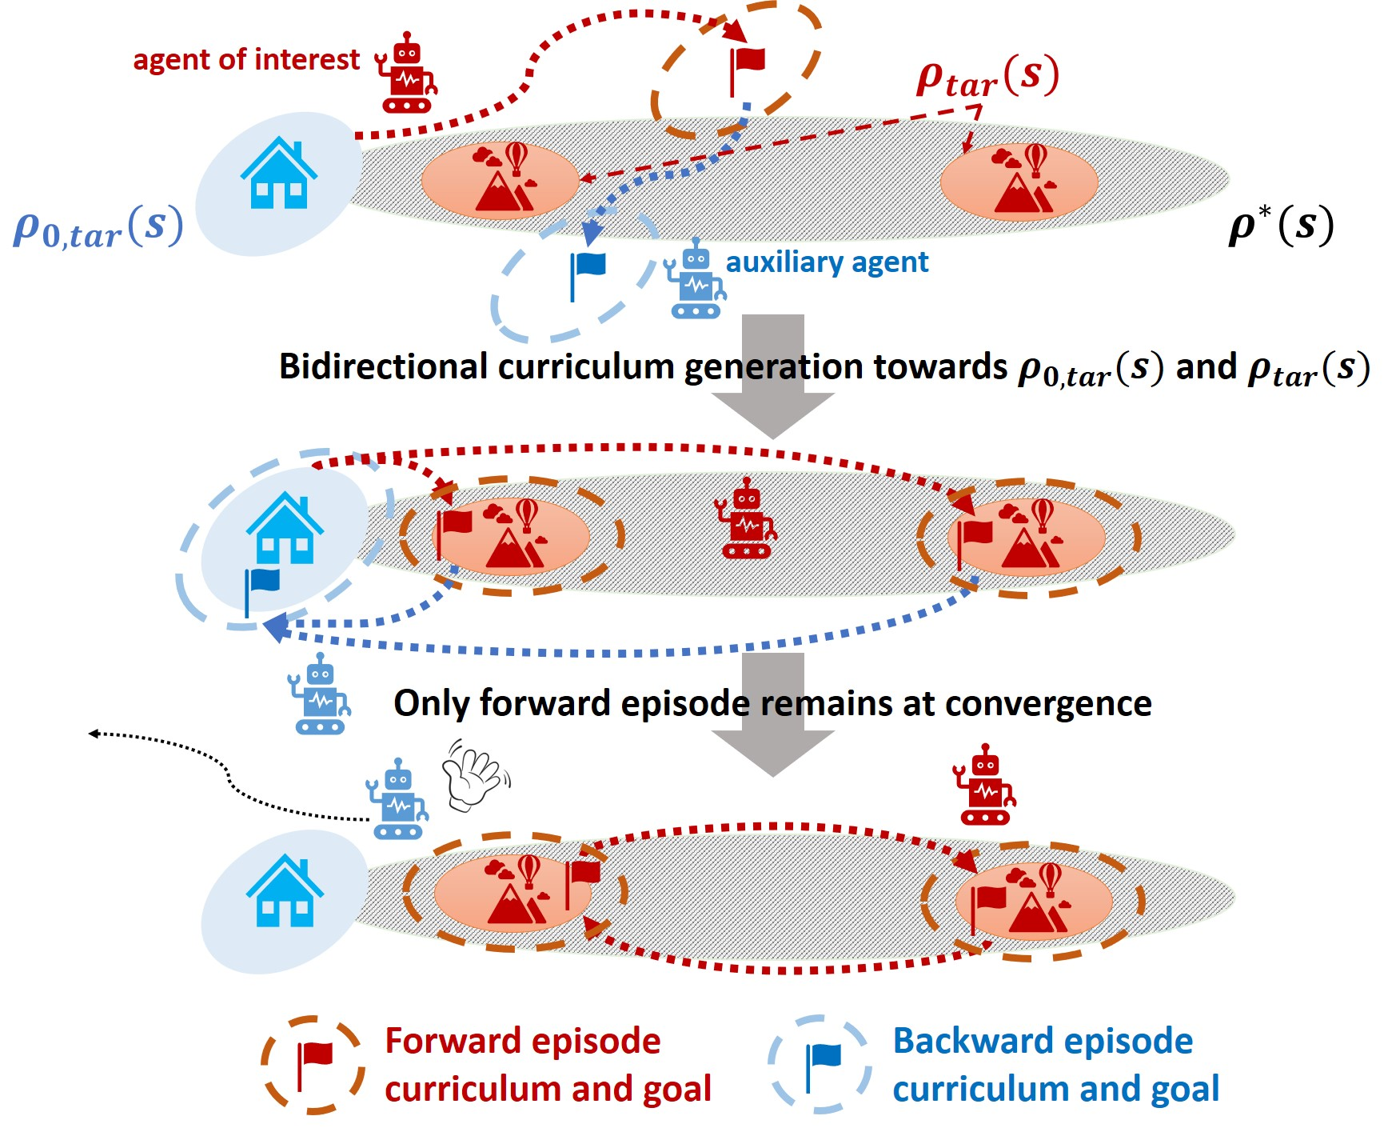


Demonstration-free Autonomous Reinforcement Learning via Implicit and Bidirectional
Curriculum
Jigang Kim^{1,2}, Daesol Cho^{1,2}, H. Jin Kim^{1,3}
¹ Seoul National University ² AI Institute of SNU (AIIS) ³ ASRI
Problem
Method
Key Results
Headline Numbers
The goal: learn robotic tasks from
scratch with no resets and no
demonstrations.
Two roles alternate: a forward agent π_{f} does the
task; an auxiliary agent π_{a} resets it toward target
states, firing only on failure so it fades as an implicit
curriculum.
Method
Demos
Resets
0
6
sparse-reward envs
Oracle RL (episodic)
0
required
demonstrations ·
manual resets
~10
target states (vs
thousands)
Standard RL resets to a fixed initial state
after every episode; real autonomous robots
cannot, so they must learn from one
continual, non-episodic stream.
VaPRL / MEDAL
expert
0
IBC (ours)
0
0
yet matches episodic oracle
RL
5
seeds averaged
A bidirectional curriculum solves a Wasserstein
Barycenter (Min-Cost-Max-Flow) for K forward + K
auxiliary goals.
SOTA success on all 6 environments — beats
demo-using VaPRL & MEDAL, approaches the
episodic oracle
Takeaway
By pairing a self-fading auxiliary agent with
an optimal-transport bidirectional goal
curriculum, IBC is the first method to learn
robotic manipulation and locomotion tasks
autonomously — no resets, no
demonstrations — while matching
approaches that rely on expert data.
Motivation
Lipschitz-relaxed objective; = optimal-transport distance to the target distribution.
Naive reset-free RL is unstable: an
untrained agent wanders to arbitrary
states, so each attempt starts from a
wildly different condition.
Prior methods still need manual resets,
lucky interactions, or (VaPRL, MEDAL)
demonstrations to seed their curricula.
First demonstration-free, reset-free
autonomous RL that rivals
demonstration-based methods and
approaches the episodic oracle.
Ablations confirm both components are
necessary. IBC assumes reversible
(ergodic) environments and needs a human-
specified sparse reward.
Evaluation success rate vs. steps: IBC (blue) reaches the
episodic oracle (dashed) while demo-free baselines stay near
zero. Shading = std over 5 seeds.
SO WHAT → IBC matches oracle-level success with zero demonstrations or resets; demo-based baselines falter where task interactions are sparse (e.g. the Fetch tasks).
Scan to Read
A demonstration-free VaPRL performs far worse than
the original — prior methods lean heavily on that extra
data.
Bidirectional curriculum; the auxiliary agent
fades once the agent is capable.
IBC training loop; only forward policy π_f is deployed at
evaluation.
Paper
Code

