Slide 1


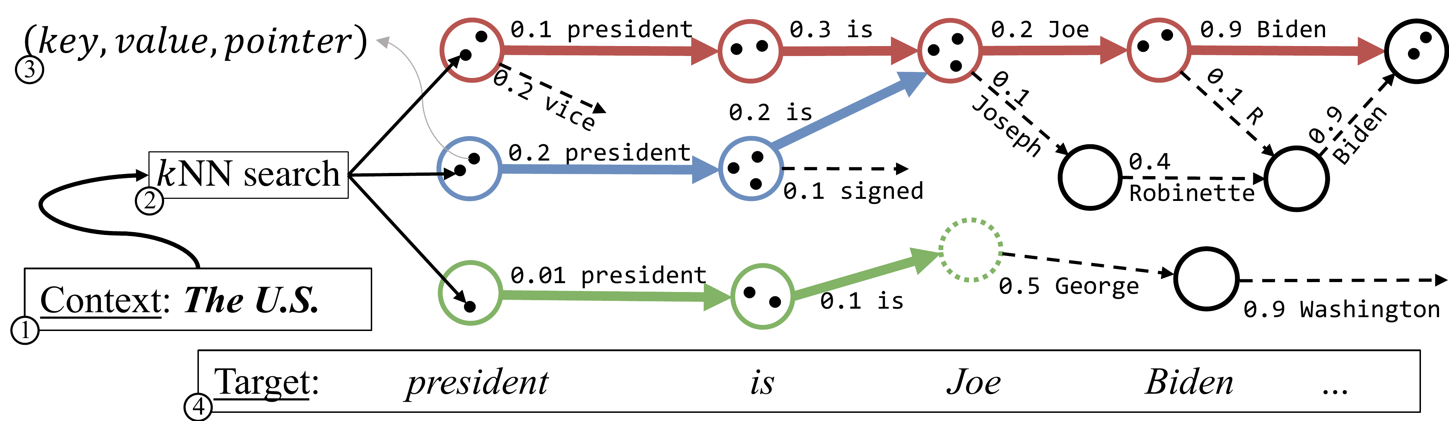
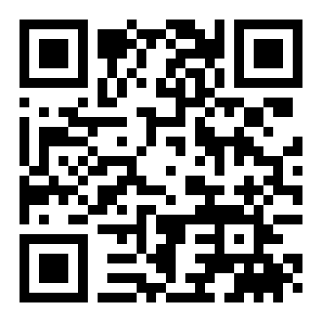
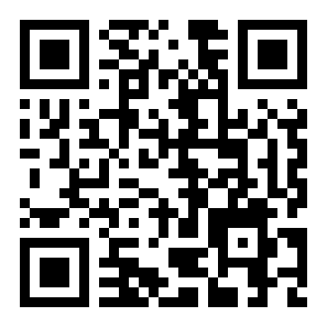
Neuro-Symbolic Language Modeling with
Automaton-augmented Retrieval
Uri Alon¹, Frank F. Xu¹, Junxian He¹, Sudipta Sengupta², Dan Roth³, Graham Neubig¹
¹ Carnegie Mellon University ² Amazon AWS ³ AWS AI Labs
Problem
Method
Ablation Study
Retrieval-based LMs improve quality by
searching an external datastore, but that
nearest-neighbor search runs as often
as every time step — the dominant
computational cost at inference.
1
Build the datastore. Store every entry as a triple (key, value, pointer), where the pointer references the entry
that followed it in the corpus.
WIKITEXT-103
PPL (FOSS=0)
SAVED
Pointers only
16.12
>60%
2
Cluster & traverse. Group close keys into states that share pointers; at inference follow near-free pointers,
searching only when valid transitions fall below τ.
+ Clustering (full)
16.08
81%
SO WHAT → Pointers drive most of the gain at low FoSS; clustering pays off at high FoSS (≥0.7), enabling longer search-free runs.
The search is far slower than the LM's
forward pass, blocking retrieval LMs
from deployment despite their
accuracy, domain-adaptability, and
provenance.
Automaton distribution interpolated with the base LM.
Headline Numbers
83%
81%
saved
(WikiText-103)
Motivation
kNN searches saved,
no PPL loss
16.08
PPL vs 16.65
kNN-LM treats the datastore as a flat
list and searches it token by token,
ignoring that consecutive retrieved
entries are highly correlated in time.
or up to −1.85 PPL when the
budget is kept
7.10
Law-MT PPL
Takeaway
Nearby key vectors tend to be followed
by the same token, yet a flat search
rediscovers those same neighbors from
scratch at every step.
RetoMaton at inference: parallel automaton traversals reuse datastore entries, skipping the full kNN search at most steps.
A pointer-and-cluster automaton lets an
LM carry retrieval across time steps,
skipping most kNN searches with no loss in
perplexity.
Dataset / Benchmark
Key Results
In-domain: WikiText-103 — 103M tokens, 247M-
param Transformer LM; datastore of 103M entries
clustered into 1M states.
PPL (FoSS=0)
WikiText
Law-MT (ft)
Unsupervised, model-agnostic, cross-
domain — unifying token, chunk, and
sequence retrieval.
Prior search-saving work (AdaptRet)
skips searches but backs off to the base
LM alone — discarding the retrieval
signal exactly when it helps most.
kNN-LM
16.65
7.93
AdaptRet
16.35
7.81
Adaptation: Law-MT (English) — 19M tokens, 656M-
param LM; 19M entries clustered into 200K states.
RetoMaton
16.08
7.10
If a retrieved entry helps now, the entry
that followed it in the text is very likely
useful next — structure a flat datastore
throws away.
Matches kNN-LM while skipping 81% of searches;
−17.5% PPL on fine-tuned Law-MT.
Scan to Read
Average cluster size stays near 100 entries in both
datastores; the automaton is built fully unsupervised,
with no extra training.
Paper
arxiv.org/abs/2201.12431
SO WHAT → Degrades only gently as searches are saved. FoSS = fraction of saved kNN searches.
Code
github.com/neulab/retomaton
WikiText-103
Law-MT
kNN-LM
AdaptRet
Paper
Code

