Slide 1




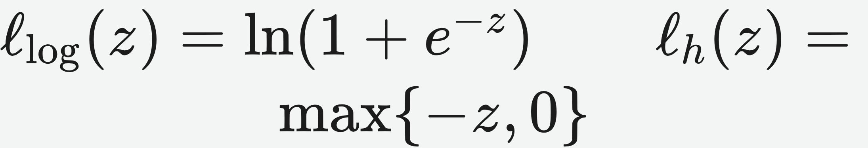


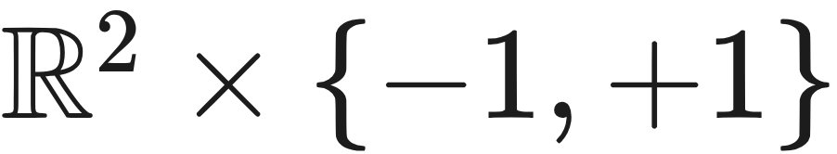

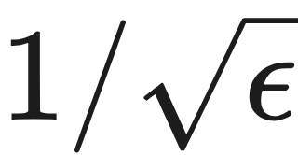
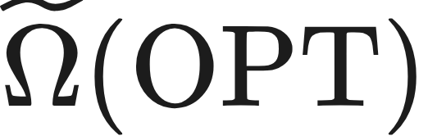
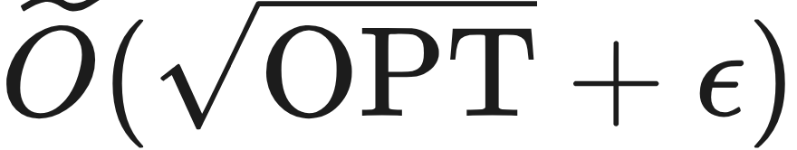
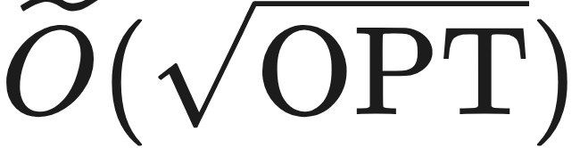


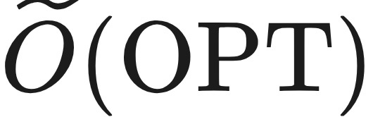
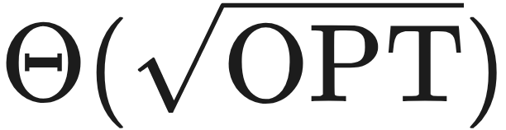
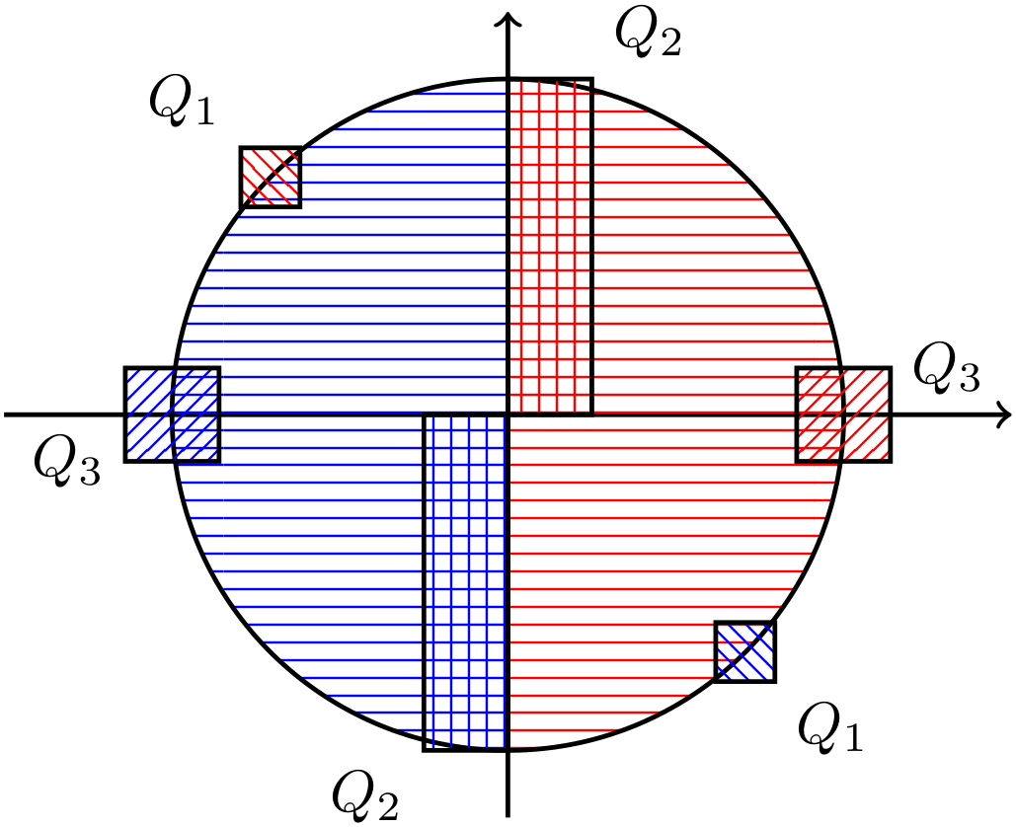
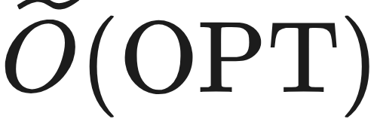

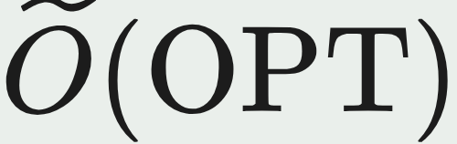

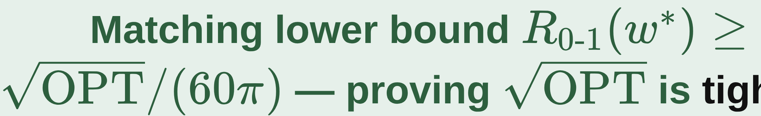
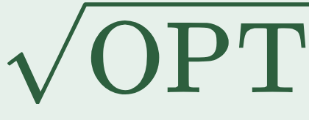
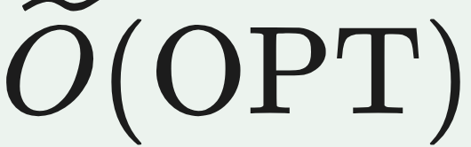
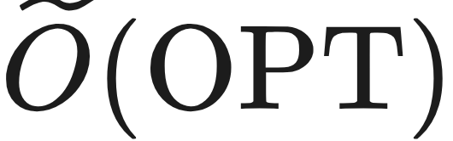
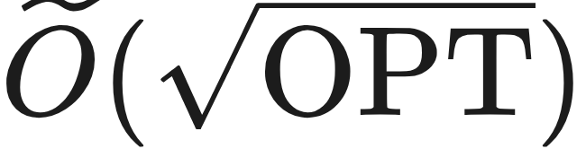

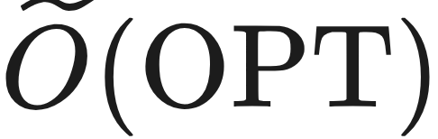
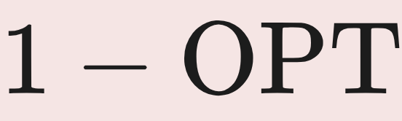

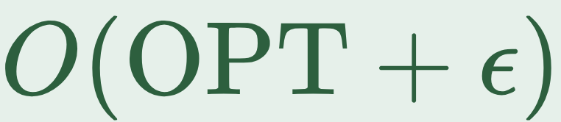

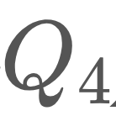
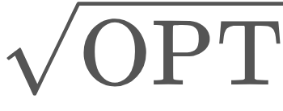
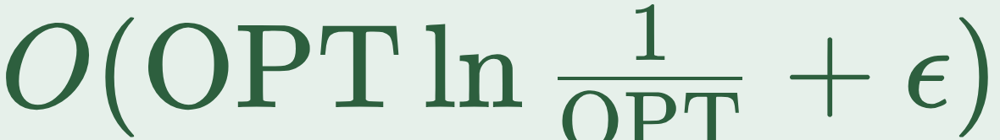
Agnostic Learnability of Halfspaces via Logistic Loss
Ziwei Ji¹, Kwangjun Ahn², Pranjal Awasthi³, Satyen Kale³, Stefani Karp^{3,4}
¹ UIUC ² MIT ³ Google Research ⁴ CMU
Problem
Method
Setting
Analysis
How well does plain logistic regression
agnostically learn homogeneous
halfspaces? An adversary corrupts an
OPT fraction of labels, and we must
compete with the best linear classifier —
whose zero-one risk is exactly OPT.
No empirical datasets — a learning-theory paper.
Positive results hold for every well-behaved
distribution.
The versatile argument extends to the
hinge loss, enabling the perceptron
phase.
two convex surrogates; minimize the empirical risk
The lower bound is a concrete counterexample: an explicit over with four parts, valid when .
The same guarantee also covers general
well-behaved distributions.
1
Phase 1 — Logistic GD. Projected gradient descent on the logistic risk inside a ball of radius returns a direction within angle of the target .
Prior work left a wide gap: an lower bound for all convex surrogates, versus an upper bound for logistic regression.
isotropic
log-concave
soft-margin
sub-exponential
Headline Numbers
bounded ‖x‖≤B
Õ(OPT)
√OPT
LR lower
bound (tight)
2
Phase 2 — Perceptron. Projected SGD on the hinge loss (the classical perceptron update), warm-started from Phase 1 over a bounded domain , sharpening the angle to .
Key Results
Õ(d/
ε²)
Two-phase algorithm
error
sample
complexity
Motivation
METHOD
0–1 ERROR
ASSUMPTION
2
convex steps
Logistic regression is the default
classifier in practice, so its agnostic
guarantees are far from academic.
Logistic regression
well-behaved
(tight)
Takeaway
LR + radial-Lipschitz
Lipschitz
density
Logistic regression alone is provably tight at ; one perceptron step from its solution restores near-optimal error on any well-behaved distribution.
Restricting to well-behaved (isotropic
log-concave) distributions makes the
problem tractable — yet the exact rate
logistic regression attains there stayed
open.
Two-phase (LR +
perceptron)
well-behaved
only
Matching lower bound — proving is tight for logistic regression.
Radial-Lipschitzness alone already lets logistic regression reach .
The rate sat unknown between and .
WARNS
SO WHAT → A single perceptron phase closes the long-standing gap: near-optimal error on every well-behaved distribution.
Ben-David et al. (2012): the logistic-risk minimizer can suffer zero-one risk as bad as on adversarial distributions.
Figure 1: the explicit 2-D well-behaved distribution (parts – ) that forces the logistic minimizer to error.
Two-phase error: (bounded) / (sub-exp).
Scan to read the full paper
arxiv.org/abs/2201.13419

