Slide 1




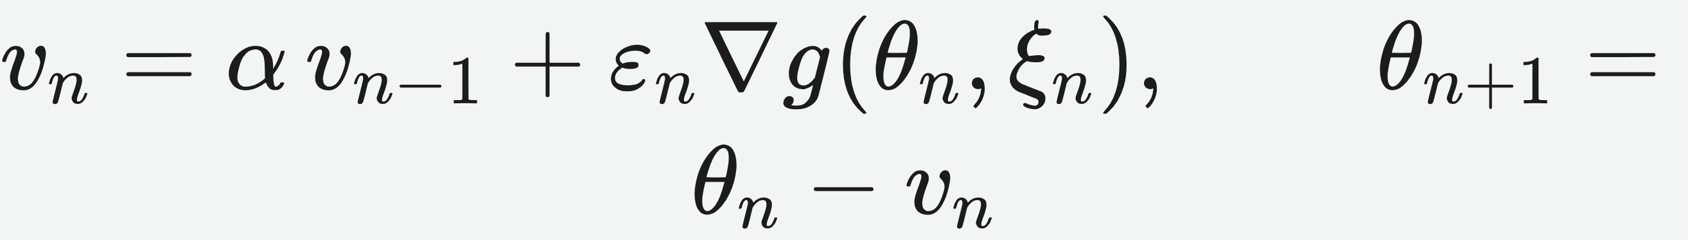
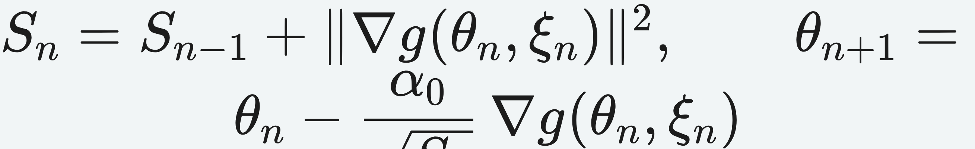
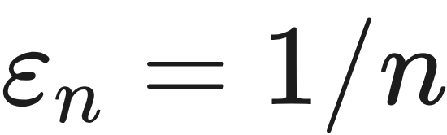
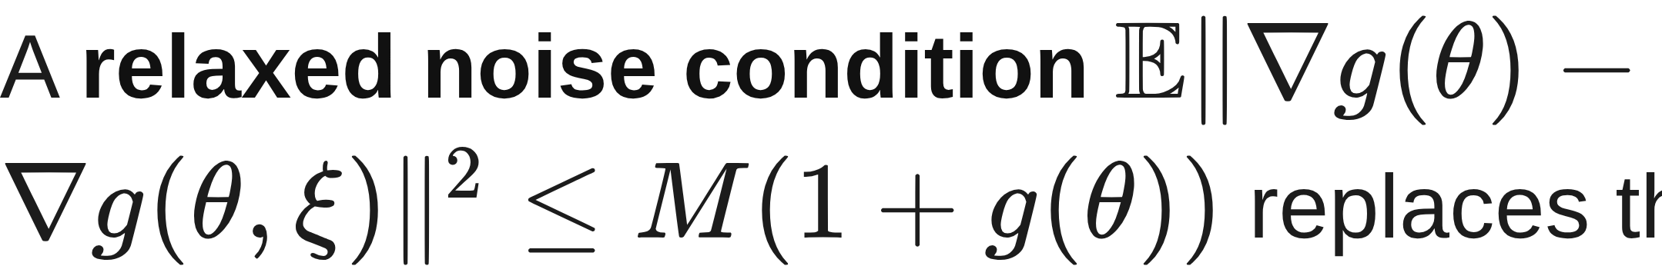
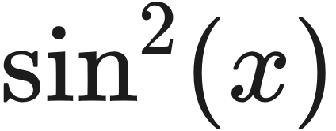

On the Convergence of mSGD and AdaGrad for Stochastic Optimization
arXiv 2022
Ruinan Jin^{1,2}, Yu Xing³, Xingkang He^{3,4}
¹ Academy of Mathematics & Systems Science, CAS ² Univ. of Chinese Academy of Sciences ³ KTH Royal Institute of Technology ⁴ University of Notre Dame
Problem
Method
Setting & Assumptions
Effect of Momentum α
Momentum SGD (mSGD) and AdaGrad
are empirically superior to plain SGD, yet
their convergence theory for smooth,
possibly non-convex losses is still poorly
established.
THEORY
α = 0
α ↑
α → 1
No datasets, benchmarks, or experiments — every
result is a proven convergence theorem.
recovers
SGD rate
smaller coefficient
rate → O(1/T)
mSGD — static momentum α, decreasing Robbins–Monro step εₙ
An analytic ablation: α = 0 recovers plain
SGD exactly; larger α provably accelerates
convergence.
Non-negative, continuously differentiable losses with
Lipschitz gradients — possibly non-convex with
many minima.
Prior proofs give only subsequence or
time-average convergence — weaker
than the almost-sure convergence
practitioners rely on.
AdaGrad — norm form, adaptive gradient-dependent step
Convergence needs only Robbins–Monro steps such as , with no convexity assumed.
Headline Numbers
A stability lemma keeps the expected loss bounded
throughout training.
The assumptions even admit non-convex examples like and quartic polynomials.
α =
0
recovers SGD
rate
A relaxed noise condition replaces the usual uniform bound.
O(1/T)
a.s.
Motivation
mSGD &
AdaGrad
mSGD time-avg rate,
α→1
M(1+g)
relaxed
noise
bound
A convergence theory for static-
momentum mSGD and norm-form
AdaGrad — without convexity, bounded-
iterate, or uniform-noise assumptions —
is missing.
AdaGrad's random step size is tamed by bounding
the conditionally dependent terms that block naive
conditioning.
Key Results
THEOREM
ALGORITHM
GUARANTEE
Takeaway
Thm 1
mSGD (static α)
a.s. → connected
stationary set
Contribution
Thm 2
mSGD rate
quantified acceleration
of SGD
Relaxed assumptions narrow the
theory–practice gap for these
optimizers.
Prior work covers only time-varying
momentum or modified AdaGrad; the
fixed momentum (α ≈ 0.9) and norm-
form AdaGrad actually deployed fall
outside those results.
FIRST
Thm 3
AdaGrad (norm
form)
a.s. → connected
stationary set
mSGD and AdaGrad converge almost
surely to stationary points of non-convex
losses, with momentum provably
accelerating convergence.
Asymptotic a.s. convergence for the static-
momentum mSGD and norm-form AdaGrad used
in practice.
Almost-sure asymptotic convergence — strictly
stronger than the subsequence and time-
average guarantees it extends.
No convexity
No bounded iterates
mSGD → a.s. convergence to a connected
stationary set, for non-convex losses.
When the stationary set is a single point, the
iterates converge to that point.
Static momentum α
Norm-form AdaGrad
Quantified mSGD rate — momentum as a provable
acceleration of SGD.
Guarantees hold for every realization (with
probability one) — not merely a subsequence or a
time average.
Scan to Read
Goal: analyze both algorithms exactly
as deployed.
AdaGrad (norm form) → a.s. convergence to a
connected stationary set.
Paper

