Slide 1


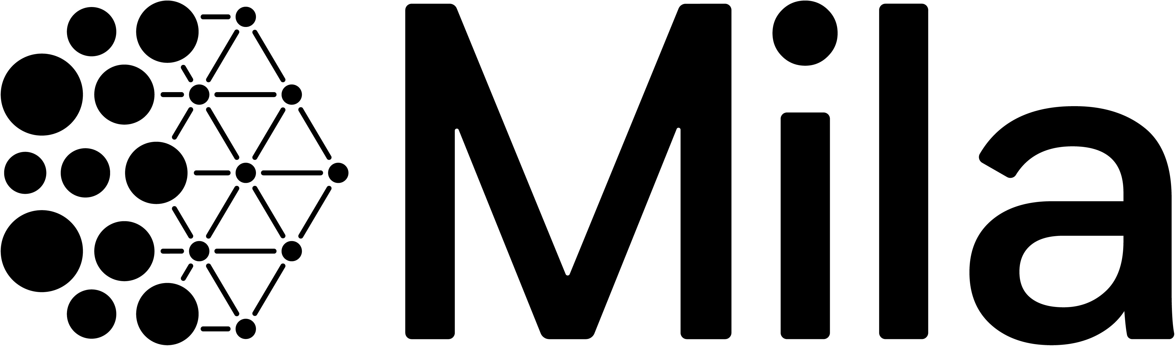
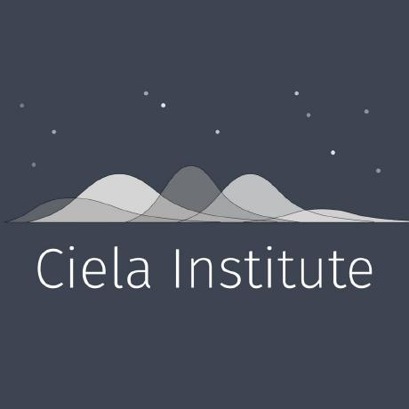

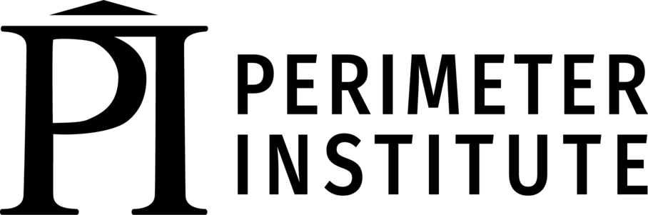
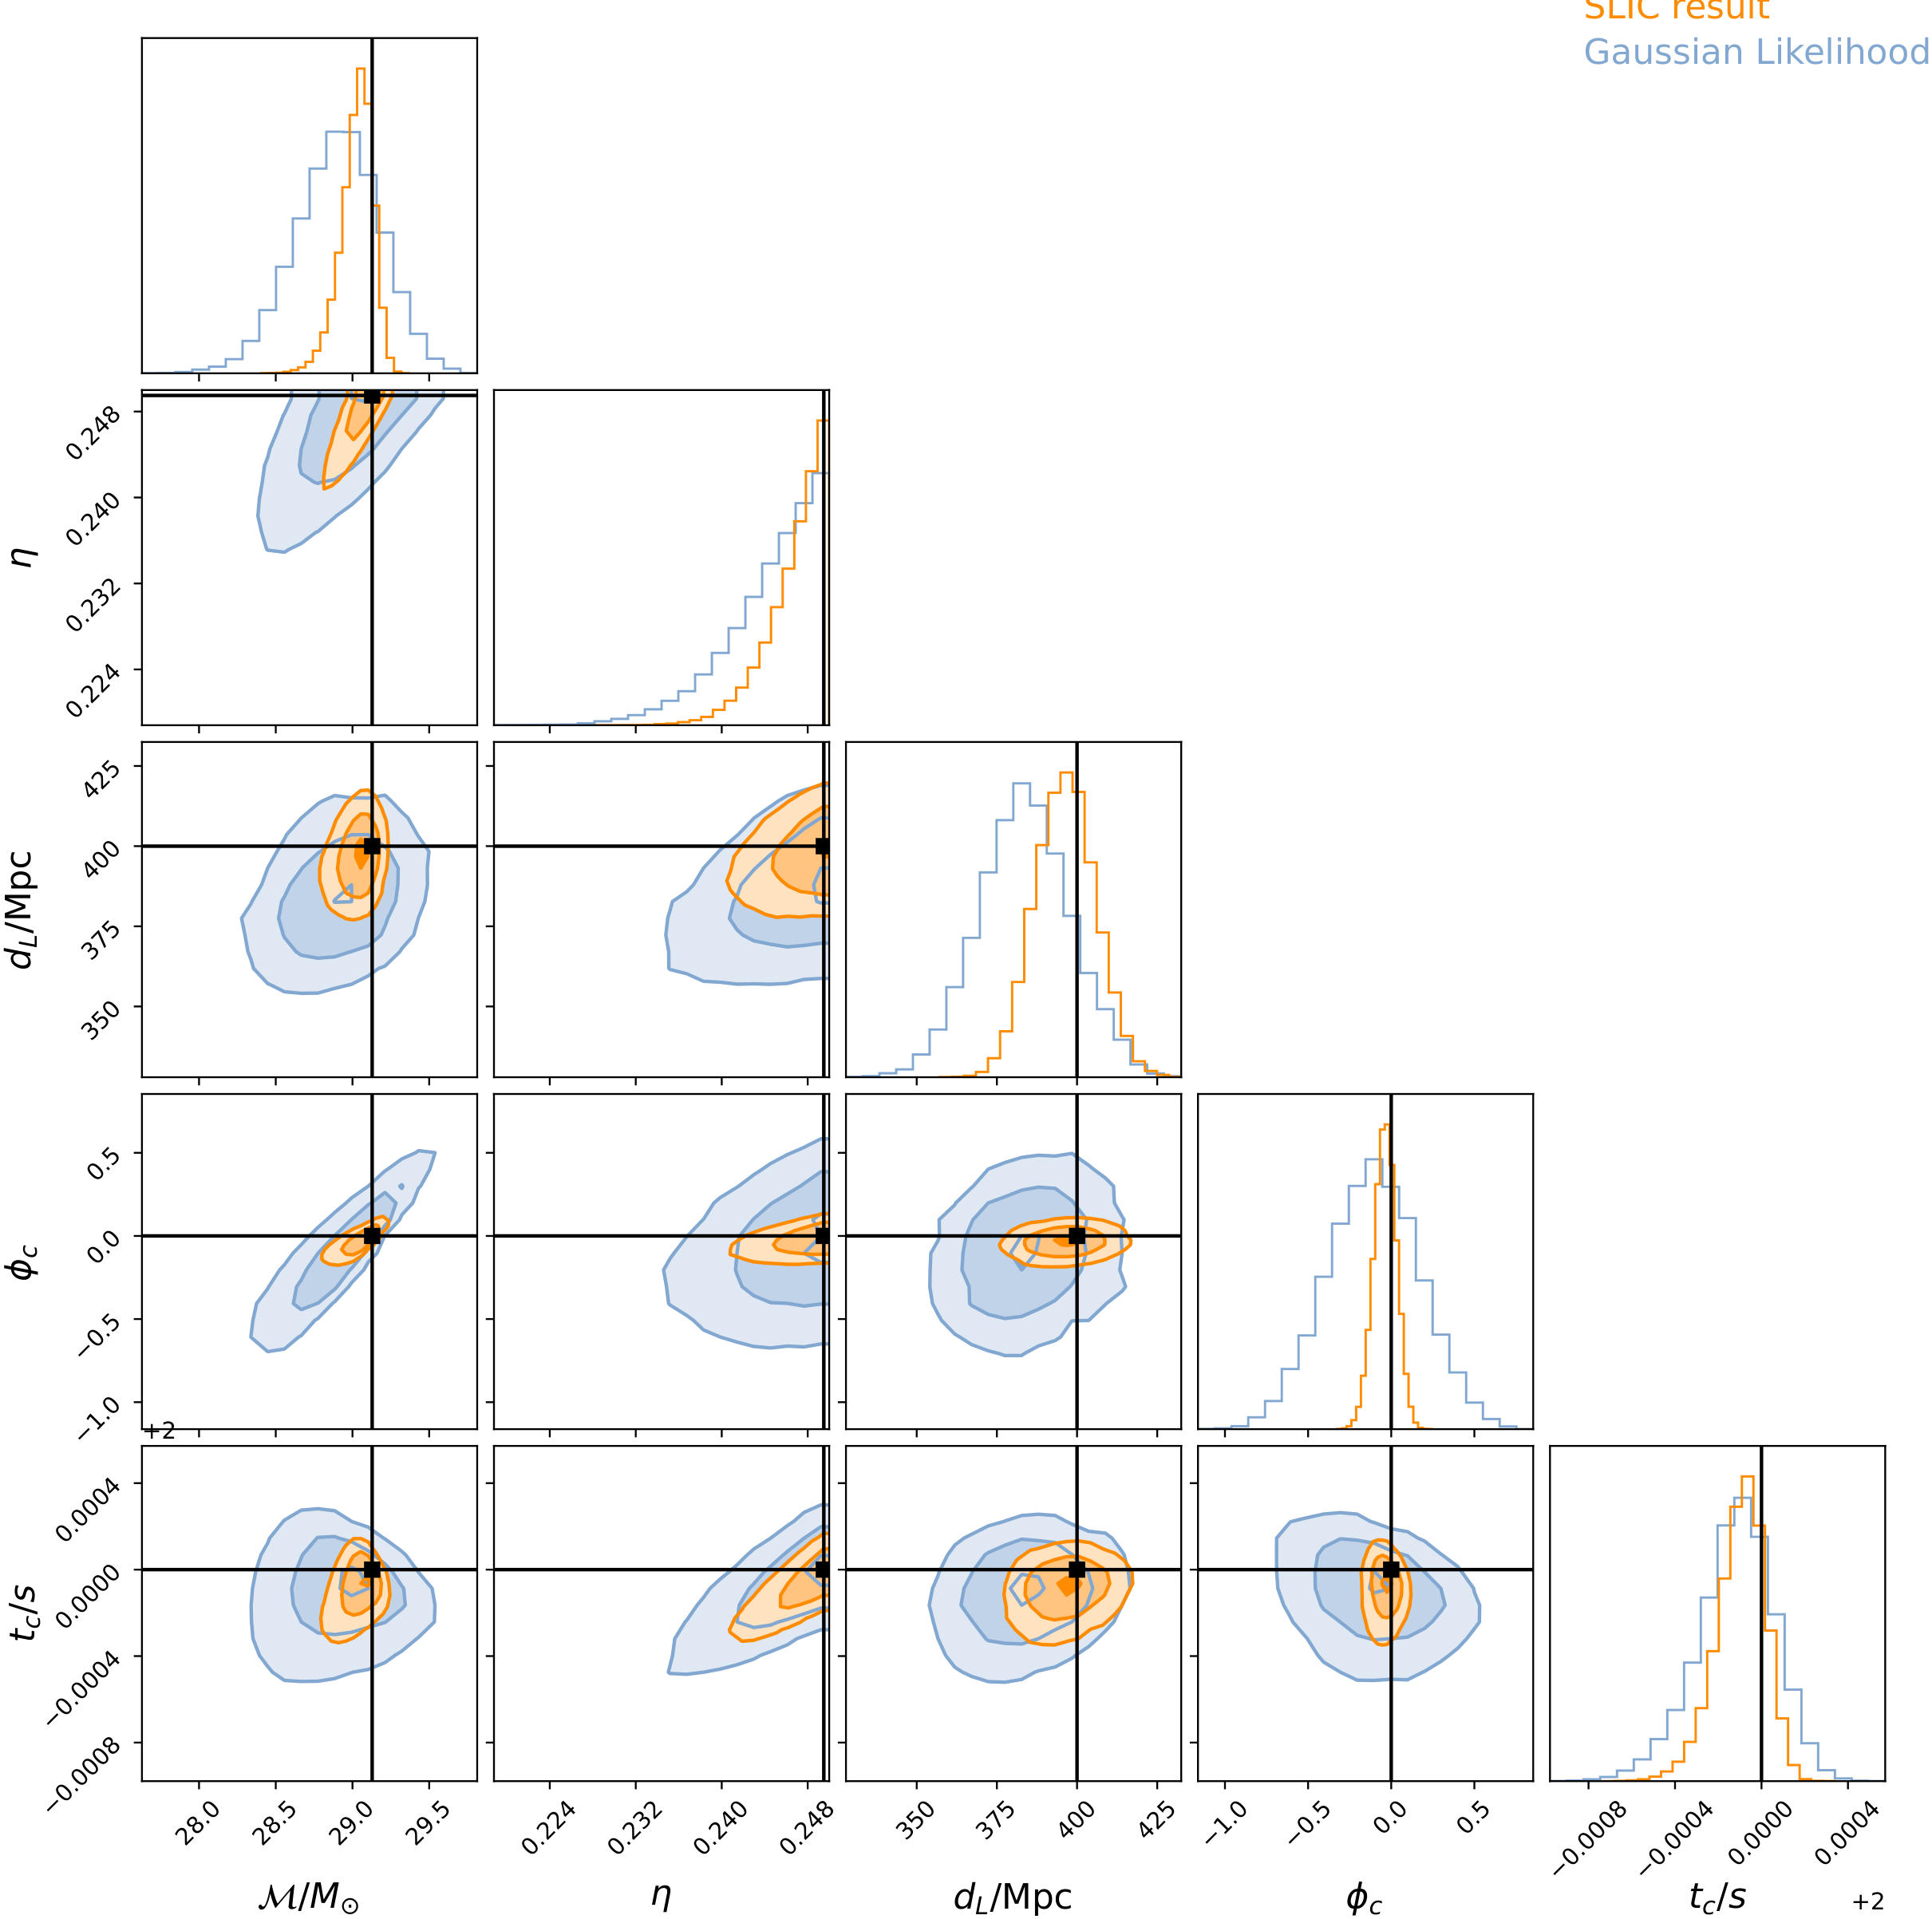
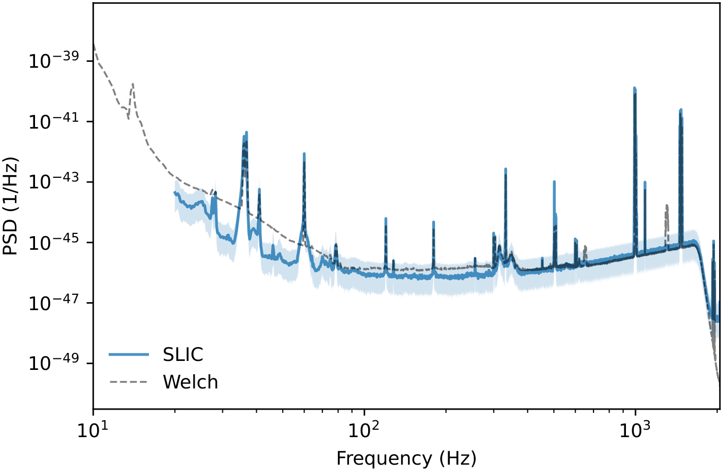
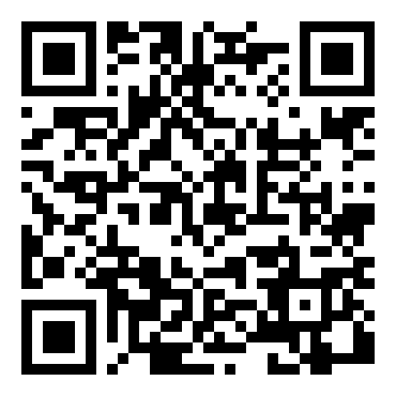
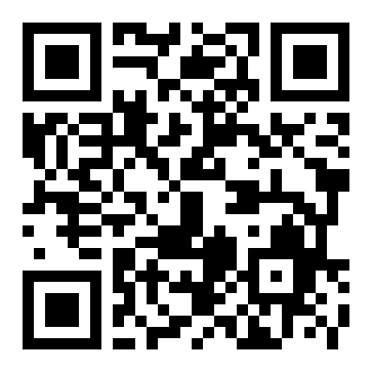
Towards Unbiased Gravitational-Wave Parameter Estimation
using Score-Based Likelihood Characterization
Ronan Legin^{1,2,3}, Maximiliano Isi⁴, Kaze Wong⁴, Alexandre Adam^{1,2,3}, Laurence Perreault-Levasseur^{1,2,3,4,5}, Yashar Hezaveh^{1,2,3,4,5}
¹ Université de Montréal ² Mila ³ Ciela Institute ⁴ Flatiron CCA ⁵ Perimeter Institute
Problem
Method
Key Results
Headline Numbers
Gravitational-wave parameter estimation conventionally assumes Gaussian, stationary detector noise — but real LIGO, Virgo, and KAGRA data deviate strongly, biasing inference.
Cast inference as an additive-noise inverse problem: the observation is a deterministic waveform M(θ) plus noise x.
11 h
1024
synthetic noise draws
real LIGO-Hanford noise
5
params recovered
A score-based diffusion model learns the noise score ∇ₓ log Q(x) directly from real LIGO data via denoising score matching.
score-model training data (GW150914 epoch)
4096 Hz
sample rate, 4 s segs
Real data carry glitches, drifting spectral lines, and subthreshold signals — handled today by costly, bias-prone fixes.
Takeaway
Chain it with the Jacobian of a differentiable IMRPhenomD waveform (ripple) to form the likelihood score; sample with MALA.
Learn the real noise with a diffusion model, couple it to a differentiable waveform — and get unbiased GW likelihoods without assuming Gaussian, stationary noise.
Motivation
4096
4 s
20 Hz
As catalogs grow, analyzing many signals makes the pipeline sensitive to tiny departures from Gaussianity that accumulate into systematic biases.
Hz sample rate
segment length
integration f_{low}
Scope & next steps
learned noise score × waveform Jacobian gives an unbiased likelihood score, with x_O = M(θ) + x
Proof of concept: 4 s single-detector segments sampled with MALA.
Keep the trusted deterministic waveform models, but drop the unrealistic noise assumption — no bespoke data surgery per artifact.
Scaling up: longer segments for neutron-star signals; coherent multi-detector analysis.
Posterior over the five recovered parameters using SLIC (orange) vs. the standard Gaussian likelihood (blue); black lines mark the true injected values. Contours: 10%, 39.35%, 90%.
Faster inference: pair the learned likelihood with samplers like flowMC for the full 15-D problem.
Next-gen observatories will record far more events, so a scalable, assumption-free noise model becomes foundational.
SLIC recovers all 5 parameters with high credibility — and a tighter posterior than the Gaussian likelihood.
A tiny non-Gaussian bias, multiplied across a growing catalog of events, compounds into a systematic error.
Scan to Read
Paper
Code
One-sided noise PSD from 1024 synthetic segments of the score-based model (SLIC, blue) vs. a Welch estimate from real LIGO-Hanford noise (dashed); SLIC resolves spectral lines more finely (11 h vs 1 h of data).
SO WHAT → The learned noise model matches the real LIGO PSD (incl. fine spectral lines) and yields unbiased, lower-variance parameter recovery.
LIGO
Virgo
KAGRA
Cosmic Explorer
Einstein Telescope

