Slide 1
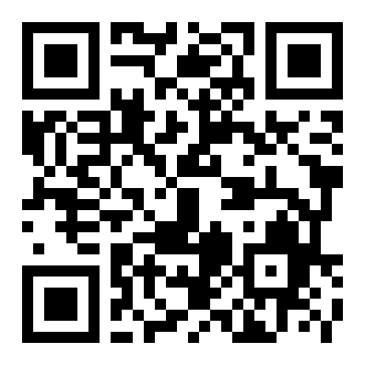

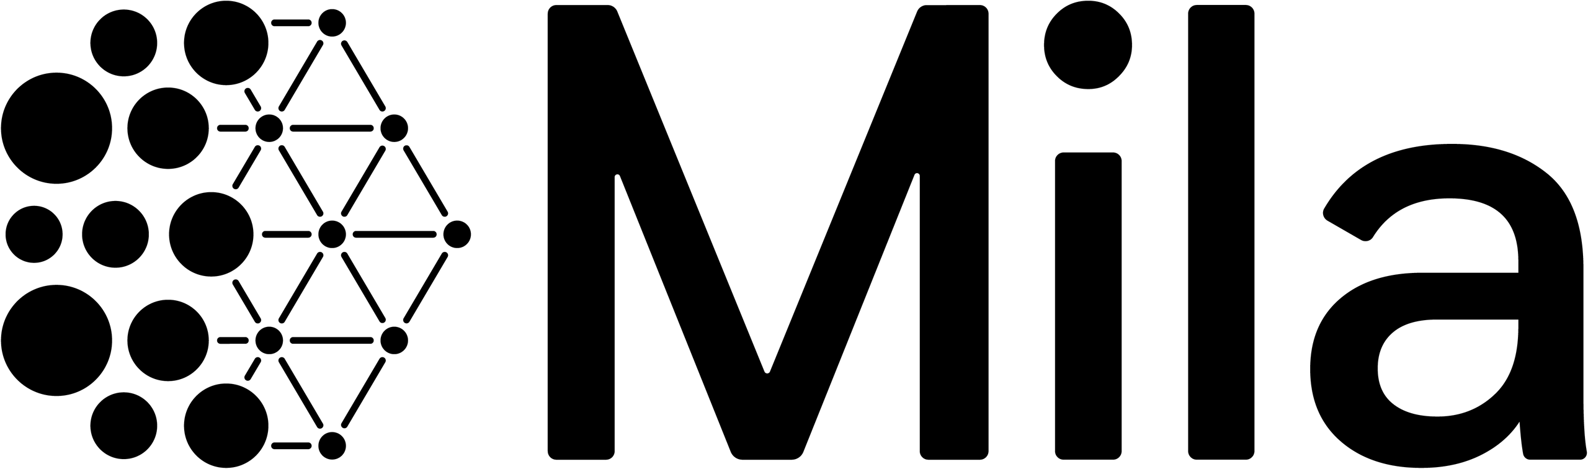

RIPPLES IN SPACETIME · REAL DETECTOR NOISE
ICML 2023 · ML4ASTRO WORKSHOP
Towards Unbiased
Gravitational-Wave
Parameter Estimation
SLIC
Score-based Likelihood Characterization
Standard inference assumes Gaussian, stationary noise — but real
LIGO, Virgo and KAGRA data break that with glitches and drifting lines.
Diffusion model learns noise
+
Differentiable waveform
R. Legin, M. Isi, K. Wong, A. Adam, L. Perreault-Levasseur, Y. Hezaveh
Université de Montréal · Mila · Ciela · Flatiron Institute · Perimeter Institute
github.com/RonanLegin/slicgw
Scan · Paper & Code

Slide 2
THE PROBLEM
The Gaussian noise assumption breaks on real data
01 · INFERENCE
02 · THE ASSUMPTION
Inference needs a likelihood
A convenient assumption
Extracting astrophysics from gravitational waves
For decades the field assumed detector noise is
means Bayesian inference over masses and spins —
Gaussian and stationary, because it makes the
and that inference requires a noise likelihood.
likelihood tractable and cheap to evaluate.
03 · REALITY
04 · THE COST
But real detectors are messy
Costly fixes that can bias results
Sensitivity drifts over time, and data carry
With no generative model, artifacts are handled
transient glitches and narrow, wandering spectral
segment-by-segment with bespoke fixes. Famously,
lines that violate the Gaussian model.
GW170817 landed right on a loud LIGO glitch.
SLIC · Unbiased Gravitational-Wave Parameter Estimation
02

Slide 3
MOTIVATION
Gravitational-wave astronomy is scaling up fast
Why now?
More events, more sensitivity — and small noise errors no longer
stay small. The idealized-noise shortcut is running out of road.
BIAS ACCUMULATES
THE GOAL
Tiny departures pile up
Keep the physics, drop the assumption
Analyzing large catalogs makes the whole pipeline
Retain the trusted deterministic waveform models,
sensitive to even tiny departures from Gaussian
but stop assuming idealized noise — analyzing
noise, which quietly accumulate into systematic bias.
artifact-contaminated signals without data surgery.
Built for the next-generation detectors:
Cosmic Explorer
Einstein Telescope
bias
events analyzed →
SLIC · Unbiased Gravitational-Wave Parameter Estimation
03

Slide 4
CONTRIBUTION
Bringing SLIC to gravitational-wave inference
THE CORE IDEA
Adapt Score-based Likelihood Characterization (SLIC) to learn real detector noise instead of assuming it.
1
Learn, don't assume
2
Unbiased likelihood
3
Shown end-to-end
Originally developed for
Couple that learned noise
astronomical imaging with
score with a differentiable
Generates realistic
Hubble and Webb, SLIC learns
physical waveform model to
LIGO noise
the score of the noise
produce an unbiased estimate
capturing even sharp
distribution — instead of
of the likelihood — no
spectral lines
assuming its functional form.
Gaussian assumption required.
Recovers the true
injected parameters
from a signal in real
LIGO detector noise
SLIC · Unbiased Gravitational-Wave Parameter Estimation
04

Slide 5
METHOD
How SLIC works
THE SETTING · INVERSE PROBLEM WITH ADDITIVE NOISE
An observation is a deterministic signal model plus noise:
x
O
= M(θ) + x
LEARN THE NOISE SCORE → BUILD THE LIKELIHOOD SCORE
∇
log p( x
| θ )
=
−
∇
log Q(x)
·
∇
M(θ)
θ
O
x
θ
STEP A · LEARN NOISE
STEP B · CHAIN PHYSICS
Score-based diffusion model
Differentiable waveform Jacobian
Trained on real LIGO noise via
IMRPhenomD from the ripple package
denoising score matching to learn
gives the waveform Jacobian
∇x log Q(x)
∇θ M(θ)
Sample the posterior with MALA
The likelihood score drives a Metropolis-adjusted Langevin algorithm to draw samples of the source parameters θ.
SLIC · Unbiased Gravitational-Wave Parameter Estimation
05

Slide 6
DATASET & BENCHMARK
Trained and tested on real LIGO data
The demonstration uses real detector data — not simulated noise.
TRAINING DATA
PRE-PROCESSING
Score network on LIGO-Hanford
Trained in the Fourier domain
11 hours of real LIGO-Hanford noise
after applying a Tukey window to each 4 s segment.
recorded around the GW150914 event
sampled at 4096 Hz, split into 4 s segments
TEST SETUP · INJECTION
the segment with the true signal is discarded
Inject a known signal into real noise
A simulated GW150914-like signal is injected into a
held-out stretch of real LIGO noise recorded after
11 h
4096 Hz
4 s
the training window — never seen during training.
real LIGO noise
sample rate
segment length
29 M⊙
400 Mpc
χ = 0
chirp mass
distance
zero spins
SLIC · Unbiased Gravitational-Wave Parameter Estimation
06

Slide 7
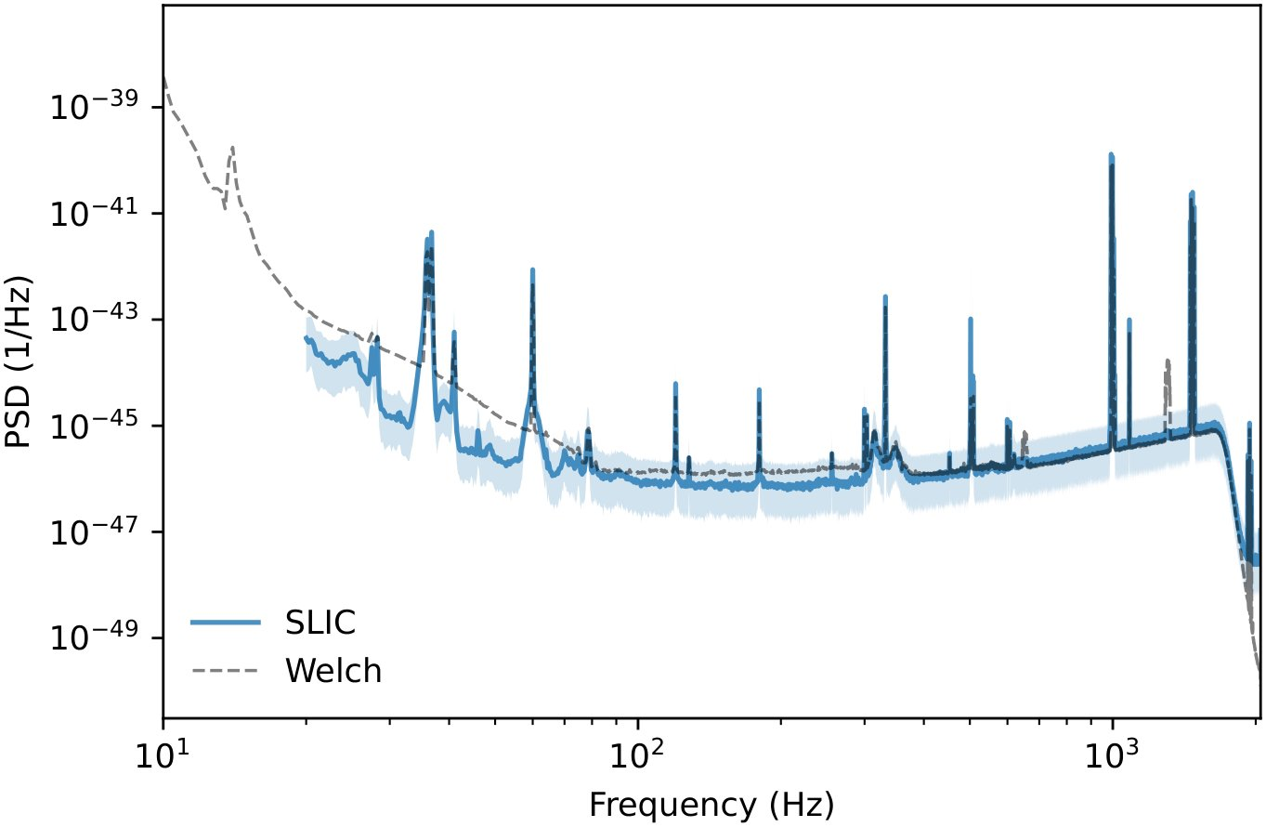
KEY RESULT
Reproduces LIGO noise, recovers the signal
The results are encouraging — on both the learned noise and the recovered parameters.
FIGURE 1 · LEARNED NOISE PSD
1024 realizations
PARAMETER RECOVERY
Recovers the injected
signal
5 / 5
varied parameters recovered
with high credibility
Tighter posterior
Smaller variance than the standard
Gaussian-likelihood posterior.
SLIC (blue) matches the Welch estimate (gray), resolving narrow spectral lines even more finely.
SLIC · Unbiased Gravitational-Wave Parameter Estimation
07

Slide 8
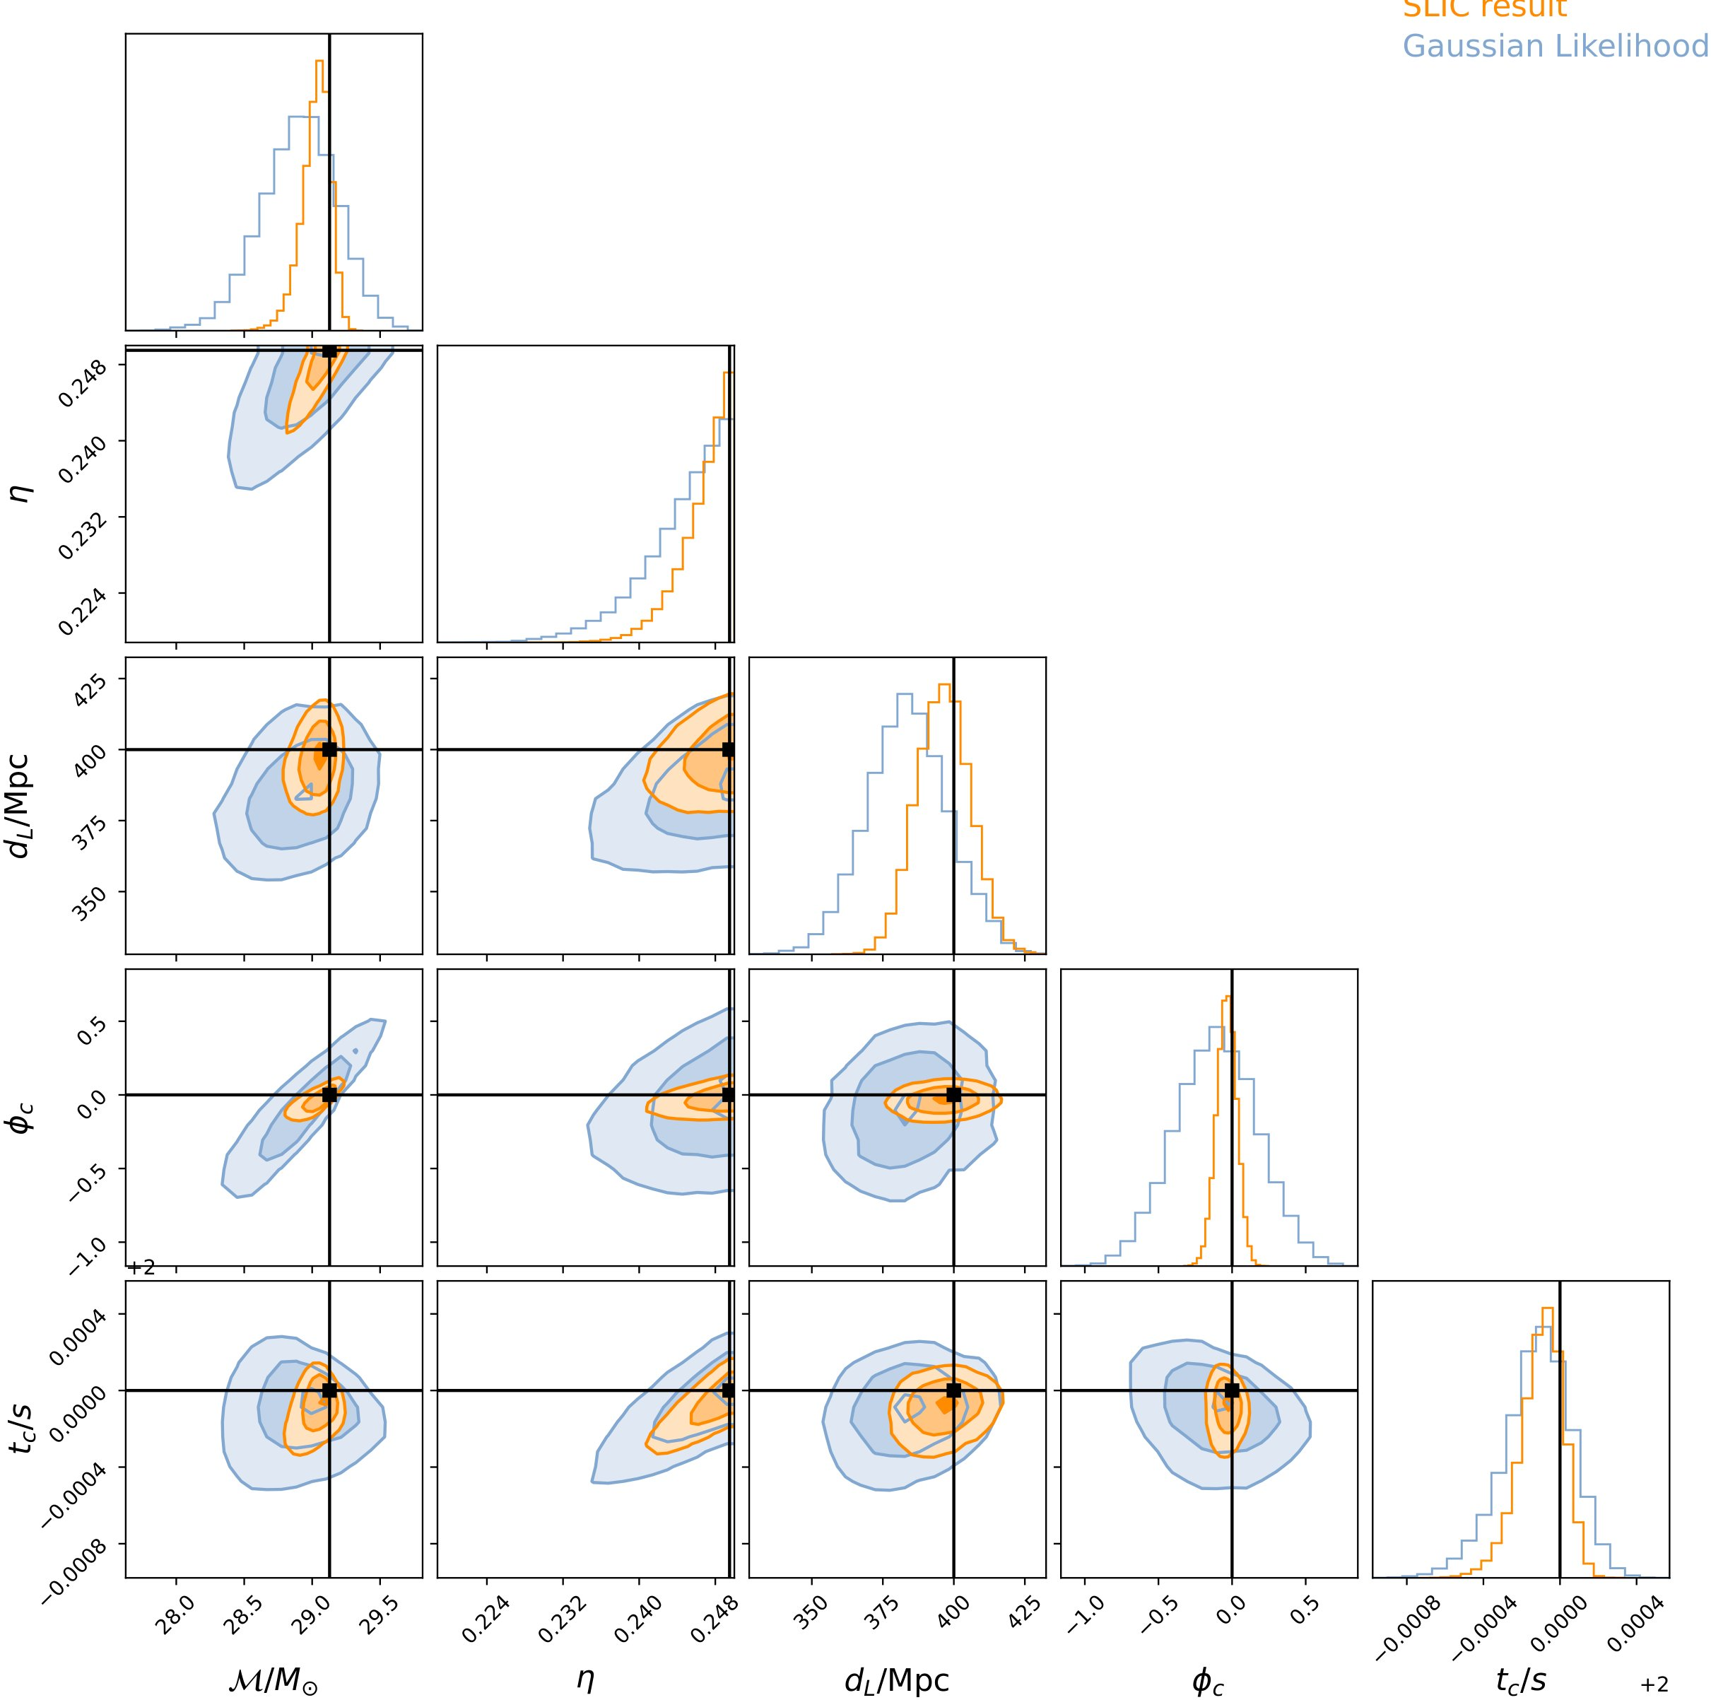
ABLATION · HEAD-TO-HEAD
SLIC vs the standard Gaussian likelihood
The key comparison is against the conventional Gaussian-likelihood approach.
THE SETUP
FIGURE 2 · POSTERIOR COMPARISON
Run inference twice
GLITCH-FREE SEGMENT
The same injected signal is
Both recover
analyzed with both likelihoods,
the truth
isolating the noise model's effect.
On this clean case, SLIC is
SLIC likelihood
validated against the trusted
baseline.
learned score-based noise model
SLIC is tighter
Gaussian likelihood
standard baseline from a Welch PSD
Smaller-variance posterior,
hinting at larger gains once
noise is truly non-Gaussian.
Black lines mark the true injected values.
SLIC · Unbiased Gravitational-Wave Parameter Estimation
08

Slide 9
HEADLINE NUMBERS
The demonstration, by the numbers
TRAINING NOISE
PSD VALIDATION
11 h
1024
of real LIGO-Hanford noise
synthetic noise realizations
used to train the score-based model
validate the learned power spectrum
PARAMETERS RECOVERED
DATA FORMAT
5
4096 Hz
4 s
source parameters
M, η, d
L
, t
c
, φ
c
sampling rate
segment length
chirp mass, mass ratio, distance, time, phase
SLIC · Unbiased Gravitational-Wave Parameter Estimation
09

Slide 10
TAKEAWAY
Unbiased likelihoods, learned from real noise
You no longer have to assume the noise is Gaussian and stationary.
SLIC produces an unbiased gravitational-wave likelihood directly from detector data.
THE RECIPE, IN ONE LINE
PROOF OF CONCEPT · NEXT
CODE & MODELS
Learn the noise, keep the physics
Toward scalable inference
Learn the real noise distribution with a diffusion
Today: single-detector, 4 s, MALA.
model, couple it to a differentiable waveform, and
get an unbiased likelihood straight from data —
Longer segments (BNS)
recovering true parameters on real LIGO noise.
Multi-detector coherent
Advanced samplers (flowMC)
Assumption-free noise
Scan to explore
Fast, scalable, unbiased inference.
github.com/RonanLegin
Legin et al. · ICML 2023 ML4Astro Workshop
10

