Slide 1


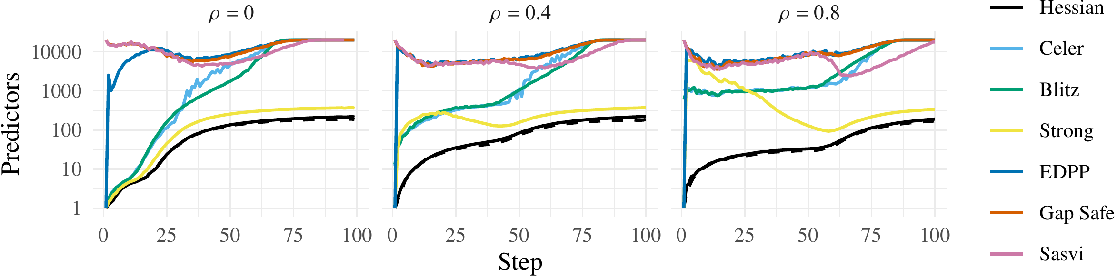
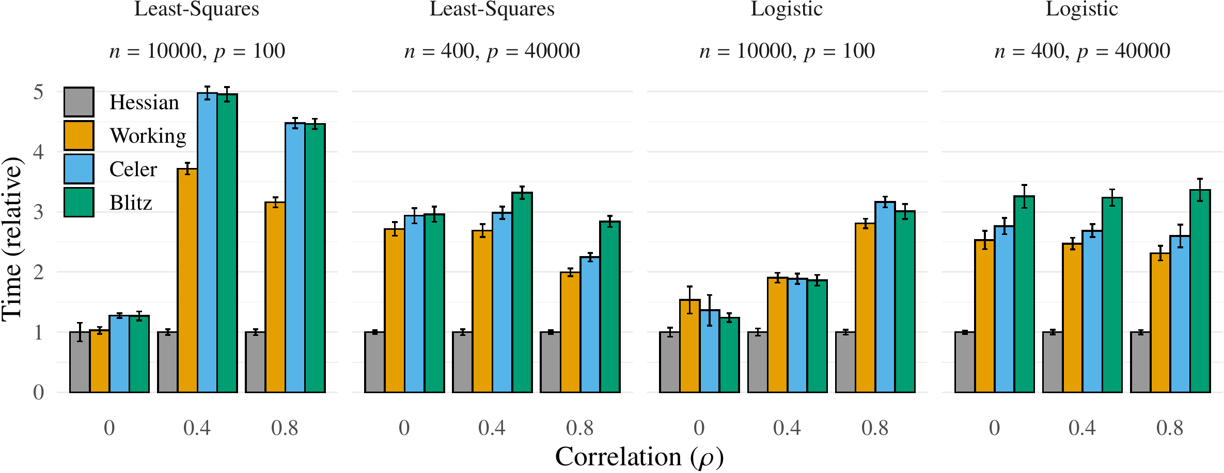
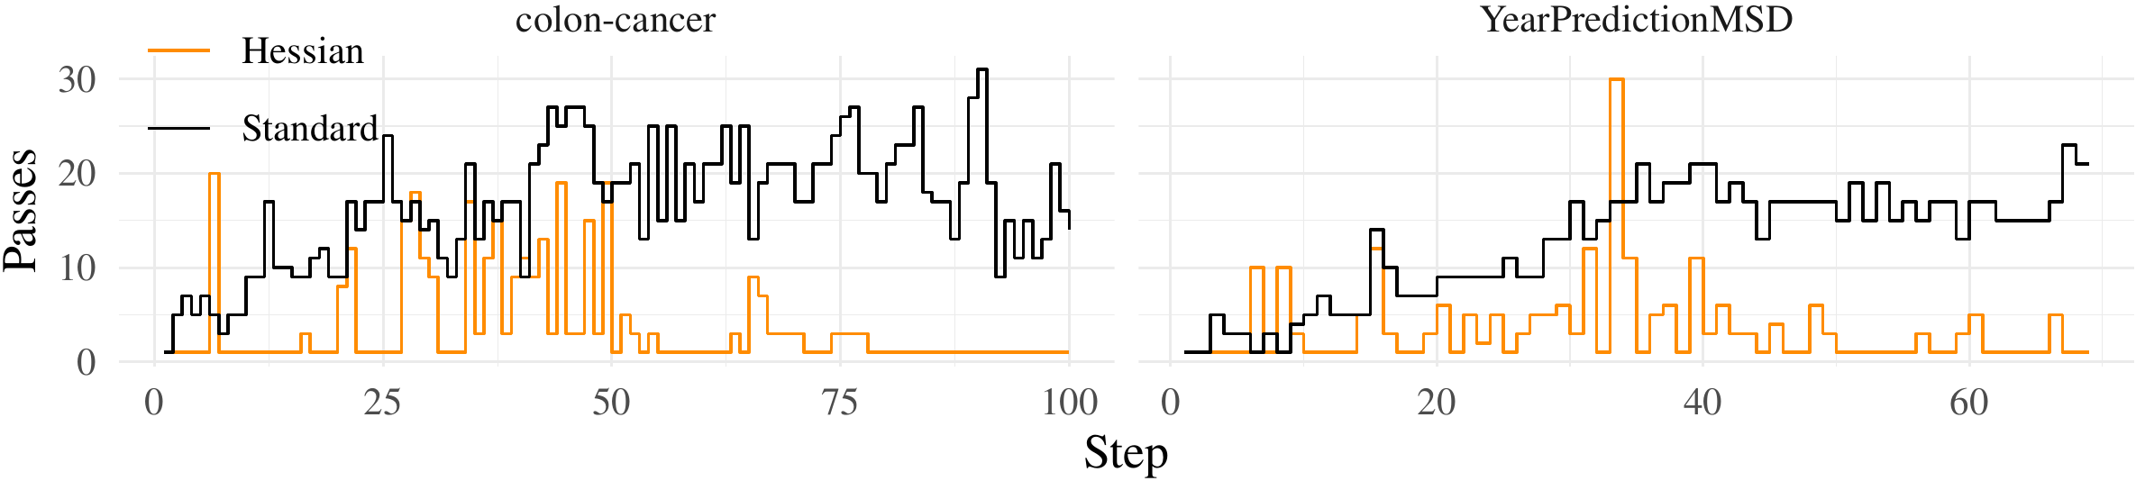


The Hessian Screening Rule
Johan Larsson¹, Jonas Wallin¹
¹ Department of Statistics, Lund University
Problem
Method
Key Results
Ablation Study
Fitting the lasso along a full regularization path is costly: the optimal penalty λ is unknown, so it is tuned by cross-validation — refitting the whole path repeatedly.
On any interval where the active set is fixed, the lasso solution is linear in λ, so the Hessian gives a second-order estimate of the next-step correlation.
PATH-FIT TIME (S)
HESSIAN
WORKING
CELER
BLITZ
10³–10⁴×
YearPredictionMSD
78.8
541
712
706
fewer predictors screened than rivals
e2006-tfidf
14.3
143
335
277
The same Hessian inverse gives a warm start that is exact while the active set is fixed, so a single coordinate-descent sweep usually suffices per path step.
e2006-log1p
205
438
835
756
Screening rules discard predictors before the solver runs — but existing rules screen conservatively under high correlation.
bcTCGA
3.00
7.67
10.6
11.7
SO WHAT → Warm start: also cuts coordinate descent to ~1 pass/step.
scheetz
0.369
0.643
0.801
0.706
Restrict inner products to the strong-rule set for cost; maintain H and H⁻¹ by low-rank updates; place the λ grid by approximate homotopy.
colon-cancer
0.054
0.134
0.169
0.177
duke-breast-cancer
0.111
0.210
0.262
0.251
Headline Numbers
Motivation
arcene
4.35
3.27
3.99
4.42
≈10×
6.9×
Sequential rules (the strong rule, working-set) rely on a first-order estimate of the next-step correlation.
YearPredMSD
≈ 7–10× faster than the best prior method on the largest real data sets, and fastest in every simulated configuration
Faster · e2006-tfidf
2.6×
bcTCGA
14.3 s vs 143 s — the biggest real-data speedup, ≈10× over the runner-up
4.8×
madelon
That crudeness over-screens and yields inaccurate warm starts, forcing costly KKT re-checks and extra solver passes.
second-order screening estimate of the next-step correlation Hessian warm start — exact while the active set is fixed
2.5×
colon-cancer
Takeaway
Reusing second-order Hessian information pays off twice — tighter screening and near-exact warm starts — the fastest way to fit lasso and ℓ₁-regularized logistic regression paths.
One shared root — a first-order guess — fixable with curvature.
Contribution
Predictors screened vs. path step at correlation ρ ∈ {0, 0.4, 0.8} (n = 200, p = 20000). The Hessian rule (black) hugs the true active-set floor (dashed); rivals keep orders of magnitude more.
Relative path-fit time vs. correlation ρ for ℓ₁ least-squares and logistic regression; time is relative to the fastest per group. Hessian (grey) is lowest in every panel.
One Hessian, double duty — the fastest lasso & ℓ₁-logistic path solver, with the largest edge under high correlation.
The Hessian Screening Rule: second-order screening and a near-exact warm start, both from one Hessian.
SO WHAT → Fastest in every simulated setting and on nearly all 12 real data sets: on YearPredictionMSD, 78.8 s vs 541 s for the runner-up — in all but one least-squares case, under half its time.
Efficient low-rank updates of H and H⁻¹, plus an approximate-homotopy λ-grid.
Extends to smooth convex losses (ℓ₁-logistic); open C++/R code.
Coordinate-descent passes along the path on colon-cancer and YearPredictionMSD: Hessian warm starts (orange) collapse to ~one pass per step vs. standard warm starts (black).
Scan to
Read
5/5
<½
3×2
Contact
johan.larsson@stat.lu.se
Lasso
ℓ₁-logistic
C++
R
least-squares sets won
runner-up time (4/5)
sim. settings, all won
Paper
Code

