Slide 1



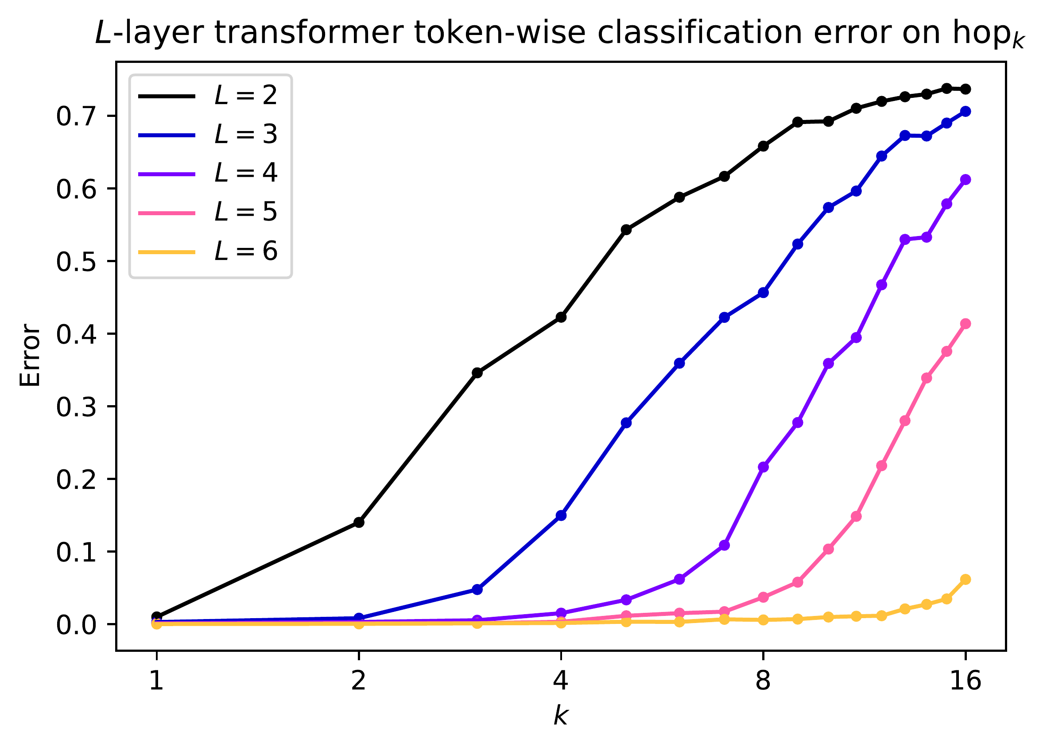
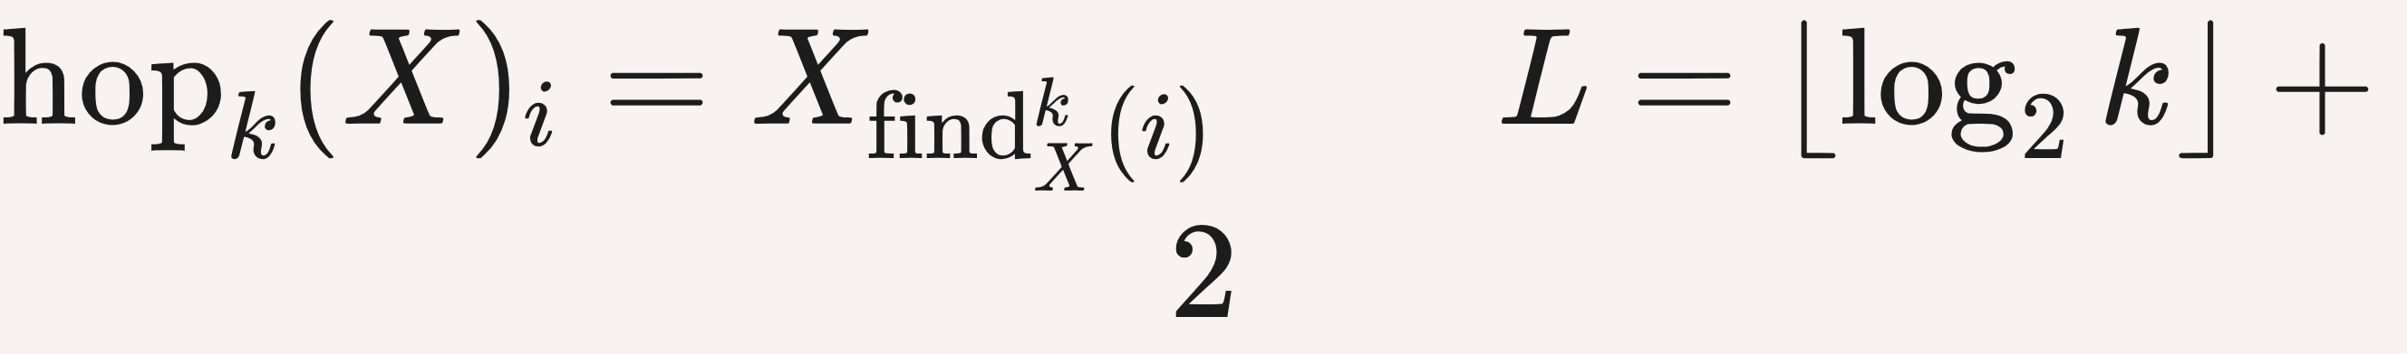



Transformers, Parallel Computation, and
Logarithmic Depth
Clayton Sanford¹ Daniel Hsu¹ Matus Telgarsky²
¹ Department of Computer Science, Columbia University ² Courant Institute, New York University
Problem
Method
Key Results
Ablation Study
What fundamentally distinguishes transformers from other sequence models stays unclear.
Routing gadget (Lemma 3.2). A single self-attention layer implements MPC's simultaneous message routing.
On the new k-hop induction heads benchmark (N = 100, |Σ| = 4, k ∈ {0, …, 16}), depth L = Θ(log k) is proven both necessary and sufficient to solve the task.
2→6
×2
1–3k
depth sweep
width (m, H)
train samples
Depth is the driver. Doubling width (m, H) from 128/4 to 256/8 barely moves the ⌊log₂ k⌋ + 2 boundary; deeper models also generalize better.
No existing theory isolates the one property that sets transformers apart from recurrent networks.
Multiple hashing encodes each message redundantly in fixed packets; sparse propagation keeps Q, K, V tall-and-skinny, so embedding width stays small.
Universality results hold only for impractically large models.
Reverse direction (Thm 3.4). Each transformer layer packs into a single MPC round, so a depth-L transformer is captured by an O(L)-round protocol, giving matching lower bounds.
Headline Numbers
Constant-depth, growing-context analyses land in a regime where even matching parentheses is impossible.
×2
R+1
run R-round MPC
larger learnable k per added layer
≥ k
RNN / Mamba depth
1
Encode each machine's message into redundant packets via multiple hashing.
6
solve k ≤ 16
Motivation
Both proven and observed in trained transformers of depth 2–6.
Make the attention ↔ MPC link precise and you get one lens for both the power and the limits of transformers.
2
Route — one attention layer moves all packets at once (one layer = one MPC round).
Takeaway
Figure 2. Token-wise error of trained transformers (depths L = 2–6) vs. hop count k. Each added layer roughly doubles the largest learnable k — the boundary lands at ⌊log₂ k⌋ + 2.
Attention is a parallel operation — every pair of tokens interacts in one layer via a query–key inner product.
3
Stack R such layers to simulate an R-round protocol in depth R + 1.
The real edge of the transformer is not scale — it is the ability to do many things at once.
ARCHITECTURE
DEPTH FOR K-HOP
IN K
Transformer (this work)
⌊log₂ k⌋ + 2
logarithmic
Parallelism is the defining strength of transformers. Up to logarithmic depth they are equivalent to Massively Parallel Computation, solving in log k depth what serial models need order k to match.
Recurrence is serial, threading information through the sequence one step at a time.
Multi-layer RNN / Mamba
≥ k
linear
A tailored causal construction of constant width solves k-hop at depth .
Sub-quadratic attn (Performer)
≥ k
linear
That parallelism mirrors Massively Parallel Computation (MPC), the MapReduce-style model for distributed algorithms.
FREE
The MPC link instantly gives log-depth transformers for graph connectivity, near-optimal under a standard conjecture.
Trained models obey the threshold to the layer — six layers solve every k ≤ 16.
Scan to Read
Paper
arxiv.org/abs/2402.09268
MPC precisely captures what a few self-attention layers compute.
In short, a transformer's depth budget is precisely its budget of parallel communication rounds.
SO WHAT → Learned attention patterns are interpretable, mirroring the proof's intermediate find_{j} pointers.
Code
github.com/chsanford/…
Paper
Code
Scan a code to open the paper or the code release.

