Slide 1


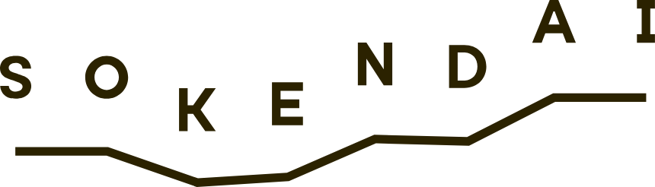
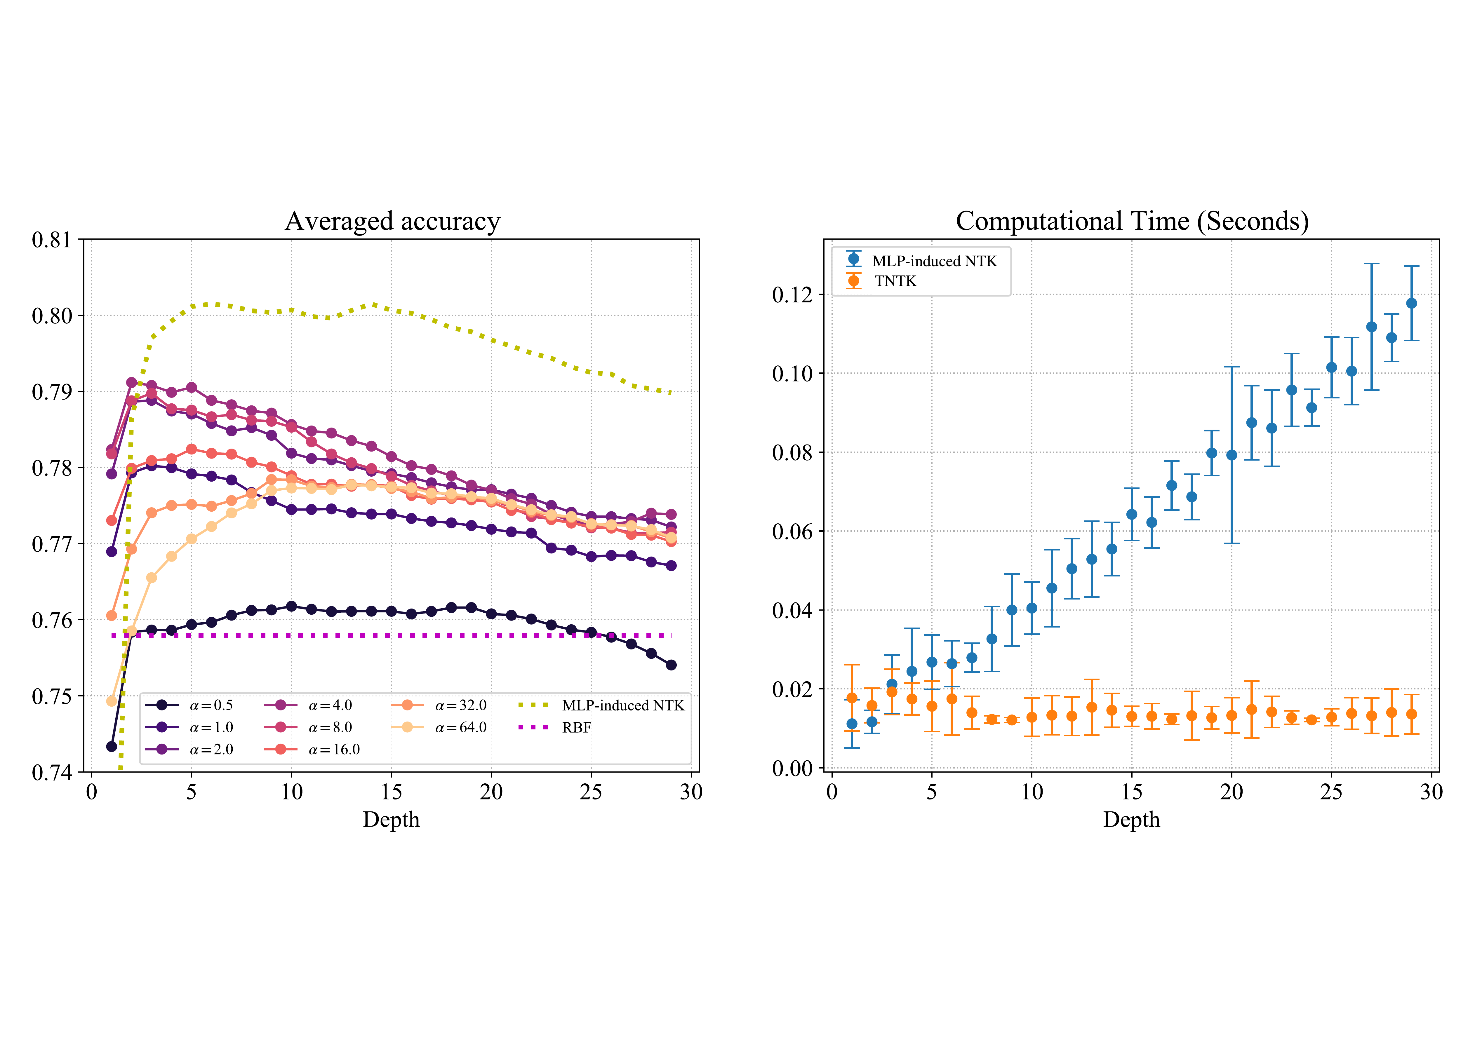
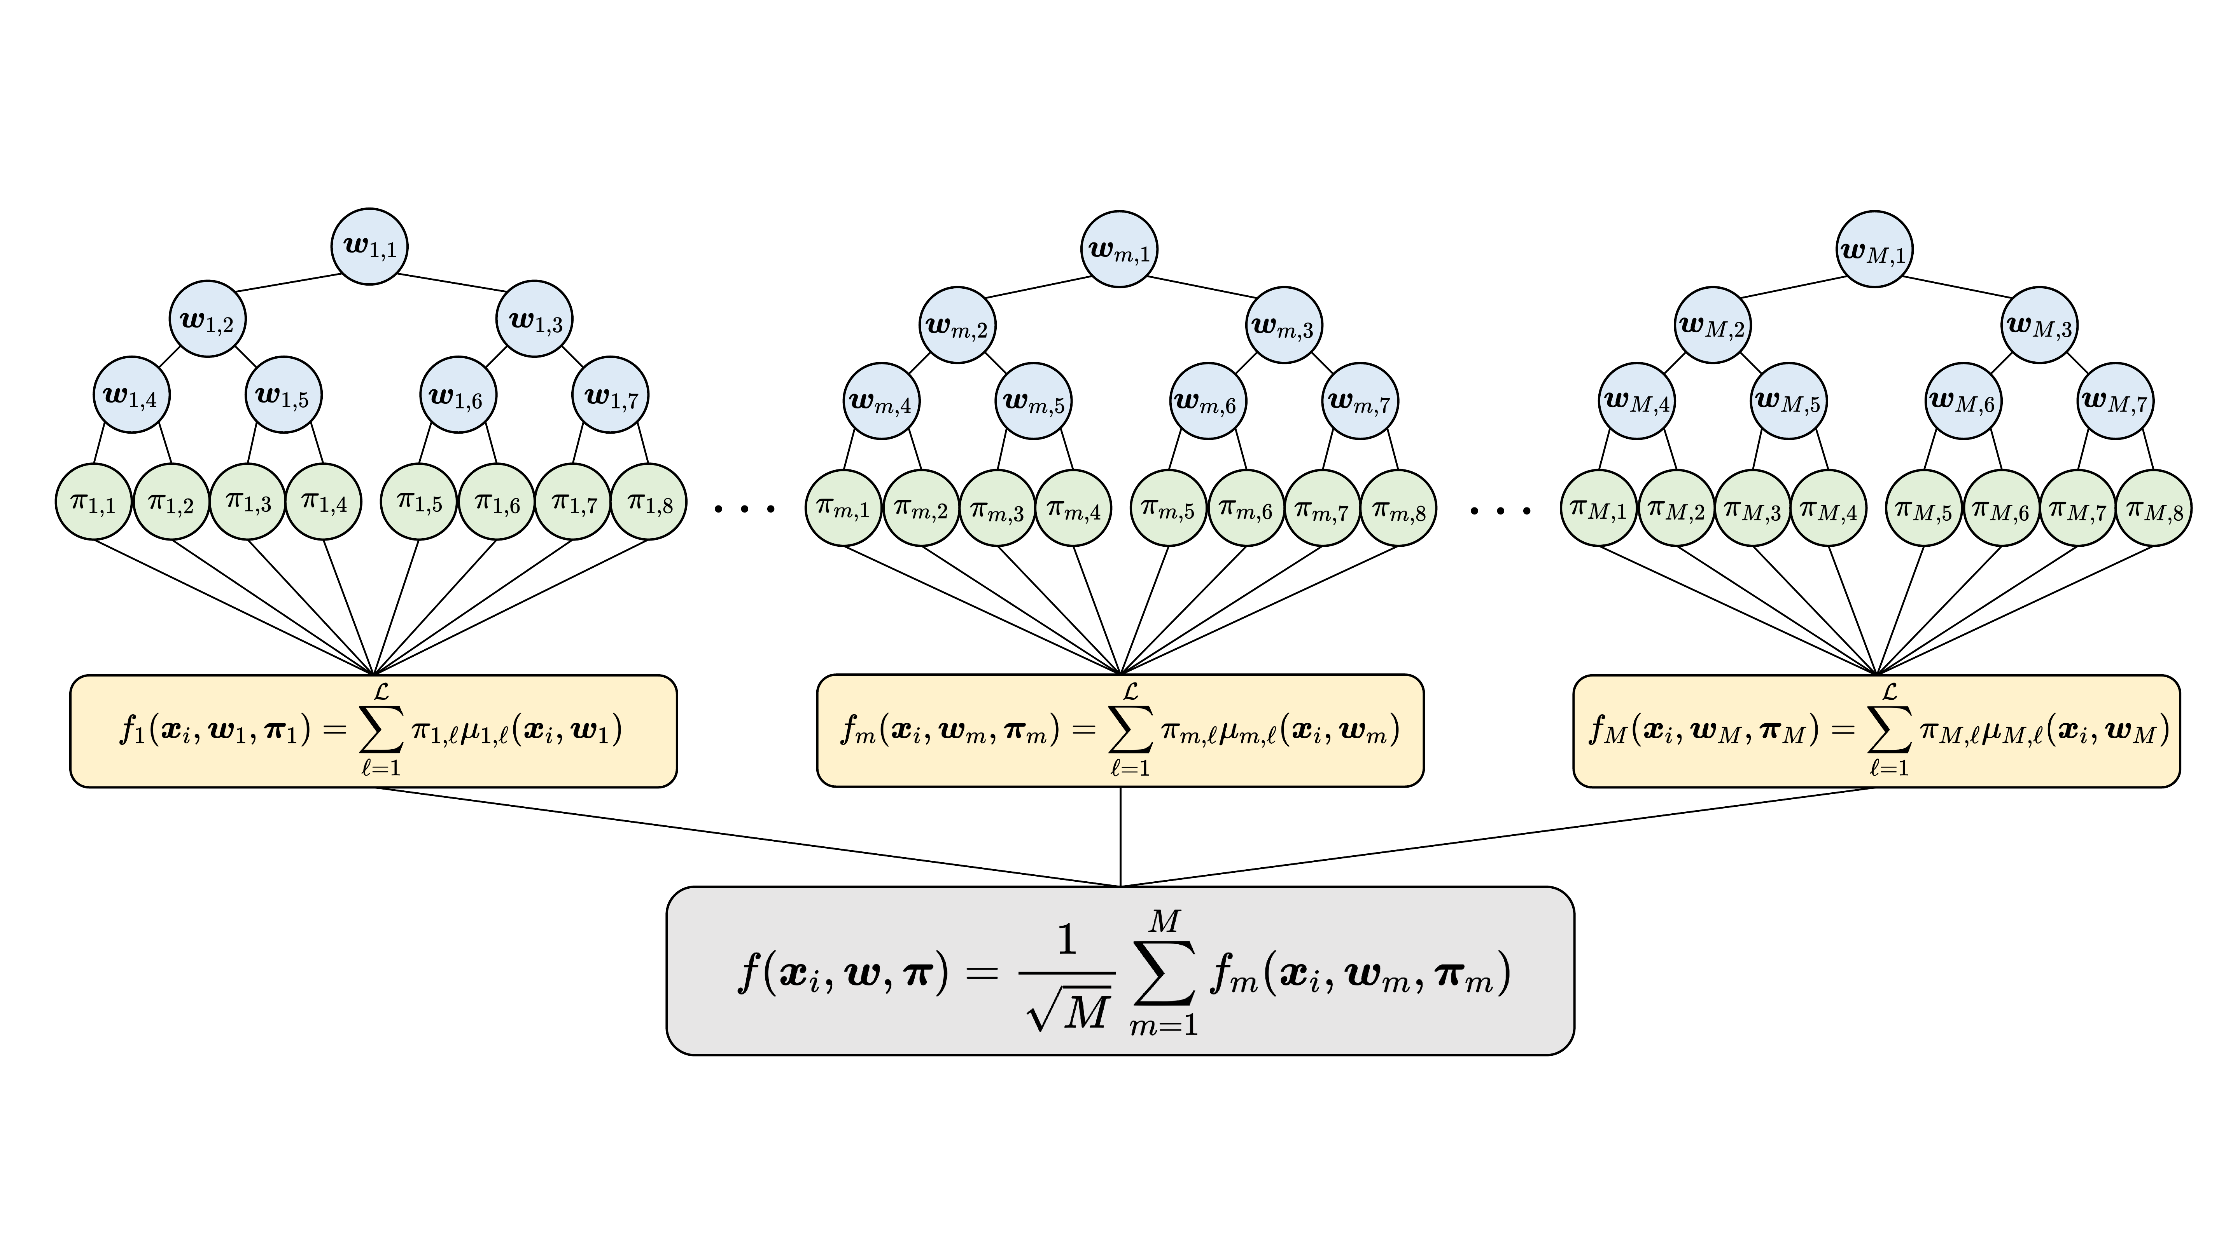
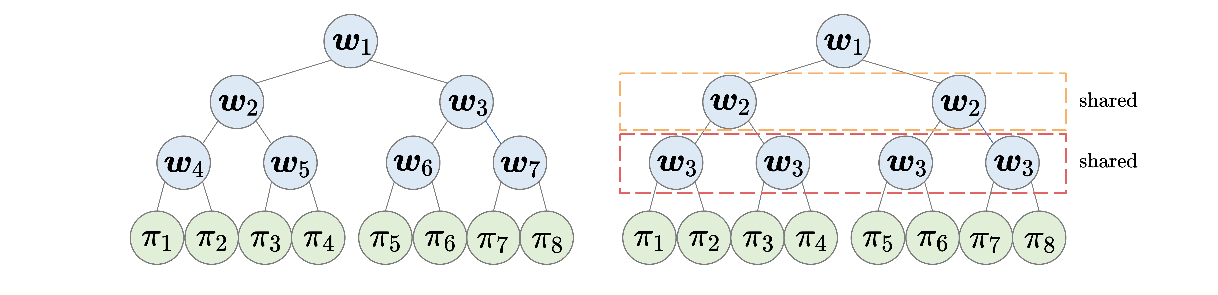
A Neural Tangent Kernel Perspective of Infinite Tree
Ensembles
Ryuichi Kanoh^{1,2}, Mahito Sugiyama^{1,2}
¹ National Institute of Informatics ² The Graduate University for Advanced Studies, SOKENDAI
Problem
Method
Key Results
Soft tree ensembles are trained by gradient descent and excel on tabular data, yet almost no theory explains their training dynamics, generalization, or the empirical tricks practitioners rely on.
Take the number of trees to infinity (M → ∞): the Tree NTK converges in probability to a deterministic kernel with separate inner-node and leaf contributions.
TNTK beats the MLP-induced NTK on >30% of the 90 datasets — at a kernel cost independent of tree depth.
Soft splits use a scaled error function (smooth sigmoid) of hardness α; all split expectations are closed-form, so the kernel is analytic and non-recursive in depth.
Strong in practice, opaque in theory — gradient-trained trees had no kernel-theoretic foundation.
The TNTK is positive-definite and stays fixed during training, so learning is exactly kernel regression and gradient descent is guaranteed to converge globally.
Motivation
Oblivious trees (NODE-style depth-wise parameter sharing) induce the same TNTK as ordinary trees — the architectural constraint is free in the infinite limit.
The Neural Tangent Kernel (NTK) explains training and generalization of infinitely-wide networks — and every architecture induces its own distinct kernel.
But an NTK had never been derived for tree models, leaving infinite soft-tree ensembles theoretically opaque.
Closed-form TNTK for depth-d perfect binary trees. T = split expectation, Σ = input inner product. Constant during training ⇒ learning = kernel regression.
Normal tree (left) vs. oblivious tree (right): oblivious trees share the splitting rule within each depth, while leaf values stay free.
Left: averaged test accuracy over 90 datasets vs. depth. Right: kernel computation time — the TNTK stays flat as depth grows while the MLP-NTK rises.
SO WHAT → The finite-ensemble kernel converges to the closed-form TNTK, training dynamics match kernel regression, and harder splits win more often.
Takeaway
The Tree NTK gives the first kernel theory of infinite soft-tree ensembles — explaining global convergence, why oblivious trees lose nothing, why deep trees degenerate, and why harder splits help.
Headline Numbers
>30%
34.9%
peak win (α=32)
It also delivers a depth-free kernel, competitive with and often superior to the MLP-induced NTK.
An ensemble of M soft trees: each internal node w applies a soft split, leaf outputs π are averaged and scaled by 1/√M.
datasets where TNTK beats the MLP-NTK
11.8%
RBF baseline
of 90 real-world datasets
O(1)
cost vs depth

