Slide 1
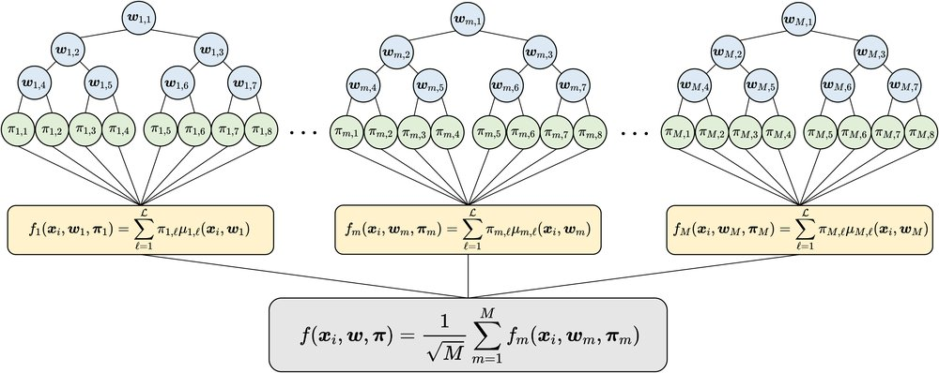



PAPER · DEEP READ · ICLR 2022 · arXiv:2109.04983
Neural Tangent Kernels
for Infinite Tree Ensembles
AN ENSEMBLE OF M SOFT TREES
A closed-form kernel for infinitely many soft trees
Ryuichi Kanoh · Mahito Sugiyama
National Institute of Informatics · SOKENDAI
THE GAP
Soft trees rival neural nets on tabular data
gradient-trained decision trees, yet their training has lacked theory.
COST INDEPENDENT OF TREE DEPTH
THE TOOL
90 datasets · depths 1 – 29
The Tree Neural Tangent Kernel (TNTK)
a closed-form kernel describing an ensemble of infinitely many soft trees.
Paper
AFFILIATIONS
THE PAYOFF
arXiv
Global convergence · deep-tree degeneracy
2109.04983
one theory for many soft-tree behaviours, validated on 90 real-world datasets.
01 / 10

Slide 2
Powerful soft trees, missing theory
PROBLEM · WHY SOFT TREE ENSEMBLES NEED A THEORY
TWO DOMINANT FAMILIES
WHAT IS A SOFT TREE
Trees and neural nets
Differentiable splitting rules
Tree ensembles and neural networks are two of
A decision tree whose splitting rules are made
the most widely used model families in machine
differentiable, so the whole model trains by
learning today.
gradient descent instead of greedy search.
This work bridges the two.
End-to-end learnable, like a neural network.
THEY WORK WELL
BUT NO THEORY
Strong on tabular data
Why do they work?
Ensembles of soft trees excel on tabular data.
Yet almost no theory explains why these models,
Practitioners rely on hard-won training tricks:
or their training tricks, work so well.
parameter sharing · split hardness ·
This paper fills that gap.
over-parameterization
02 / 10

Slide 3
The NTK lens, never aimed at trees
MOTIVATION · A KERNEL FOR INFINITELY MANY SOFT TREES
1
THE NTK
2
MANY ARCHITECTURES
A tool for infinite-width nets
One kernel per architecture
The Neural Tangent Kernel has become a powerful
It has been derived for multi-layer perceptrons,
tool for understanding neural networks with
convolutional networks, and many more, each
infinitely many hidden nodes.
yielding its own distinct kernel.
Training becomes exact kernel regression.
The architecture shapes the kernel.
3
THE MISSING PIECE
4
THE INSIGHT
No NTK for tree ensembles
Soft trees are the natural next step
Despite this breadth, no one had ever derived
Because soft trees inherit characteristics of
a Neural Tangent Kernel for an ensemble of
neural networks, the NTK framework is the
trees.
natural lens for them.
Trees fell outside the theory.
Goal: a closed-form kernel for infinitely many soft trees.
03 / 10

Slide 4
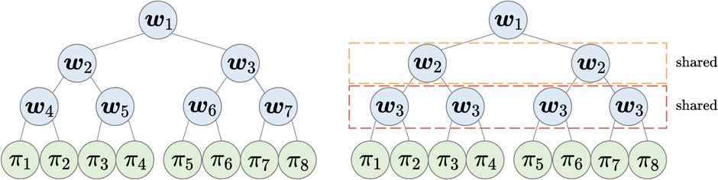
One kernel, four contributions
CONTRIBUTION · WHAT THE TNTK DELIVERS
AT A GLANCE
1 · DERIVE THE KERNEL & PROVE CONVERGENCE
4
The TNTK for infinitely many perfect binary trees
contributions
Derived at initialization for trees of arbitrary depth, the kernel stays essentially
constant during training. That lets learning be analyzed as kernel regression
The paper makes four distinct
and yields a proof of global convergence.
theoretical contributions.
2 · OBLIVIOUS EQUALS ORDINARY
3 & 4 · SHAPE AND DEGENERACY
Parameter sharing costs nothing
From linear to degenerate
Oblivious ensembles share splitting rules within
Third, it characterizes the decision function:
each depth, as in NODE, yet converge to the same kernel.
nearly linear in the basic case, and more
nonlinear as splits are made harder.
Fourth, it uncovers a degeneracy where very
deep trees flatten the kernel to near-constant.
04 / 10

Slide 5
Take the trees to infinity, in closed form
METHOD · DERIVING THE TREE NEURAL TANGENT KERNEL
STEP 1 · INFINITE ENSEMBLE
STEP 2 · A DETERMINISTIC KERNEL
M → ∞
Two interpretable parts
Θ(d) = Θsplit + Θleaf
The method takes the number of soft trees
For perfect binary soft trees of depth d, the
in the ensemble to infinity.
kernel splits into a contribution from the inner
The randomness averages out into a fixed kernel.
splitting nodes and one from the leaves.
STEP 3 · CLOSED-FORM SPLITS
STEP 4 · WHY IT IS POWERFUL
A scaled error function, sharpened by α
Constant, positive definite, depth-free
Each soft split is a scaled error function, a
The kernel stays constant and positive definite,
smooth sigmoid whose sharpness is set by the
so training reduces to kernel regression with
scaling parameter α. Its expectations have
guaranteed global convergence. The formula is
closed forms, so the whole kernel is analytic.
not recursive in depth, so its cost is
Larger α means harder, more decisive splits.
independent of tree depth.
05 / 10

Slide 6
Ninety datasets and a cost benchmark
DATASETS & SETUP · HOW THE TNTK IS EVALUATED
STUDY DESIGN
GENERALIZATION · 90 REAL-WORLD DATASETS
2
Kernel regression, three kernels compared
kinds of data
The authors run kernel regression with the Tree NTK on ninety real-world
datasets, comparing it against two baselines.
One track for generalization,
one for computational cost.
Infinite-width MLP-induced NTK
Classic RBF kernel
HYPERPARAMETER SWEEPS
COMPUTATIONAL COST · SYNTHETIC DATA
Depth and split-hardness
A controlled timing benchmark
TREE DEPTH
SPLIT HARDNESS
SAMPLES
GAUSSIAN FEATURES
1 – 29
α swept
300
10
Depth is tuned from one up to twenty-nine, and
Cost is measured on a synthetic set of 300
α is swept across a wide range.
samples with ten Gaussian features.
06 / 10

Slide 7
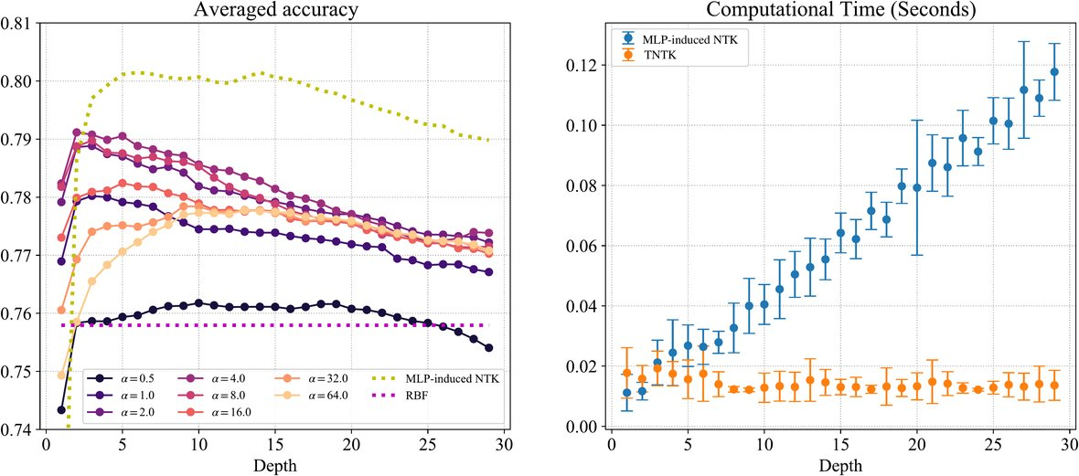
Every prediction, confirmed
KEY RESULT · ACCURACY OVER 90 DATASETS & KERNEL COMPUTE TIME
DEPTH DEGENERACY
THEORY CONFIRMED
Deeper first helps, then hurts
Convergence and dynamics match
As the number of trees grows, the empirical kernel
converges to the closed-form Tree NTK, and training
dynamics match the kernel-regression prediction.
WHERE TREES WIN · > 30% OF DATASETS
The MLP kernel wins on average
but the tree kernel is better on more than 30% of the
datasets, wherever the tree inductive bias fits better.
Left: averaged accuracy over 90 datasets vs depth. Right: kernel compute time.
CONSTANT-COST COMPUTE · DEPTH-FREE
Making trees deeper first improves then hurts
Far faster as trees get deeper
accuracy, exactly the degeneracy the theory
Because the tree kernel's cost never grows with depth
predicted for very deep soft trees.
(right panel), it is dramatically faster to compute than
the MLP kernel as depth increases.
07 / 10

Slide 8
Harder splits win more often
ABLATION STUDY · SPLIT HARDNESS, DEPTH, AND OBLIVIOUS TREES
SPLIT HARDNESS α → WIN RATE vs MLP KERNEL
TWO CENTRAL ABLATIONS
Harder splits, more dataset wins
Split hardness · tree depth
35%
Plus an empirical check of the oblivious-tree theorem.
24%
DEPTH SWEEP
Degeneracy, reproduced
14%
Sweeping tree depth reproduces the degeneracy story:
RBF ≈ 12%
accuracy first improves, then declines as trees deepen.
OBLIVIOUS THEOREM · VERIFIED
soft α
medium α
hard α
Oblivious matches ordinary
The authors verify empirically that oblivious trees, as
Dataset-wise win rate against the MLP kernel climbs
used by the NODE model, induce the same kernel as
from about 14% for soft splits to nearly 35% for the
ordinary soft trees in the infinite limit.
hardest, all above the RBF baseline.
Parameter sharing is free in the infinite ensemble.
08 / 10

Slide 9
The headline numbers
RESULTS AT A GLANCE · WIN RATE, COST, AND DEPTH RANGE
IMPACT IN BRIEF
DATASET-WISE WIN RATE vs MLP KERNEL (90 DATASETS)
A few numbers
> 30%
of datasets favor the tree kernel,
capture the impact
peaking near 35% when splits are hard.
Where trees win, how cheap they
≈ 35%
peak (hard splits)
< 12%
RBF kernel baseline
are, and how far they scale.
COMPUTE COST vs DEPTH
DEPTH RANGE STUDIED
O(1)
1 – 29
in tree depth
Cost independent of depth
A wide sweep of tree depth
The tree kernel's cost does not grow with tree depth
Experiments span tree depths from one all the way up
at all, while the multi-layer perceptron kernel scales
to twenty-nine, tracing the full accuracy-versus-depth
linearly with depth.
degeneracy curve.
09 / 10

Slide 10
The NTK lens now reaches trees
TAKEAWAY · ONE THEORY FOR MANY SOFT-TREE BEHAVIOURS
THE BIG IDEA
ONE THEORY · FOUR BEHAVIOURS EXPLAINED
The NTK framework, once
The Tree NTK explains it all
only for neural networks,
1 · Training converges globally
now applies to trees.
the constant, positive-definite kernel guarantees it.
The Tree NTK carries kernel theory into soft
2 · Oblivious sharing costs nothing
tree ensembles for the first time.
it induces the very same kernel in the infinite limit.
AND A PRACTICAL PAYOFF
3 · Deep trees degenerate
A fast, depth-free kernel
very deep trees flatten the kernel to near-constant.
It also delivers a practical kernel whose cost is
independent of depth, an attractive, fast
4 · Harder splits help
alternative to the MLP kernel on tabular data.
sharper splitting yields a more useful nonlinear kernel.
Read the paper · arXiv:2109.04983 · ICLR 2022
10 / 10

