Slide 1


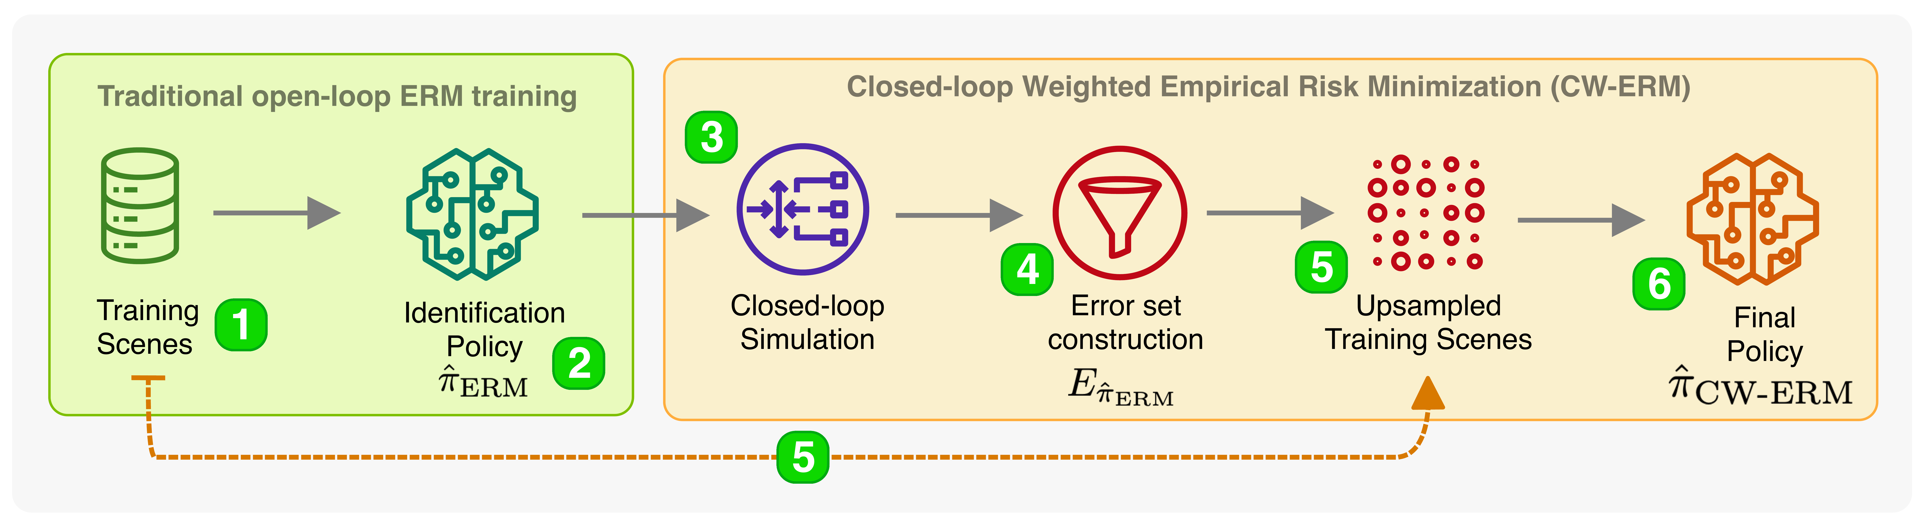
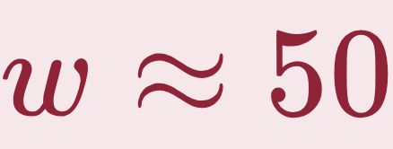
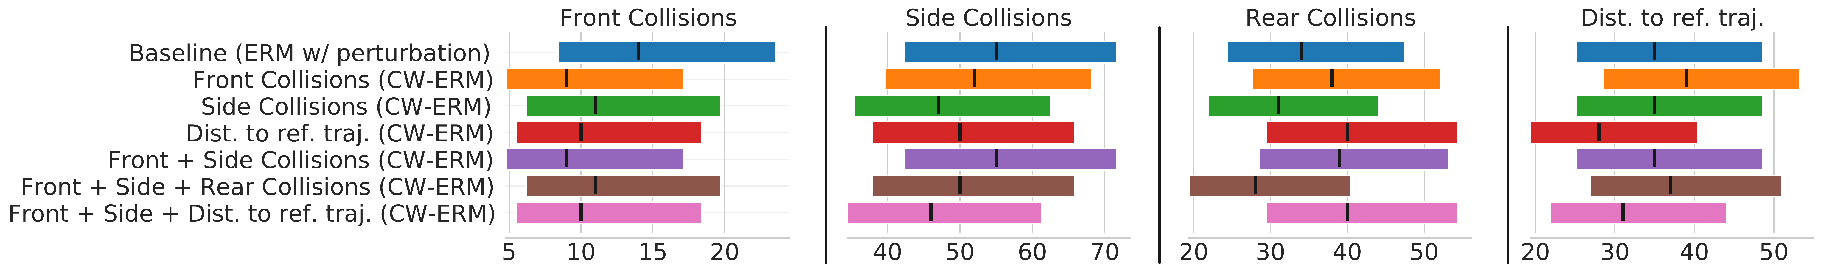


CW-ERM: Improving Autonomous Driving Planning with Closed-loop Weighted Empirical
Risk Minimization
Eesha Kumar¹, Yiming Zhang², Stefano Pini¹, Simon Stent¹, Ana Ferreira², Sergey Zagoruyko¹, Christian S. Perone¹
¹Woven Planet UK · ²Woven Planet North America
Problem
Method
Ablation Study
Behavioral-cloning driving policies are trained open-loop with Empirical Risk Minimization, matching only per-step expert actions. Deployed closed-loop, small prediction errors compound into covariate shift and collisions.
1
ERM identification policy
›
2
Closed-loop rollout → error set
›
3
Weighted ERM upsamples failures
Single-metric upsampling wins its target metric; multi-metric trades a Pareto front.
Adding rear collisions regresses; best near .
Non-differentiable safety metrics like collisions are invisible to the surrogate loss — training and deployment optimize different objectives.
Headline Numbers
35 → 28
Dist-to-ref failures
14 → 9
55 → 47
Side collisions
Front collisions vs. baseline
Motivation
≈35%
Peak metric gain
Closed-loop remedies like backprop-through-time in a differentiable simulator are expensive, need differentiable metrics, and scale poorly.
The six-step CW-ERM pipeline: identify failures closed-loop, upsample them, and retrain.
Takeaway
Dataset / Benchmark
Key Results
Simulate once, upsample the failures, and retrain — no differentiable simulator, oracle, or added latency.
Unrolling policies through a simulator during training carries a heavy memory cost and does not scale to large fleets of scenes.
Real-world urban driving logs (ego + agents + HD maps); simulator & metrics open-sourced via l5kit.
Diverse scenarios: lead-vehicle stops, intersections, dense mixed traffic.
METRIC-AGNOSTIC
Closed-loop collision counts (95% CIs) vs. the best baseline (ERM w/ perturbation) across four metrics; each CW-ERM row upsamples a different metric.
Failure-weighting ≈ covariate-shift correction via density-ratio estimation.
Collecting on-policy data or adding human oracles is costly; prior debiasing (LfF, JTT) targets classifier group robustness, not closed-loop driving.
Scenes 11–13 s (up to 30 s); train / val / test balanced by scenario.
Metrics: front / side / rear collisions + distance-to-reference.
CW-ERM cuts collisions up to ~35% vs. the best baseline.
Scan to Read
Paper
Code
Can we get closed-loop benefits by using a simulator only to pick which training scenes matter — no new loss, no differentiability?
180 h
60 h
~13 s
SO WHAT → Front collisions fall 14→9 and side collisions 55→47; gains transfer to related metrics (side-collision upsampling also cuts rear collisions), with lower variance than the baseline.
training
val / test each
per scene
San Francisco
Palo Alto
Intersections
Dense traffic
Pedestrians & cyclists

