Slide 1




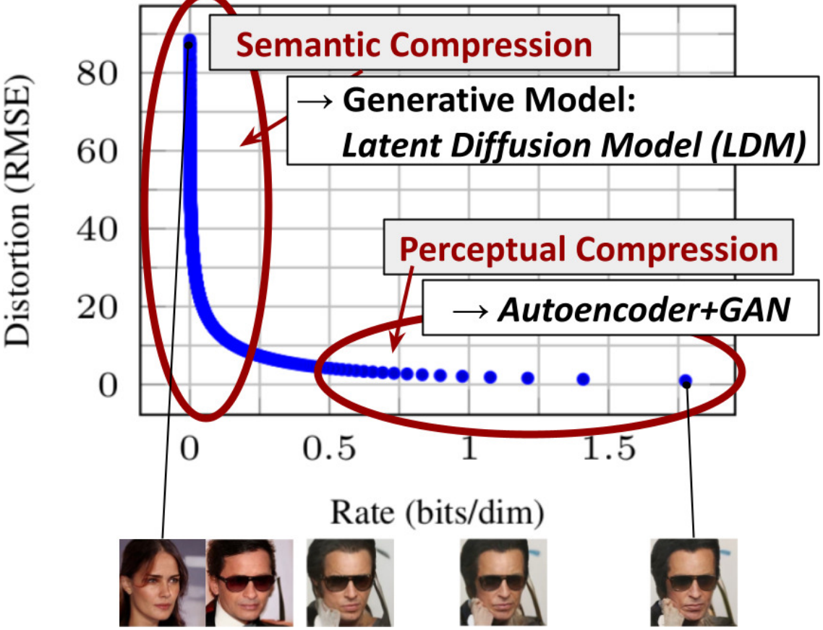
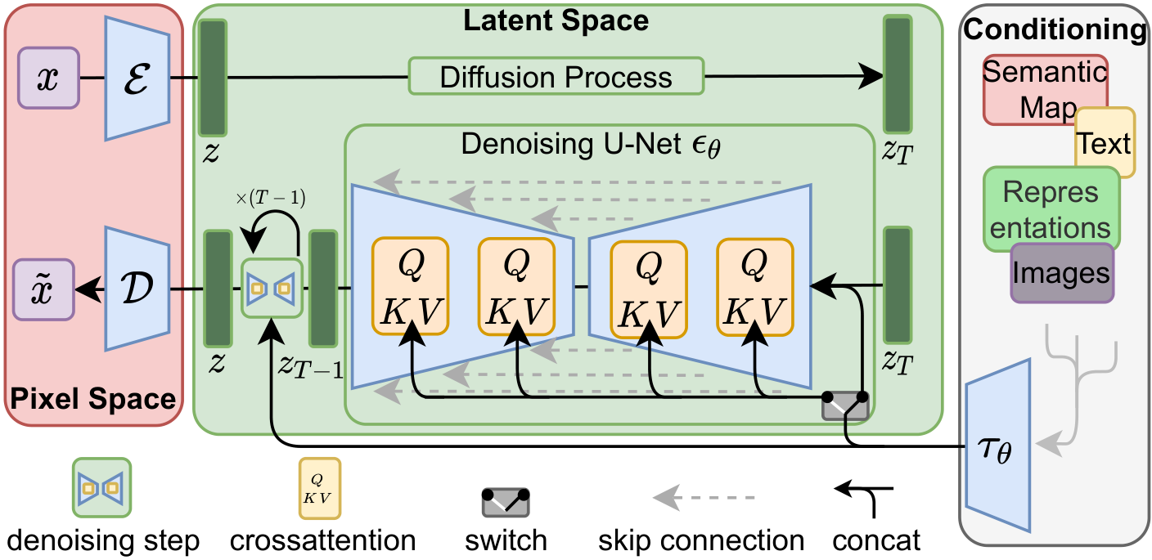
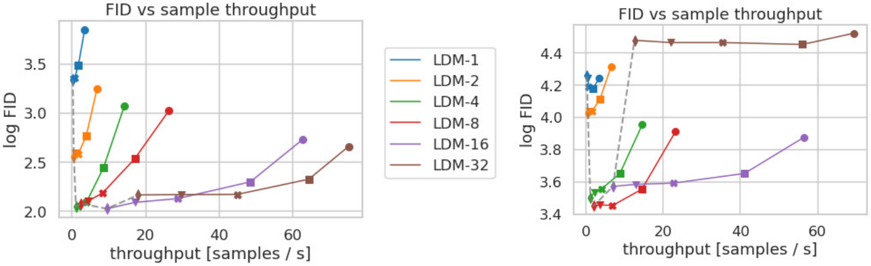
CVPR
High-Resolution Image Synthesis with Latent Diffusion Models
2022
Robin Rombach¹, Andreas Blattmann¹, Dominik Lorenz¹, Patrick Esser², Björn Ommer¹
POSTER
¹ Ludwig Maximilian University of Munich & IWR, Heidelberg University ² Runway ML
Paper
Code
Problem
Method
Dataset / Benchmark
Ablation Study
Diffusion models lead image synthesis, but
run directly in pixel space — training the
most powerful models costs 150–1000
GPU days, and sampling is slow and
memory-heavy.
1
Encode →
z
›
2
Latent
diffusion
›
3
Decode →
x̃
Evaluated across generation, super-resolution, and
inpainting — on a single A100 GPU.
DOWNSAMPLING
F
OUTCOME
Stage 1 — Perceptual autoencoder. Compress
images by a factor f into a latent using a perceptual
+ patch-adversarial loss, regularized by a slight KL
penalty or vector quantization.
CelebA-HQ
FFHQ
LSUN-Churches
f=1 (pixel) / f=2
slow, worse FID
LSUN-Bedrooms
ImageNet
COCO
Places
FID
f=4 – f=8
best FID + fast
sampling
Most of that compute models detail
humans cannot even perceive.
IS
P/R
PSNR/SSIM/LPIPS
f=16 / f=32
detail lost, capped
Stage 2 — Latent diffusion. Train a time-
conditional UNet entirely in that compact latent
space, where each denoising step is far cheaper
than in pixel space.
Key Results
Headline Numbers
Motivation
SETTING
FID ↓
CelebA-HQ · unconditional
5.11
5.11
Most image bits are imperceptible
high-frequency detail; a likelihood
model wastes its capacity there, not on
semantics.
Cross-attention conditioning injects text, layouts,
or class labels at every UNet layer; fully-
convolutional sampling lifts 256² training to
megapixel synthesis.
ImageNet · class-cond. (CFG)
3.60
ImageNet · LDM-8-G variant
7.76
FID · CelebA-HQ (new SOTA)
beats prior GANs & likelihood models
Prior work down-weighted that, but the
net still ran on every pixel — wasted
compute remained.
Mild downsampling (f=4–8) hits the sweet spot
between complexity reduction and detail
preservation.
New SOTA FID 5.11 on CelebA-HQ · 3.60 on
class-conditional ImageNet
3.60
1×A100
f=4–8
FID · ImageNet
(CFG)
single-GPU
training
best compression
SO WHAT → LDMs match or beat pixel-space diffusion and GANs at a fraction of the training and inference cost.
Takeaway
Run diffusion in a compact,
perceptually-faithful latent space —
not raw pixels — cutting training and
inference cost at equal-or-better
quality; cross-attention adds general
conditioning.
FID vs. throughput by compression factor (CelebA-HQ left,
ImageNet right): f=4–8 dominates; f=1 and f=16/32 lag.
From GPU-days to one GPU
— the basis for Stable
Diffusion.
Most image bits are imperceptible
perceptual detail; semantic structure is
where generative capacity belongs.
LDM architecture: an autoencoder maps pixels ↔ latent z; a
UNet runs diffusion in latent space, conditioned via cross-
attention on text, layouts, images, or class labels.
Also SOTA on inpainting; super-resolution beats
SR3 in FID.
Legacy

