Slide 1




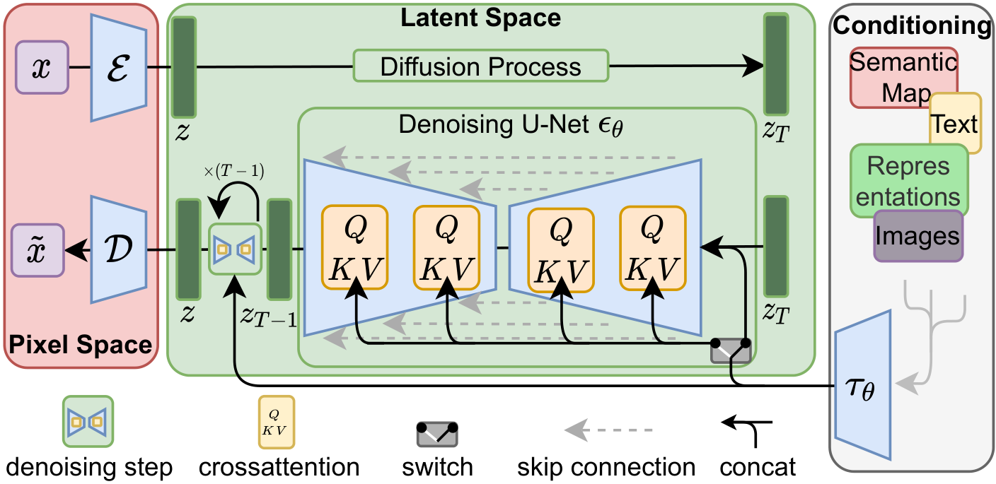
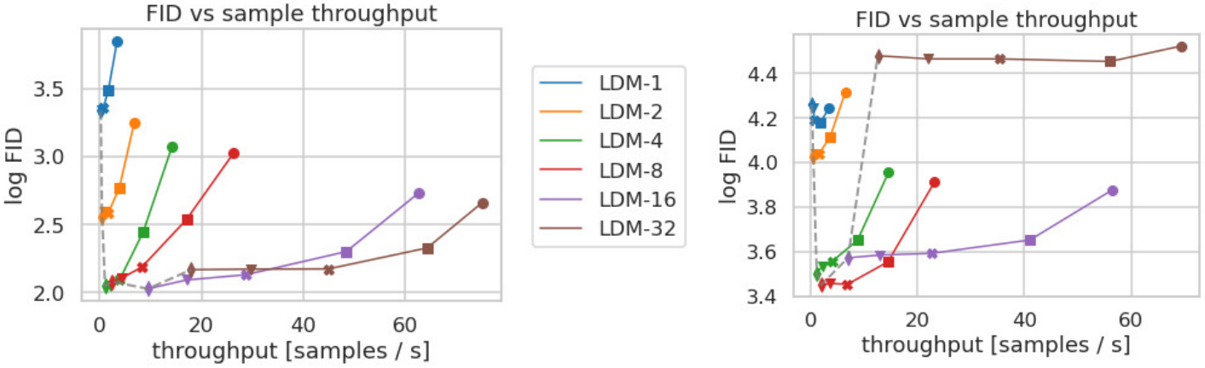
High-Resolution Image Synthesis with Latent
Diffusion Models
CVPR
2022
Robin Rombach¹, Andreas Blattmann¹, Dominik Lorenz¹, Patrick Esser², Björn Ommer¹
¹ LMU Munich & IWR, Heidelberg University ² Runway ML
Paper
Code
Problem
Motivation
Diffusion models set the state of the art in image synthesis, but they
run directly in pixel space — so training the most powerful models
costs hundreds of GPU-days, and every sampling step is slow and
memory-hungry.
Most bits of an image encode imperceptible high-frequency
detail; a likelihood model spends the bulk of its capacity and
compute on pixels, not semantics.
This confines high-resolution generative modeling to the few labs with
massive compute, leaving a large carbon footprint and limiting access
for the broader research community. Sampling is also sequential, so
each image needs many costly denoising passes.
Prior diffusion work down-weighted those details in the loss, yet
the network still had to be evaluated on every pixel — so the
wasted computation remained.
PIXEL SPACE
vs.
LATENT SPACE
Training a top pixel-space diffusion model can take 150–1000
V100-days — out of reach for all but a handful of labs.
Spends capacity on
imperceptible detail; evaluates
every pixel.
Train where semantics live —
a compact, perceptual code.
Stage 1 — autoencoder. A perceptual
autoencoder (KL- or VQ-regularized, perceptual
+ patch-adversarial loss) compresses images by
a factor f into a compact latent.
Stage 2 — latent diffusion. A time-conditional
UNet runs the diffusion process entirely in that
latent space, where every forward pass is far
cheaper than in pixels.
Conditioning. Cross-attention layers inject text,
layouts, or class labels, turning the UNet into a
general-purpose multi-modal generator.
LDM architecture — an autoencoder maps pixels ↔ latent; a UNet denoises in latent space,
conditioned via cross-attention (τθ).
1
Encode
→ latent
›
2
Diffuse
in latent
›
3
Cross-
attn
condition
Headline Numbers
Key Results
5.11
Class-cond. ImageNet
FID ↓
Params
FID · CelebA-HQ 256² (LDM-4)
ADM
10.94
554M
New state of the art on CelebA-HQ.
LDM-4 (ours, no cfg)
10.56
400M
3.60
1×A100
f = 4–8
≥1.6×
ADM-G
4.59
608M
FID · ImageNet (LDM-
4-G)
all main experiments
best compression
inpainting FID gain
LDM-4-G (ours)
3.60
400M
−0.99 FID vs ADM-G — with 34% fewer parameters
Ablation Study
SO WHAT → LDM-4-G reaches near-SOTA class-conditional ImageNet FID using ~⅔ the parameters and a fraction of pixel-space compute.
Compression sweet spot: f = 4 and f = 8 reach far lower FID and
faster sampling than pixel-space LDM-1; aggressive f = 16/32
discard too much detail.
Data-dependent: complex ImageNet benefits from more
compression than simple face data; VQ vs. KL latents trade
reconstruction against sample FID.
The autoencoder's compression factor — not the diffusion
model — is the decisive lever on quality and speed.
FID vs. sampling throughput across compression factors on CelebA-HQ (left)
and ImageNet (right) — mild compression (LDM-4/8) gives the best quality–
speed trade-off.
SO WHAT → Mild perceptual compression (f = 4–8) is the key lever balancing efficiency and quality — neither pixel-space LDM-1 nor aggressive f = 32 competes.
Also SOTA in inpainting, beats SR3 in super-resolution FID, and
powers text- & layout-to-image synthesis.

