Slide 1


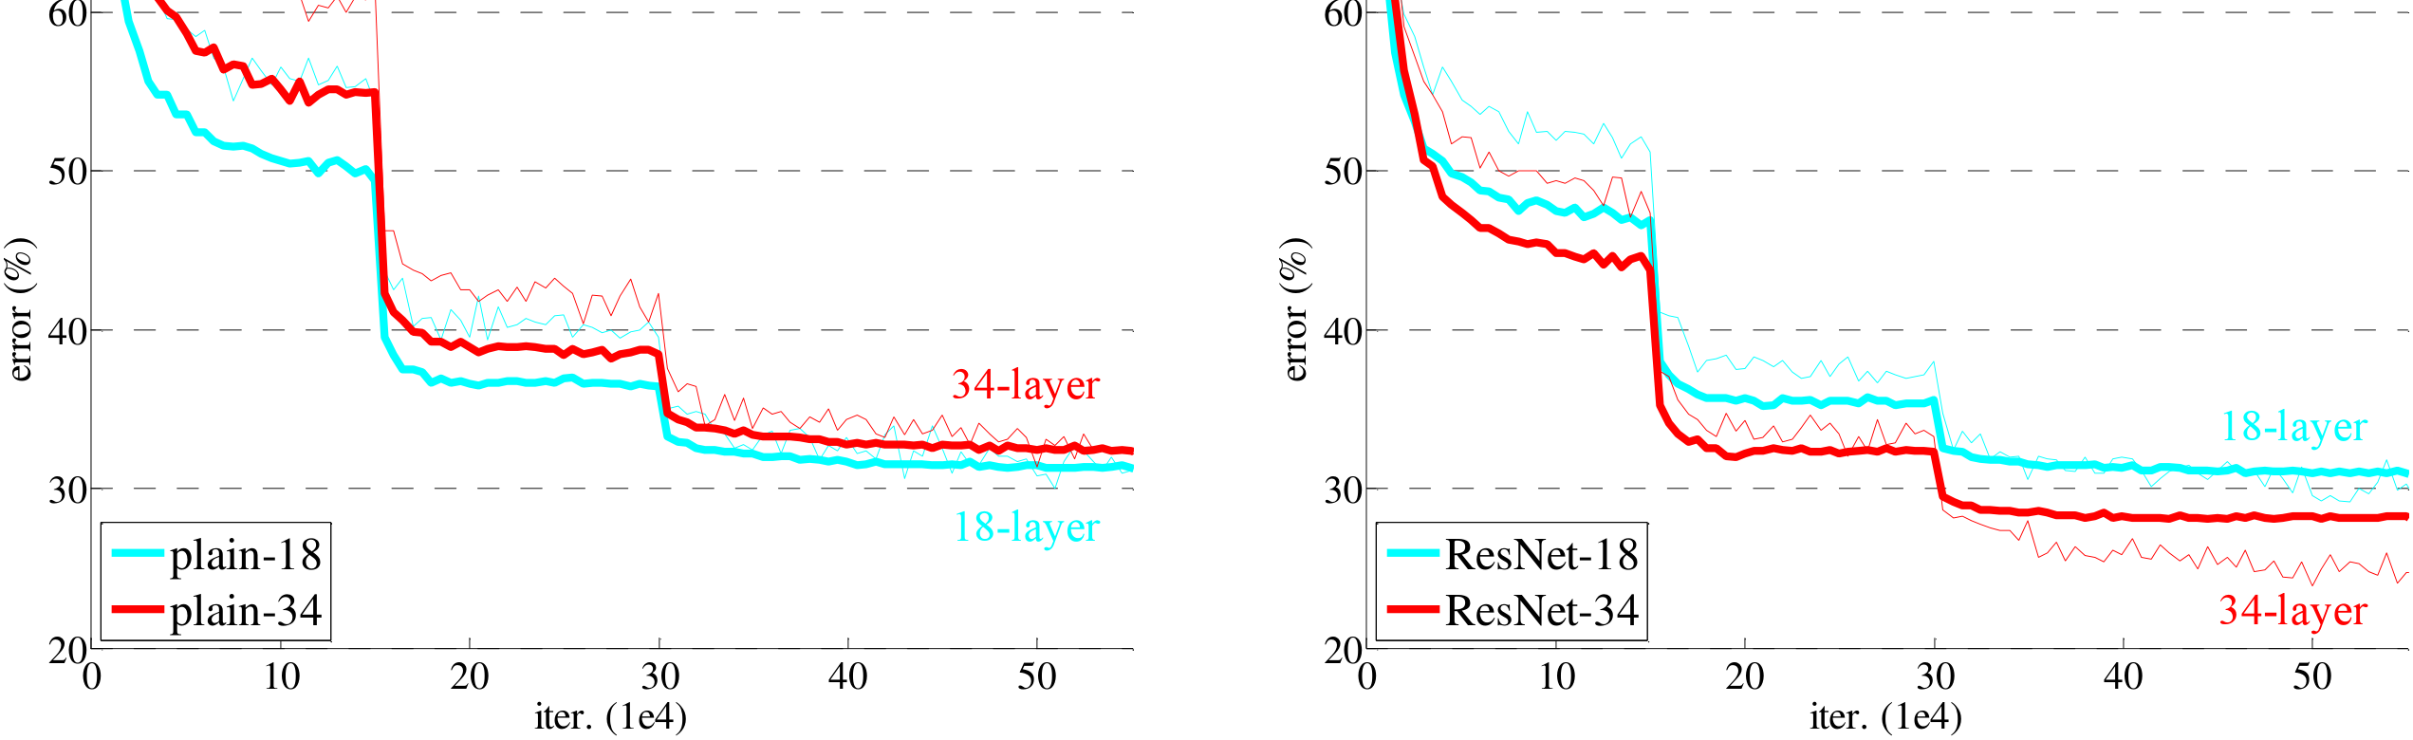
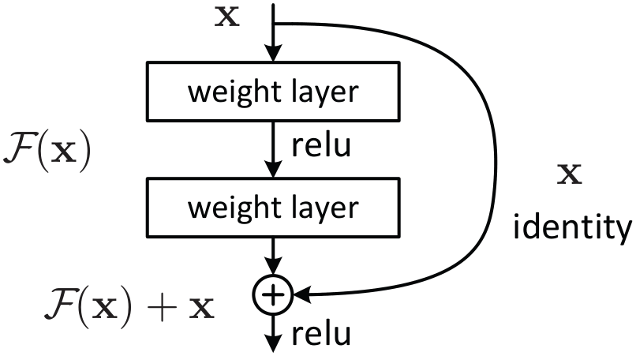
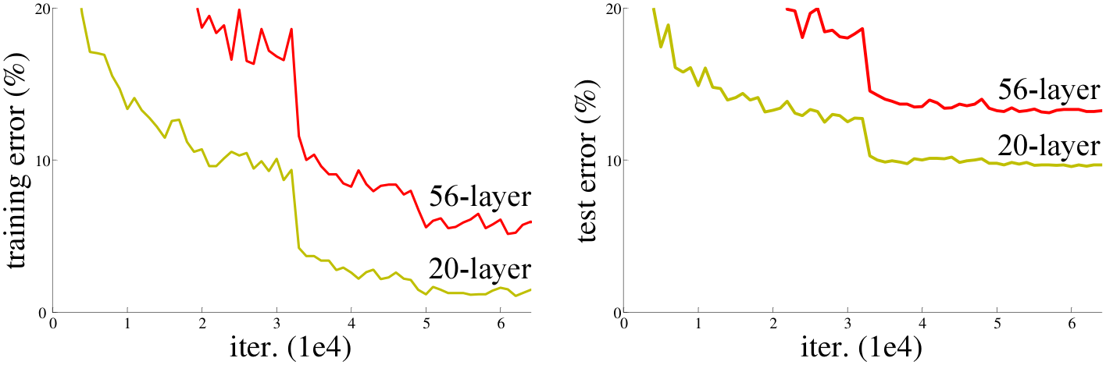
CVPR
Deep Residual Learning for Image Recognition
2016
Kaiming He¹, Xiangyu Zhang¹, Shaoqing Ren¹, Jian Sun¹
BEST PAPER
¹ Microsoft Research
Paper
Problem
Method
Key Results
Headline Numbers
Plain deep networks suffer a degradation problem: past a depth threshold, training accuracy saturates and gets worse — an optimization failure on very deep stacks, not overfitting from added capacity.
Each block learns a residual; the input is added back through a parameter-free identity shortcut, adding no extra parameters and almost no compute.
IMAGENET VAL (10-CROP)
TOP-1
TOP-5
3.57%
Plain-34
28.54
10.02
ResNet-34
25.03
7.76
ImageNet top-5 · ILSVRC 2015 winner
When dimensions change, choose zero-padding (Option A) or a 1×1 projection (Option B).
ResNet-50
22.85
6.71
152-layer ResNet ensemble — 1st place
A 56-layer plain net has higher training error than a 20-layer one — depth itself starts to hurt.
ResNet-101
21.75
6.05
4.49%
+28%
152
Bottleneck blocks (1×1 → 3×3 → 1×1) make 50/101/152-layer nets cheaper than VGG.
ResNet-152
21.43
5.71
single-model top-5
COCO mAP gain
layers (8× VGG)
Trained with SGD (batch 256, lr 0.1 with step decay), BN after each conv, He init, weight decay 1e-4 — no dropout anywhere.
−3.51 pts top-1: Plain-34 → ResNet-34 — degradation cleared.
Ablation Study
Motivation
Shortcut type (ResNet-34 top-1): A 25.03 → B 24.52 → C 24.19. Identity shortcuts are enough; projections everywhere add little.
Depth matters, but vanishing/exploding gradients alone — already mitigated by BN and He init — don't explain the new degradation.
$y=F(x,\{W_{i}\})+x$
F is a stack of 2–3 weight layers; the + is element-wise addition through a parameter-free shortcut.
1202-layer CIFAR-10 ResNet trains to <0.1% error — no optimization difficulty at 10³ layers.
A deeper net could match a shallower one by identity-padding the extras — yet plain stacks fail.
Figure 4. ImageNet training curves. Thin = train, bold = val. Left: plain — deeper is worse. Right: ResNet — deeper is better.
Normalized init + BN + warm-up can't push past the ~30-layer wall; a structural reformulation is needed.
Takeaway
+6.0
+28%
5×
ILSVRC + COCO 2015 wins
Residual learning with identity shortcuts removes the degradation barrier — accuracy keeps improving as depth grows into the hundreds.
COCO mAP@[.5,.95]
relative gain
SO WHAT → A single 152-layer ResNet beats every prior ensemble on ImageNet, and the 6-model ResNet ensemble wins ILSVRC 2015 at 3.57% top-5. The same ResNet-101 backbone, dropped into Faster R-CNN with no architectural changes, also powers the COCO and ImageNet detection / localization winners — a backbone-level win, not a task-specific trick. ResNet became the default vision backbone for years.
Figure 2. Residual learning: a building block — the residual F(x) is added to an identity shortcut x.
Depth + the right structural prior is a clear win.
2-layer block
3-layer bottleneck
Identity shortcut
The residual connection became a building block reused across deep learning — Transformers, diffusion, and beyond.
Figure 1. CIFAR-10 error: 56-layer plain net is worse than the 20-layer one — degradation, not overfitting.
1×1 projection
BN
He init
SGD 256

