Slide 1


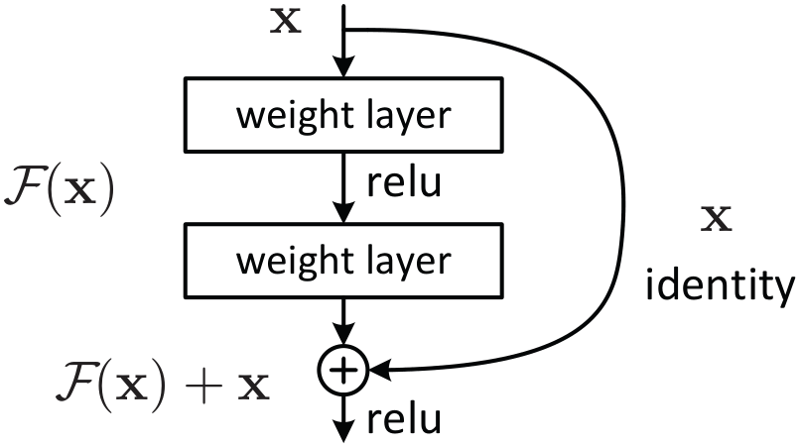
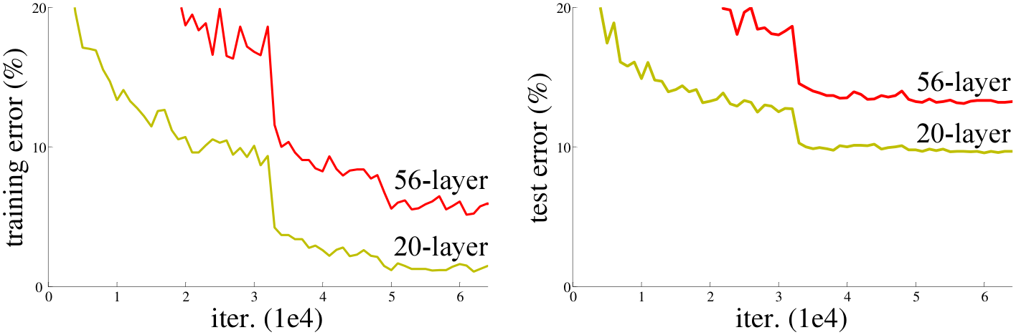
CVPR
Deep Residual Learning for Image Recognition
2016
Kaiming He¹, Xiangyu Zhang¹, Shaoqing Ren¹, Jian Sun¹
BEST PAPER
¹ Microsoft Research
Paper
Method
Each block computes y = F(x, {W_{i}}) + x — the 2–3-layer residual F is added through an identity shortcut that introduces zero extra parameters and almost no extra compute over a plain stack.
When channel count or spatial size changes, the shortcut either zero-pads (option A) or applies a 1×1 projection (B); deeper nets stack 1×1, 3×3, 1×1 bottleneck blocks for compute efficiency at extreme depth.
BatchNorm after every conv, He initialization, SGD batch 256, LR 0.1 with step decay, weight decay 1e−4, momentum 0.9, no dropout; 60×10⁴ iterations on ImageNet.
Downsampling lives in stride-2 convs at conv3_1 / conv4_1 / conv5_1; CIFAR-10 ResNets follow a 6n+2 recipe with identity shortcuts everywhere.
Fig. 2 · A residual building block: two weight layers learn F(x), and an identity shortcut adds x back — the entire framework adds no extra parameters and almost no extra compute.
Problem
Key Results
Plain deep networks suffer a degradation problem: as depth grows past a point, training accuracy saturates and then gets worse — not from overfitting, but from optimization difficulty. A 56-layer plain CNN has higher training error than a 20-layer one on CIFAR-10: deeper actively hurts.
Method
Top-1
Top-5
Plain-34 (baseline)
28.54
10.02
ResNet-34
25.03
7.76
ResNet-152 (single)
21.43
4.49
ResNet-152 ×6 (ensemble)
—
3.57
Motivation
−3.51 pts top-1 from Plain-34 to ResNet-34 — the degradation curve flips: ResNet-34 BEATS ResNet-18 by 2.8 pts top-1, the opposite of the plain-net trend.
BatchNorm + He init already tame vanishing gradients — gradient norms stay healthy at 30+ layers, so degradation is NOT a gradient-flow issue.
Same ResNet-101 backbone, dropped into Faster R-CNN, lifts COCO mAP@[.5,.95] by +28% relative over VGG-16. The 152-layer net is 8× deeper than VGG-19 with lower theoretical FLOPs.
A deeper net can match a shallower one by setting extra layers to identity — degradation is a pure optimization failure of SGD on very deep stacks, not a representational limit.
Ablation Study
Shortcut type (Tbl. 3, ResNet-34): zero-pad A 25.03 / 7.76 → proj-on-change B 24.52 / 7.46 → everywhere C 24.19 / 7.40 — small gaps confirm parameter-free identity shortcuts are sufficient.
Fig. 1 · CIFAR-10 train (left) / test (right): the 56-layer plain net loses to the 20-layer one at every step. Both train AND test error rise — ruling out overfitting and exposing pure optimization failure.
Layer-response std (Fig. 7) drops with depth — deeper ResNets settle to smaller per-layer outputs, so residuals stay closer to zero, confirming the framework's central learned-residual hypothesis.
Takeaway
Headline Numbers
Residual learning with identity shortcuts removes the degradation barrier — accuracy keeps improving as depth grows into the hundreds, turning depth from a liability into an asset. The same ResNet backbones swept the 2015 ILSVRC + COCO challenges, and the residual block became the default primitive across vision — reused in Transformers, U-Nets, diffusion.
3.57%
Top-5 error · ImageNet 2015 (1st, ILSVRC)
152
11.3B
+28%
layers (8× VGG-19)
FLOPs (VGG-19: 19.6B)
rel. COCO mAP

