Slide 1



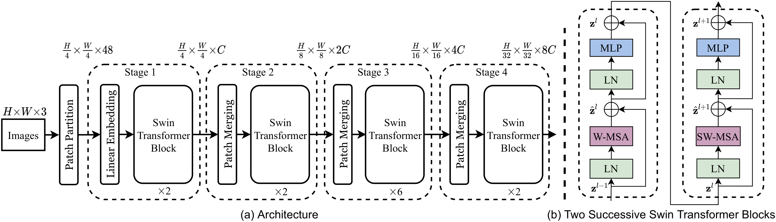
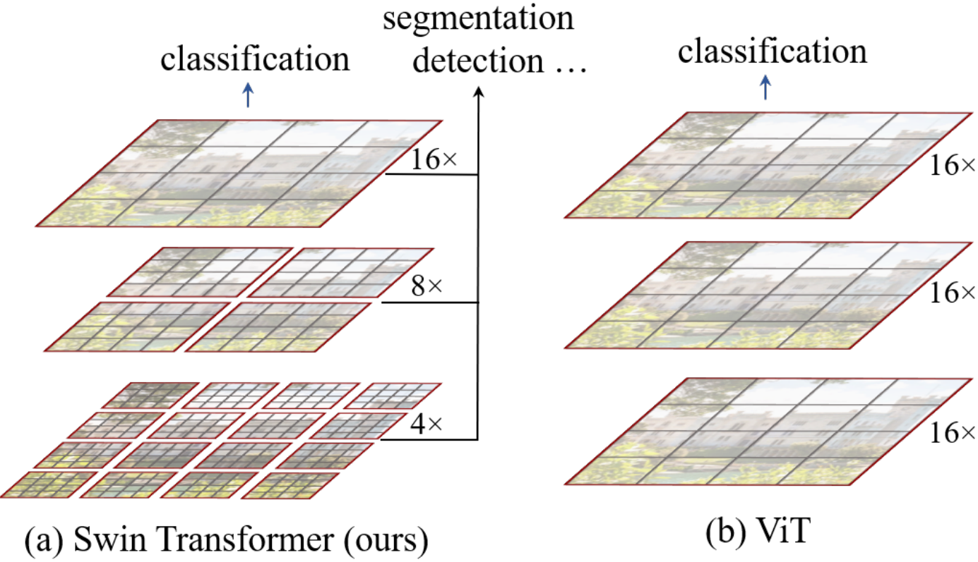
ICCV
Swin Transformer: Hierarchical Vision Transformer using Shifted Windows
2021
Ze Liu¹, Yutong Lin¹, Yue Cao¹, Han Hu¹, Yixuan Wei¹, Zheng Zhang¹, Stephen Lin¹, Baining Guo¹
¹ Microsoft Research Asia
Paper
Code
Problem
Method
Headline Numbers
Standard vision Transformers like ViT compute global self-attention at one low resolution — quadratic cost in image size, and a single coarse feature map that detection and segmentation heads can’t plug into.
1
Split image into 4×4 patches; self-attention inside M×M windows — linear cost. Next layer shifts by ⌊M/2⌋ to restore cross-window context.
87.3%
2
Patch-merging → pyramid: H/4, H/8, H/16, H/32.
Top-1 · ImageNet-1K · Swin-L
w/ ImageNet-22K pretrain
58.7
51.1
53.5
COCO box AP
COCO mask AP
ADE20K mIoU
ViT works for classification but isn’t a general-purpose vision backbone — per-pixel tasks need both multi-scale features and tractable cost.
Ablation Study
Drop the shift → −1.1% ImageNet, −2.8 box AP, −2.8 mIoU. Cross-window propagation is essential.
Motivation
(a) Swin Transformer (Swin-T) architecture — four stages of patch-merging and Swin blocks. (b) Two successive Swin blocks alternating W-MSA (regular windows) and SW-MSA (shifted windows).
Relative position bias beats both no-PE and absolute PE on all three benchmarks.
A general-purpose backbone needs hierarchical multi-scale features and linear complexity, without losing Transformer’s long-range modeling. Sliding-window attention is accurate but slow in practice.
Datasets
Key Results
Cyclic-shift trick makes shifted-window SW-MSA as fast as W-MSA in practice.
ImageNet-1K
ImageNet-22K
COCO 2017
ADE20K
BENCHMARK
PRIOR SOTA
SWIN-L
Classification: ImageNet-1K (1.28M imgs / 1000 classes) plus ImageNet-22K (14.2M / 22K) for large-scale pre-training.
COCO — box AP
56.0
58.7 (+2.7)
COCO — mask AP
48.5
51.1 (+2.6)
Takeaway
ADE20K — mIoU
50.3
53.5 (+3.2)
Shifting non-overlapping local windows turns the Transformer into a hierarchical, linear-complexity vision backbone.
Detection & instance seg: COCO 2017 — 118K train, 5K val, 20K test-dev images.
ImageNet-1K — top-1
—
87.3%
Semantic seg: ADE20K — 150 classes, dense per-pixel labels at high resolution.
One backbone, three new SOTAs — classification + detection + segmentation.
Four Swin scales — T (29M params, 4.5G FLOPs), S (50M, 8.7G), B (88M, 15.4G), L (197M, 103.9G at 384²) — matched on compute to ResNet-50, ResNet-101, ViT-B and ViT-L respectively.
First Transformer to set SOTA on classification, detection, AND segmentation simultaneously — now a drop-in ResNet replacement for dense prediction.
Swin-T beats ResNet-50 by +3.4 to +4.2 box AP across four detection frameworks (Cascade R-CNN, ATSS, HTC, RepPoints v2) at matched latency — gains hold at every model scale.
(a) Swin builds hierarchical feature maps via local-window self-attention (linear). (b) ViT yields one low-res map via global attention (quadratic).

