Slide 1



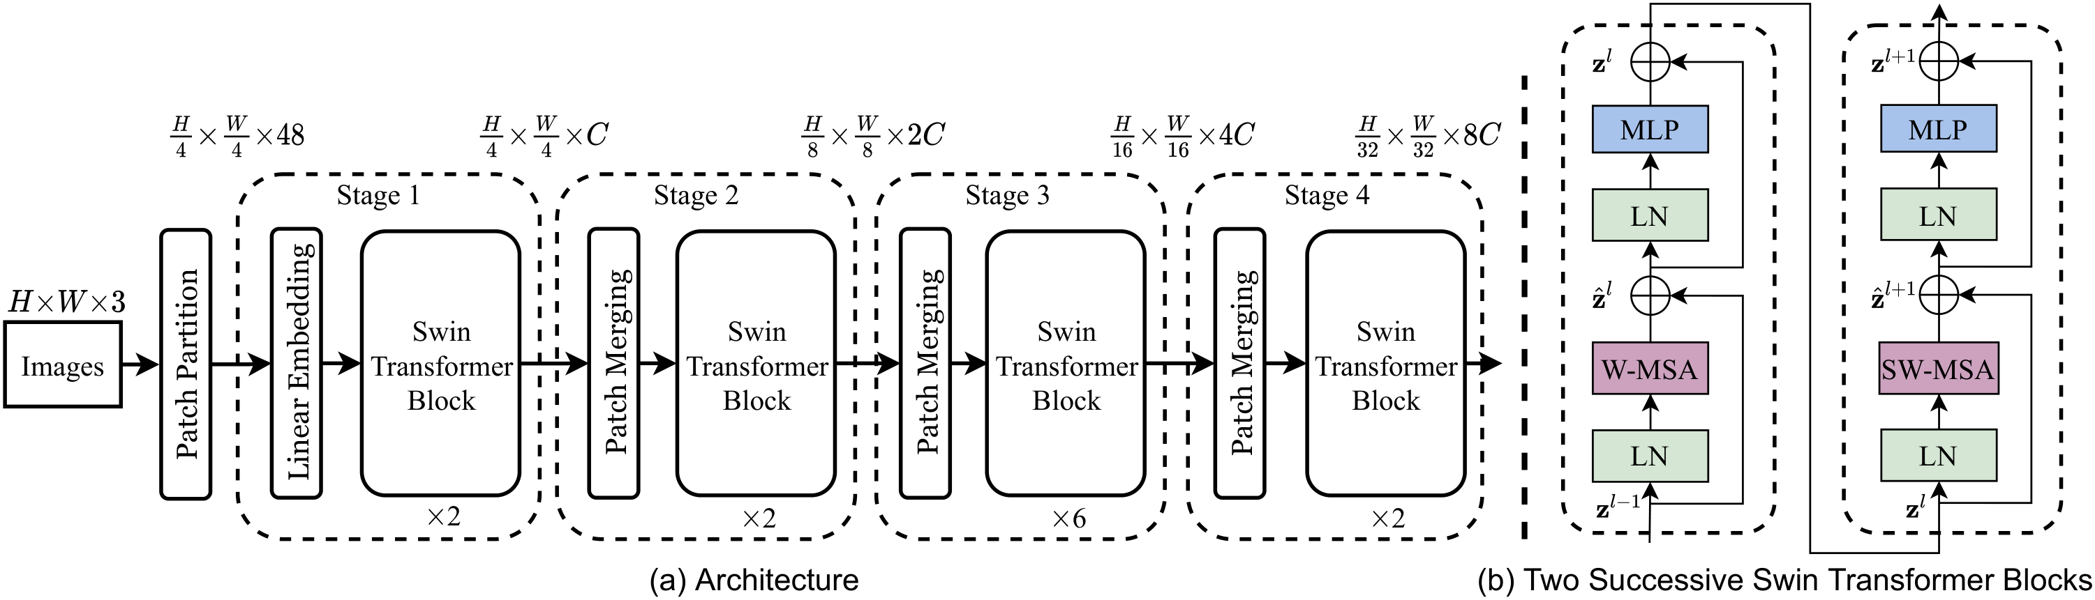
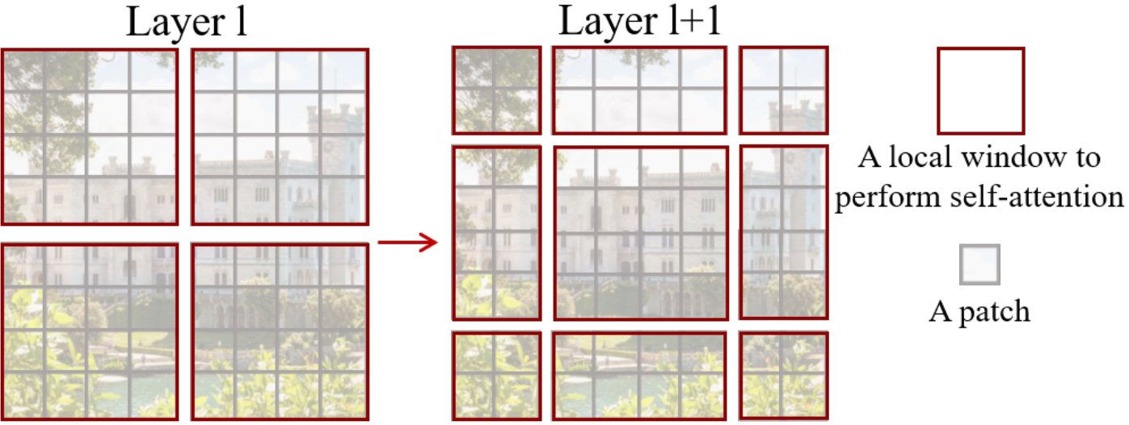
Swin Transformer: Hierarchical Vision Transformer using Shifted Windows
ICCV
2021
Ze Liu¹, Yutong Lin¹, Yue Cao¹, Han Hu¹, Yixuan Wei¹, Zheng Zhang¹, Stephen Lin¹, Baining Guo¹
POSTER
¹ Microsoft Research Asia
Paper
Code
Method
Partition the image into non-overlapping M×M windows and compute self-attention only inside each window, giving linear complexity in image size instead of ViT's quadratic.
Alternate consecutive blocks between a regular partition and one shifted by ⌊M/2⌋, so attention propagates across window boundaries every layer.
Use patch merging between four stages to halve resolution and double channels, producing a hierarchical pyramid at H/4, H/8, H/16, H/32 — drop-in for ResNet backbones.
Swin-T architecture: 4 stages with patch merging between them; each block alternates W-MSA (window) and SW-MSA (shifted window) self-attention.
Problem
Dataset / Benchmark
Standard vision Transformers like ViT compute global self-attention at a single low resolution, giving quadratic cost in image size and feature maps unsuitable as a general-purpose backbone for dense prediction tasks.
ImageNet-1K (1.28M train / 50K val / 1000 classes) and ImageNet-22K (14.2M images / 22K classes) for classification.
COCO 2017 (118K train / 5K val / 20K test-dev) for detection & instance segmentation; ADE20K (150 classes) for semantic segmentation.
Visual elements vary enormously in scale and images carry far higher token counts than text, so per-pixel tasks like detection and segmentation are intractable for ViT-style global attention on high-resolution inputs.
Key Results
Motivation
Task / Metric
Prior SOTA
Swin-L
ImageNet-1K top-1 (IN-22K)
86.4
87.3
A general-purpose backbone needs hierarchical multi-scale features and linear complexity in image size. Plain non-overlapping windows give linear cost but cut off information flow between windows; alternating regular and shifted partitions fixes this without per-pixel sliding-window latency.
COCO box AP (test-dev)
56.0
58.7
COCO mask AP (test-dev)
48.5
51.1
ADE20K mIoU (val)
50.3
53.5
+2.7 box AP · +2.6 mask AP · +3.2 mIoU vs. previous SOTA
SO WHAT → A single backbone family sets new SOTA across all three tasks at unusually large margins; with ImageNet-1K only training, Swin-T (81.3%) still matches or beats DeiT, RegNet and EfficientNet.
Ablation Study
Removing the shifted-window scheme drops 1.1% ImageNet, 2.8 box AP / 2.2 mask AP COCO, 2.8 mIoU ADE20K.
Takeaway
Learned relative position bias beats no positional encoding and absolute position embeddings across all three tasks.
Shifting non-overlapping local windows between layers turns the Transformer into a hierarchical, linear-complexity vision backbone — SOTA across classification, detection, and segmentation, and a drop-in alternative to ResNet for dense prediction pipelines.
Cyclic-shift keeps shifted attention as fast as plain windowed (3.0 vs 2.8 ms), ~40× faster than naive sliding-window.
Headline Numbers
The same recipe also lifts all-MLP backbones, suggesting hierarchy and local-window communication are general design primitives for vision modeling beyond attention alone — Swin is now the default Transformer backbone for high-resolution dense prediction.
87.3%
58.7
51.1
53.5
COCO box AP
COCO mask AP
ADE20K mIoU

