Slide 1
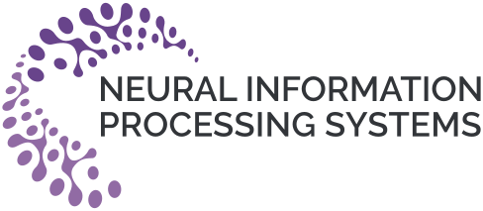


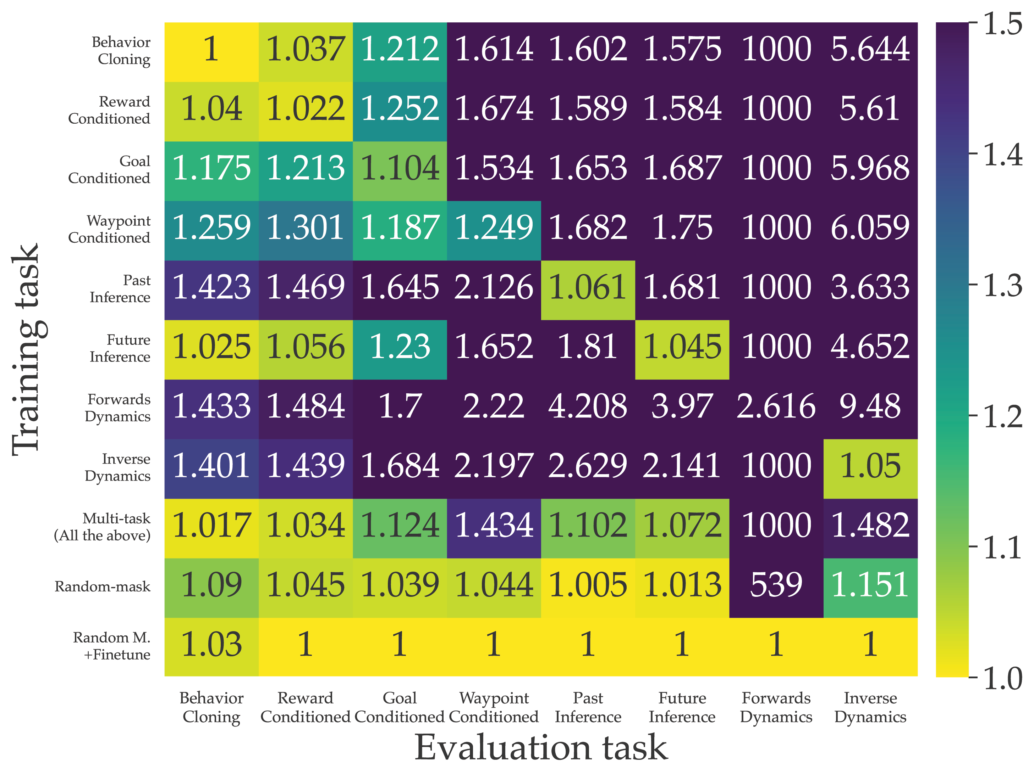
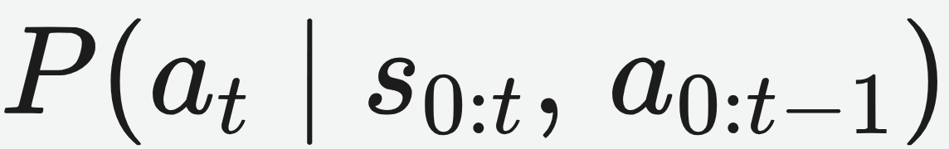

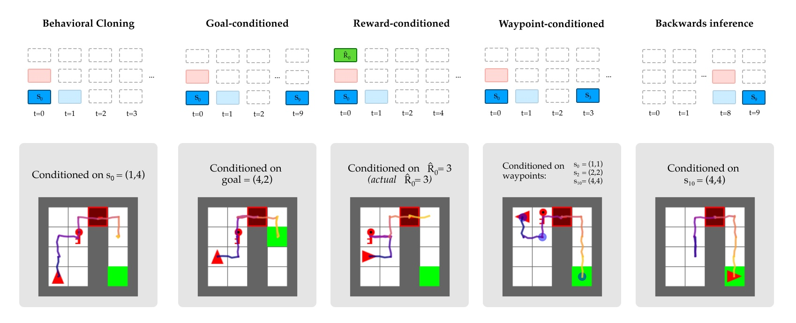
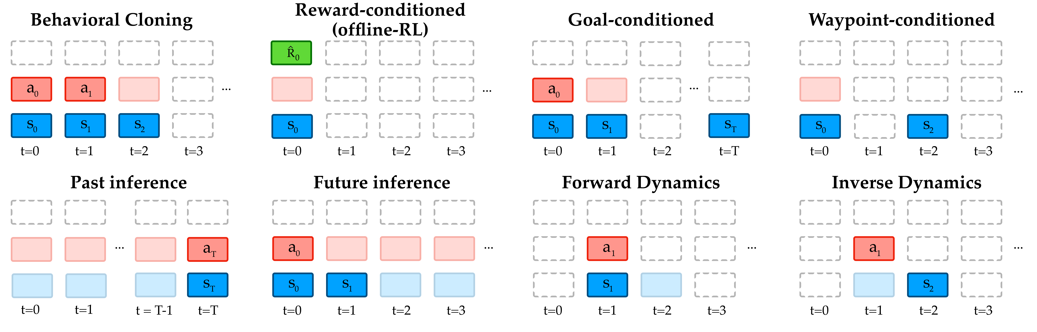
Uni[MASK]: Unified Inference in Sequential Decision Problems
Micah Carroll¹, Orr Paradise¹, Jessy Lin¹, Raluca Georgescu², Mingfei Sun², David Bignell², Stephanie Milani³, Katja Hofmann², Matthew Hausknecht², Anca Dragan¹, Sam Devlin²
¹UC Berkeley · ²Microsoft Research · ³Carnegie Mellon University
Problem
Method
Key Results
Sequential decision problems are usually solved one task at a
time — a separate model for behavior cloning, offline RL,
dynamics prediction, or goal conditioning — even though the tasks
share deep structure.
Tokenize a trajectory into per-timestep state, action, and
property (return-to-go) tokens.
MAZE2D REWARD · CL 5
BC
RC
Decision Transformer
1.13
1.49
A masking scheme picks inputs vs. predicted outputs; a
bidirectional BERT transformer predicts the masked ones.
Uni[MASK] + finetune
2.73
2.73
All of these inferences run over the same trajectory of states,
actions and returns — and could share representations — yet
each is trained in isolation.
≡ behavior cloning Every task is a masking scheme, e.g. conditions an action on a goal state + return-to-go.
≡ behavior cloning
Motivation
Masked language modeling (BERT) trains models to predict
randomly masked tokens, yielding bidirectional representations
that transfer to many downstream tasks.
Decision-making inferences are just different maskings of a
trajectory: mask the last action given prior states and actions,
and predicting it is exactly a behavior-cloning inference.
One Uni[MASK] model executes five inference tasks in MiniGrid —
behavioral cloning, goal-, reward-, waypoint-conditioned, and
backwards inference — each just a different masking. Four training
regimes (single-task, multi-task, random-mask, +fine-tune) are
compared.
A single masked-prediction objective can express the whole
family — behavior cloning, offline RL, dynamics, and goal or
waypoint conditioning — with no task-specific heads.
MiniGrid cross-task validation loss (relative to best). Random-mask +
finetune (bottom row) hits 1.0 on every task and beats single-task
everywhere; single-task rows degrade sharply off-diagonal.
Takeaway
Many sequential-decision tasks are just different maskings
of one trajectory — so one masked-prediction model
replaces a zoo of specialized ones, and random-mask
pretraining + fine-tuning generally beats task-specific
training.
Headline Numbers
2.73
RC reward
(vs 1.49 DT)
2.73
Uni[MASK] framework: eight decision-making tasks — BC, offline RL, goal
/ waypoint conditioning, past / future inference, and forward / inverse
dynamics — written as masking schemes over one trajectory (solid =
input, translucent = predicted).
BERT-style backbones shine at short contexts but struggle to
generate over longer sequences — GPT-style backbones with
random masking are a promising next step.
1
model, all
8 tasks
Maze2D reward · fine-tuned (CL 5)
vs 1.13 for Decision Transformer
5
seeds,
1000 rollouts

