Slide 1

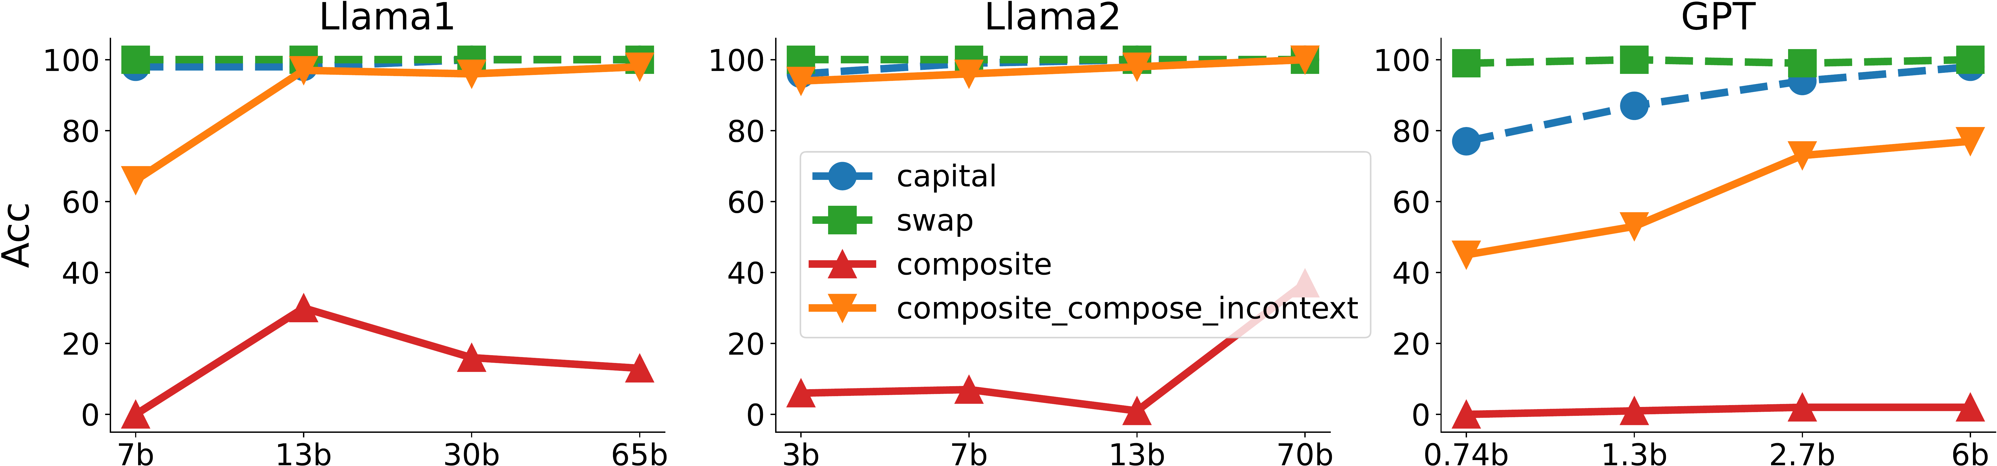
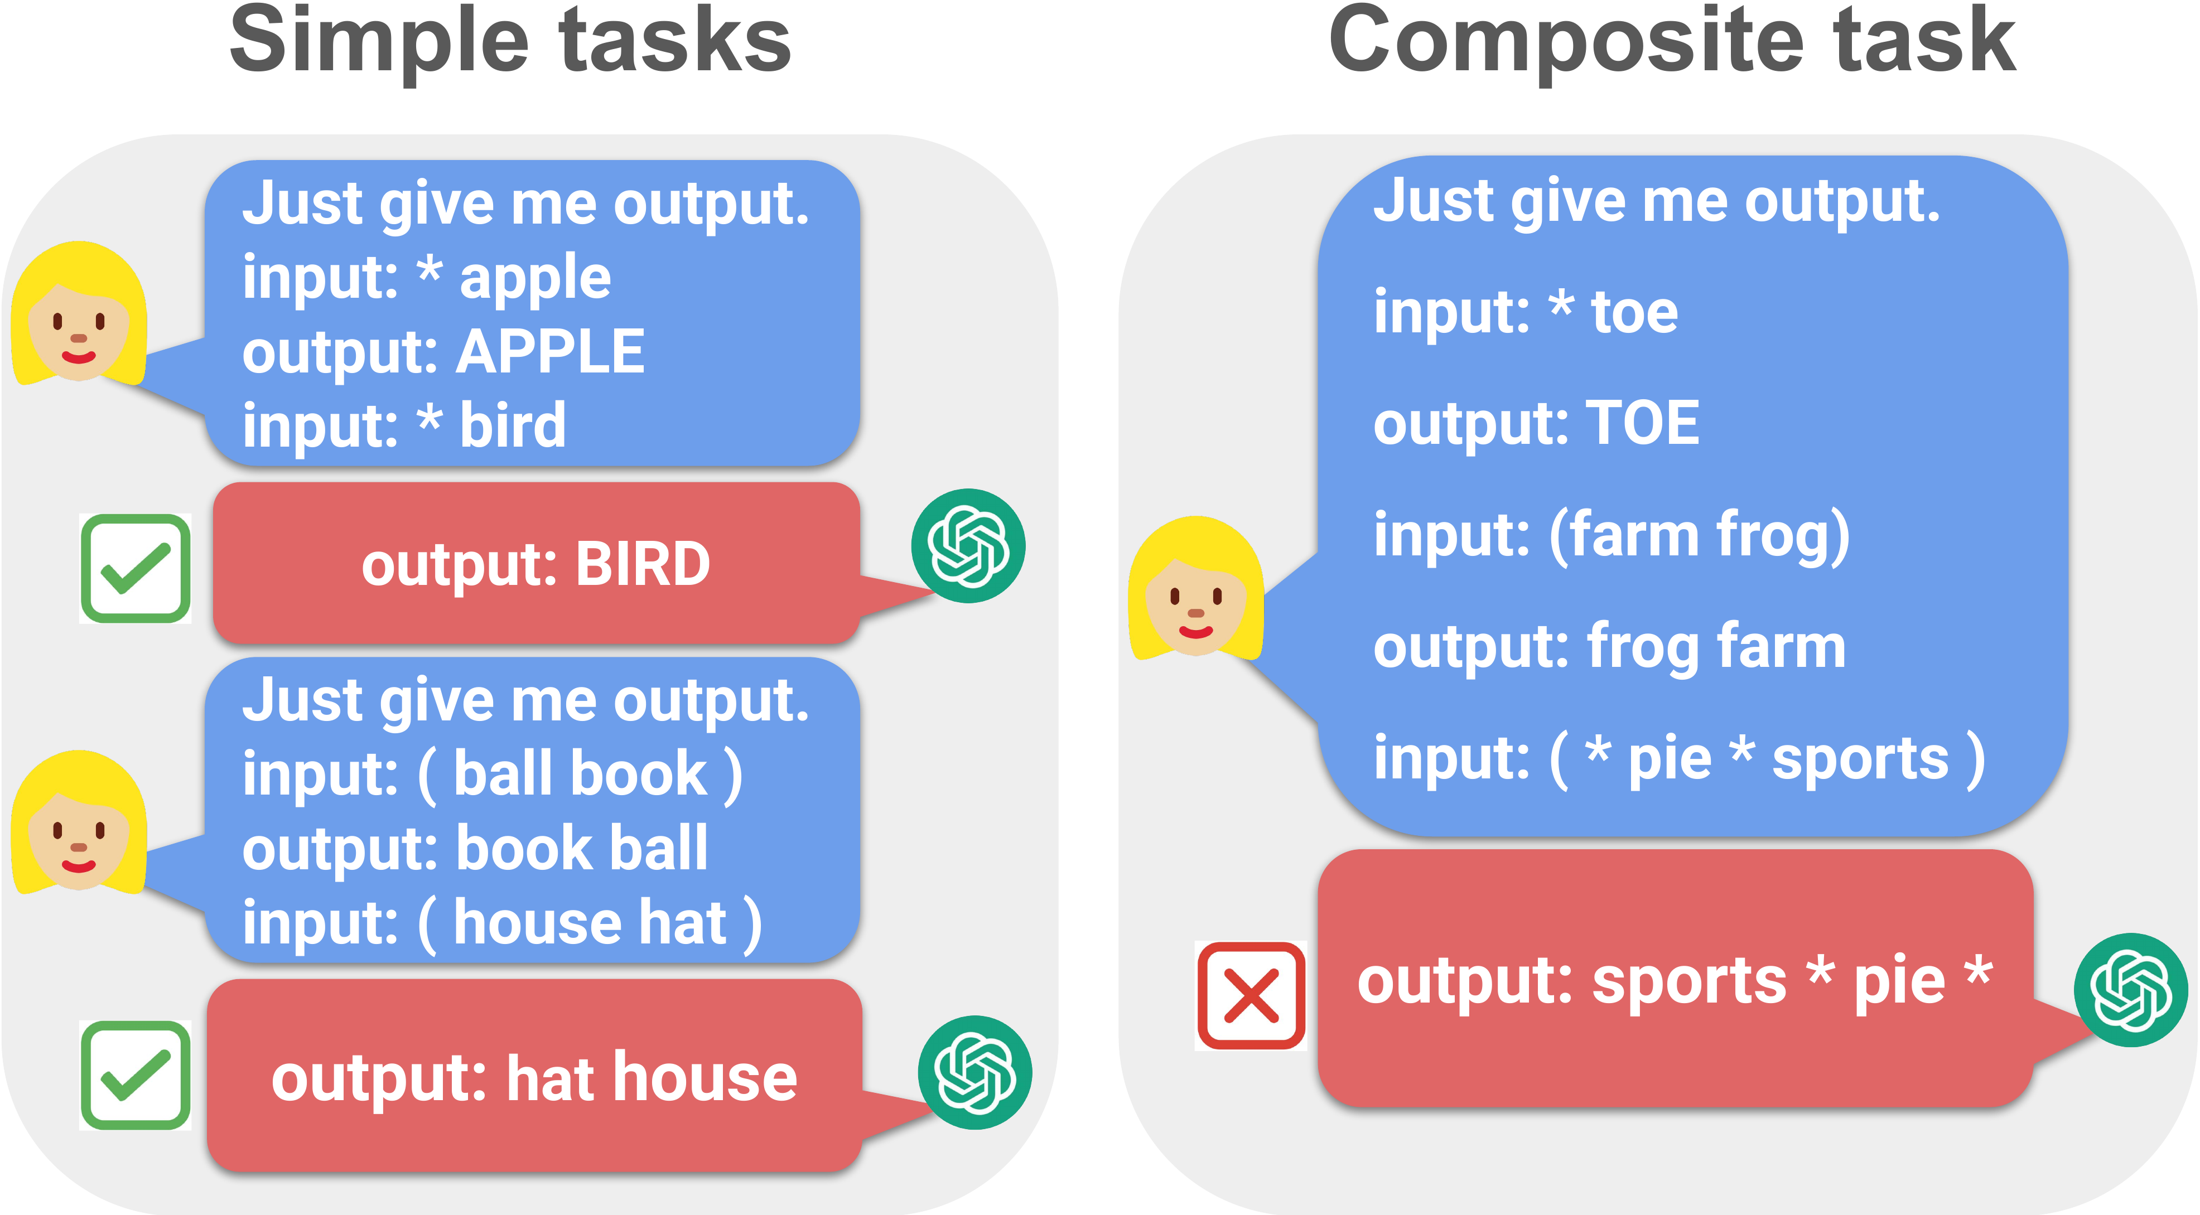


COLM 2024
Do LLMs Have Compositional Ability? Limitations
and Scalability of In-Context Composition
Zhuoyan Xu¹, Zhenmei Shi¹, Yingyu Liang¹
¹ University of Wisconsin-Madison
Problem
Method
Headline Numbers
Can an LLM that has learned two simple
tasks from in-context examples
automatically solve their composition —
an unseen composite task — without ever
seeing a composite example?
Standard ICL (K=10 demos + test input); four settings — simple, composite (simple demos → composite test),
and composite in-context, the gold-standard upper bound.
~90%
→
~20%
0.74–
70B
model scale
range
Theory: a one-layer linear self-attention model composes iff the two simple tasks have confined support —
separate embedding subspaces.
4
model families
Trivial for humans — yet largely
untested, and often broken, for LLMs.
Simple → compose-
by-step accuracy
(Llama)
K=10
in-context
examples
no gain from scaling
Motivation
Takeaway
LLMs ace individual in-context tasks, but
real reasoning demands fusing skills —
and whether ICL integrates or fails to
compose them is unknown.
LLMs compose two skills only when the
sub-tasks act on separate parts of the
input; for tasks needing chained multi-step
reasoning they fail, and scaling does not
rescue them.
Accuracy vs scale: simple tasks near-perfect; composite (red) collapses; composite in-context (orange) recovers.
Even GPT-4 and Claude 3 solve each
rule yet fail their composite, and prior
work offers no theory for when
composition succeeds.
Dataset / Benchmark
Key Results
A custom test suite of composite tasks, each built
from two simple building blocks:
COMPOSITE TASK
SIMPLE
COMPOSITE
SO WHAT
(A)+(F) separable
~90%
~90%
Whether extra compute helps a
composite task is predictable from its
structure: separable tasks scale,
entangled multi-step tasks do not.
Capitalization
Swap
Phrase Recombination
Cap. & Swap (step)
~90%
~20%
Passive→Active
Two Sum
Modular
Plus One
(A)+(C) @ large scale
~90%
44%
separable
compose-by-step
(B)+(D) @ large scale
~90%
66%
SEPARABLE
vs.
COMPOSE-BY-STEP
~90% on simple tasks → ~20% on the composite
— no gain from scale.
Scan to Read
Distinct input parts —
compose well, improve
with scale.
Shared, chained
reasoning — fail;
scaling does not help.
SO WHAT → Composite in-context demos recover accuracy — the models have the power, they just fail to compose it from simple-task demos alone.
GPT-4 solves the two simple tasks (left) but fails
their composite (right): correct answer SPORTS
PIE, not sports * pie *.
SO WHAT → Metrics: exact-match & WER.
Paper
Code

