Slide 1



COLM 2024 · UNIVERSITY OF WISCONSIN–MADISON
Compositional in-context learning · arXiv 2407.15720
?
Can a model combine two skills it already knows?
Do LLMs Have
Compositional Ability?
Solving an unseen composite task by fusing two simple tasks seen only separately —
an investigation into its limitations and scalability.
SEPARABLE ✓
COMPOSE-BY-STEP ✗
Sub-tasks on separate inputs
Chained multi-step reasoning
compose well and improve with scale
fails — and scaling up does not help
Zhuoyan Xu · Zhenmei Shi · Yingyu Liang
University of Wisconsin–Madison
Paper
Code
Notes:
Can large language models combine skills they already know? This COLM 2024 paper tests whether models solve an unseen composite task by fusing two simple tasks seen separately. Across Llama and GPT, a sharp dichotomy emerges.

Slide 2
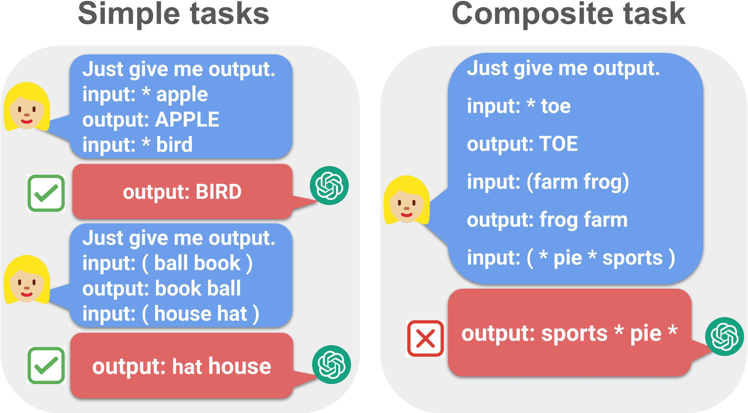
THE PROBLEM
Each skill alone is easy — together they break
TWO SIMPLE TASKS, IN-CONTEXT
FIGURE 1 · COMPOSITIONAL IN-CONTEXT LEARNING
Capitalize ( * )
Swap ( )
* apple
( ball book )
→ APPLE
→ book ball
NOW COMBINE BOTH AT ONCE
( * pie * sports )
must swap and capitalize — a task never shown as an example
Trivial for humans — yet models stumble
Simple tasks are solved (✓ ✓); the composite that needs
✗
Even GPT-4 and Claude 3 often fail this composite.
both operations at once produces a wrong output (✗).
Xu, Shi & Liang · COLM 2024 · Figure 1
02
Notes:
Suppose a model learned two simple tasks in-context, capitalizing certain words and swapping others. Given an input needing both, can it combine the skills? For humans this is trivial, yet even GPT-4 and Claude 3 often fail.

Slide 3
MOTIVATION
Why compositional ability, and why now
⛓
Real reasoning means
!
A gap prior work
chaining skills
left open
LLMs are increasingly asked to combine
Earlier studies of compositional
skills for real tasks, not just repeat one
generalization are narrow and offer
operation.
little theory.
Skill A
+
Skill B
→
Composite
EASY TO REPRODUCE
Show a frontier model two simple rules,
then test both together — and it stumbles,
Yet we lack a clear account of exactly
even though each rule alone is easy.
when that chaining actually works.
Xu, Shi & Liang · COLM 2024
03
Notes:
Models are increasingly asked to chain skills for real reasoning, yet we lack a clear account of when chaining works. Prior studies are narrow with little theory, and the failure reproduces easily on frontier models.

Slide 4
CONTRIBUTIONS
Three contributions
01
02
03
A test suite
An empirical dichotomy
A supporting theory
Linguistic and logical
Running the suite across
A linear self-attention
composite tasks, with the
the Llama and GPT families
model explains precisely
in-context examples drawn
at many scales reveals a
when compositional ability
only from the simple
clear split in behavior.
emerges — and when scale
sub-tasks.
helps.
Structure of a task predicts whether more scale will help — the thread running through every result.
Xu, Shi & Liang · COLM 2024
04
Notes:
Three contributions: a test suite of linguistic and logical composite tasks with simple-task examples only; evaluation across Llama and GPT scales revealing a clear dichotomy; and a linear self-attention theory explaining when composition emerges.

Slide 5
METHOD
How the study is built — in two halves
Two complementary halves · Empirical evaluation + Theoretical explanation
EMPIRICAL · FOUR IN-CONTEXT SETTINGS (K = 10)
THEORETICAL · LINEAR SELF-ATTENTION
1 · Simple task A alone
f(E) = E + W_pv · E · (Eᵀ W_kq E) / N
demos and test both from sub-task A
one-layer, single-head linear self-attention
Composition succeeds under confined support
2 · Simple task B alone
demos and test both from sub-task B
SEPARATE SUBSPACES ✓
OVERLAPPING ✗
3 · Composite ← the real test
simple-task demos, but a composite test input
A
B
A∩B
4 · Composite in-context
Each task in its own embedding subspace →
all composite — a gold-standard upper bound
the model can combine them. When the
subspaces overlap, composition breaks down.
Tested across Llama-1/2/3 and GPT families at many scales.
Xu, Shi & Liang · COLM 2024 · §3–4
05
Notes:
Two halves. Empirically, each composite task is tested in four settings with ten in-context examples: each simple task alone, a composite test with simple-task demos, and an all-composite gold standard. Theoretically, a linear self-attention model shows composition succeeds under confined support.

Slide 6
TEST SUITE
A purpose-built suite of composite tasks
Each composite is built from two simple building-block tasks.
LINGUISTIC TASKS
LOGICAL TASKS
Capitalization
Swap
Phrase Recombination
Two Sum
Modular
Plus One
Passive → Active
Object → Subject
combined with word-level operations
Word-level operations and longer-chain translations.
Arithmetic rules paired with a linguistic operation.
TWO FAMILIES — THE HEART OF THE STUDY
Separable composites
Compose-by-step composites
The two operations act on different parts
The operations must be chained through
of the input.
shared, multi-step reasoning.
e.g. Capitalization & Plus One
e.g. Capitalization & Swap
Scoring: exact-match accuracy (logical) · word error rate (translation)
06
Notes:
The suite pairs simple building blocks. Linguistic tasks include capitalization, swapping, and translations like phrase recombination and passive-to-active. Logical tasks combine arithmetic with word operations. Tasks split into separable composites, acting on different input parts, and compose-by-step composites requiring chained reasoning.

Slide 7
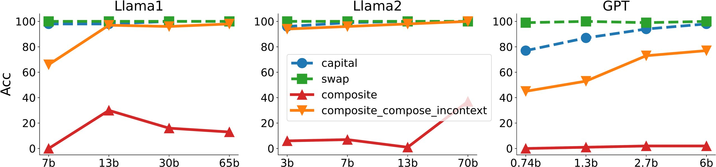
KEY RESULT
Composition works — or collapses — by task type
A sharp split in behavior
FIGURE 2 · CAPITALIZATION & SWAP (COMPOSE-BY-STEP) · ACCURACY vs SCALE
THE OTHER SIDE
Separable tasks
Models compose the two
skills well.
composite (red) collapses to ~20% or below and stays flat as the model grows.
capital / swap stay near 90–100% on each simple task alone.
Accuracy climbs with scale,
composite in-context recovers — so the ability is there, unused.
approaching the composite
in-context gold standard.
The models have the representational power — what they lack is composing it from simple-task demos alone.
Xu, Shi & Liang · COLM 2024 · Figure 2
07
Notes:
A sharp split. On separable composite tasks, models compose well and improve with scale, approaching the gold standard. On compose-by-step tasks they collapse: Llama solves each simple task near ninety percent, but the composite drops below twenty percent, and scaling doesn't help.

Slide 8
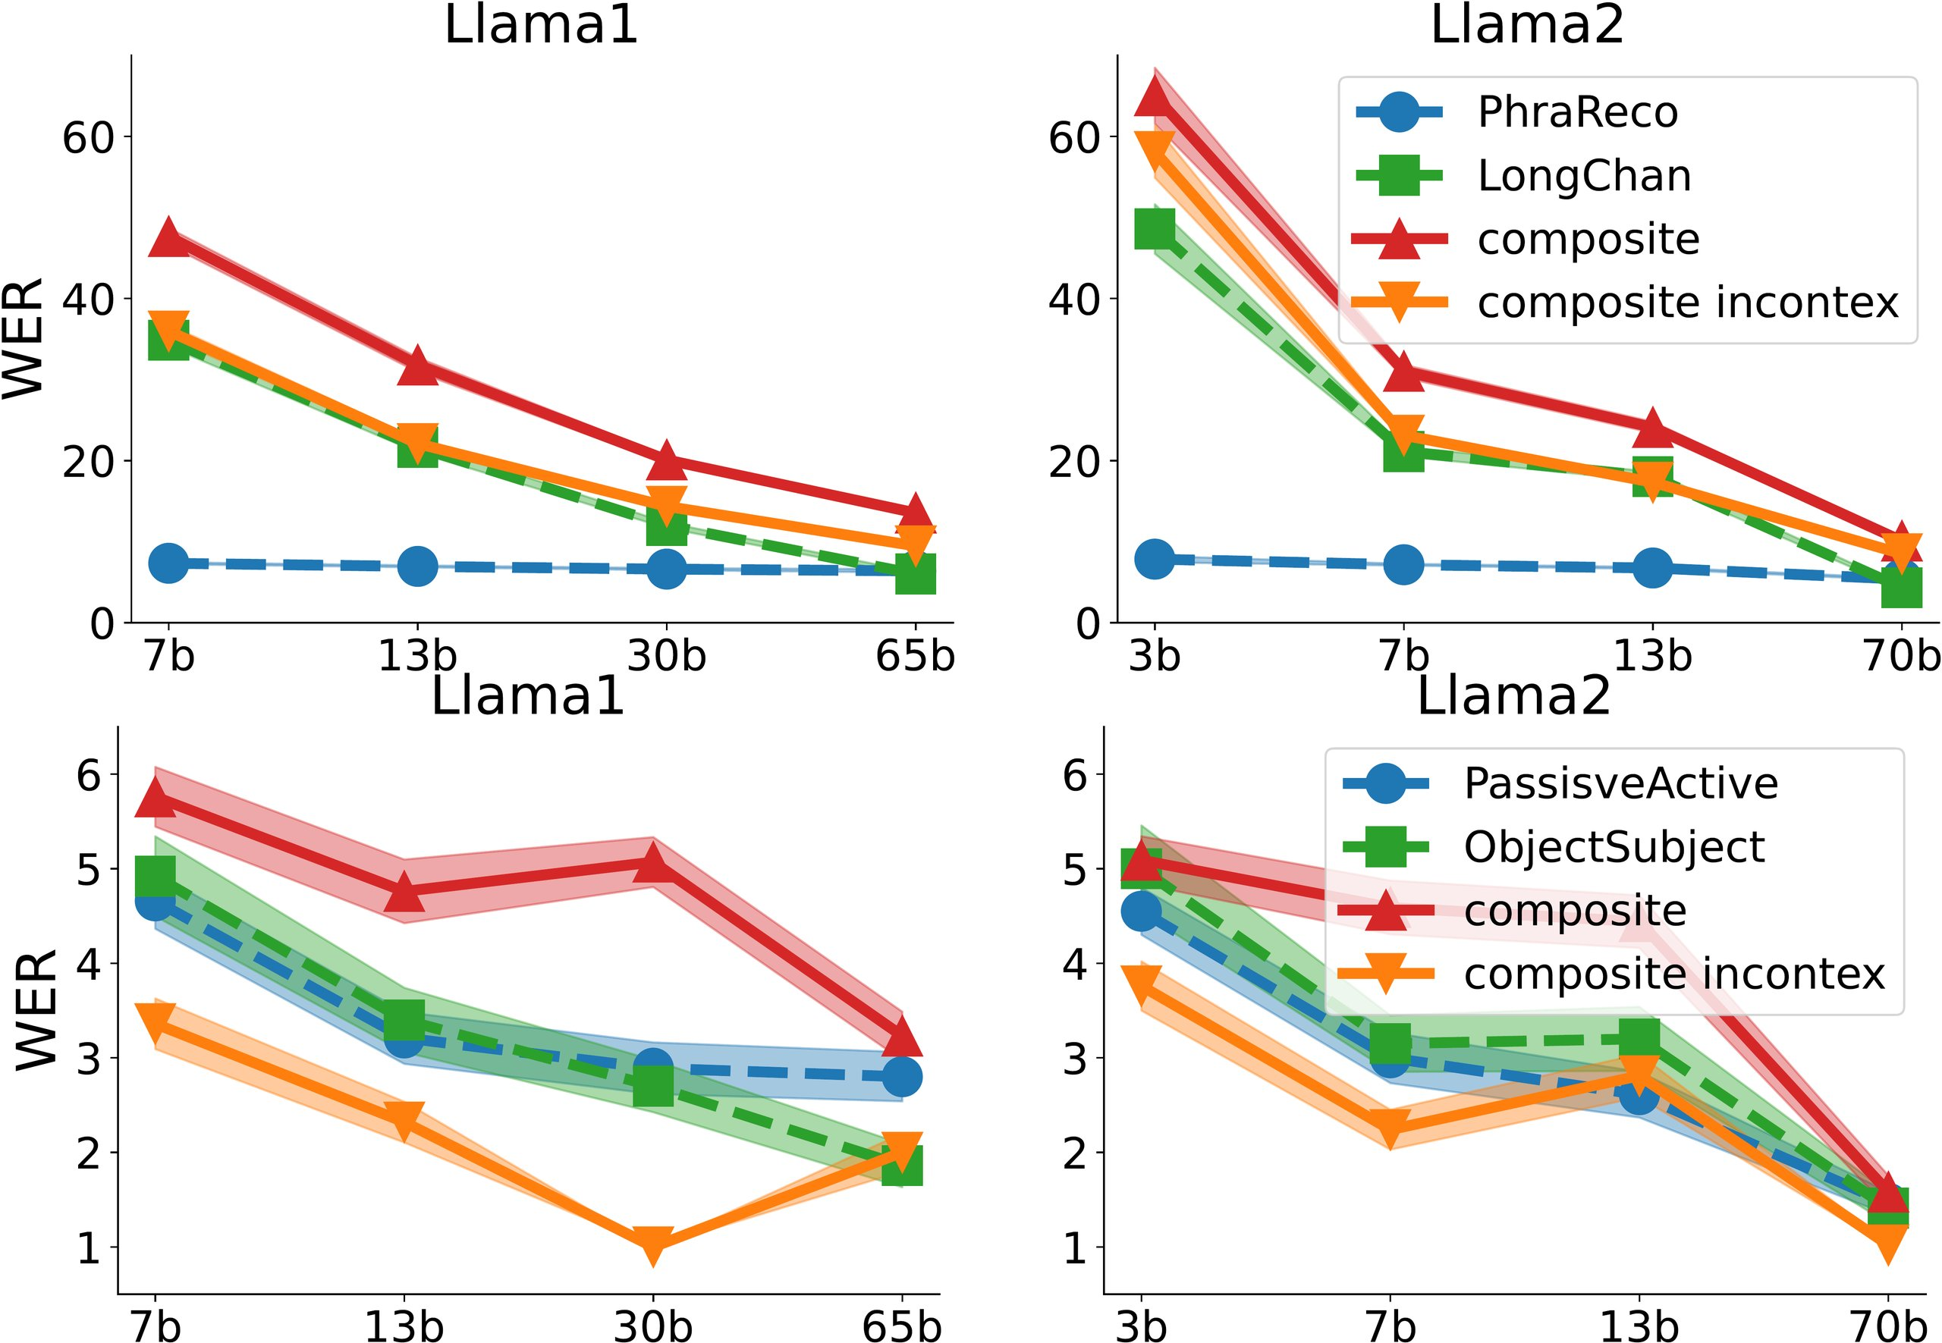
ABLATION
What scale changes — and what it does not
The scale sweep is the key ablation
FIGURE 3 · TRANSLATION COMPOSITES · WER vs SCALE
SWAP THE DEMONSTRATIONS
Replace simple-task demos with
composite ones — and performance
recovers.
simple-task demos
→
composite demos
composite fails
recovers
WHAT THIS ISOLATES
Composition — not capability —
is the bottleneck.
Larger models help only when the simple
tasks improve too — as the theory predicts.
On these separable translation tasks, error falls steadily as the model scales.
Xu, Shi & Liang · COLM 2024 · Figure 3
08
Notes:
The scale sweep is the key ablation. On separable tasks accuracy rises with scale; on compose-by-step tasks it stays flat or degrades. Swapping simple-task demos for composite ones recovers performance, isolating composition, not capability, as the bottleneck.

Slide 9
HEADLINE NUMBERS
The story in four numbers
The numbers tell it
SIMPLE TASKS
COMPOSE-BY-STEP
MILDER SEPARABLE CASES
~90%
<20%
44%
Capitalization + Two-Sum
66%
Capitalization & Swap
Composite version
Each simple task alone,
Of the same tasks —
for the Llama families.
and no gain from scaling.
Swap + Two-Sum
climbing with larger scale
All evaluated with K = 10 in-context examples across the Llama-1/2/3 and GPT model scales.
Xu, Shi & Liang · COLM 2024
09
Notes:
The numbers tell it. Simple capitalization and swap reach about ninety percent for Llama. The compose-by-step version falls to twenty percent or lower, with no gain from scaling. Milder separable cases climb to forty-four and sixty-six percent.

Slide 10
TAKEAWAY
Composition follows the shape of the task
✓
When composition works
✗
When it fails
Models can combine two learned skills
When a task demands genuinely chained,
only when those skills act on separate
multi-step reasoning, the models fail
parts of the input.
to compose.
Separable → composes, and scales.
More parameters will not rescue them.
THE PRACTICAL RULE
Task structure predicts whether scaling helps:
separable tasks scale · entangled multi-step tasks do not.
Do LLMs Have Compositional Ability? · Xu, Shi & Liang
COLM 2024 · University of Wisconsin–Madison · arXiv 2407.15720
Paper
Code
Notes:
The takeaway: models combine two skills only when they act on separate parts of the input. When a task needs genuinely chained, multi-step reasoning, they fail, and more parameters won't help. Task structure predicts whether scaling helps.

