Slide 1
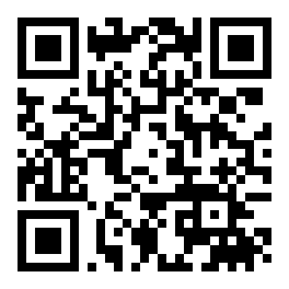
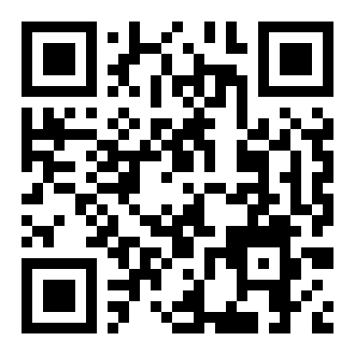



PAPER DEEP-READ · ICML 2024 · arXiv 2402.04841
Data-efficient Large
AUTOREGRESSIVE LVM
One generalist model, many tasks
Vision Models
Images and annotations are encoded into a
single 1D sequence, then predicted token by
token — like a language model for vision.
through Sequential Autoregression — DeLVM
TWO SIMPLE, CLASSICAL IDEAS
Data Augmentation
Knowledge Distillation
Jianyuan Guo · Zhiwei Hao · Chengcheng Wang · Yehui Tang
Han Wu · Han Hu · Kai Han · Chang Xu
Random crop & flip to
Compress a large
University of Sydney · Beijing Institute of Technology · Huawei Noah's Ark Lab
rebalance long-tailed
teacher into a compact
multi-task data.
student model.
THE QUESTION
SCAN FOR PAPER & CODE
Do we really need 3B parameters
and 400B visual tokens?
DeLVM asks whether all that scale is really necessary.
Paper
Code
Guo, Hao, Wang, Tang, Wu, Hu, Han, Xu · DeLVM · ICML 2024
01
Notes:
Large vision models trained by autoregression promise a single generalist model for many visual tasks, but today's versions demand billions of parameters and hundreds of billions of visual tokens to train. This ICML 2024 paper, DeLVM, asks whether we really need all that. The authors show that two simple, classical ideas, data augmentation and knowledge distillation, let a compact autoregressive vision model reach strong performance on a limited dataset, cutting both the parameter footprint and the training data requirement dramatically.

Slide 2
Powerful, but heavy — and blind to rare tasks
THE PROBLEM · MASSIVE SCALE + LONG-TAILED DATA
FROM LANGUAGE TO VISION
Autoregressive models like GPT thrive on a universal token interface. Recent work extends this to vision —
treating images and their annotations as "visual sentences" predicted token by token.
WHAT THE LEADING LVM DEMANDS
THE COST
Expensive to train,
3B+
~400B
1B+
impractical at the edge
parameters
visual tokens
source
This scale is out of reach for most labs and
in the model
to train on
images
cannot be deployed on-device.
WORSE — THE VISUAL WORLD IS LONG-TAILED
Segmentation
abundant data
Pose estimation
starved
Train on the raw mixture and the model never learns the rare tasks at all.
DeLVM · ICML 2024 — the scale and imbalance problem
02
Notes:
In language modeling, autoregressive models like GPT thrive on a universal token interface. Recent work extends this idea to vision, treating images and annotations as visual sentences. But the leading large vision model needs over three billion parameters and roughly four hundred billion visual tokens drawn from more than a billion images. That scale is expensive and impractical for edge deployment. Worse, the visual world is long-tailed: some tasks like segmentation have abundant data while others like pose estimation are starved, and training on the raw mixture leaves the model unable to learn the rare tasks at all.

Slide 3
Why NLP recipes don't transfer to vision
MOTIVATION · THE GAP THIS PAPER CLOSES
LANGUAGE MODELS
COMPUTER VISION
One epoch, vast corpora
Tiny, scarce datasets
LMs train for roughly a single pass over
Many vision tasks have only small datasets,
enormous text corpora — enough data that
so the one-epoch language schedule simply
overfitting simply is not a concern.
does not carry over.
THE FIELD KEEPS SCALING — WHILE CLASSICAL REMEDIES STAY UNTRIED
Yet the classical fixes for scarce, imbalanced data are
barely explored for autoregressive vision:
›
Data Augmentation
Knowledge Distillation
← barely tried in AR vision
Bigger models & datasets
THIS PAPER
DeLVM closes that gap — bringing augmentation and distillation to autoregressive vision.
DeLVM · ICML 2024 — motivation
03
Notes:
Language models are typically trained for a single epoch over vast corpora to avoid overfitting. Computer vision rarely has that luxury: many tasks have only tiny datasets, so the language training schedule does not carry over. At the same time, the community keeps scaling model and dataset size, while classical remedies for scarce and imbalanced data, namely data augmentation and knowledge distillation, have barely been tried in the autoregressive vision setting. This paper closes that gap.

Slide 4
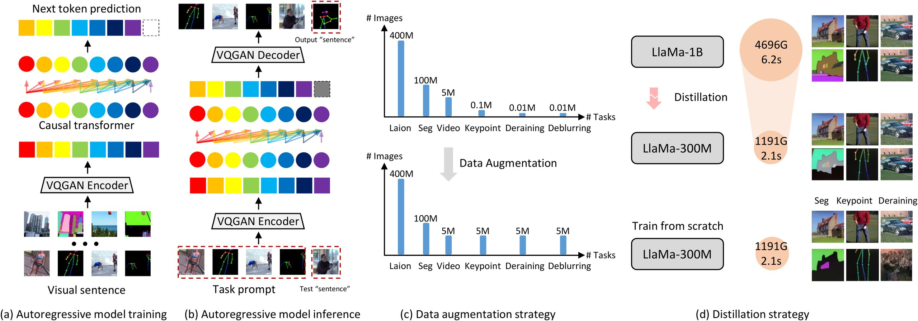
Three contributions
CONTRIBUTION · AUGMENTATION + FIRST-EVER KD + A PRACTICAL 80M MODEL
FRAMEWORK OVERVIEW — THREE MAIN CONTRIBUTIONS
Figure 1 · Autoregressive LVM encodes images to a 1D sequence, made data-efficient via augmentation + distillation.
1
Augmentation
2
First-ever KD
3
Practical 80M
Simple random crop and flip
Knowledge distillation for AR
83%
rebalance long-tailed multi-task
large vision models for the very
ImageNet
data — improving the model just
first time — lifting the student on
top-1 accuracy
as effectively as collecting more
single- and multi-task benchmarks.
An 80M model combining both
real samples.
techniques — hinting generation
and understanding can be
crop + flip ≈ adding real data
LLaMA-1B
→
300M
learned together.
DeLVM · ICML 2024 — contributions
04
Notes:
The authors make three main contributions. First, they show that simple data augmentation, random crop and flip, rebalances long-tailed multi-task data and improves an autoregressive vision model just as effectively as collecting more real samples. Second, they bring knowledge distillation to autoregressive large vision models for the first time, using a LLaMA one-billion teacher to lift a compact three-hundred-million student across single-task and multi-task benchmarks. Third, they build a practical eighty-million-parameter model that, combining both techniques, surprisingly reaches eighty-three percent top-one accuracy on ImageNet, suggesting generation and understanding can be learned together.

Slide 5
Datasets, benchmarks & the tokenizer
DATASET / BENCHMARK · THREE CORE TASKS + EVALUATION
THREE CORE TASKS
Image segmentation
Human pose estimation
Image deraining
Subsets of SA-1B
Full COCO-Pose dataset
Rain13K benchmark
ranging from 1% to 10%
the data-scarce task
low-level restoration task
VALIDATION
EXTRA BENCHMARKS
TOKENIZER
Held-out splits
Pascal-5i
VQGAN
Evaluated on held-out
Foreground segmentation for
The VQGAN tokenizer that
SA-1B splits together with:
the distilled models, scored
encodes images into discrete
by mean IoU.
tokens is trained on the
MPII
Test2800
Laion dataset.
ImageNet
Metrics: validation loss,
Classification — where the
Used off the shelf — fixed
pixel accuracy, perplexity,
practical 80M model is tested.
and mIoU.
DeLVM · ICML 2024 — datasets & benchmarks
05
Notes:
Experiments cover three core tasks. Image segmentation uses subsets of SA-1B ranging from one to ten percent; human pose estimation uses the full COCO-Pose dataset; image deraining uses Rain13K. Validation relies on held-out SA-1B splits together with MPII and Test2800. The distilled models are also benchmarked on Pascal five-i foreground segmentation using mean intersection-over-union, and the practical eighty-million model is evaluated on ImageNet classification. Throughout, the VQGAN tokenizer is trained on the Laion dataset and used off the shelf.

Slide 6
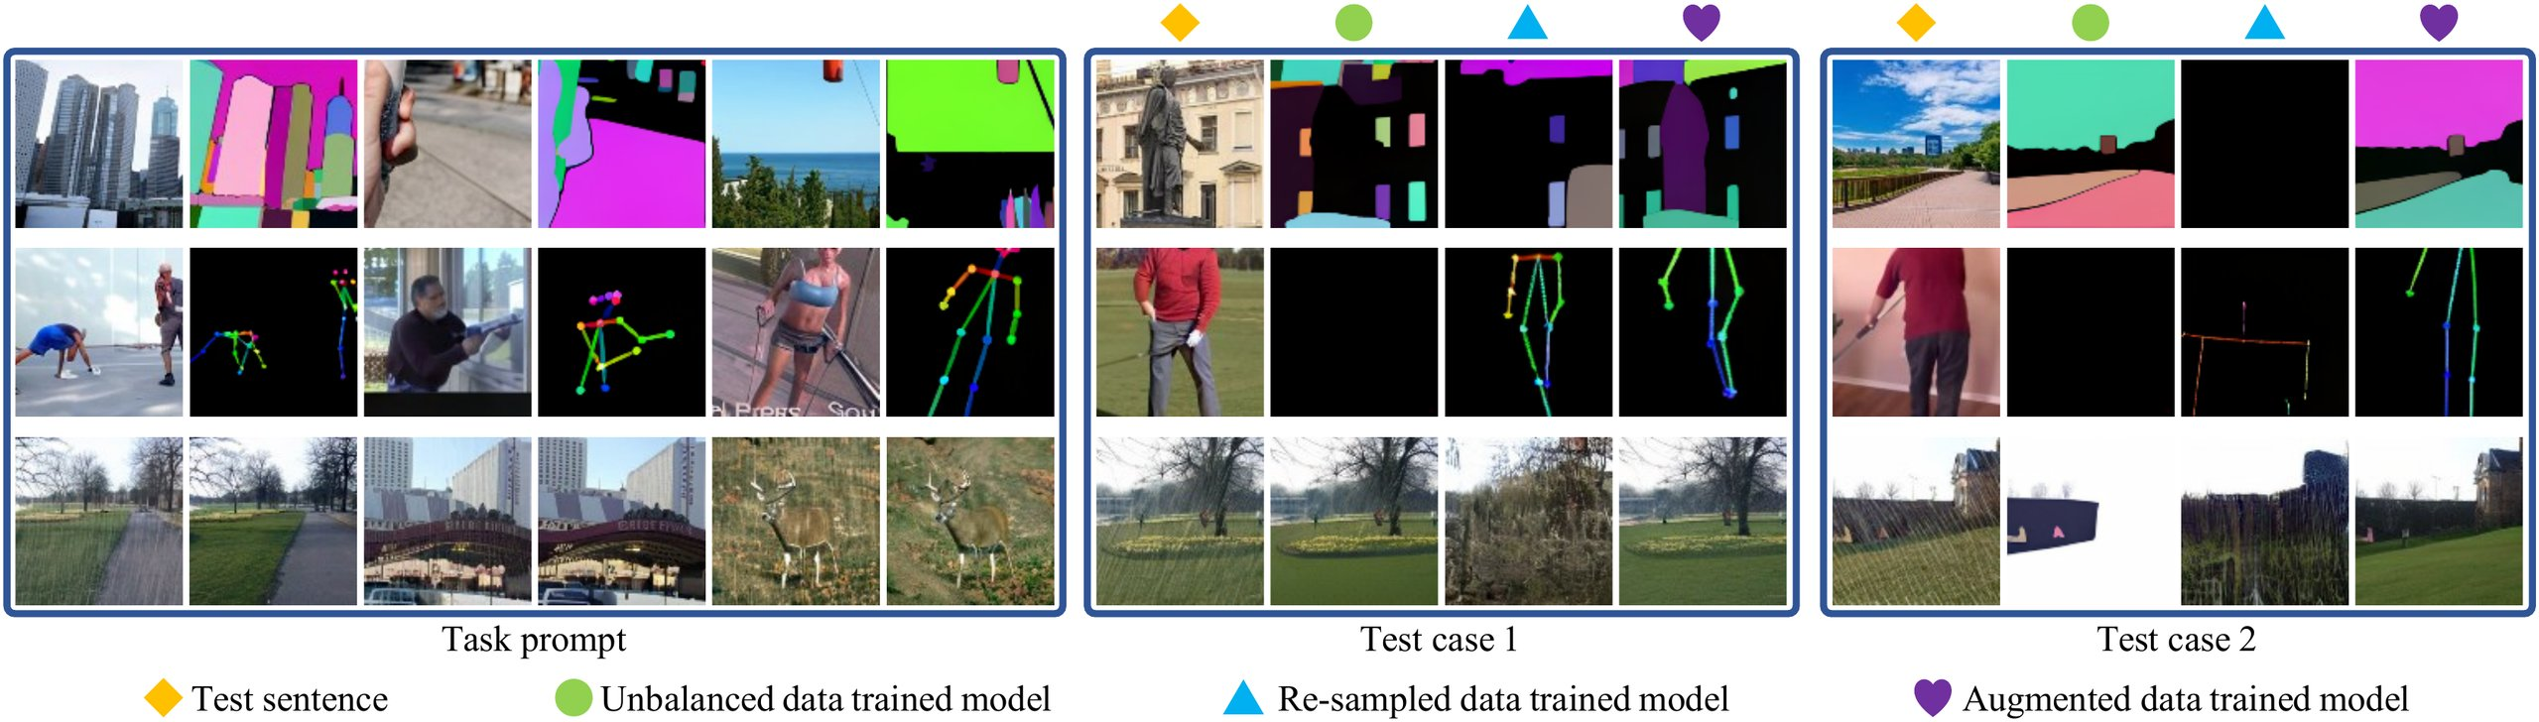
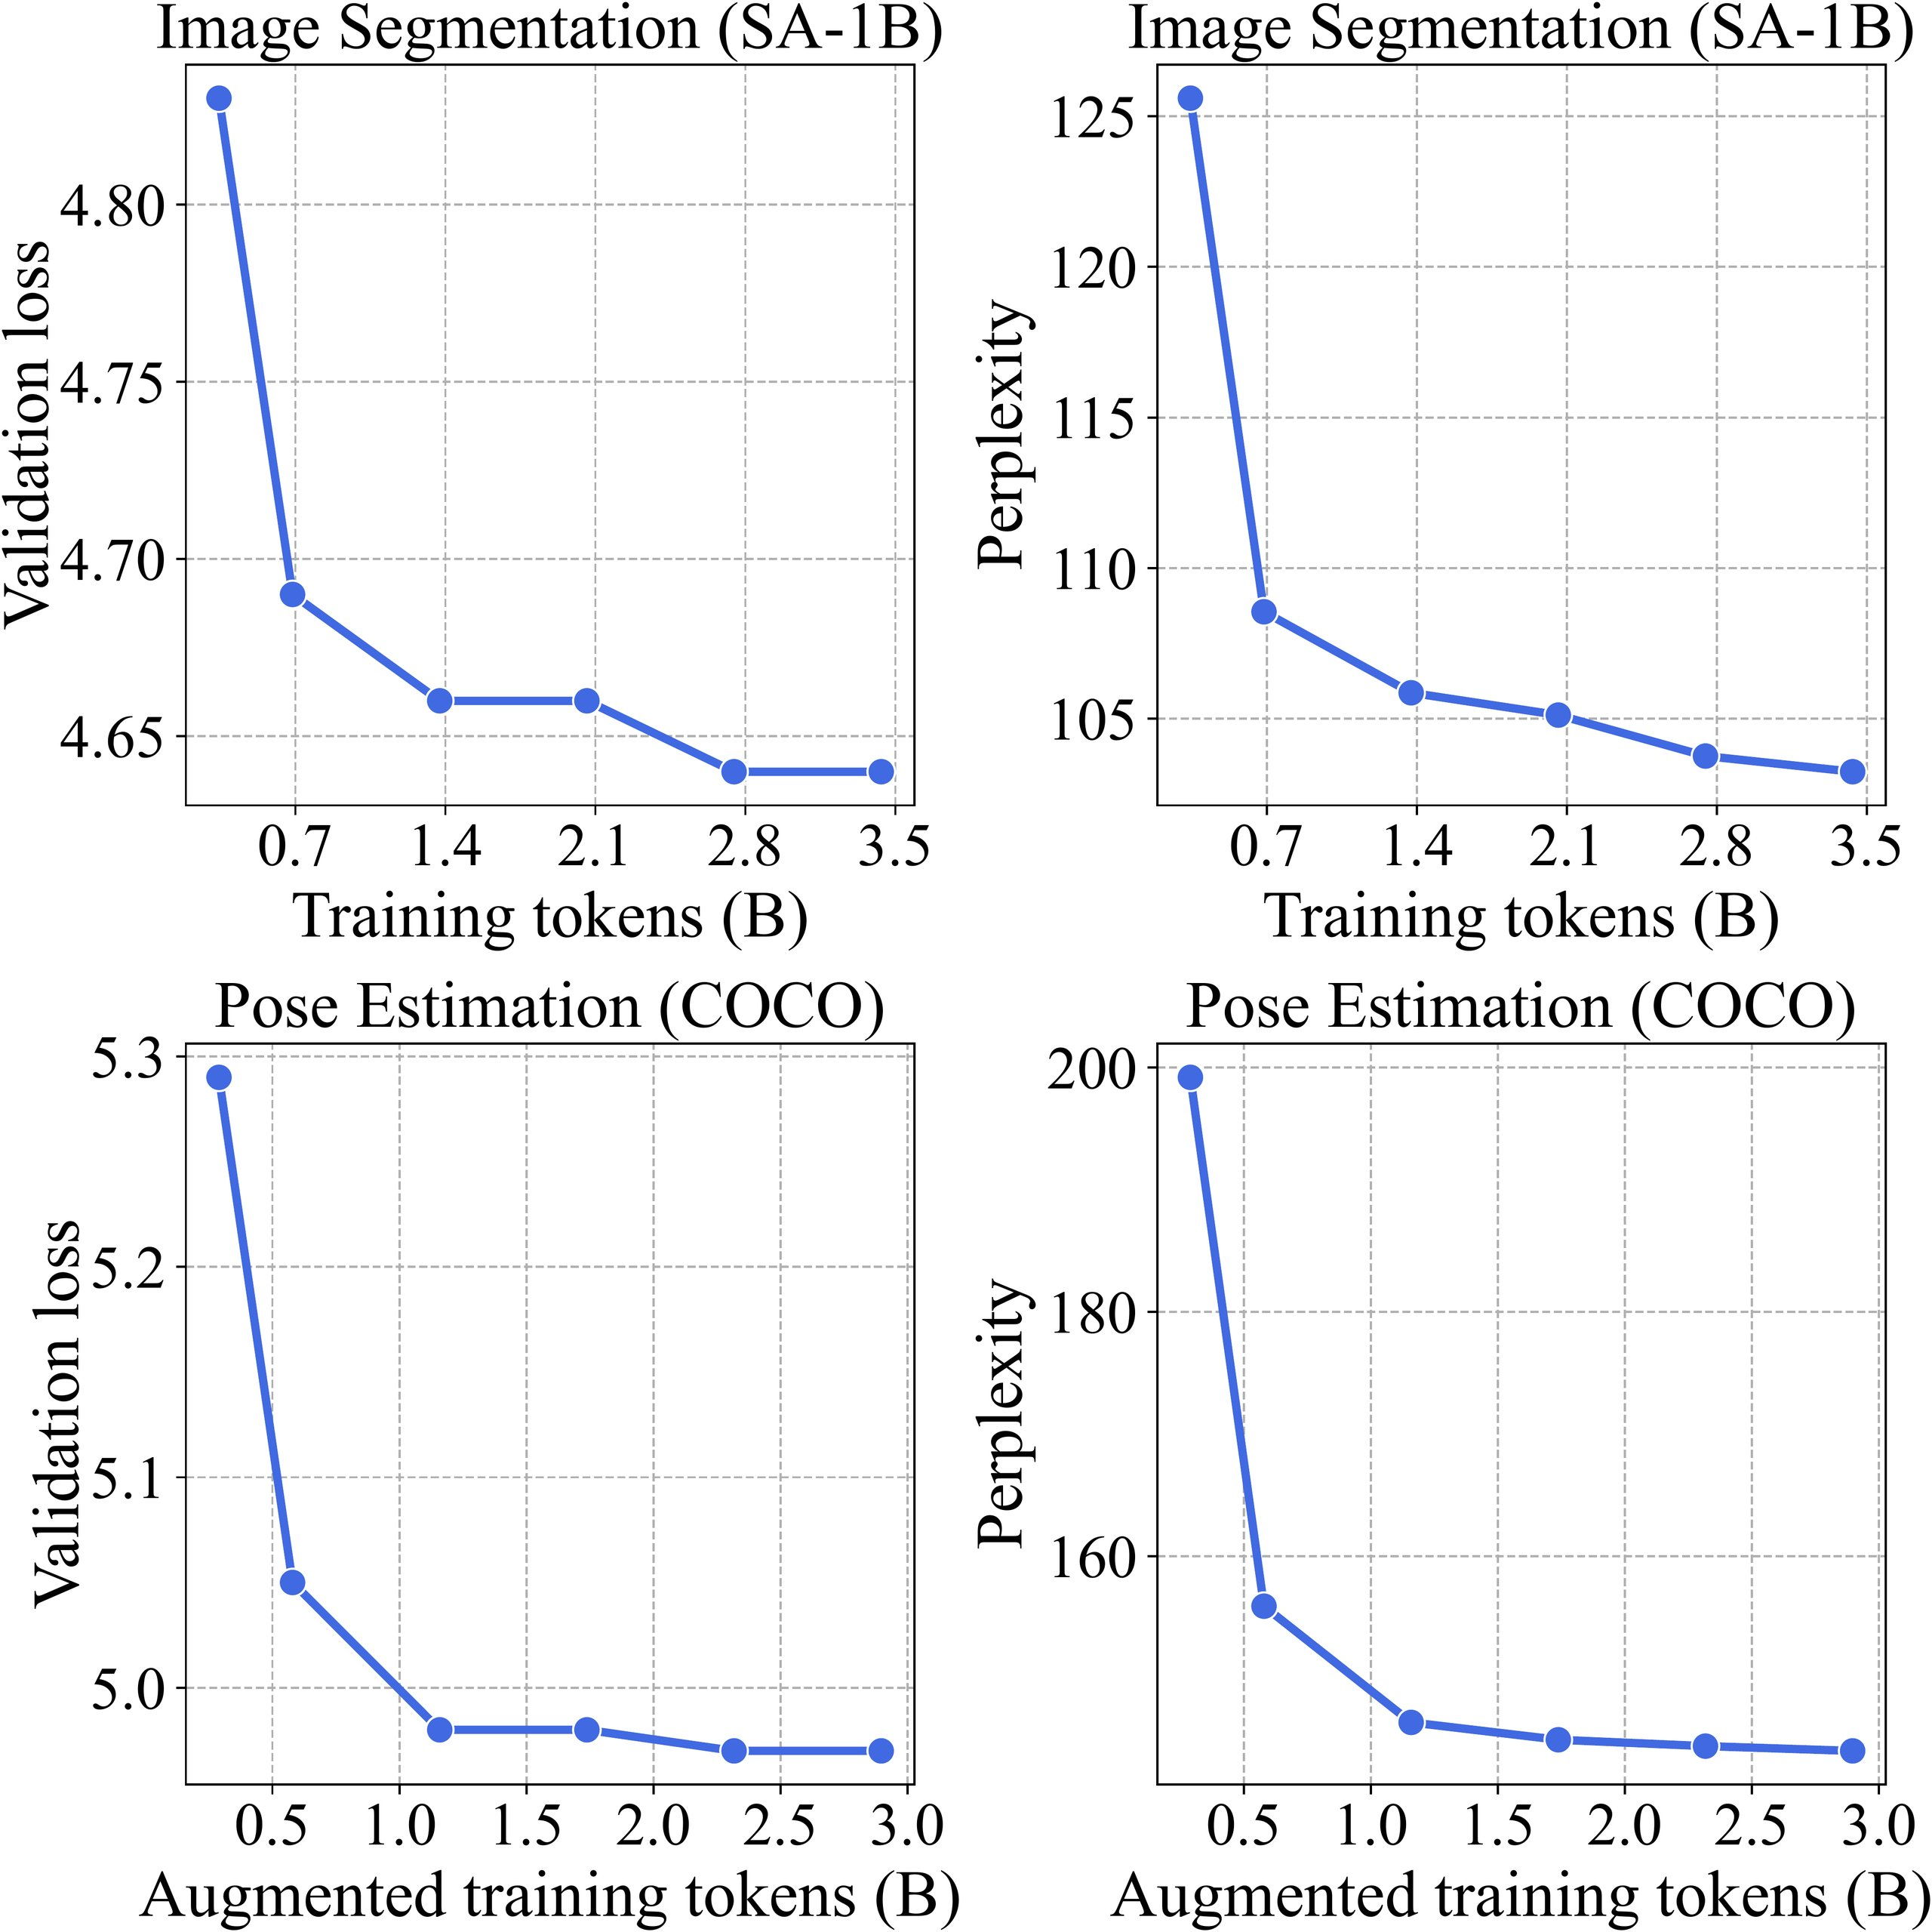
The recipe consistently wins
KEY RESULT · BALANCING · DISTILLATION · DATA-SCALING
BALANCING THE 3-TASK MIXTURE
SCALING DATA — REPRODUCED BY AUGMENTATION
SA-1B segmentation 1% → 10%
−0.19
validation loss
−22.4
perplexity
Re-sampling collapses on scarce tasks · augmentation balances best
Augmentation reproduces it — no new data
Figure 3 · Inference results under unbalanced / re-sampled / augmented data.
Figure 2
DISTILLATION LIFTS THE STUDENT
PASCAL-5i FOREGROUND SEGMENTATION
KD improves the compact student on every task —
Distilled + fine-tuned 300M clearly surpasses the
in both single-task and multi-task training.
same model trained from scratch.
✓ Segmentation
✓ Pose
✓ Deraining
DISTILLED 300M mIoU · SPLITS 0–3
18.58
21.32
19.90
21.08
The 300M student trained with a LLaMA-1B teacher
tracks the teacher far more closely than from scratch.
All four splits beat the from-scratch baseline.
DeLVM · ICML 2024 — key results (Figures 2–4)
06
Notes:
The results consistently favor the proposed recipe. On the mixed three-task benchmark, balancing the data through augmentation beats both the raw unbalanced mixture and naive re-sampling, which actually collapses on the scarce tasks. Knowledge distillation then improves the compact student on segmentation, pose estimation, and deraining, in both single-task and multi-task training. On the Pascal five-i foreground segmentation benchmark, the distilled and fine-tuned three-hundred-million model clearly surpasses the same model trained from scratch. And scaling data on segmentation from one to ten percent lowers validation loss by nearly two tenths and perplexity by over twenty-two points, an effect augmentation reproduces with no new data at all.

Slide 7
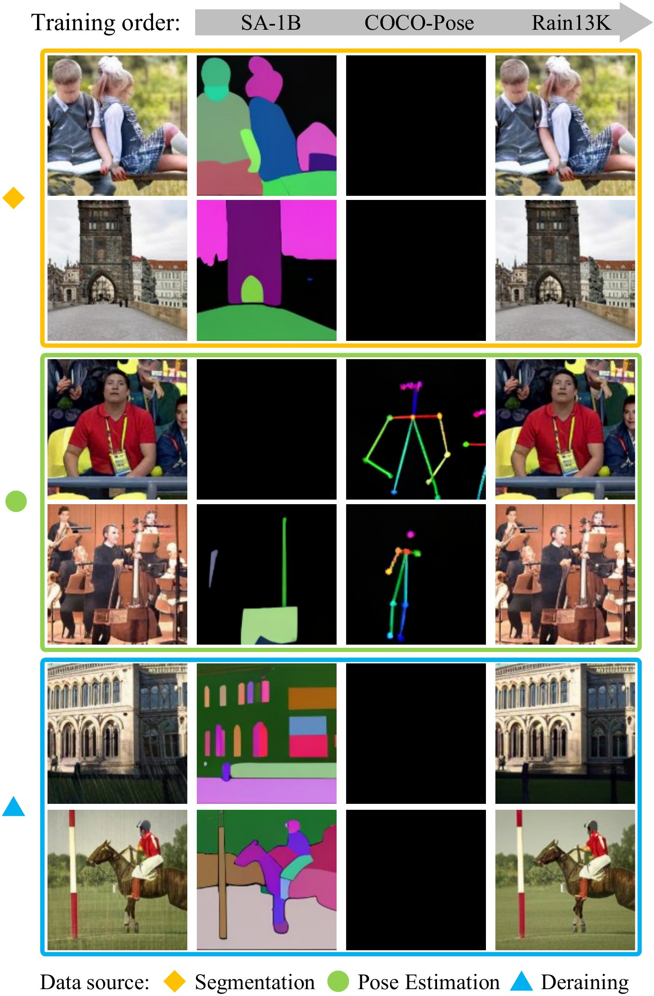
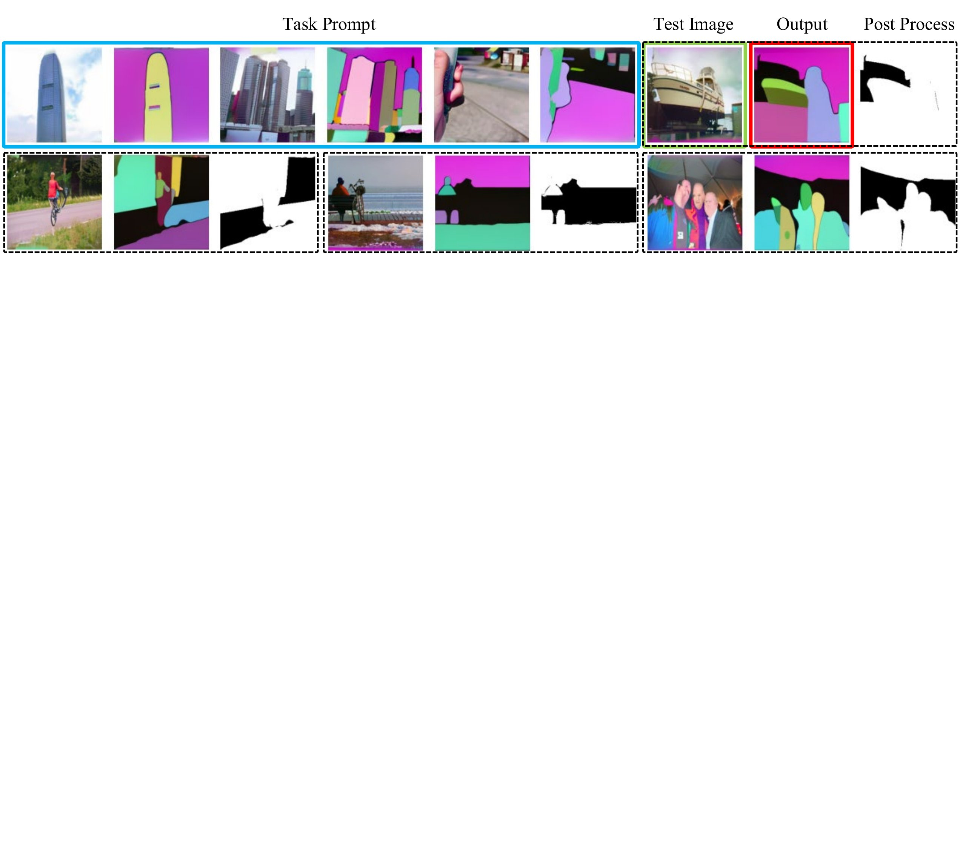
Ablations that sharpen the picture
ABLATION · PROMPT COLOR · SHUFFLING · KD AT 80M
Several ablations sharpen the picture — from prompt design to training order to model size.
PROMPT BACKGROUND COLOR
NO SHUFFLING → CATASTROPHIC FORGETTING
The prompt background
Train tasks in sequence
color controls the
without shuffling and the
generated background.
model stays good only at its
most recent task.
Black-background prompts
1000+ perplexity
make a simple grayscale-
threshold step reliable.
on earlier tasks — shuffling is essential.
Figure 5 · Generated output + foreground segmentation after post-processing.
Figure 6 · Inference across training stages (no shuffling).
EVEN AT 80M PARAMETERS
Knowledge distillation still improves validation perplexity across segmentation, pose, and deraining.
DeLVM · ICML 2024 — ablations (Figures 5–6)
07
Notes:
Several ablations sharpen the picture. Changing the prompt background color changes the generated background, and using black-background prompts makes a simple grayscale-threshold post-processing step reliable. Training without shuffling the task data triggers catastrophic forgetting: the model becomes proficient only on its most recently seen task, with perplexity on earlier tasks exploding into the thousands, underscoring that shuffling is essential for multi-task LVMs. Finally, even at just eighty million parameters, knowledge distillation still improves validation perplexity across segmentation, pose estimation, and deraining.

Slide 8
TAKEAWAY
Refreshingly simple.
THE PAYOFF
83%
You don't need a 3B-parameter model and
hundreds of billions of tokens
ImageNet top-1 — from an 80M model
to build a capable autoregressive vision model.
TWO CLASSICAL TECHNIQUES, WORKING TOGETHER
Pointing toward efficient,
deployable generalist vision
Data Augmentation
Knowledge Distillation
models that unify generation
and understanding.
Rebalances long-tailed tasks
Compresses a large teacher
without collecting new data.
into a compact student.
Together they let compact, limited-data models perform strongly
github.com/ggjy/DeLVM
across segmentation, pose estimation, and deraining.
Data-efficient Large Vision Models through Sequential Autoregression · ICML 2024 · arXiv 2402.04841
08
Notes:
The takeaway is refreshingly simple. You do not need a three-billion-parameter model and hundreds of billions of tokens to build a capable autoregressive vision model. Two classical techniques, data augmentation to rebalance long-tailed tasks and knowledge distillation to compress a large teacher, together let compact models trained on limited data perform strongly across segmentation, pose estimation, and deraining. That an eighty-million-parameter version even reaches eighty-three percent accuracy on ImageNet points toward efficient, deployable generalist vision models that unify generation and understanding.

