Slide 1



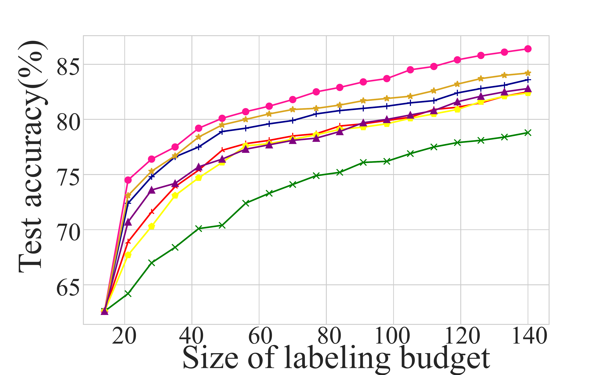
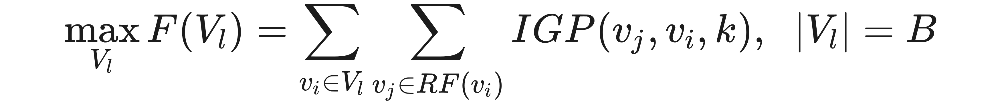
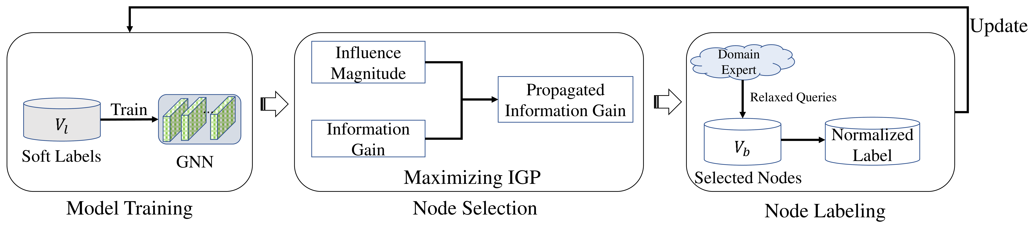
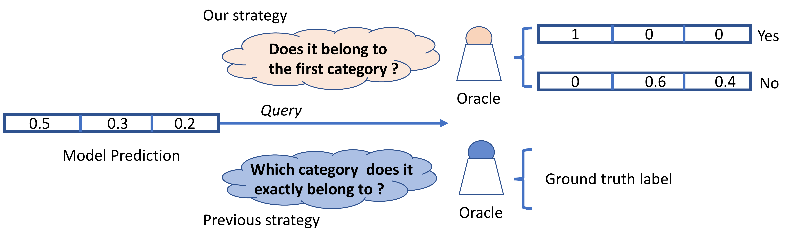
Information Gain Propagation: A New Way to Graph Active Learning with Soft Labels
Wentao Zhang¹, Yexin Wang¹, Zhenbang You¹, Meng Cao², Ping Huang², Jiulong Shan², Zhi Yang^{1,3}, Bin Cui^{1,3,4}
¹ Peking University ² Apple ³ Nat'l Eng. Lab for Big Data ⁴ Inst. Computational Social Science, PKU
Problem
Method
Key Results
GNNs need many labeled nodes, yet every prior graph active-
learning method assumes an oracle can name the exact class of
each selected node.
1
Train a GNN on the currently labeled nodes with their soft
labels.
METHOD
CORA
CITESEER
PUBMED
Random
78.8
70.8
78.9
Exact multi-class labeling is costly, especially when categories
are many or out-of-domain (e.g. ogbn-papers100M has 172
classes) — the budget is spent inefficiently.
2
Score each node's influence magnitude on its k-hop
neighbors via graph propagation.
GRAIN
84.2
74.2
81.8
IGP (ours)
86.4
75.8
83.6
3
Select the budget-limited set maximizing information gain
propagation (IGP).
Motivation
4
Relabel via a binary query → normalized soft label, then
update & repeat.
Confirming a guess is cheap. A binary yes/no query costs far
less per node than naming the exact class among many.
Labels propagate. One labeled node sways its k-hop
neighbors, yet prior criteria score only single-node uncertainty.
vs.
Select nodes whose expected information gain propagates farthest across each receptive field RF, within labeling budget B.
PRIOR AL QUERY
OUR RELAXED QUERY
"Which exact category?" — a
hard multi-class question,
~c−1× the cost.
"Is the predicted label
correct?" — one binary
yes/no → a soft label.
Figure 4: Accuracy vs labeling budget on Cora — IGP (pink) leads at every
budget.
Figure 3: The IGP active-learning loop.
Dataset / Benchmark
Takeaway
Cost-based budget. The budget is true annotation cost, not
label count — an exact query costs ~c−1× a relaxed one.
Ask a cheap yes/no question and pick nodes whose
information gain propagates farthest — graph active
learning gets more accurate and far cheaper to label, on
any GNN backbone.
Figure 1: A relaxed binary query yields a soft label, versus the exact-class
query of prior work.
Budgets swept from 2C to 20C labels (C = #classes) across five
standard graph benchmarks.
Cheaper queries plus propagation-aware selection extract more
supervision per labeling dollar.
86.4%
+2.2
5
4
Cora
Citeseer
PubMed
Reddit
ogbn-arxiv
Cora acc
pts vs GRAIN
datasets SOTA
GNN backbones

