Slide 1
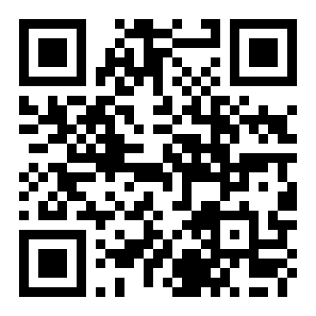


ICLR 2022 · PAPER WALKTHROUGH
Information Gain Propagation
A New Way to Graph Active Learning with Soft Labels
Wentao Zhang · Yexin Wang · Zhenbang You · Meng Cao · Ping Huang · Jiulong Shan · Zhi Yang · Bin Cui
Peking University · Apple · National Engineering Laboratory for Big Data Analysis and Applications
THE COST PROBLEM
SCAN TO READ THE PAPER
Labeling graph nodes is expensive — GNNs need many labeled nodes to train well.
THIS PAPER · ICLR 2022
Information Gain Propagation rethinks graph active learning.
THE RELAXED QUERY
Ask a cheap binary question instead of the exact class
"Does this node belong to a given class — yes or no?" The answer becomes a soft label.
THE OUTCOME
arXiv:2203.01093
Select nodes whose information gain propagates farthest
→ higher accuracy at far lower labeling cost
PKU
Apple

Slide 2
01 · PROBLEM
Exact-class labeling does not scale
HUNGRY FOR LABELS
THE USUAL FIX
GNNs rely on many labeled nodes
Active learning cuts the cost
Strong accuracy demands large amounts of
It selects the most valuable nodes to
labeled data, which is costly to obtain.
label, spending the budget where it counts.
THE SHARED ASSUMPTION
But every prior method assumes the oracle can always name a node's exact class
This is an expensive multi-class query — the oracle must pick one label out of all categories for every selected node.
Exact query cost grows with the number of classes c.
WHY IT BREAKS
When classes are many or the domain is
172
unfamiliar, the exact question is too demanding
The multi-class query exceeds expert capability, and the budget is spent inefficiently.
classes in ogbn-papers100M

Slide 3
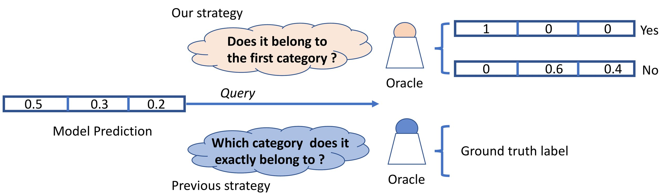
02 · MOTIVATION
Cheaper questions, and propagation nobody used
CORE INSIGHT
RELAXED QUERY · PAPER FIG. 1
Confirming a guess is far
easier than naming the class
EASY · "Yes / No" binary answer
HARD · "Which of c classes?"
WHAT PRIOR CRITERIA MISS
THE PROPAGATION EFFECT
Built for hard labels only
Labeling one node teaches
Existing node-selection criteria were designed
its whole neighborhood
for hard labels, and they only measure the
In a GNN, a labeled node propagates
uncertainty of a single node in isolation.
supervision across its k-hop neighborhood.
Single-node uncertainty
IGP exploits both: cheaper queries
ignores the graph structure around it.
and this propagation effect.

Slide 4
03 · CONTRIBUTION
Three contributions
CONTRIBUTIONS AT A GLANCE
A new paradigm, a new selection criterion, and state-of-the-art results
Relaxed queries and soft labels, plus propagation-aware node selection, validated across many GNN backbones.
01
02
03
New AL paradigm
New criterion
SOTA & general
A first active-learning framework
A node-selection criterion that
Extensive experiments beat
for graph networks that uses
maximizes information-gain
state-of-the-art baselines and
relaxed queries + soft labels
propagation
generalize across backbones:
instead of exact-class annotation.
through the graph, not just single-
node uncertainty.
SGC · APPNP
GCN · MVGRL
Consistent wins under equal
labeling cost.

Slide 5
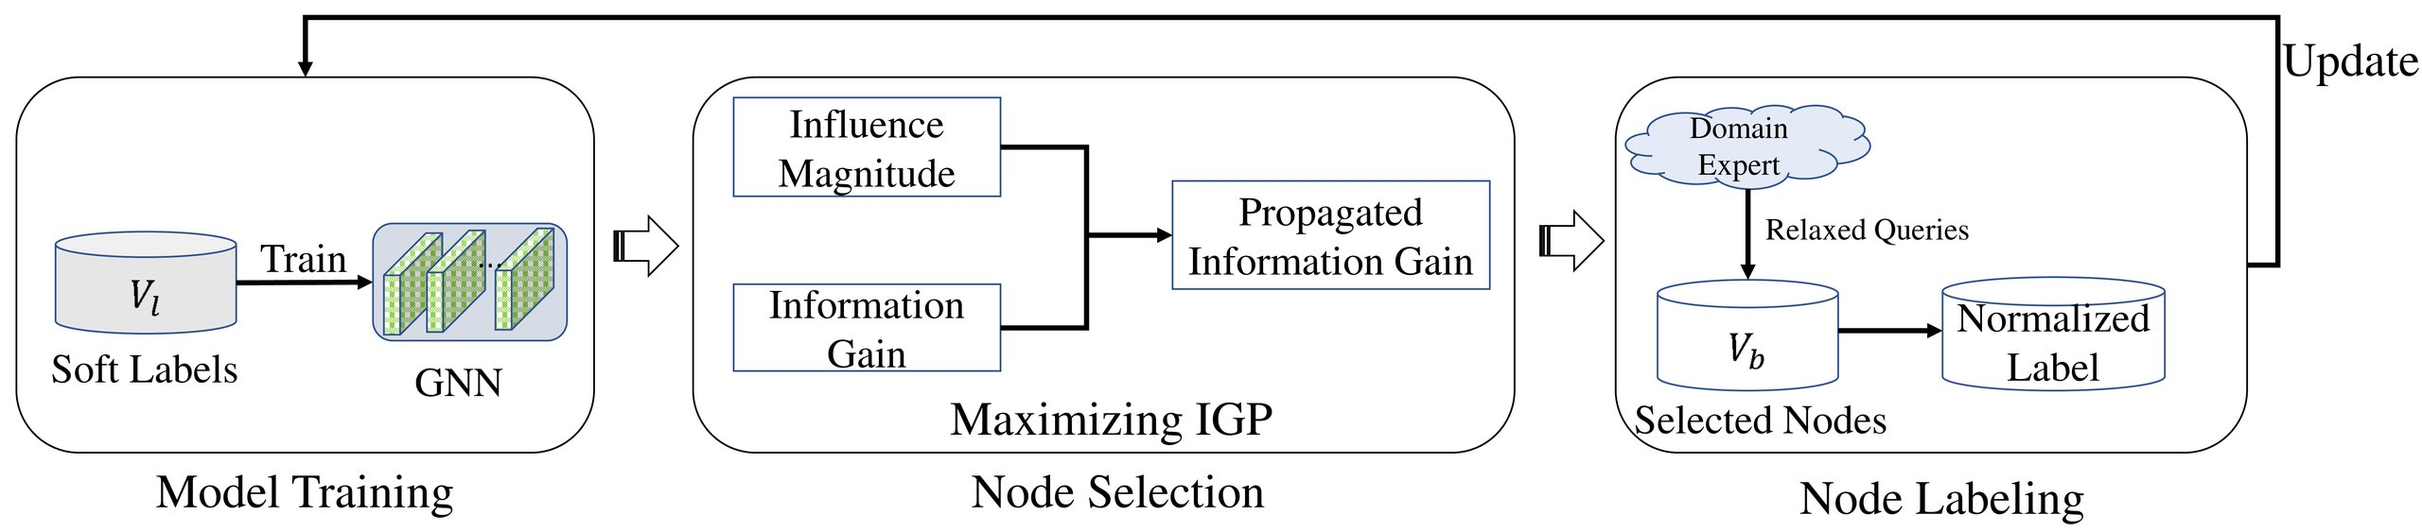
04 · METHOD
The IGP loop: train, query, select, repeat
THE IGP FRAMEWORK · PAPER FIG. 3
Model Training → Node Selection → Node Labeling → Update
1 · RELAXED QUERY
2 · SCORE NODES
3 · SELECT & REPEAT
Is the prediction
Influence × info gain
Maximize propagated
correct? Yes / No
Measure how strongly a node
information gain
For each candidate, the oracle
influences its neighbors (the
Pick the budget-limited subset
answers one binary question;
influence magnitude), times
that maximizes total propagated
the reply becomes a
the information gain (entropy
gain, then update the model
normalized soft label.
reduction) of each one.
and repeat the loop.

Slide 6
05 · DATASETS & PROTOCOL
Five benchmarks, budgeted by real cost
FIVE GRAPH BENCHMARKS
CITATION
CITATION
CITATION
SOCIAL
OGB
Cora
Citeseer
PubMed
Reddit
ogbn-arxiv
Citation network
Citation network
Biomedical
Large social
Open Graph
of papers.
of papers.
citation graph.
interaction graph.
Benchmark graph.
THE FAIR YARDSTICK
BUDGET RANGE
Budget = true annotation cost
2–20
Not a simple count of labels. Because an exact
multi-class query is far pricier than a binary one,
methods are compared at equal query cost.
labels per class
Exact query ≈ (c − 1) × the cost of one binary query
Budgets are swept from small to large
to trace accuracy versus cost.

Slide 7
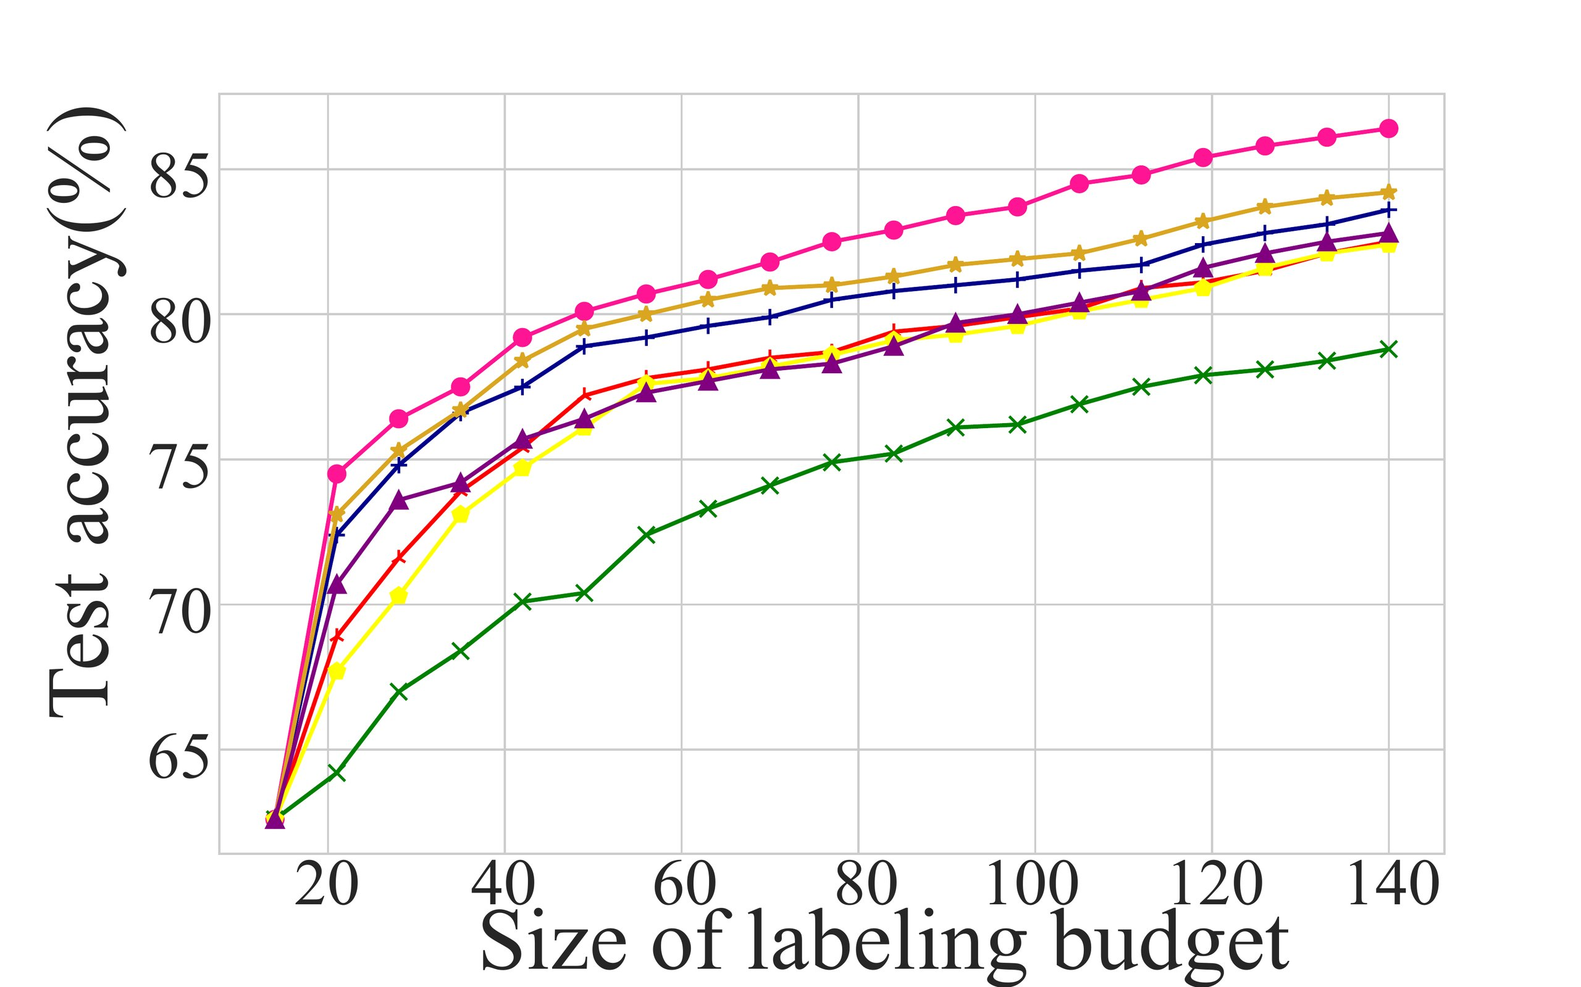
06 · KEY RESULT
Highest accuracy at every budget
ACCURACY vs LABELING BUDGET · FIG. 4
20 LABELS / CLASS · GCN
Cora
86.4%
Citeseer
75.8%
PubMed
83.6%
Beats best baseline GRAIN by +1.6–2.2%
on citation networks; consistent gains on
Reddit and ogbn-arxiv too.
HOW THE LEAD GROWS
IGP climbs fastest as budget grows
Its accuracy rises the quickest, and the lead
IGP (top curve) leads across every labeling budget.
holds across GNN backbones from SGC to MVGRL.

Slide 8
07 · ABLATION
Every component earns its place
THE SETUP
Disable one IGP component at a time and re-measure test accuracy
Components: informative selection · informative training · information quantity · normalized label
THE MOST IMPORTANT PIECE
MAX ACCURACY DROP WHEN REMOVED
Informative selection
Selection
3.2
The propagation-aware node choice.
−3.2%
Training
2.9
Norm. label
2.4
largest accuracy drop (PubMed) when removed
Info quantity
2.1
Propagation-aware selection is what sets IGP apart.
Values = worst-case % accuracy loss across datasets.
THE VERDICT
Every piece contributes — removing any one hurts accuracy
Soft-label training, influence magnitude, and normalized labels all help; propagation-aware selection helps most.

Slide 9
08 · HEADLINE NUMBERS
The result in four numbers
CORA ACCURACY
OVER BEST BASELINE
STATE OF THE ART
THE QUERY
86.4%
+2.2%
5 × 4
1
test accuracy at
accuracy gain on Cora
datasets × GNN backbones,
cheap binary question
20 labels / class
over prior SOTA (GRAIN)
SOTA on all of them
replaces exact-class labeling
IN ONE LINE
State-of-the-art accuracy from a single cheap binary question per node
IGP replaces the expensive exact-class query and still wins across five datasets and four GNN backbones,
improving citation-network accuracy by 1.6 to 2.2 percent over the strongest prior method.

Slide 10
09 · TAKEAWAY
Cheaper questions, smarter picks
THE TAKEAWAY IS SIMPLE
Relax the question, and follow the propagation
A general recipe for graph active learning that is both more accurate and far cheaper to label.
THE RECIPE
WHAT YOU GET
1
More accurate, far cheaper
Ask a cheap binary question
A simple yes-or-no query per node,
instead of the exact class, yielding
Higher test accuracy across
a soft label.
every dataset and budget,
at far lower labeling cost.
2
Follow the propagation
FULLY GENERAL
Select nodes whose information gain
Works with any graph neural network backbone.
propagates farthest
across the graph, not just the most
Information Gain Propagation · ICLR 2022
uncertain single node.
arXiv:2203.01093

