Slide 1

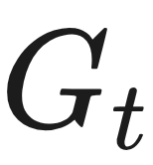
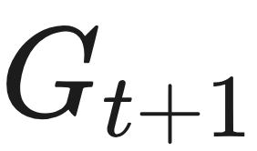
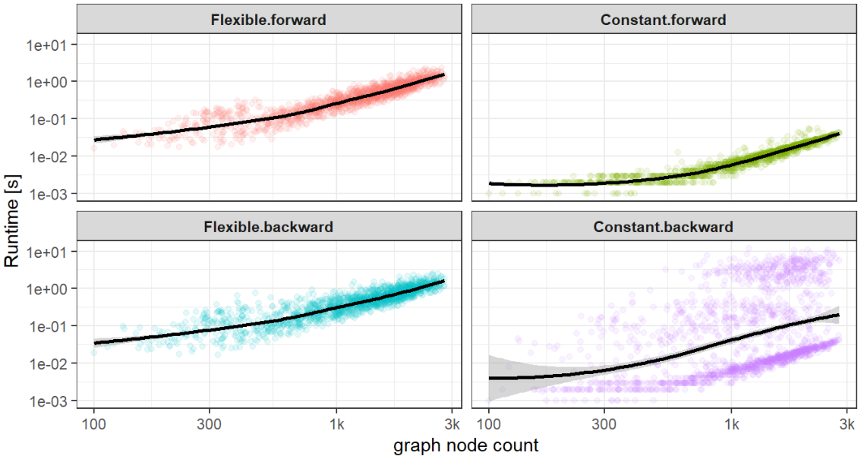

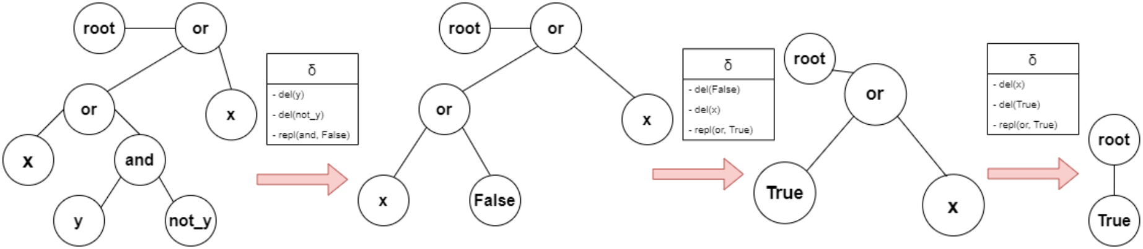
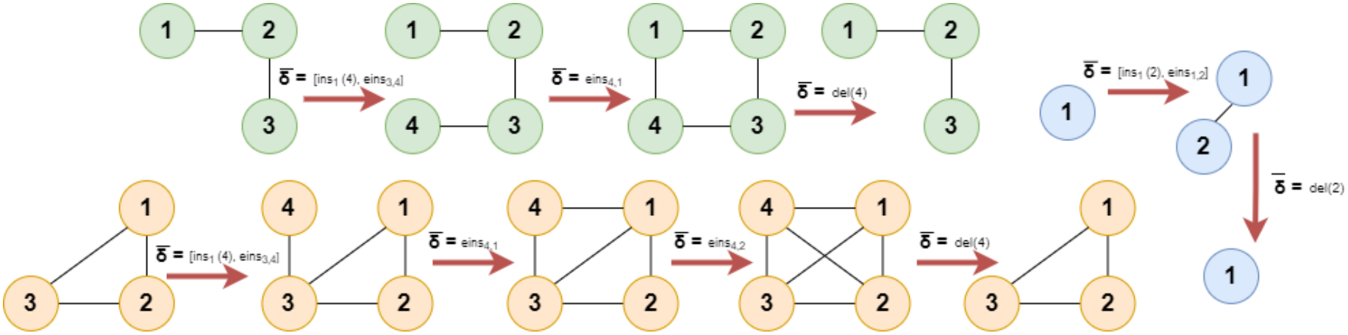

[Re] Graph Edit Networks
ReScience C 2022
Vid Stropnik¹, Maruša Oražem¹
¹ Faculty of Computer & Information Science, University of Ljubljana
Problem
Method
Key Results
Predicting how a graph evolves over time is hard: most graph
neural networks output node or edge scores, not the explicit,
interpretable sequence of structural changes needed to turn one
graph into the next.
GEN is an output layer for GNNs: given the current graph and a teaching signal from a reference mapping, it predicts an edit script — node insertions, deletions and replacements plus edge insertions/deletions — that transforms into .
Re-running GEN against a modified VGAE re-checks the paper’s
four original claims:
✓
✓
✓
✗
Graph Edit Networks (GEN) emit an edit script instead — but
the original claims rest on lightly-described synthetic
benchmarks and untested scaling arguments.
Reference pair mappings come from graph-edit-distance
approximators (exact distance is NP-hard); the reproduction
trains adapted hinge and cross-entropy loss variants with flexible
/ fixed edge filtering, against a modified VGAE baseline.
(i) beats VGAE on
dynamical DGPs
(ii) near-
perfect on trees
(iii) forward
sub-quadratic
(iv) backward
linear — refuted
Headline Numbers
1.69
1.38
Forward slope (flexible)
each edit is one insert / delete / relabel op; the ordered script is applied under a Markovian assumption
Backward-pass log-log slope (constant
filtering)
1.30
Backward slope (flexible)
0.98
Boolean acc.
Super-linear — refutes the ‘linear backward pass’ claim
(iv); forward passes stay sub-quadratic.
1.0
Peano acc.
Motivation
Boolean Formulae DGP: each step applies a δ edit script that logically
simplifies the graph — the interpretable output GEN predicts.
Runtime vs graph node count (log-log). Forward passes scale sub-
quadratically; constant-filtering backward passes are clearly super-linear
— refuting the linear-scaling claim (iv).
The original GEN paper reports wins over every baseline,
perfect tree-task accuracy, and favourable scaling.
Dataset / Benchmark
But its synthetic data generators and runtime claims were
never described in enough detail to verify independently.
Five synthetic DGPs, exhaustively documented for the first
time: three dynamical graph systems + two tree dynamical
systems.
Takeaway
Graph Edit Networks are reproducible, elegant and
interpretable, and most original claims hold — but backward
passes scale super-linearly, not linearly, and several
benchmarks reward memorisation over true expressive power.
Scaling stress-tested on the arXiv HEP-Th citation network (27,700 papers → 1,554 rolling sub-graphs, ).
Beyond the verdict, the reproduction’s careful documentation of
the five data generators is a lasting contribution for anyone
reusing these tasks.
Edit Cycles
Degree Rules
Game of Life
Boolean Formulae
Edit Cycles DGP: three cyclical graph time series, each transition
annotated with its edit script δ̄.
Peano Addition
arXiv HEP-Th

